Slide 1







Variability in Tumour Presentation:
The Influence of the Germline on Somatic Evolution
Dr. Paul C. Boutros

Slide 2
Pathway
Overview of Clinical Space
BRCA
Sex
Race & Ethnicity
Specific Polymorphisms
Summary

Slide 3
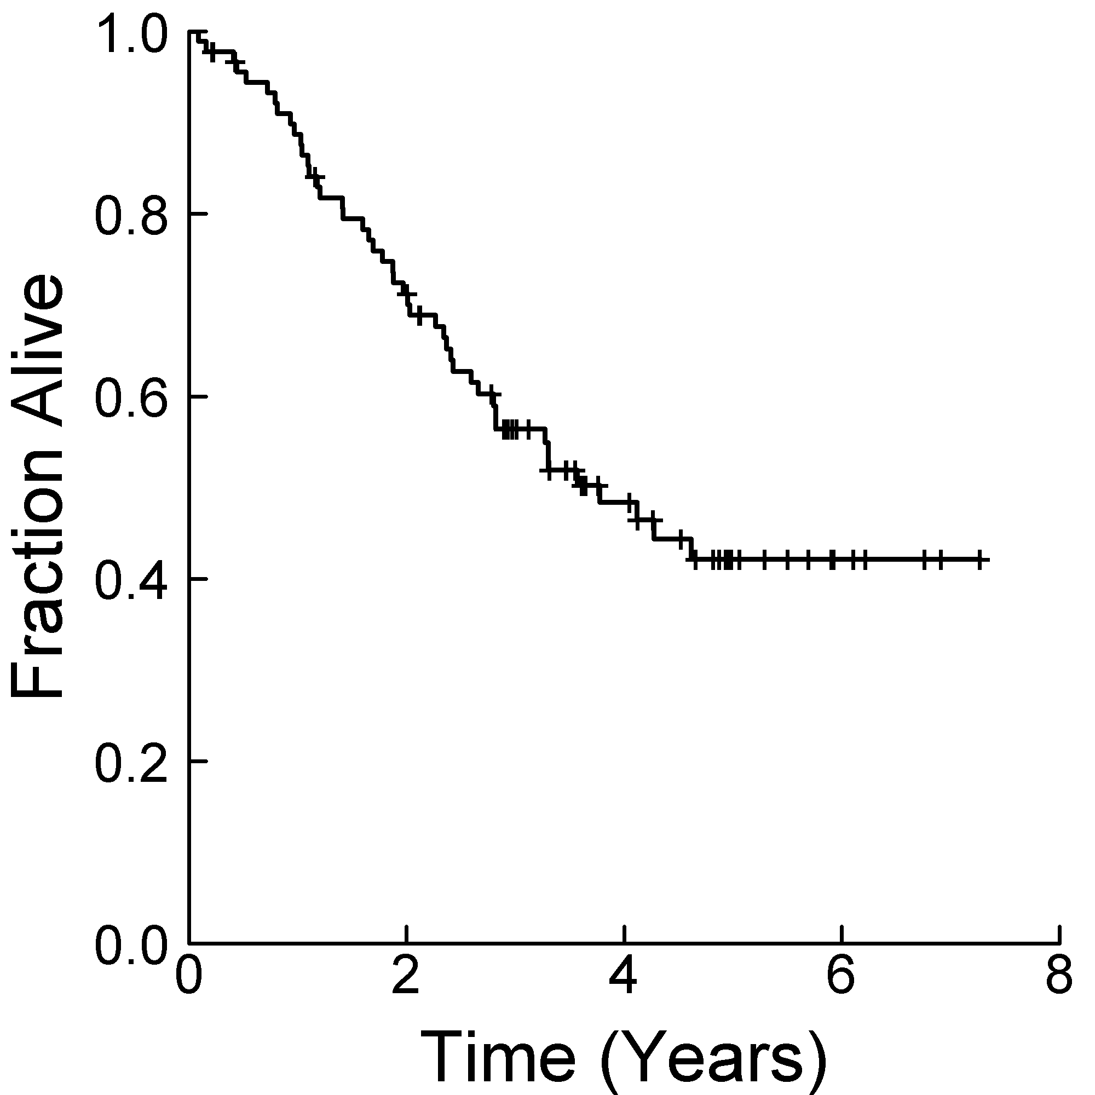
Problem: Localized Disease Outcomes Vary

Slide 4
A Solution: Prognostic & Predictive Biomarkers
Less
More

Slide 5
Why Study The Germline
Many known germline risk factors: TP53, RB1, etc.
Typical tumour: point variants
  ~3,000-30,000 somatic SNVs
  ~3,000,000 germline SNPs
Typical tumour: structural variants
  ~1% of genome with germline SVs
  ~5% of genome with somatic SVs
Consider prostate cancer
  PRS: OR > 5, ~20% of Bx can be avoided
  BRCA2: ~4% of patients, HR = ~4

Slide 6
Pathway
Overview of Clinical Space
BRCA
Sex
Race & Ethnicity
Specific Polymorphisms
Summary

Slide 7
BRCA2 Tumours Have More Genomic Instability
Taylor et al. Nat Comm 2015

Slide 8
BRCA2 Tumours Are Biased to Specific Drivers
Taylor et al. Nat Comm 2015

Slide 9
BRCA2 Tumours Preferentially Show Branched Evolution
Taylor et al. Nat Comm 2015

Slide 10
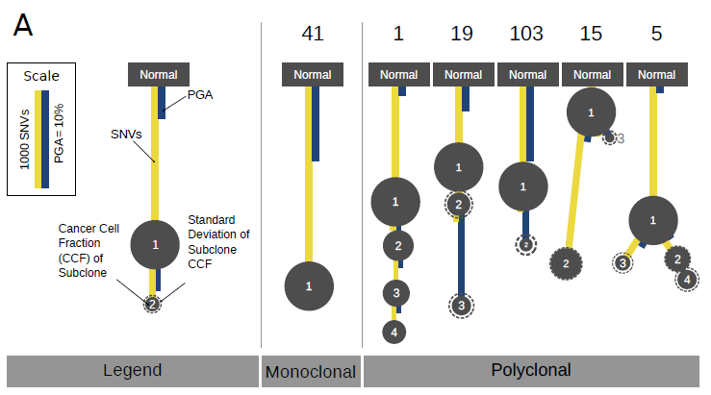
BRCA2 Tumours Preferentially Show Branched Evolution
Espiritu et al. Cell 2018

Slide 11
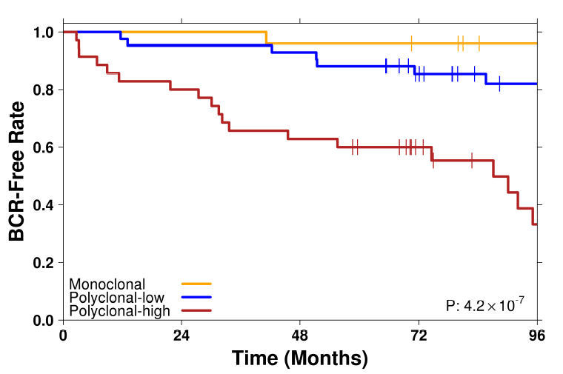
And Complex Evolution Is Associated with Lethality
Espiritu et al. Cell 2018

Slide 12
Pathway
Overview of Clinical Space
BRCA
Sex
Race & Ethnicity
Specific Polymorphisms
Summary

Slide 13
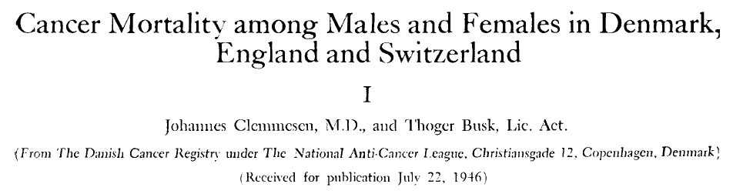
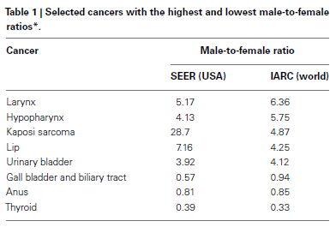
Sex Differences in Cancer: An Old Problem
Dorak MT et al. (2012) Frontiers in Genetics

Slide 14
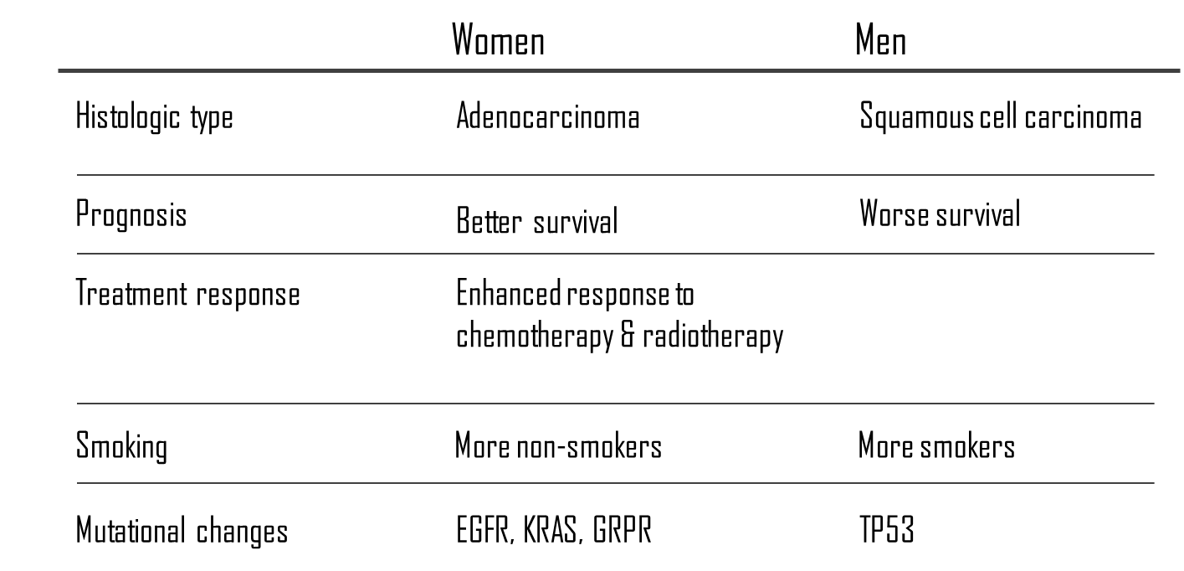
Differences in Histology, Treatment Response, Mutational Structure: Lung Cancer

Slide 15
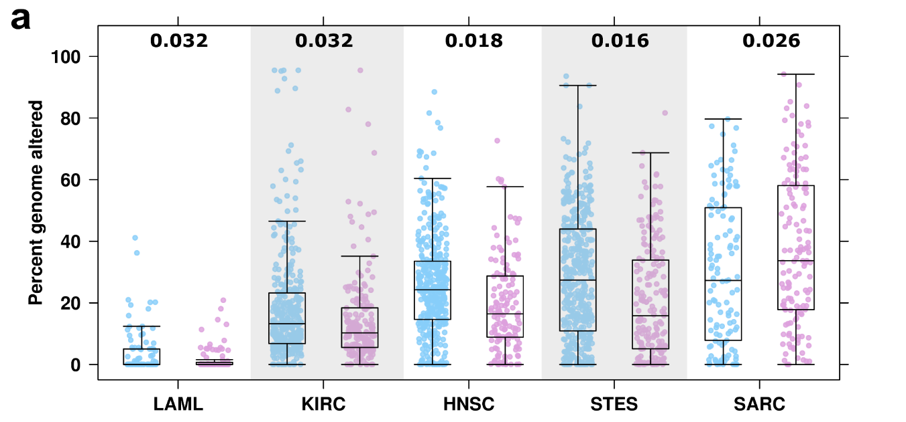
Genomic Stability Varies By Sex & Tumour Type
Li et al. Cancer Res 2018

Slide 16
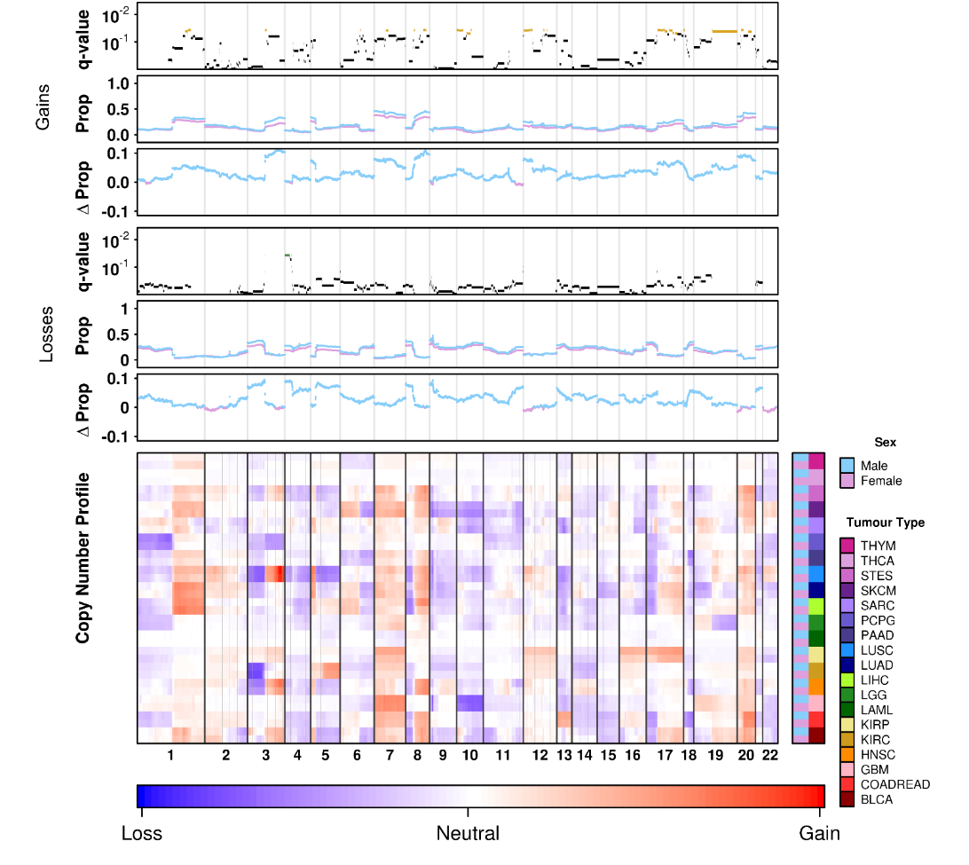
Sex Differences Localize To Specific Genomic Regions
Li et al. Cancer Res 2018

Slide 17
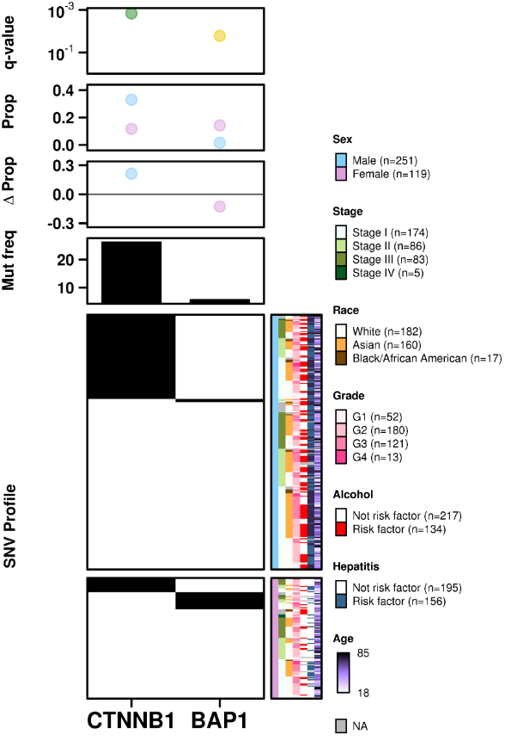
Strong Effects on Driver Genes: HCC
Li et al. Cancer Res 2018

Slide 18
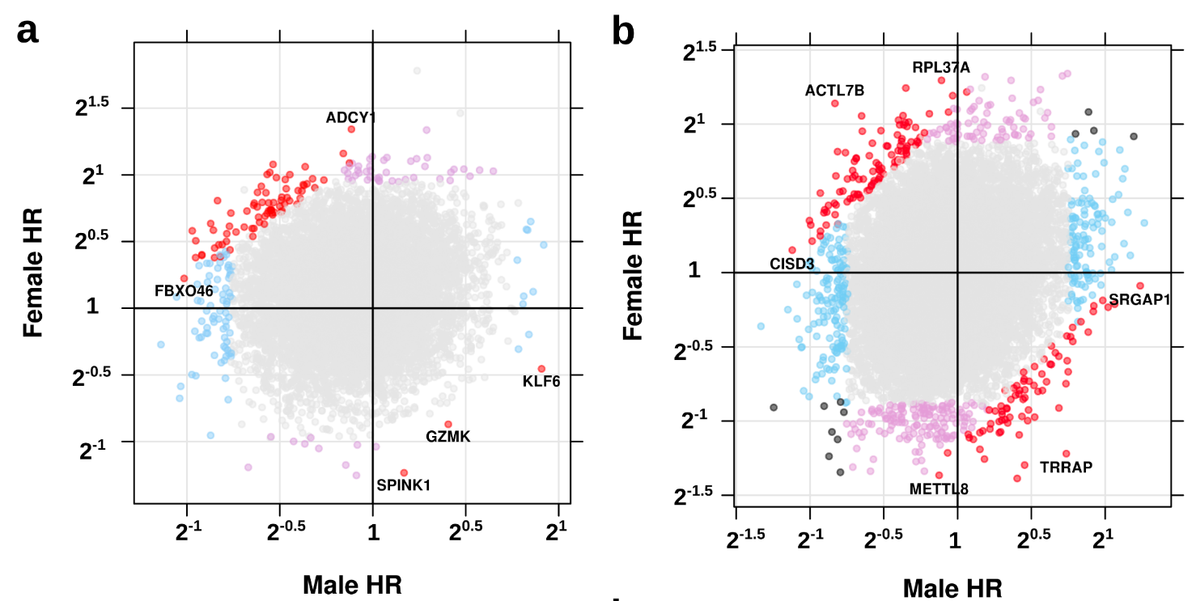
Sex Differences Affect Biomarkers: NSCLC
Li et al. Cancer Res 2018

Slide 19
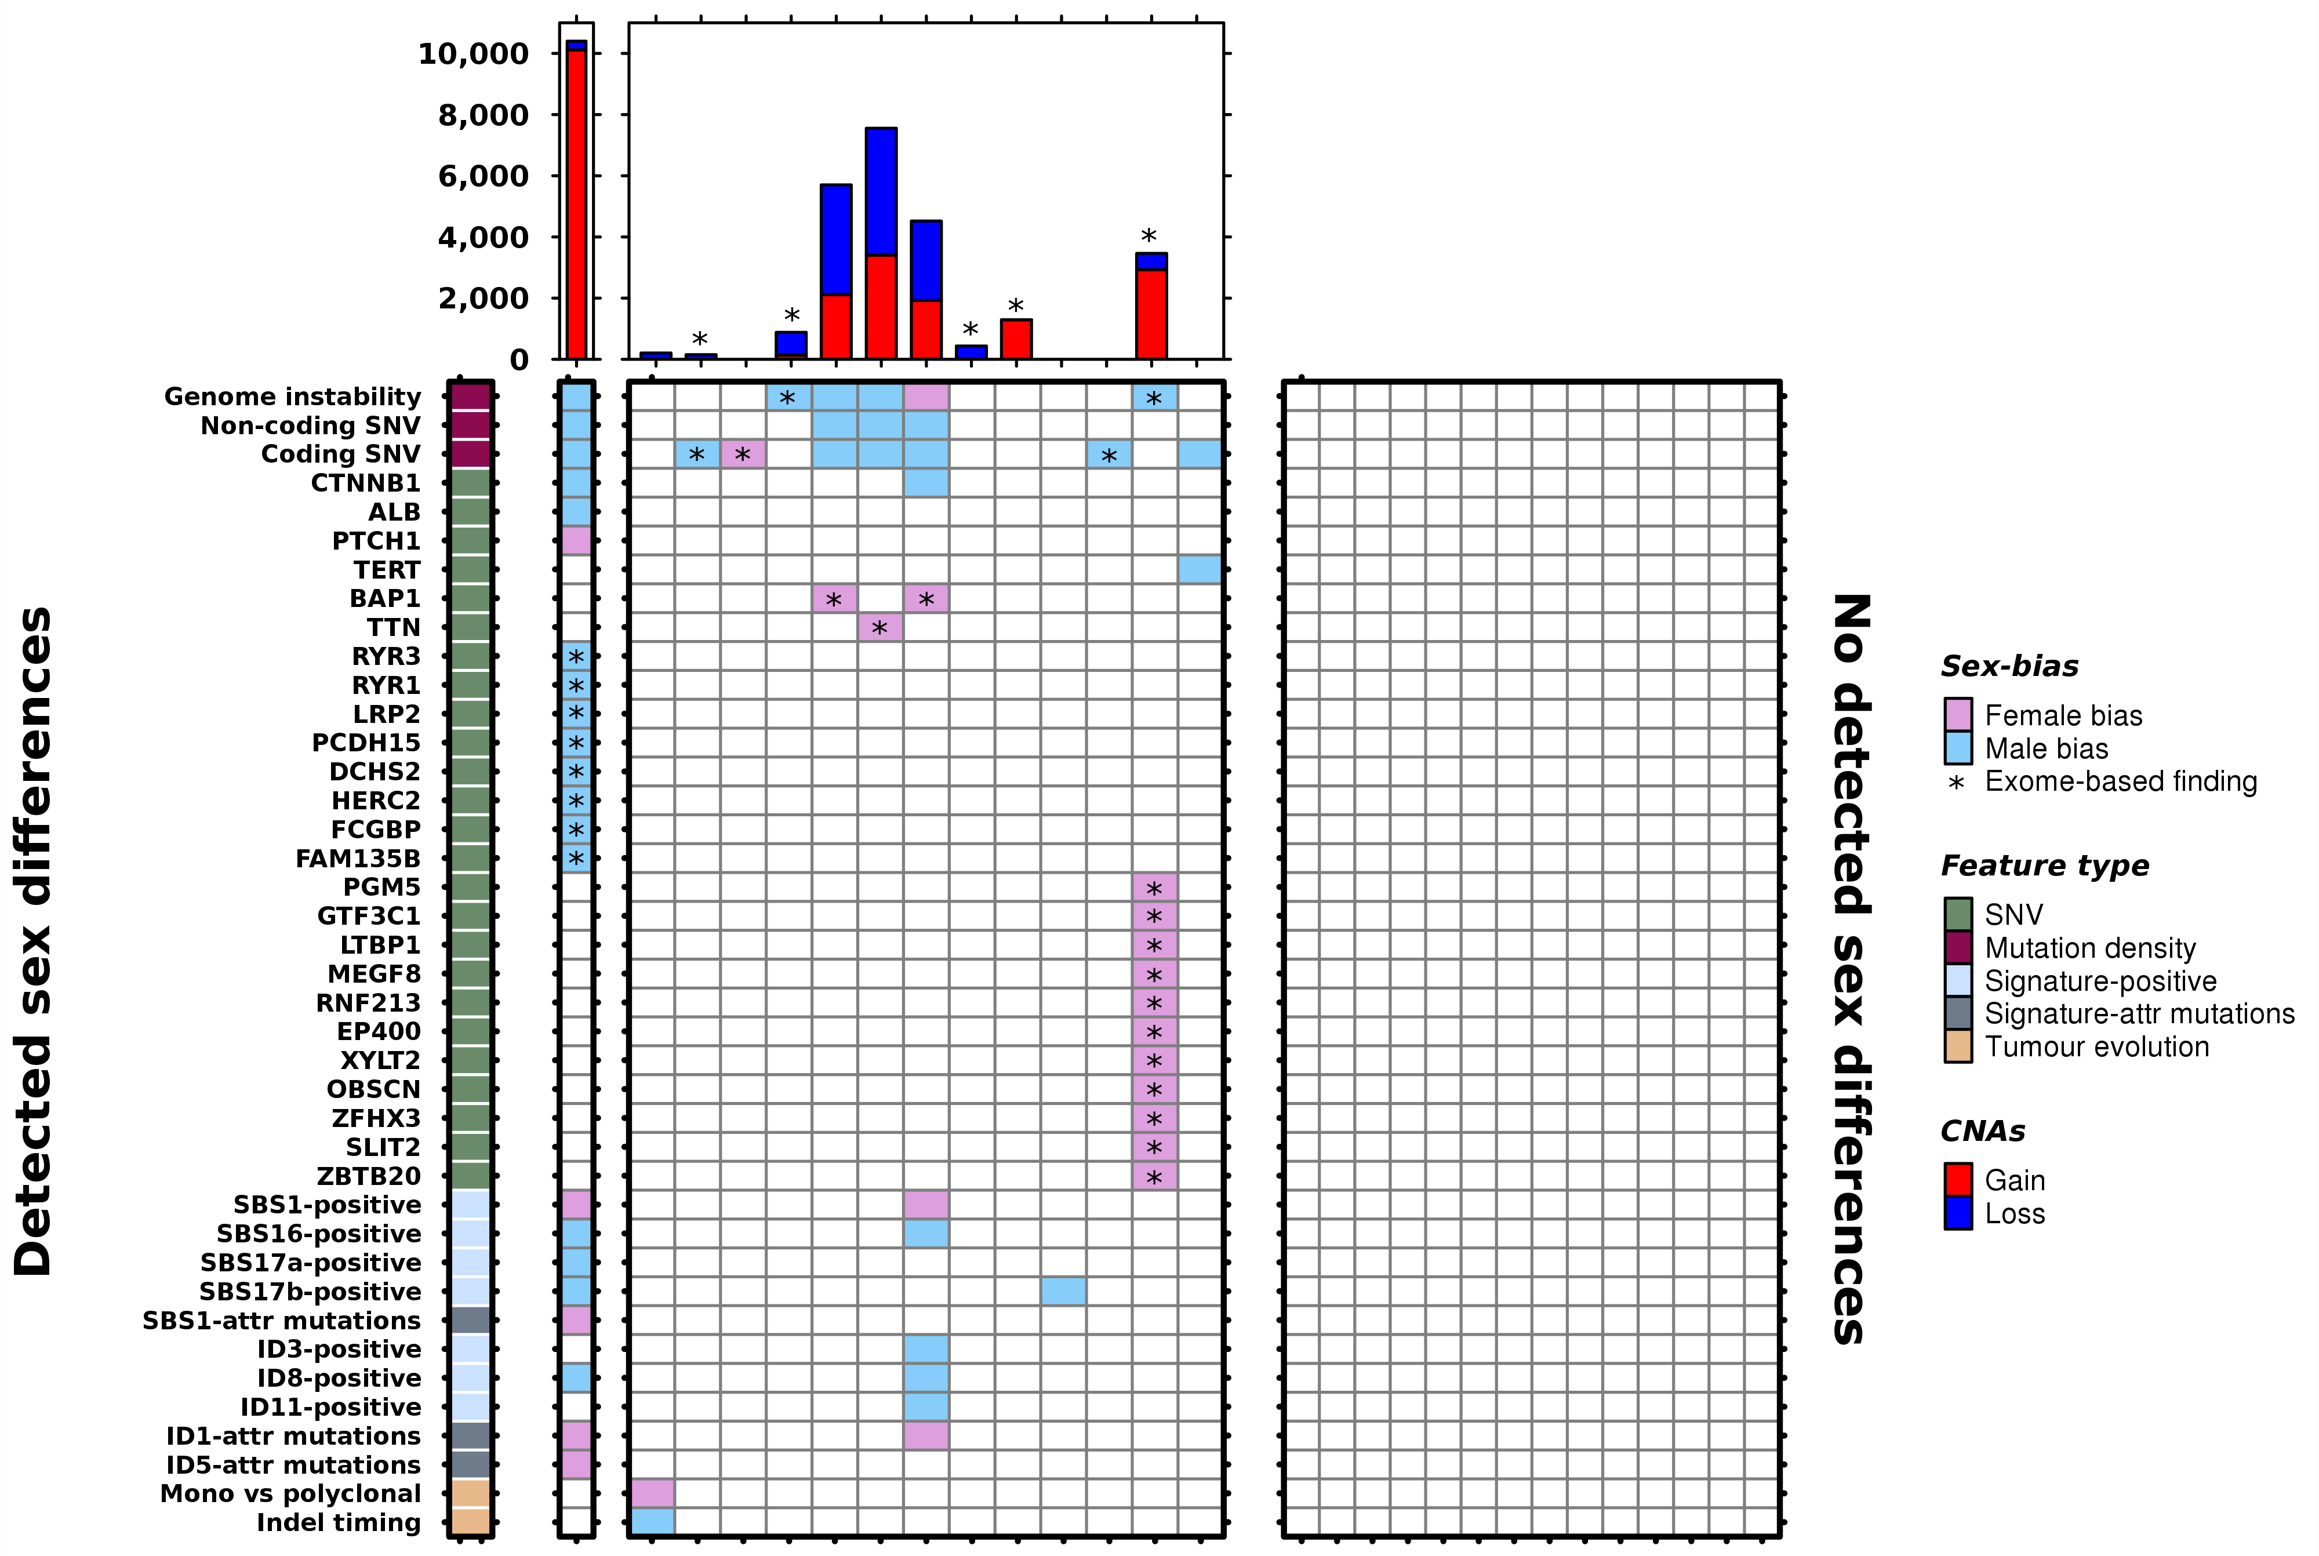
Summary of Sex Differences by Tumour Type
Li et al. submitted

Slide 20
Pathway
Overview of Clinical Space
BRCA
Sex
Race & Ethnicity
Specific Polymorphisms
Summary

Slide 21
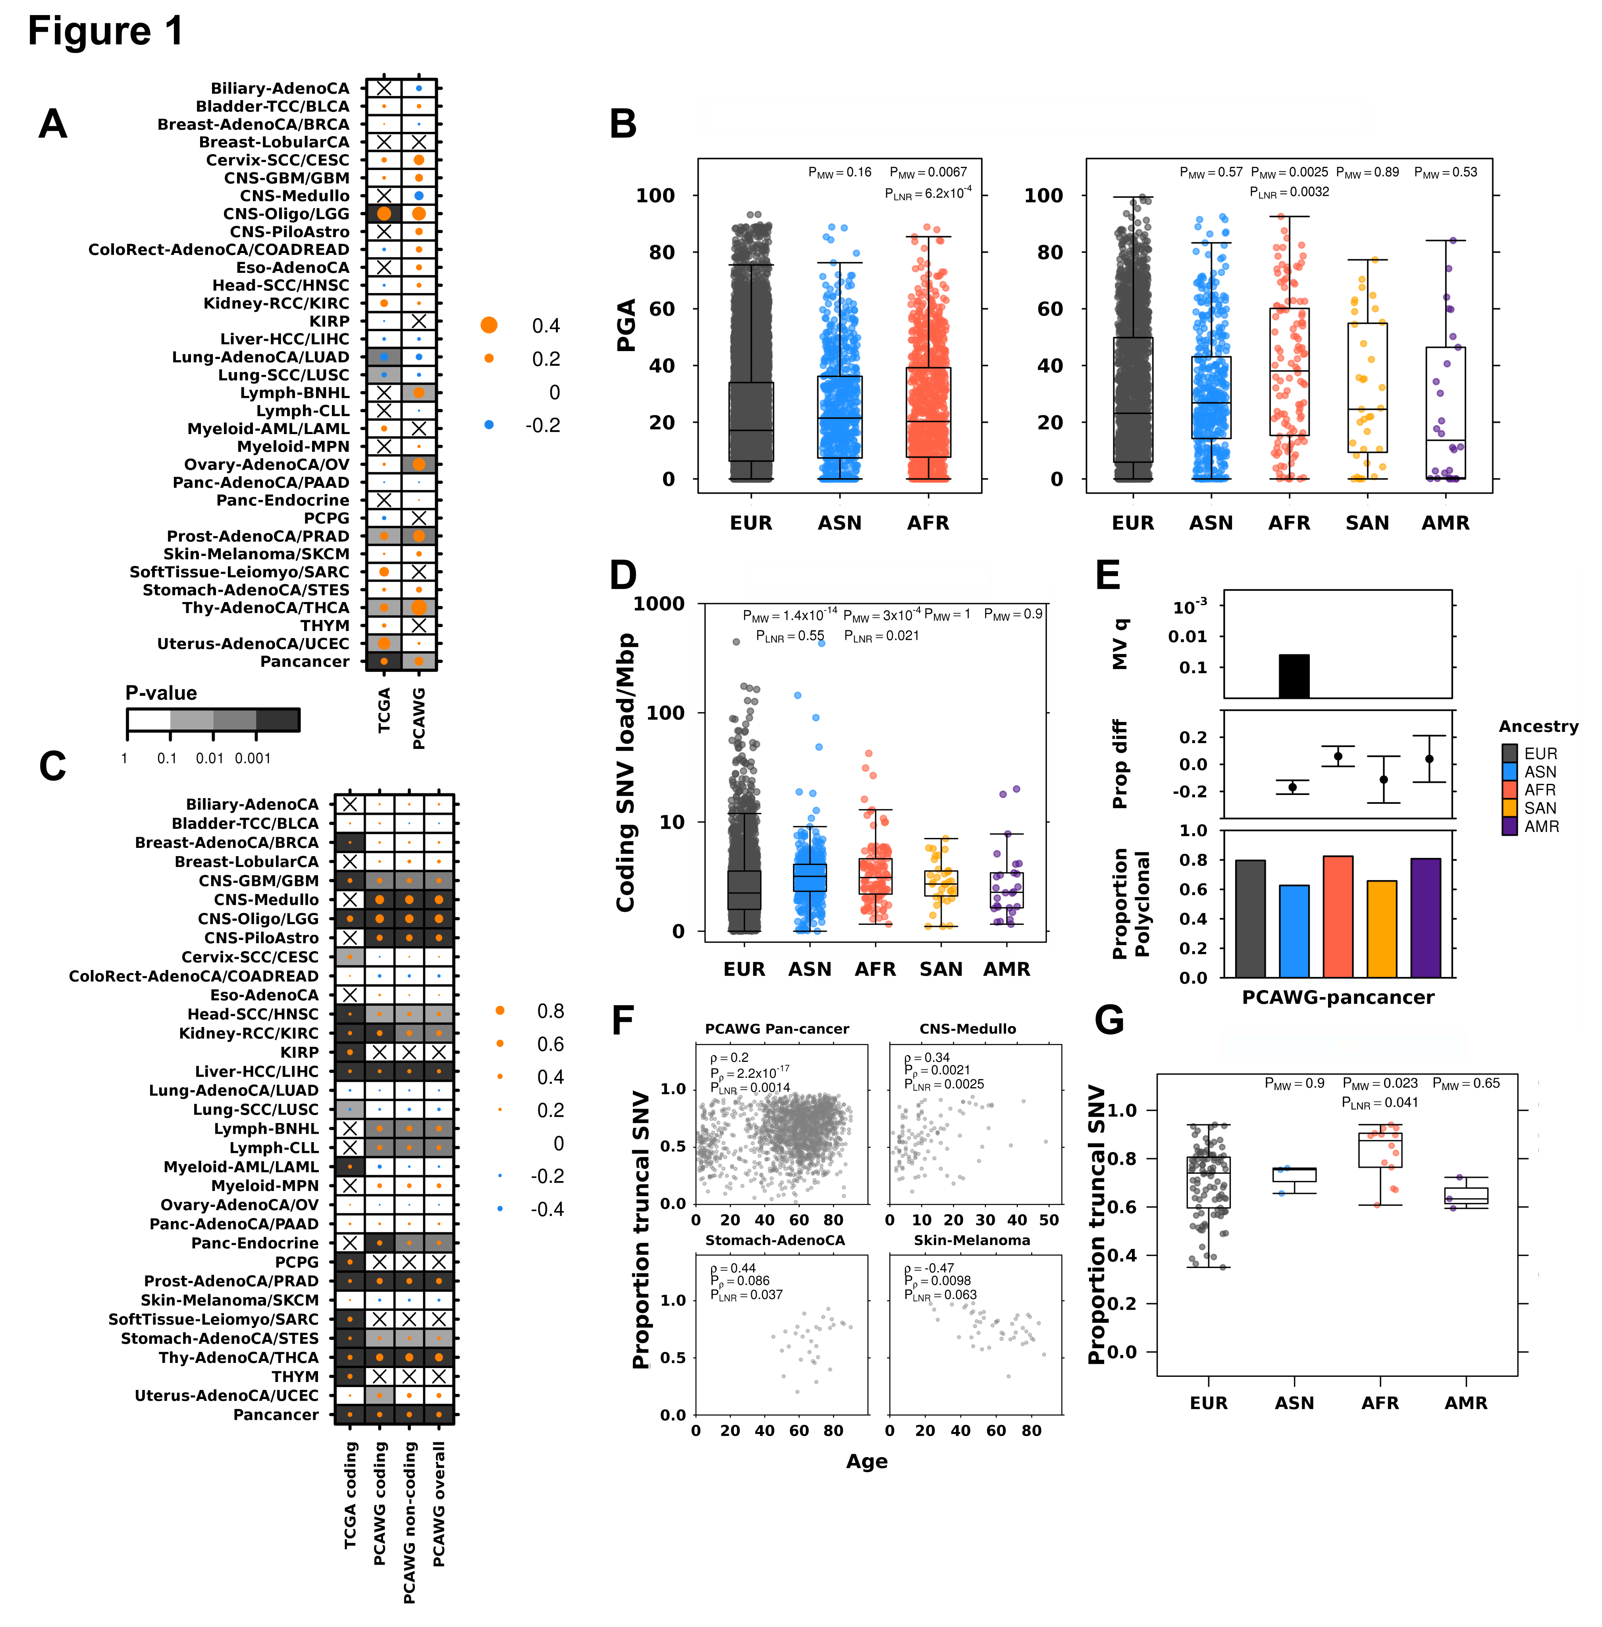
Genomic Instability Differs by Racio-Ethnicity
Li et al. submitted

Slide 22
Racio-Ancestry Influences Tumour Evolution
Li et al. submitted

Slide 23
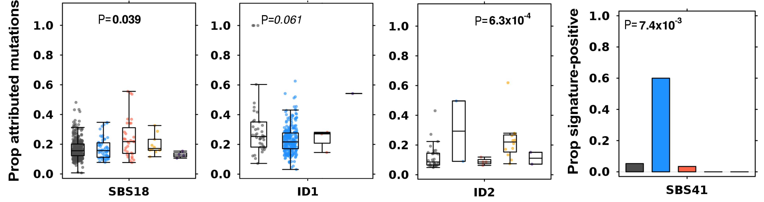
Racio-Ancestry Influences Mutational Processes
Pan-Cancer
HCC
HNSCC
Breast Cancer
Li et al. submitted

Slide 24
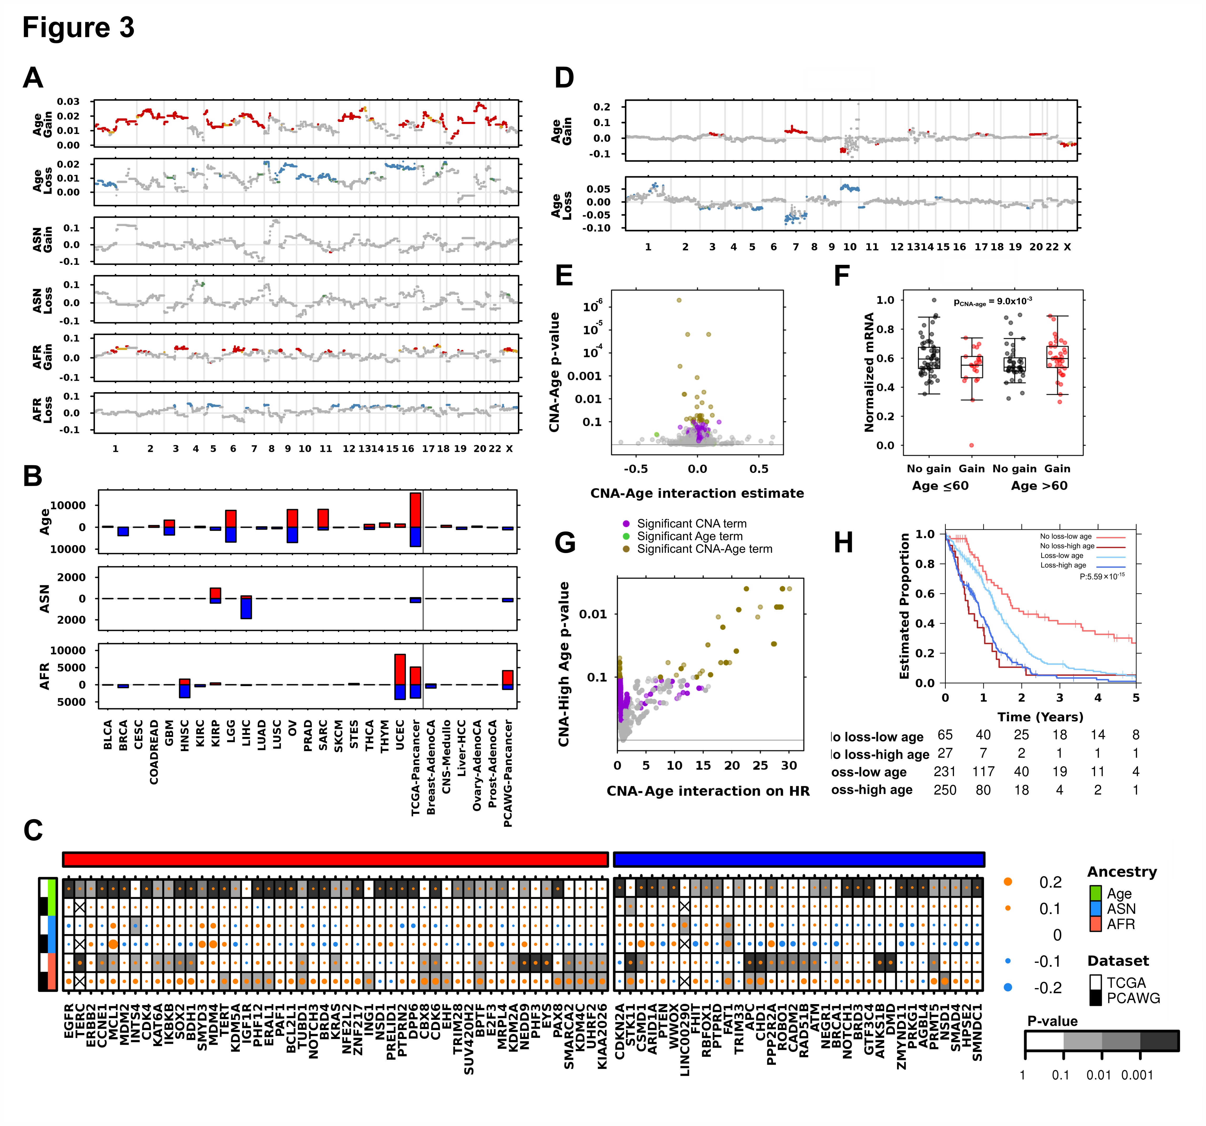
Racio-Ancestry Influences Specific Driver Mutations
Li et al. submitted

Slide 25
Pathway
Overview of Clinical Space
BRCA
Sex
Race & Ethnicity
Specific Polymorphisms
Summary

Slide 26
How Do Germline SNPs Affect Prostate Cancer?
Let’s start at the simplest place: methylation
We profiled 400 tumours:
  Germline WGS (SNPs)
  Somatic methylome
Houlahan et al. Nature Medicine in press

Slide 27
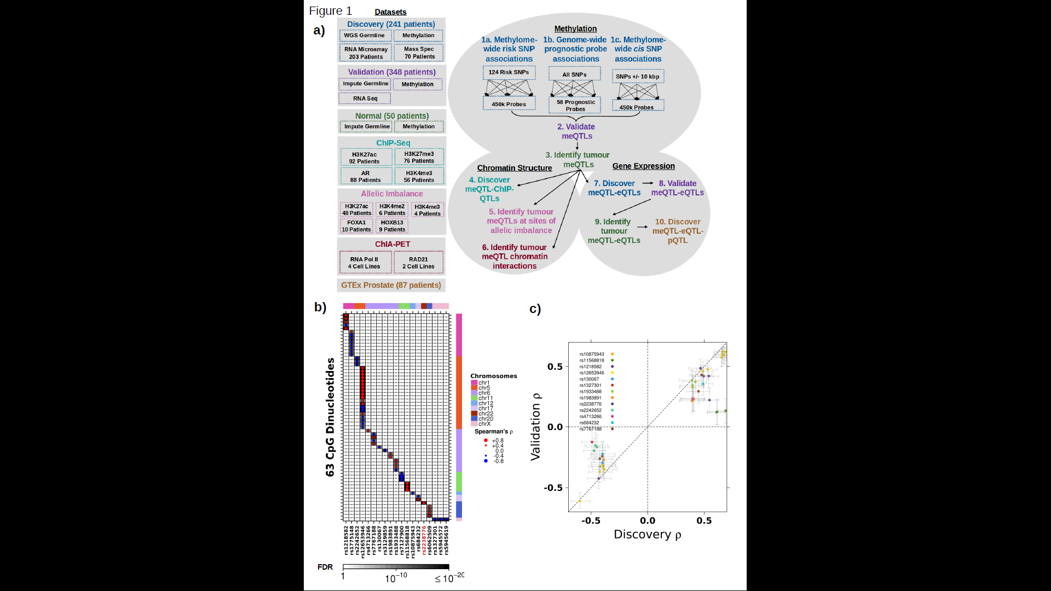
Risk SNPs Influence Somatic Methylation

Slide 28
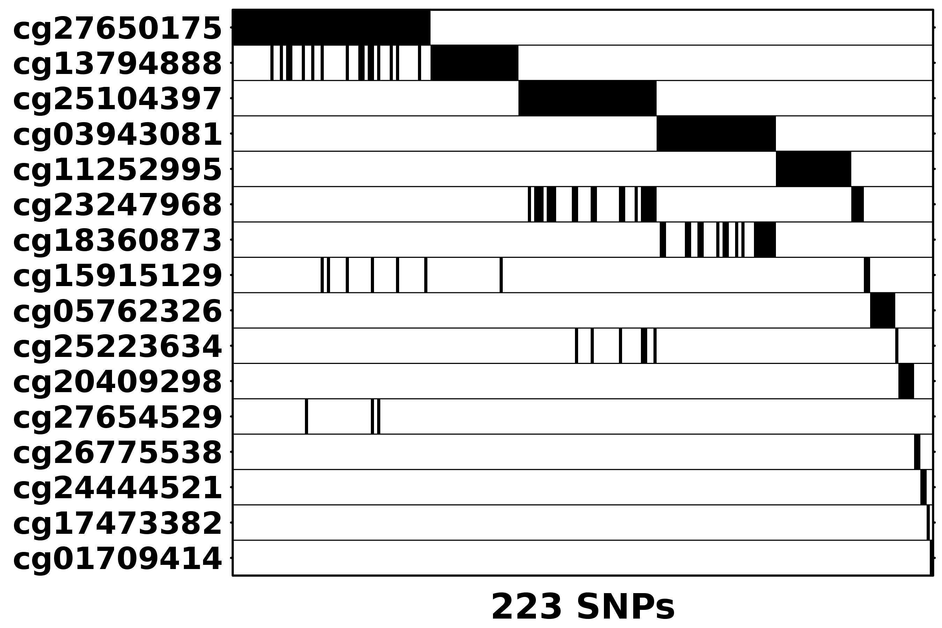
Prognostic Methylation Marks Are Germline-Associated

Slide 29
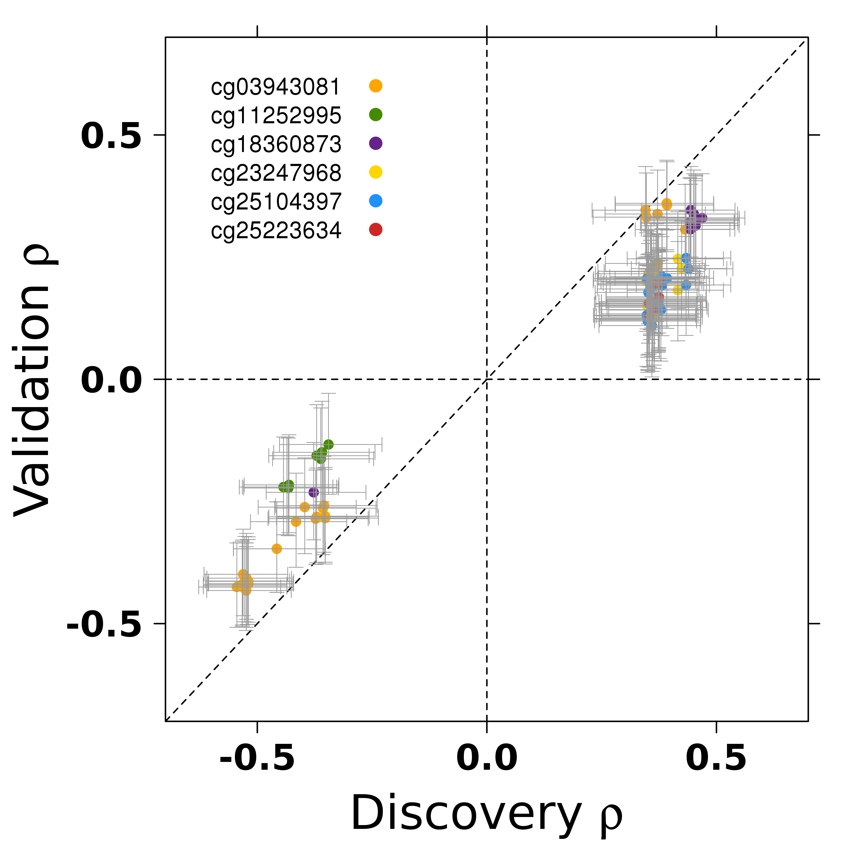
Prognostic Methylation-Associated Germline Interactions Validate

Slide 30
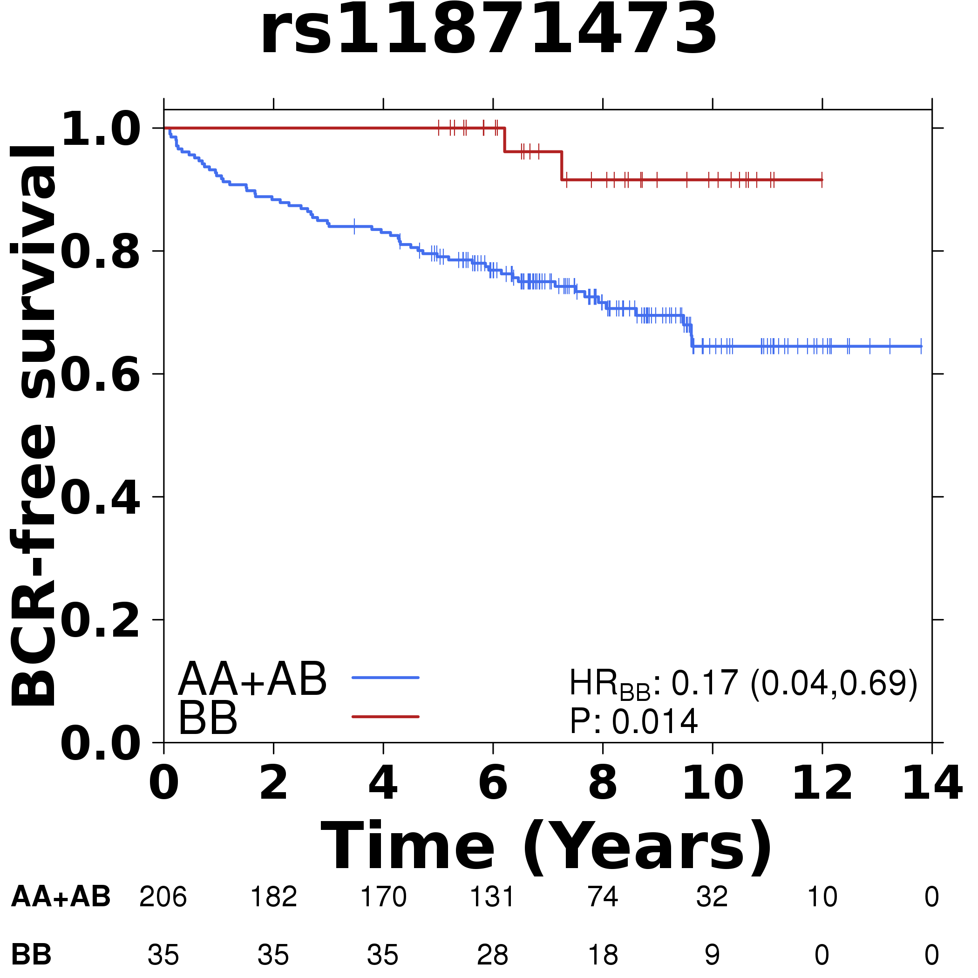
And Some SNPs Are Prognostic!!

Slide 31
So We Did a Genome-Wide Screen

Slide 32
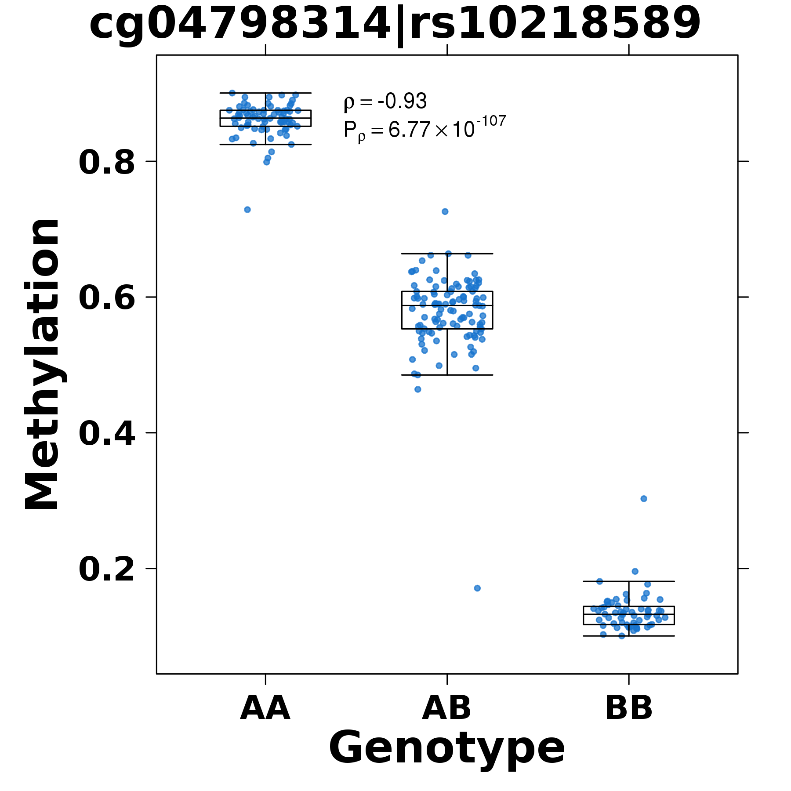
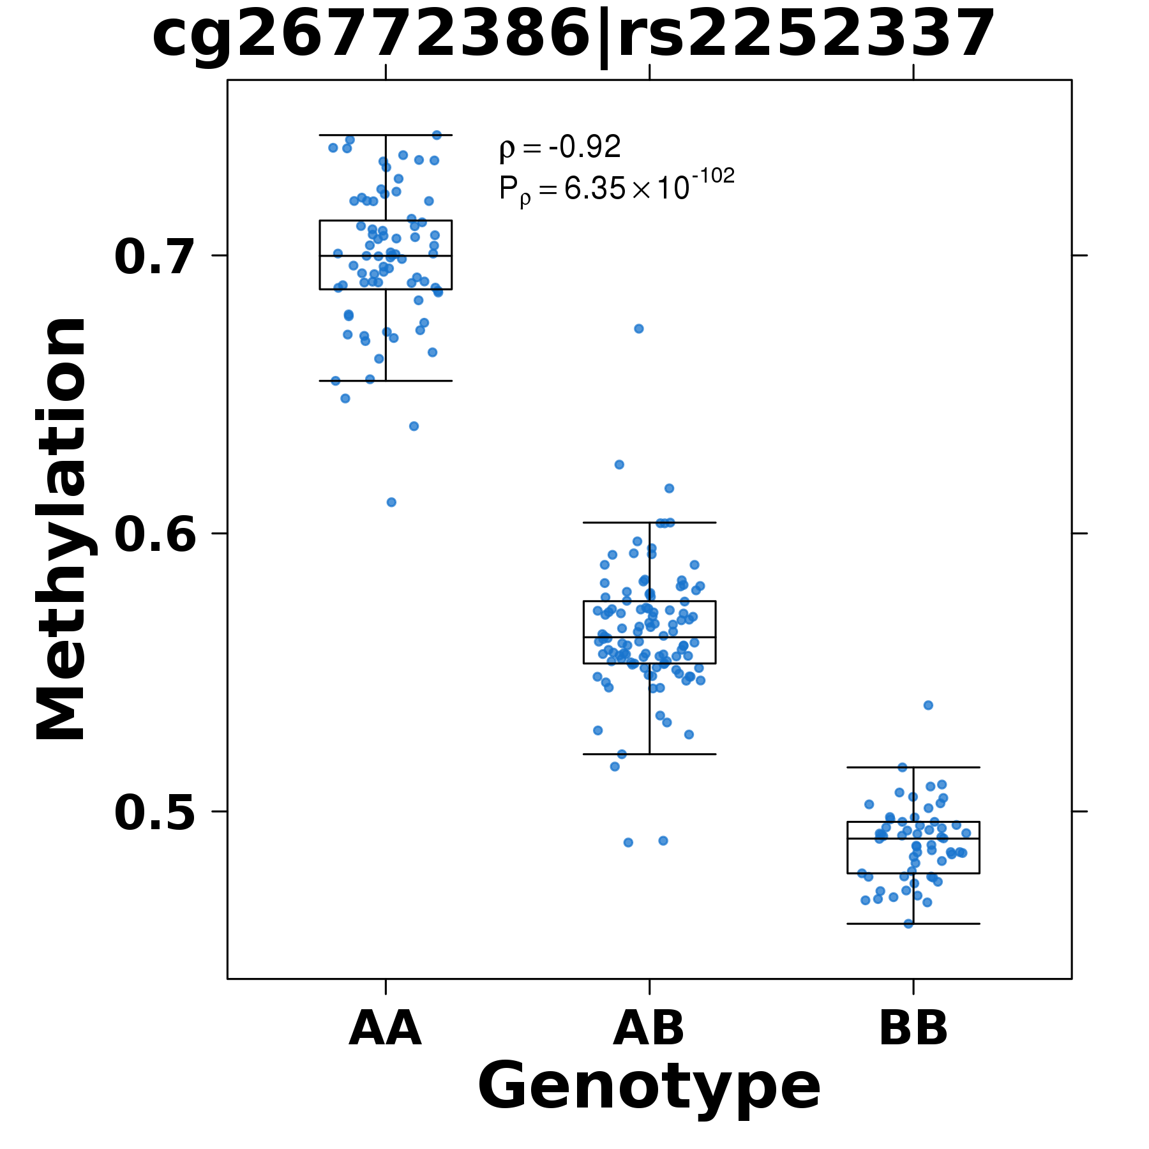
Exemplars

Slide 33
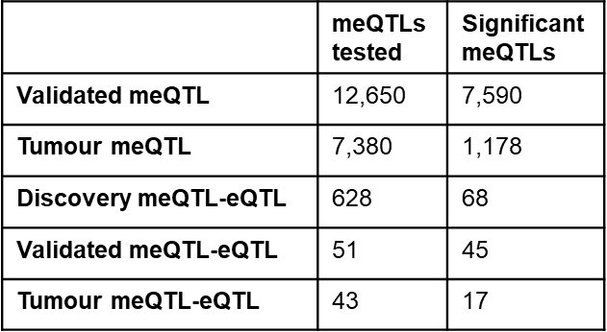
Many Strong Associations

Slide 34
Preferentially Occur in Enhancers (~100 Tumours)

Slide 35
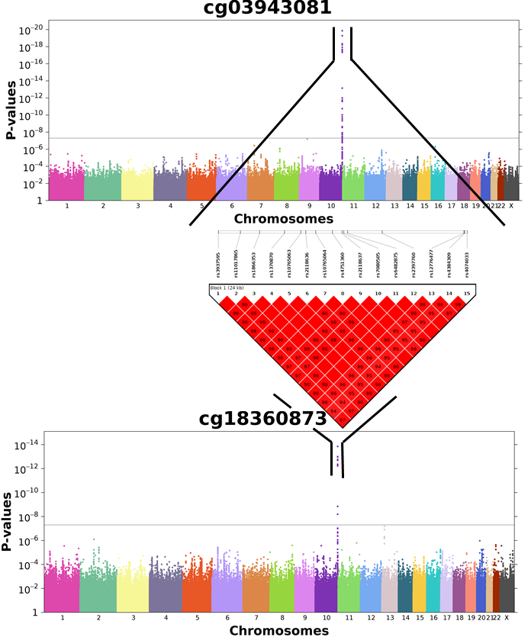
Strong Candidate: TCERG1L

Slide 36
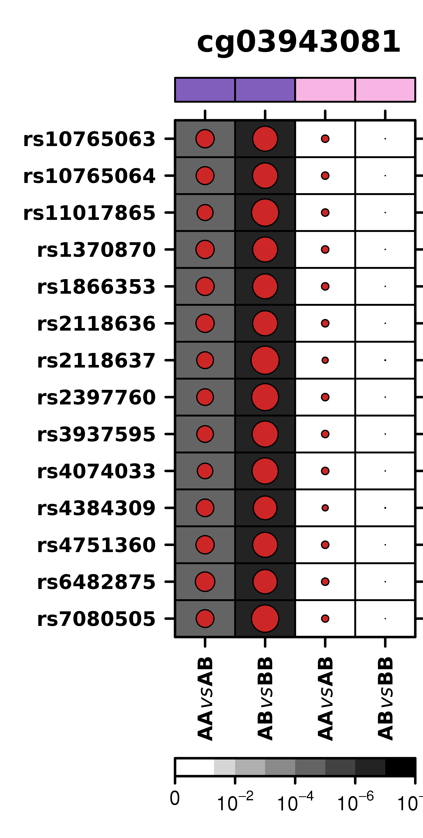
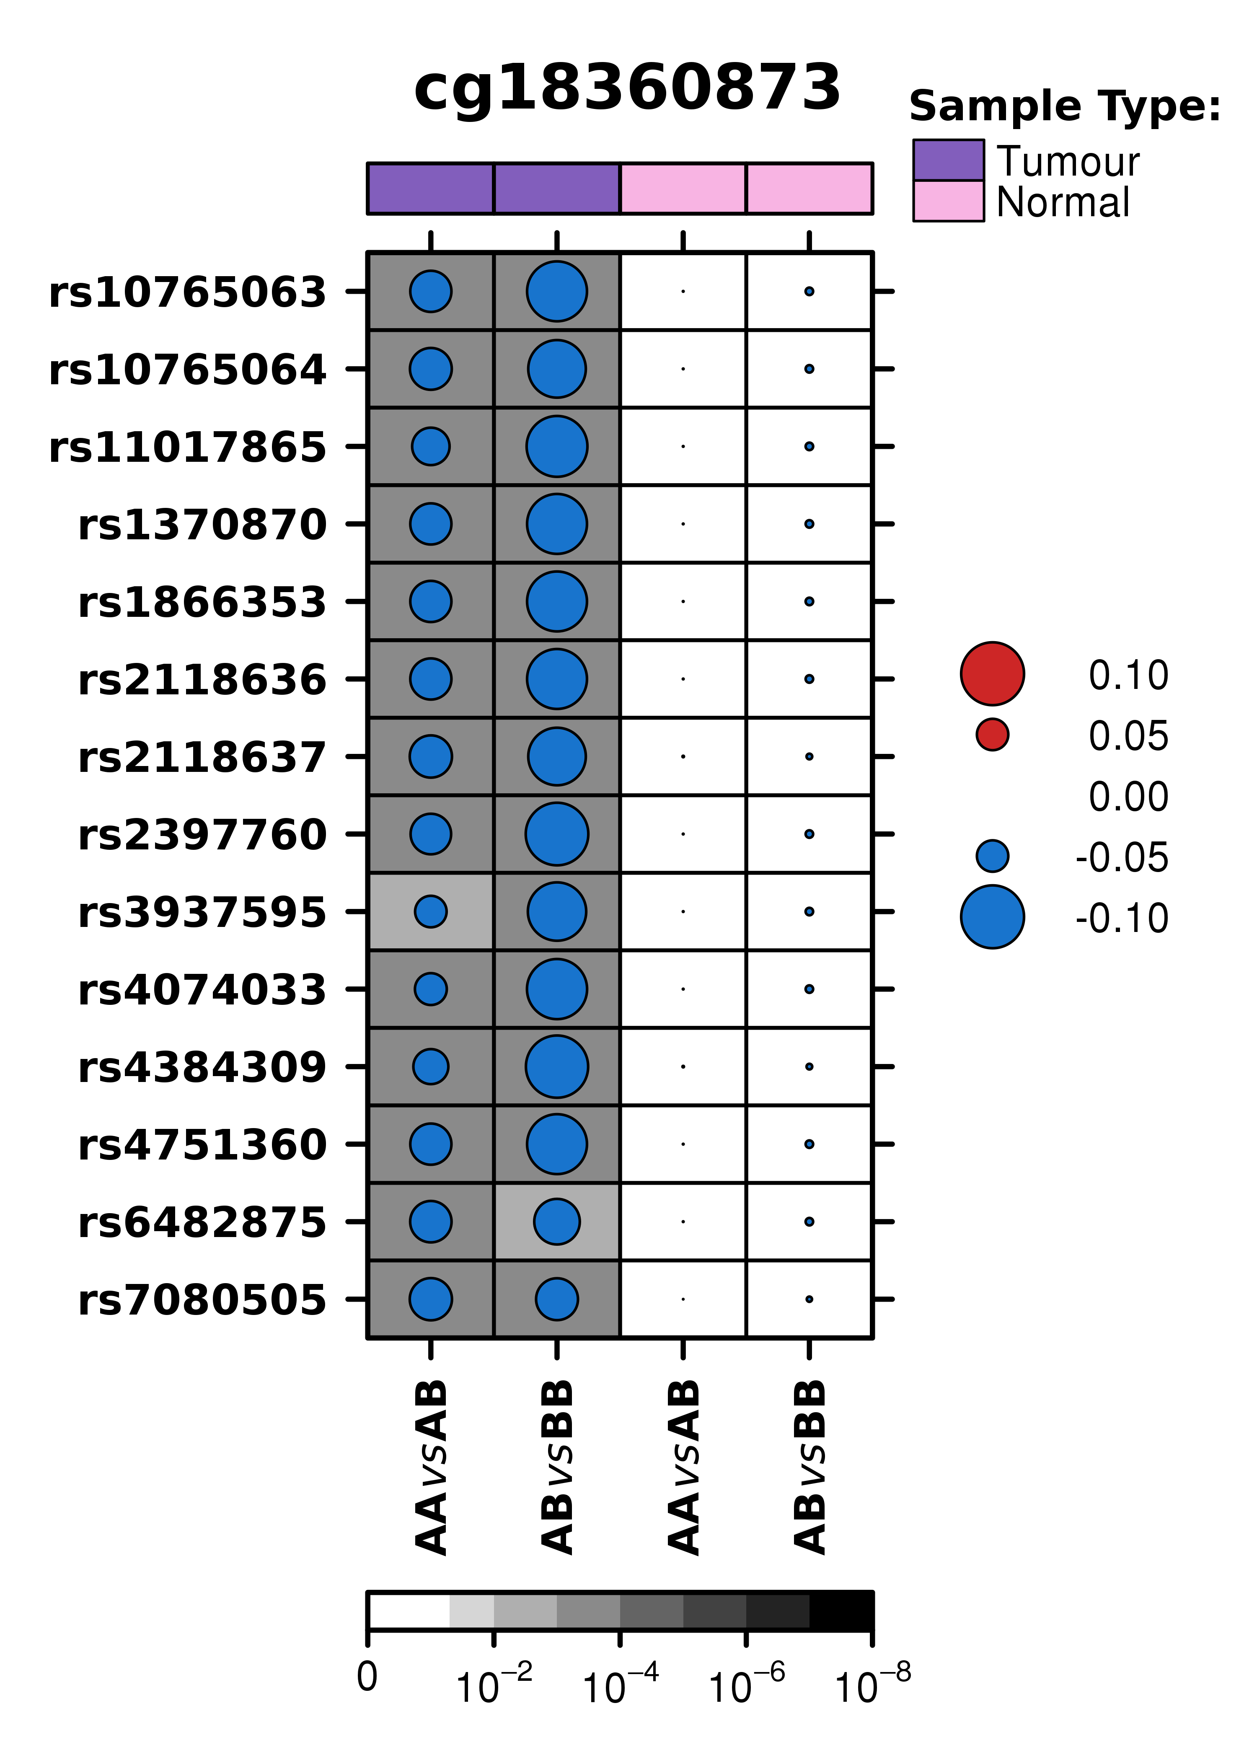
Tumour-Specificity

Slide 37
Affecting Enhancers

Slide 38
TCERG1L Is Prognostic

Slide 39
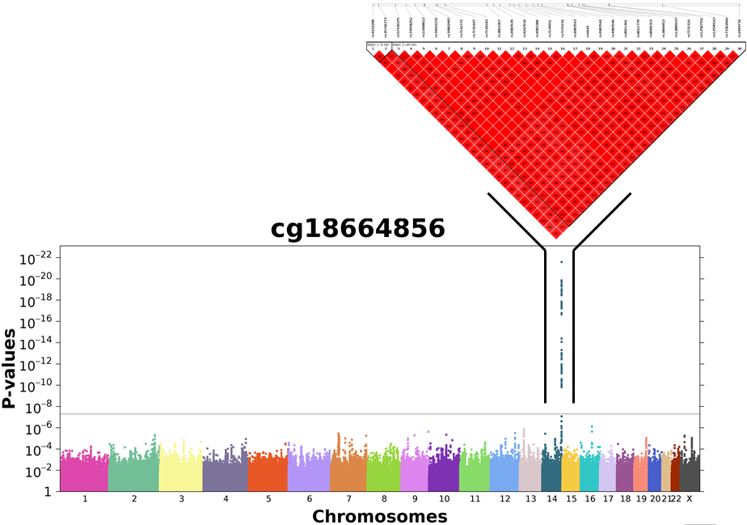
Another Strong Candidate: AKT1

Slide 40
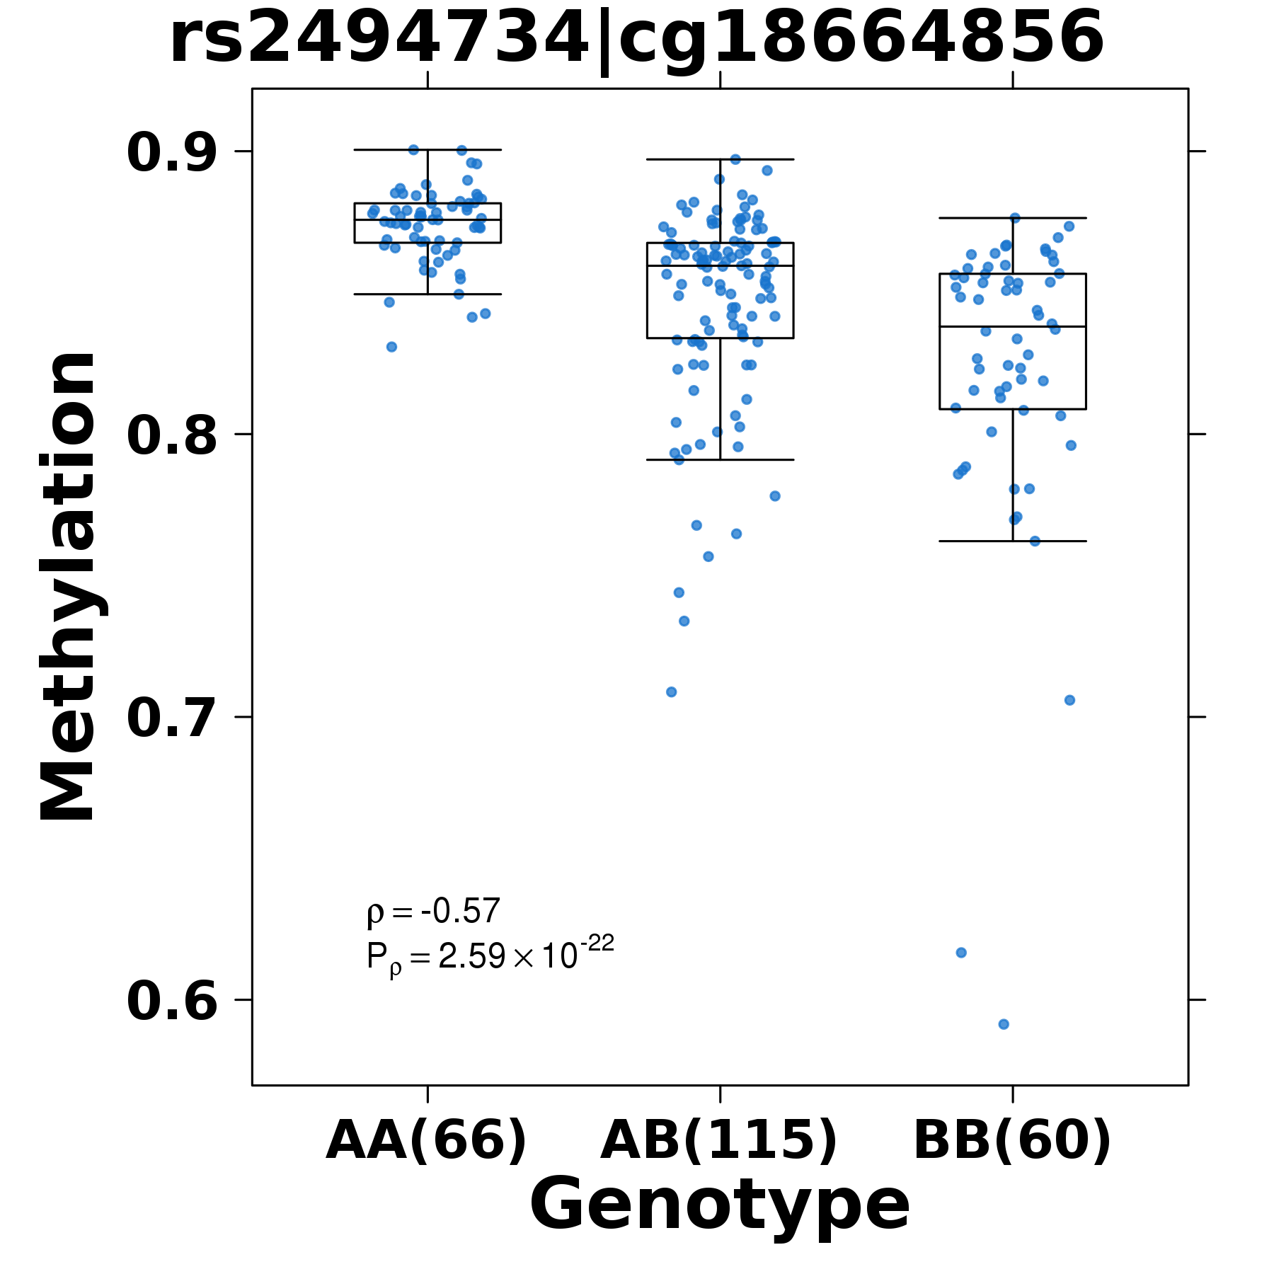
Epigenetic Effects

Slide 41
Transcriptomic & Prognostic Effects

Slide 42
Pathway
Overview of Clinical Space
BRCA
Sex
Race & Ethnicity
Specific Polymorphisms
Summary

Slide 43
What’s Next
Germline drives tumour evolution
Most SNPs are present in ~1% of the population
Most somatic events are present in ~5% of tumours
To have 100 patients with both we need:
  n = 100 / 0.01 / 0.05
  n = 200,000 patients per tumour type
UCLA Institute for Precision Health

Slide 44



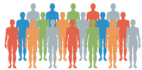
UCLA ATLAS Project
Cloud-based clinical and genomic data resource for research on all patients across the health system
Universal Consent (recruitment)
Centralized Biobanking (sample collection/storage)
Cloud Computing
(clinic-genetic data)
Genomic Analysis
(array, exome)
UCLA Institute for Precision Health
ATLAS 150k

Slide 45
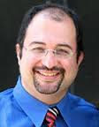

Mobilizing Universal Video Consent
Consent Questions
30 sec video introduction
4.5 min video consent
UCLA Institute for Precision Health
Currently available to individuals 18+
Consent status integrated with Epic
Currently available in English and Spanish
Translations include Farsi, Arabic, Korean, Mandarin
Piloting pediatric consent video
Arash Naeim MD PhD
Sarah Dry MD
Neil Wenger MD
Patients consent to allow research use of:
Remnant blood samples
One blood or saliva tube collected during routine care
De-identified health records

Slide 46
Current ATLAS Status
Genomic Data
  67% Consent Rate on iPads @ 17 sites across UCLA Health
  ~1,800 patients consenting per week
  ~800 patient samples collected per week
  ~700 patient genotypes generated per week
Clinical Data
  De-identified dump of synoptic EMR: ~12.5-million patients
  In quality-control right now
  Working on linking to radiology, notes, send-outs, etc.

Slide 47
Summary
Robust biomarkers can:
  Be developed using multiple data-types
  Overcome spatial heterogeneity
Different levels of biomarkers tightly correlate to one another, and these inter-relationships define different disease states
These data call for composite germline, somatic, imaging and fluid biomarkers to diagnose, prognose and monitor progression.
Next steps: add quantitative pathology and radiology, larger cohorts
These studies required extensive inter-disciplinary team-work and collaboration (and funding!).

Slide 48
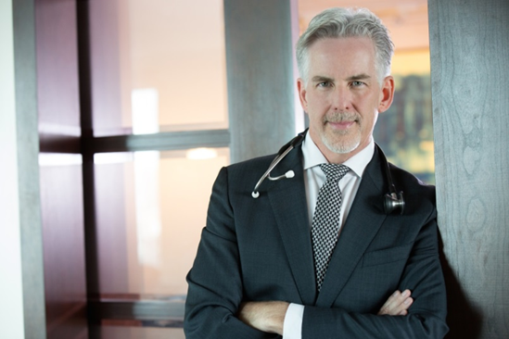
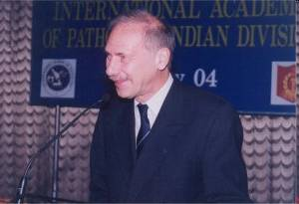
The Team
Dr. Robert Bristow
Toronto
Alejandro Berlin
Colin Collins
Melvin Chua
Michelle Downes
Neil Fleshner
Hansen He
Thomas Hudson
Thomas Kislinger
Laurie Klotz
Stanley Liu
Mathieu Lupien
John McPherson
Quaid Morris
Melania Pintilie
Dominique Trudel
Danny Vesprini
Boutros Lab
Sarah Al-Hiyari Jeohyun Jeon
Vinayak Bhandari Emilie Lalonde
Michelle Chan-Seng-Yue Alfonso Lam
Sujun Chen Constance Li
Richard de Borja Lydia Liu
Ardalan Darvarifar Julie Livingstone
Shadrielle Espiritu Courtney Penn
Michael Fraser Stephenie Prokopec
Natalie Fox Monica Reyes
Tsumugi Gebo Veronica Sabelnykova
Jenna Giafaglione Adriana Salcedo
Lawrence Heisler Sylvia Shiah
Syed Haider John Watson
Julia Hopkins Takafumi Yamaguchi
Katie Houlahan Cindy Yao
Vincent Huang Fouad Yousif
Dr. Theodore van der Kwast
Los Angeles
Dan Geschwind Andrew Goldstein
Amar Kishan Clara Lajonchere
Bogdan Pasaniuc Robert Reiter
Brian Shuch Tony Sisk
Owen Witte Huihui Ye
Global
Yves Fradet (Laval) Matt Freedman (DFCI) Lee Jones (MSKCC)
Ram Mani (UTSW) Josh Stuart (UCSC) Joachim Weischenfeldt (BRIC)

Slide 49
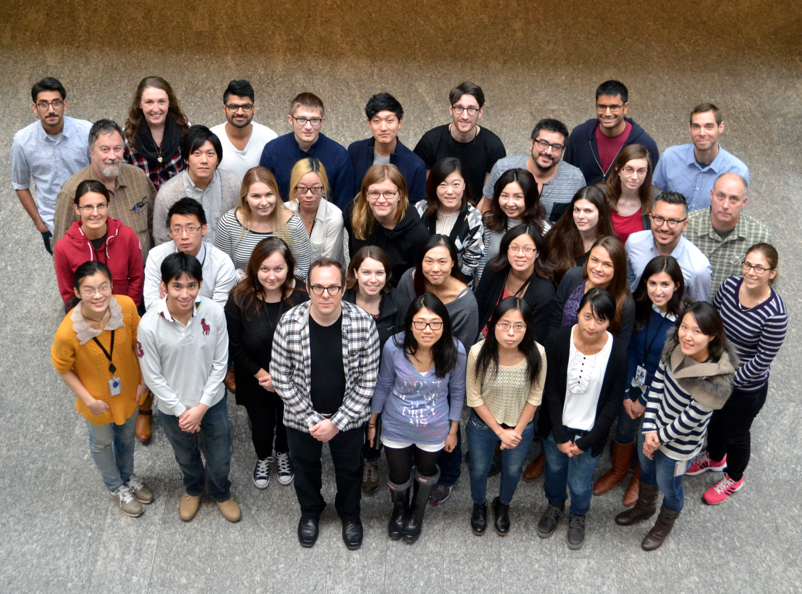
Questions?
Positions Available: pboutros@mednet.ucla.edu

