Slide 1
Illuminating the tumor microenvironment:
Astronomy informs Pathology
Dr. Janis Taube
Professor of Dermatology and Pathology
The Johns Hopkins Bloomberg~Kimmel Institute for Cancer Immunotherapy
Big Data and AI/Machine learning, EDRN, 9.10.19

Slide 2
Disclosures
Research funding from BMS, Akoya Biosciences
Consulting/Advisor Board member for BMS, Merck, Astra Zeneca
Equipment and reagents from Akoya Biosciences

Slide 3
Overview
Use case for multiplex IF/IHC
Approach to multiplex IF/IHC staining and analysis
Develop a unique facility to produce, interrogate, and present petabytes of tissue imaging data: Lessons from astronomy

Slide 4
Immunoarchitectural features associated with anti-PD-1 response
*
*
H&E
Isotype
CD20
CD3
CD4
CD8
PD-1
PD-L1
PD-L2
J Taube, et al., Clin Can Res, 2014

Slide 5
Representative 7 color, multiplex panel (tissue sparing, co-expression)
Tumor
PDL1
CD68
PD1
CD8
FoxP3
DAPI

Slide 6
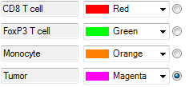
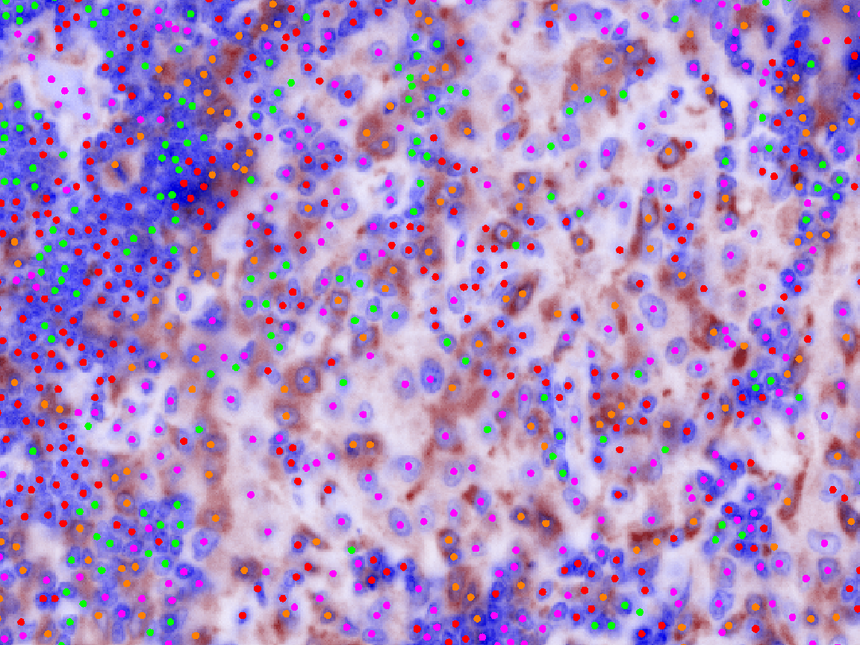
Phenotyping of Multiplex IF panel

Slide 7
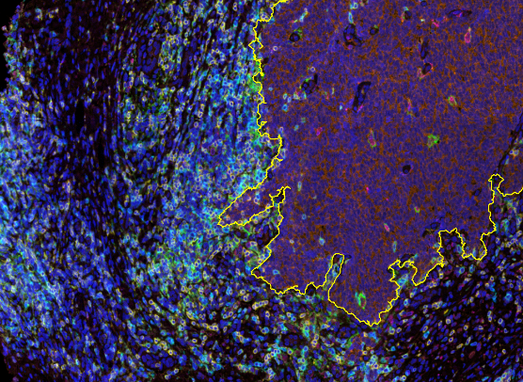
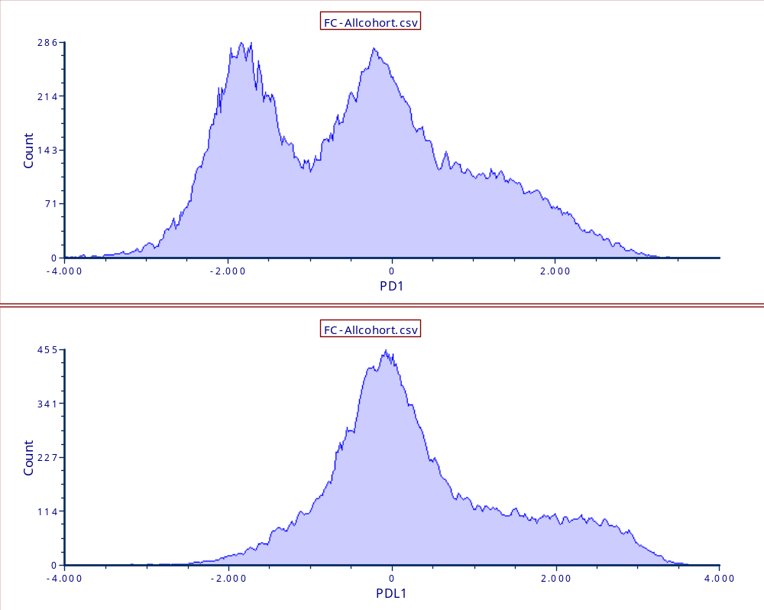
Multiplex Immunofluorescence panels can be used to identify PD-1^{low} vs. PD-1^{med} vs. PD-1^{high}
Log (normalized intensity)
Positive signal only
PD-L1, PD-1, CD163, FoxP3, CD8, tumor marker + DAPI

Slide 8
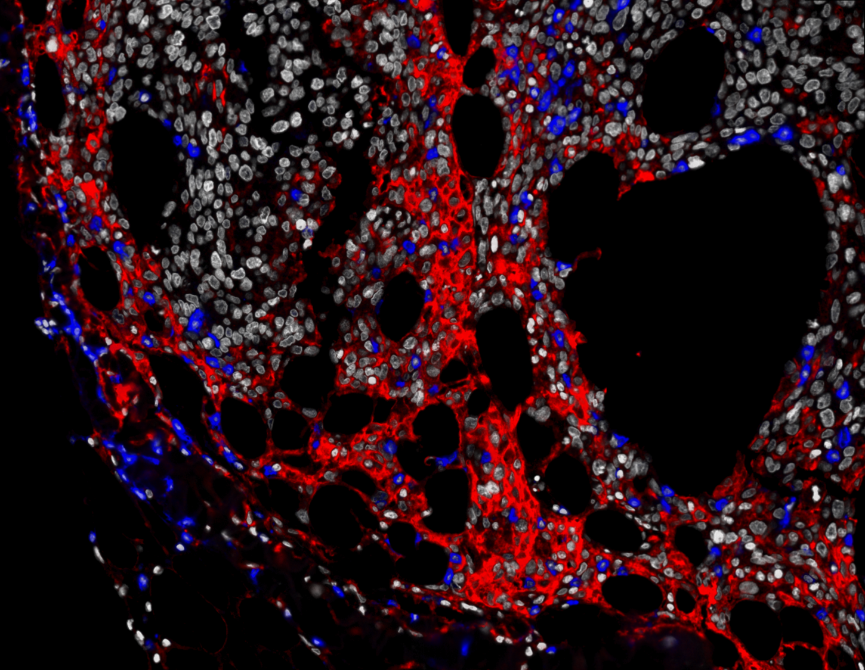
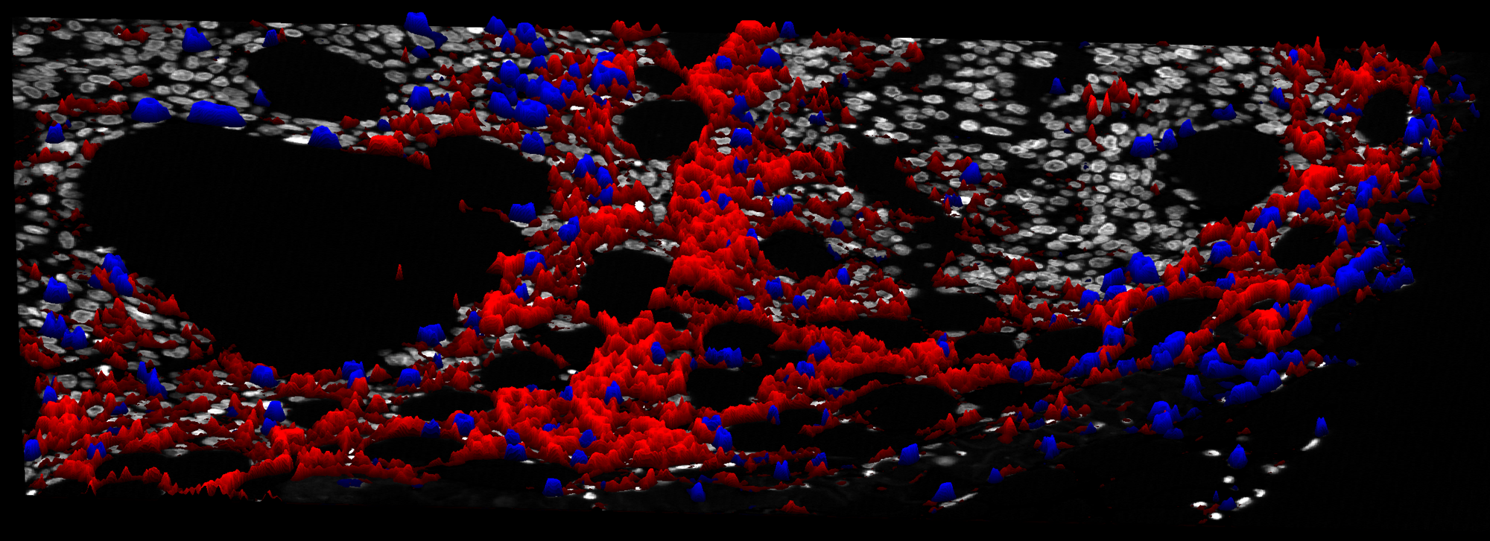
Marker intensity measurements in situ
PD-1^{high+}
PD-L1
PD-1
PD-1^{low+}

Slide 9
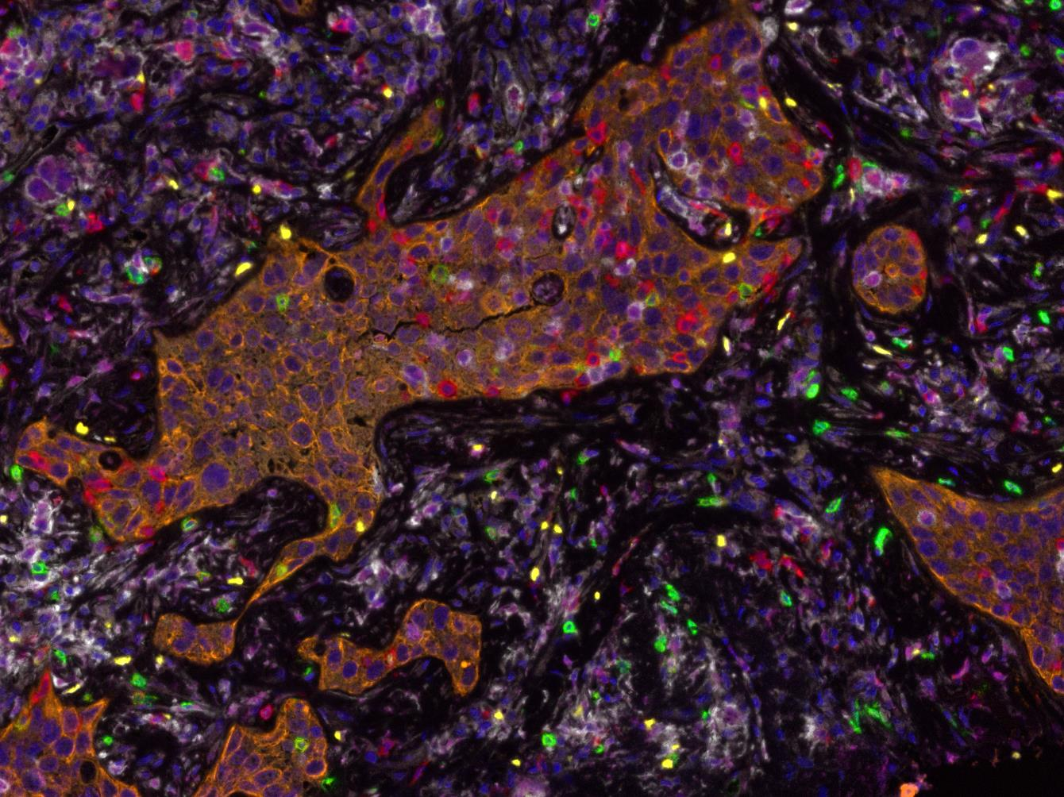
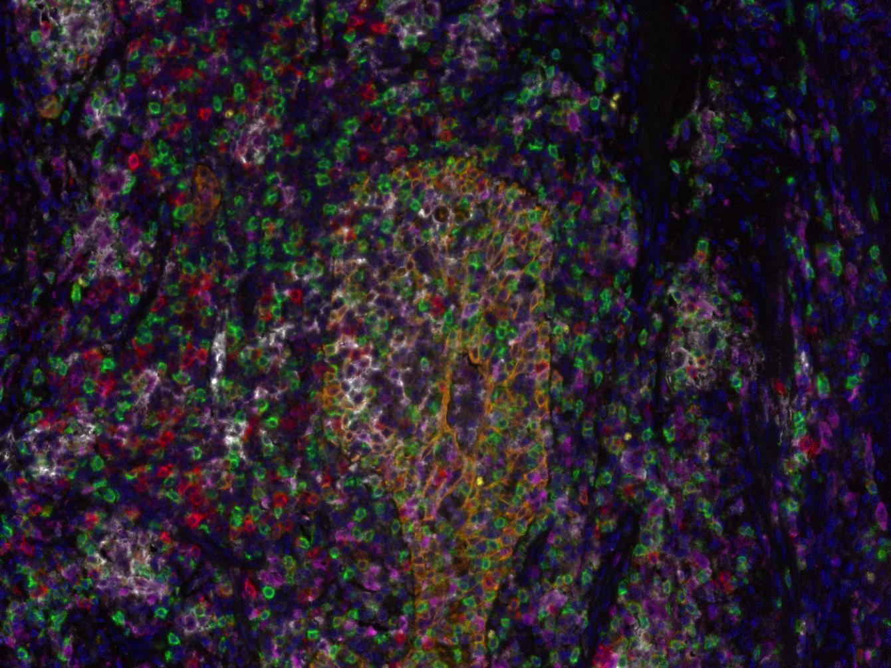
Example: Neoadjuvant anti-PD-1 in primary NSCLC
Pre-treatment
Post-treatment
PD-L1 PD-1 CD8 FOXP3 CD68 Tumor DAPI
Forde, et al. NEJM 2018

Slide 10
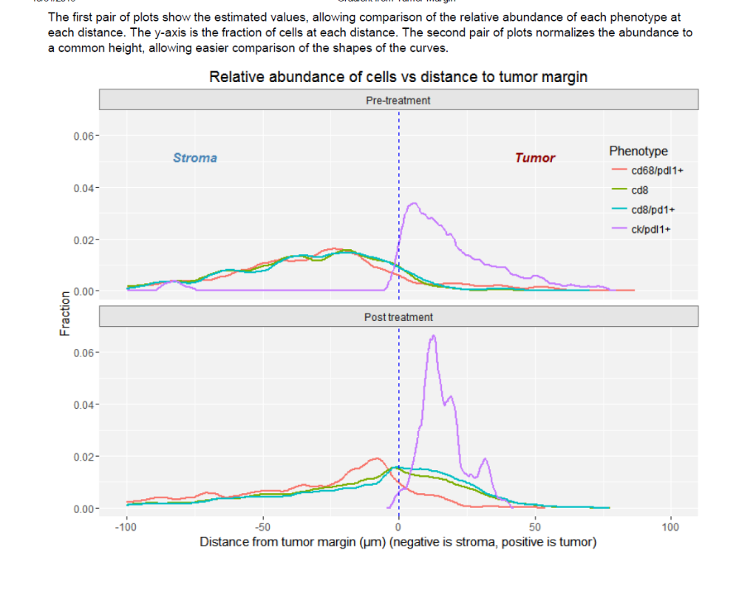
Example: Pre vs. Post Rx cell population shifts relative to tumor margin
Tricia Cottrell, MD, PhD

Slide 11
Overview
Use case for multiplex IF/IHC
Approach to multiplex IF/IHC staining and analysis
Develop a unique facility to produce, interrogate, and present petabytes of tissue imaging data: Lessons from astronomy

Slide 12
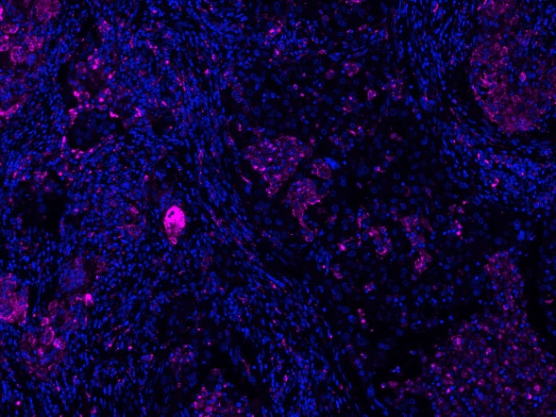
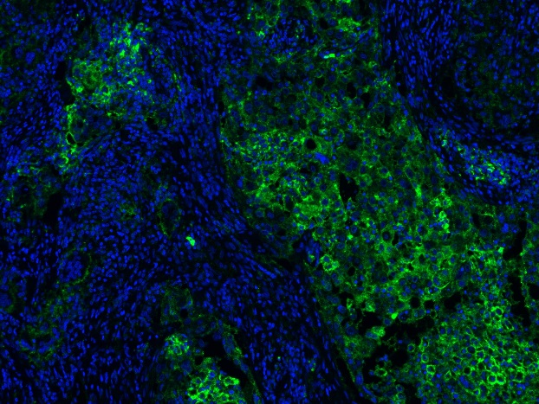
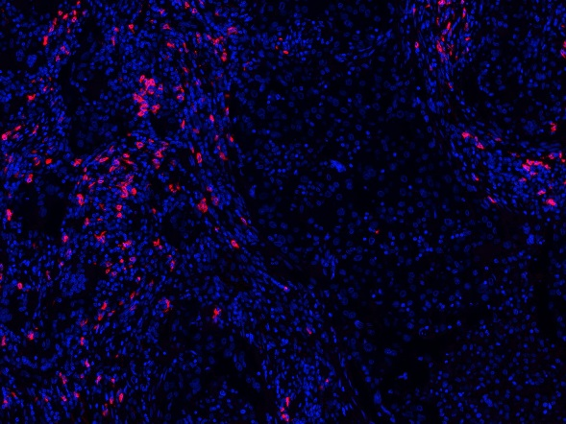
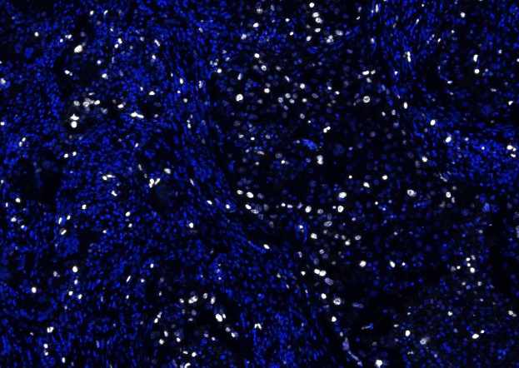
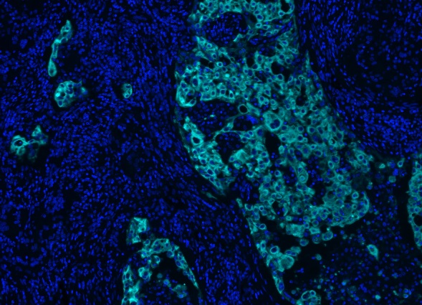
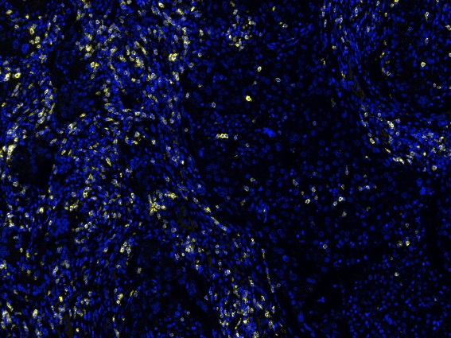
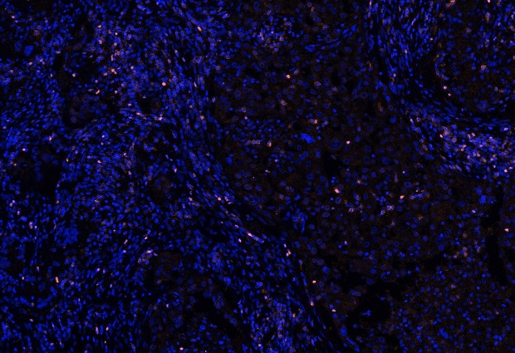
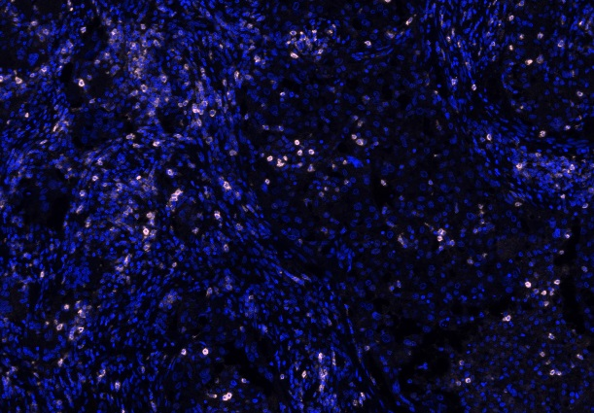
“Upping the plex” on whole slides
CD68
PD-L1
CD20
Ki-67
Tumor
CD8
FoxP3
PD-1

Slide 13
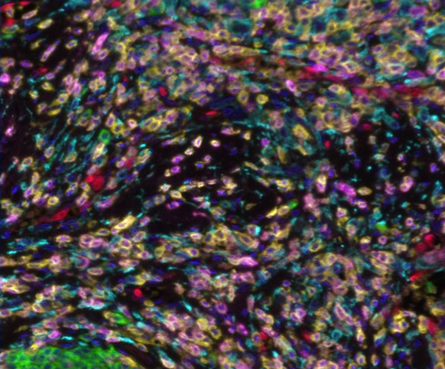
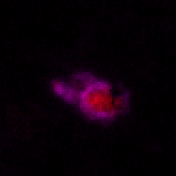
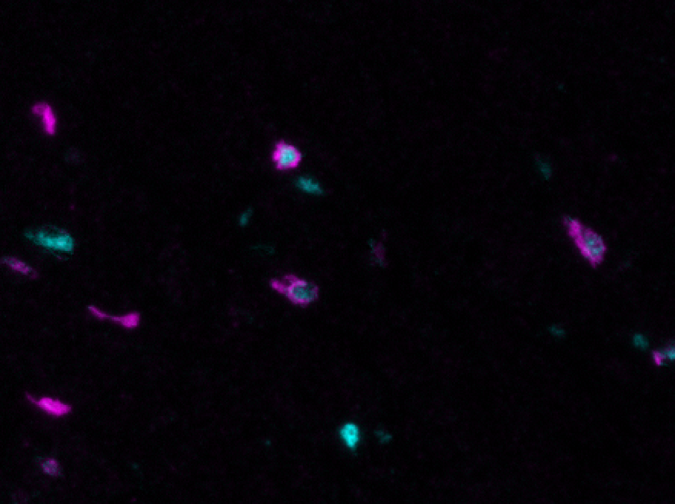
Additional multiplex panels
All
Neovasculature
CD8, Eomes
Tertiary lymphoid structure
CD8, T-bet
CD79a CD3 CD163 ERG PD-1 Tumor
B cells T cells MΦ/DC neovasc
Gzmb, Lag3, Eomes, PD-1, T-bet, CD8

Slide 14
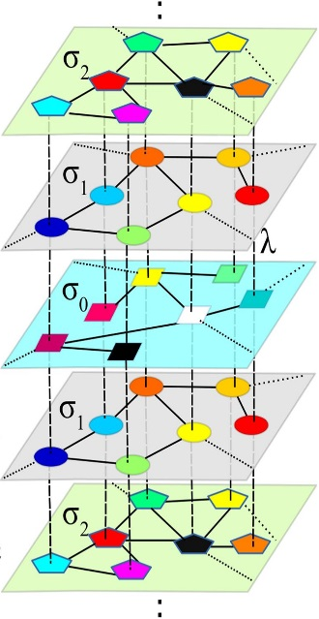


Combining approaches to increase ‘plex’
6-8 mIF labels
IHC overlay (2 labels)
Z-stacking
4 slides
~27-28 markers across a whole FFPE slide
Nicolas Giraldo and Sneha Berry, Taube lab

Slide 15
Complete quantitative analysis
Most early presentations and papers using mIF have assessed between 1-5 high power fields, same with other ‘high plex’ technologies
One tumor >1000 fields and >300 GB disk space (one staining panel)
Each square= 1 HPF*

Slide 16
Overview
Use case for multiplex IF/IHC
Next steps for multiplex IF/IHC staining and analysis
Develop a unique facility to produce, interrogate, and present petabytes of tissue imaging data: Lessons from astronomy

Slide 17
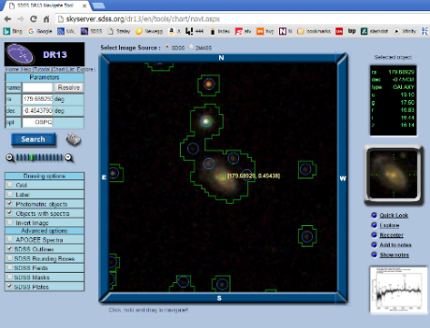
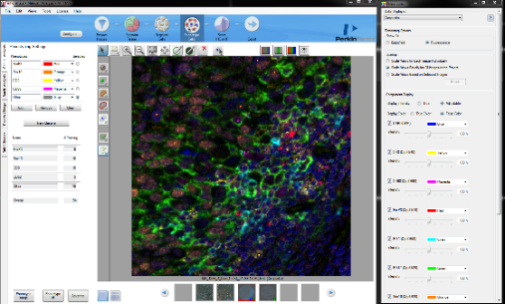
Stars and galaxies are like cells in pathology
Astronomy viewer
Pathology viewer
Strong parallels between mIF today and astronomy 25 years ago
Need to scale and organize data, multicolor photometry, image segmentation, spatial statistics

Slide 18
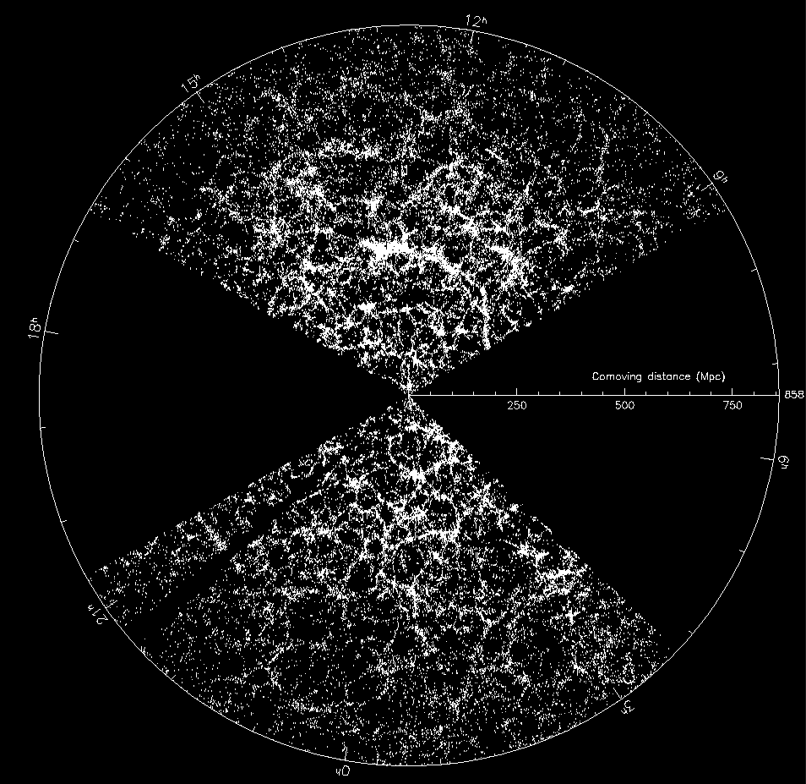
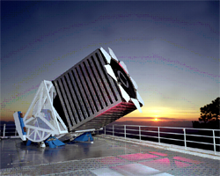
Sloan Digital Sky Survey: “The Cosmic Genome Project”
Public database and spectrograph built at JHU (SkyServer, images with spatial statistics, and catalogues)
Started in 1992, finished in 2008: The world’s most used astronomy facility today (2.8B web hits in 16 years)
We have modified the SkyServer structure to host our tumor-immune maps

Slide 19
Overlapping Tiles – following astronomy’s lead
20% overlapping area for intrinsic validation and quality control
>100x more data collected for each slide

Slide 20
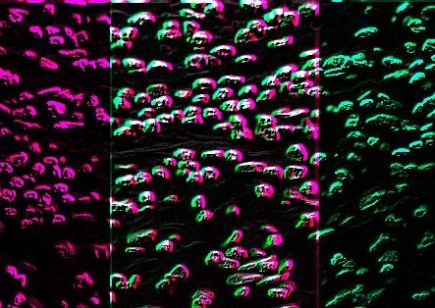
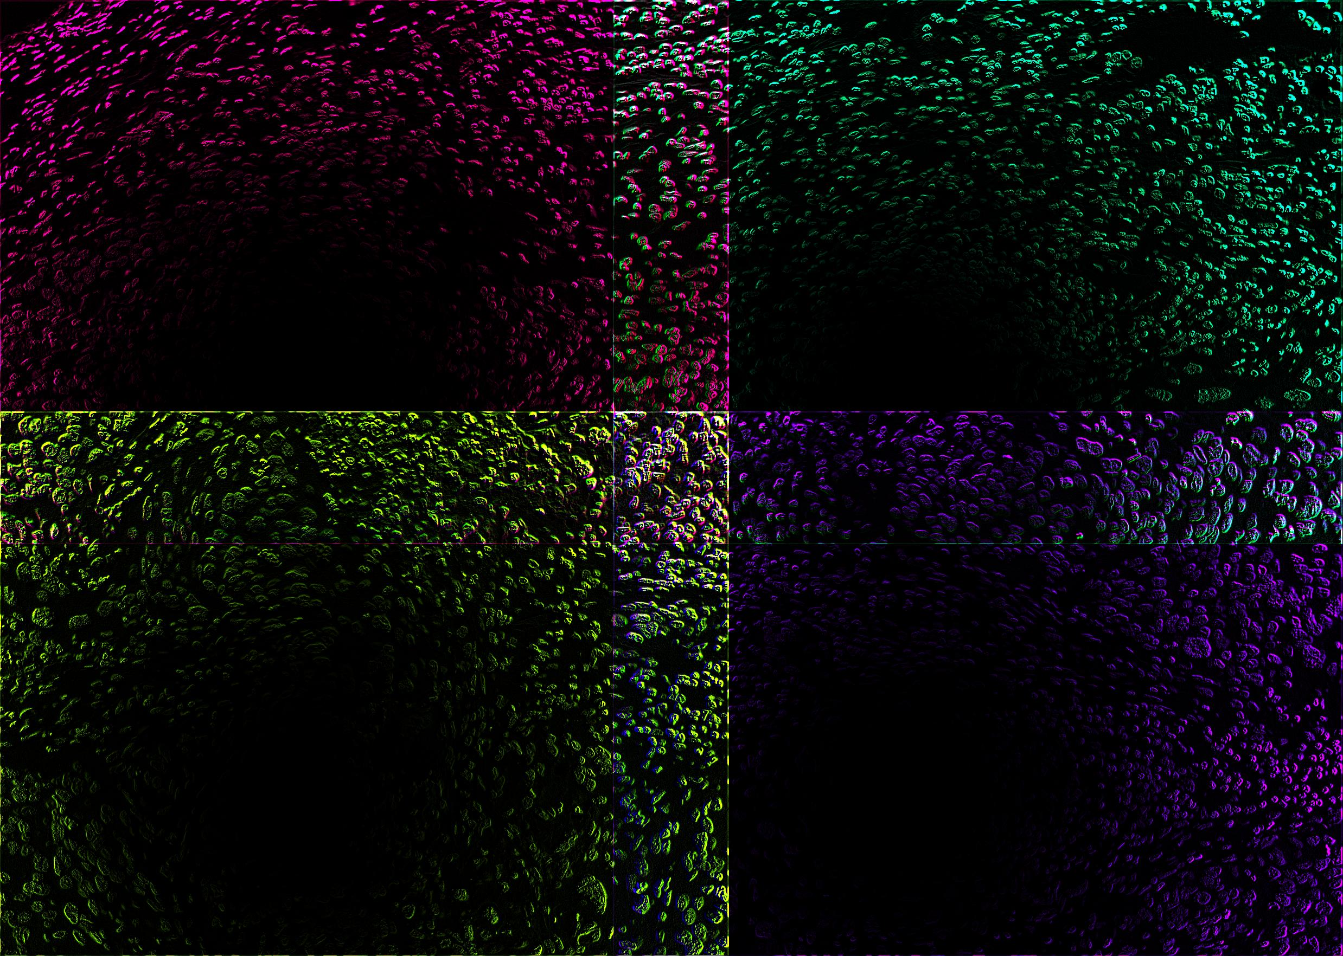

Potential for variation in field illumination and warping of image corners per HPF
Each HPF has variation in field illumination
Each HPF has warping of image corners
(‘Pin cushion effect’)

Slide 21
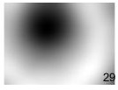
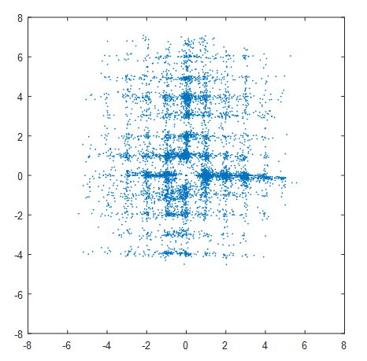










Image processing and corrections
Each HPF has variation in field illumination
Each HPF has warping of image corners
(‘Pin cushion effect’)
Overlapping field acquisition allows for improved alignment between individual HPFs
y pixel shift
x pixel shift
Courtesy of Alex Szalay

Slide 22
Multiplex IF analysis pipeline
Multiplex Staining
Image acquisition
Image processing
Phenotyping
Phenotype Q/A
Normalizing
Batch-effects

Slide 23
Multiplex IF analysis pipeline
Multiplex Staining
Image acquisition
Image processing
Phenotyping
Phenotype Q/A
Normalizing
Batch-effects
Machine learning

Slide 24
Phenotyping of Multiplex IF panel

Slide 25
Phenotyping of Multiplex IF panel
VERY TIME CONSUMING

Slide 26
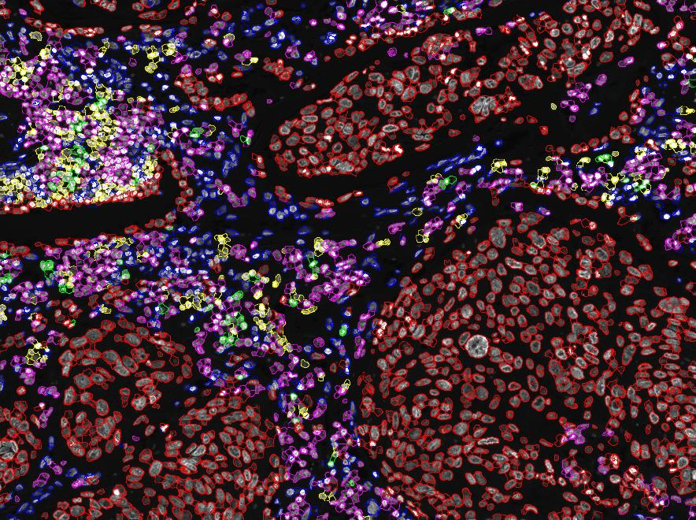
Initial results training the
ML algorithm
Seyoun Park,
Yuille lab

Slide 27
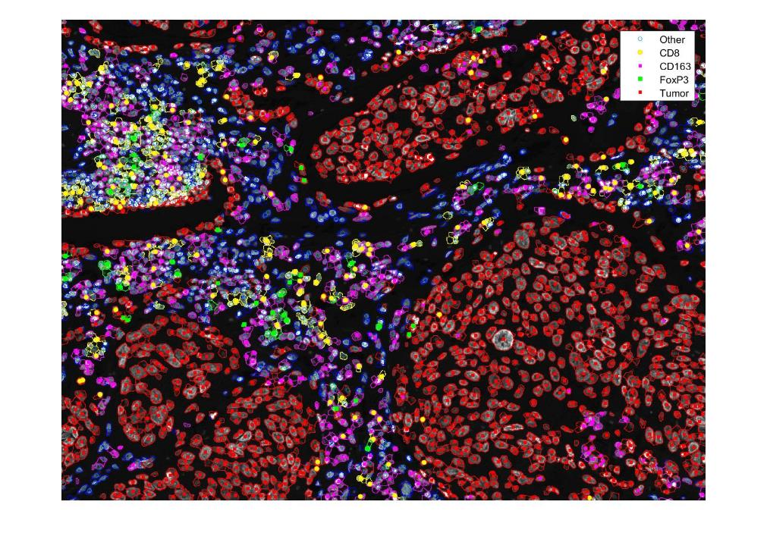
Comparison: Initial results training the
ML algorithm vs. current approach
Seyoun Park,
Yuille lab

Slide 28
Generating Big Enough Training Sets
Automate tissue segmentation in multiple steps
Challenge is that training sets/ground truth not big enough
We need to get there in multiple steps
  Use validated results from existing methods
  Build intermediate Machine Learning tool to
  bootstrap training set
  Finally, do massive Deep Learning

Slide 29
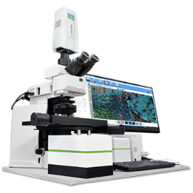
Preprocessing Workflow
Vectra
Temp
DBload
im3,
annotations
Unpack
bytes
Flat-field,
Warp
Reinsert
into im3
Segment im3
InForm/dual
Object list
merger
Table
converter
Scan
geometry
Read
Annotations
Slide
metadata
Extract
DAPI
DAPI
images
Cell tables
in CSV
Compute overlaps
Pairwise
shifts
Solve
stitching
Build
mosaic
Build tile
pyramid
Tile
metadata
Overlap
geometry
HPF
Geometry
Tile
pyramid
Courtesy of Alex Szalay

Slide 30
DB Loading Workflow
Database
Preload
Reorganize
Tables
Geometry Resolution
Data
Validation
Phase 1
DB
csv
Phase 1
DB
Build
spatial index
Precompute neighbors
Resolve
Primary/sec
Build
match table
Main
CellDB
Preload
Img pyramid
Build
indexes
Phase 1
TileDB
Main
TileDB
tiles
Courtesy of Alex Szalay

Slide 31
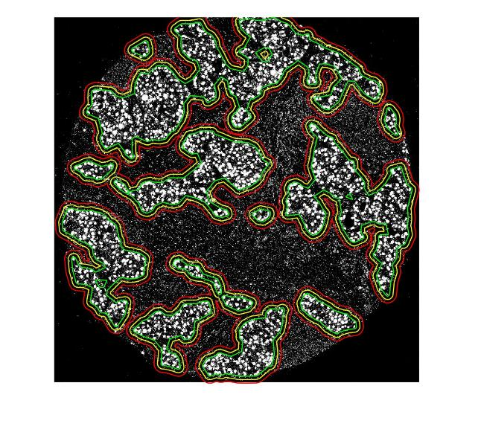
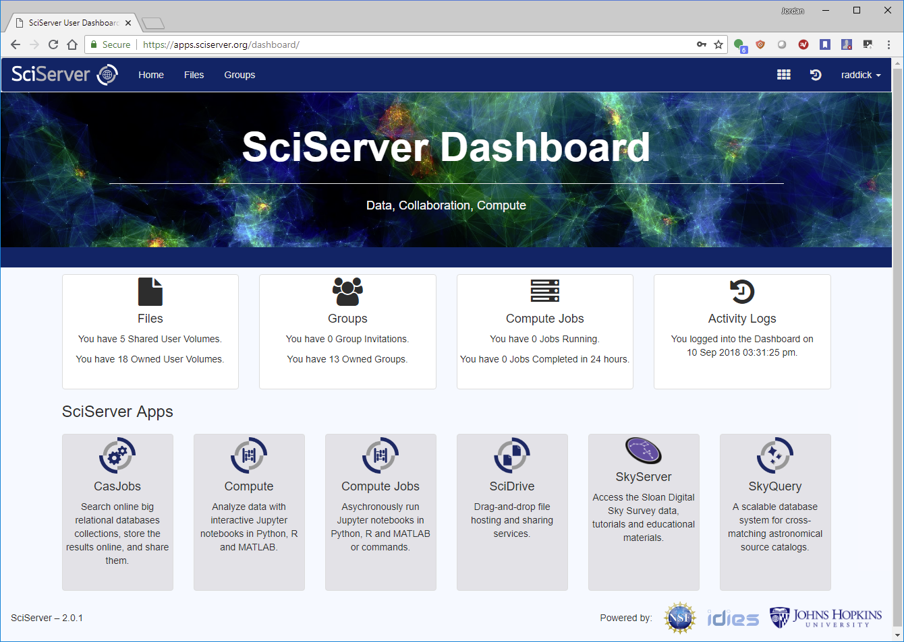
The Path to Scalability
Take 1000x more images
Dramatically decrease human labor
  Automate tissue segmentation
  Deep Learning for cell recognition
  Automated spatial statistics
Flexible Analytics Environment
  SciServer: Collaborative interface
  to machine learning
  iPython and R access to databases
  Each user can have their own DB
  for value added data, linked to
  main database
Courtesy of Alex Szalay

Slide 32
Astropath Database Summary
Spatially-mapping specific cellular subsets, immune checkpoints, and immunoactive molecule expression in patients with both early stage and advanced disease, annotated with clinical outcomes.
Developed a unique facility to produce petabytes of tissue imaging data (currently processed over 80,000 HPF, raw imaging data volume + annotations of 34 TB, current database has over >85M distinct cells)
Goal is to provide investigators with open source, web-based analysis suite for analysis of this and other whole-slide multiplex IHC/IF data sets
http://dev.cellview.idies.jhu.edu/en/default.aspx

Slide 33
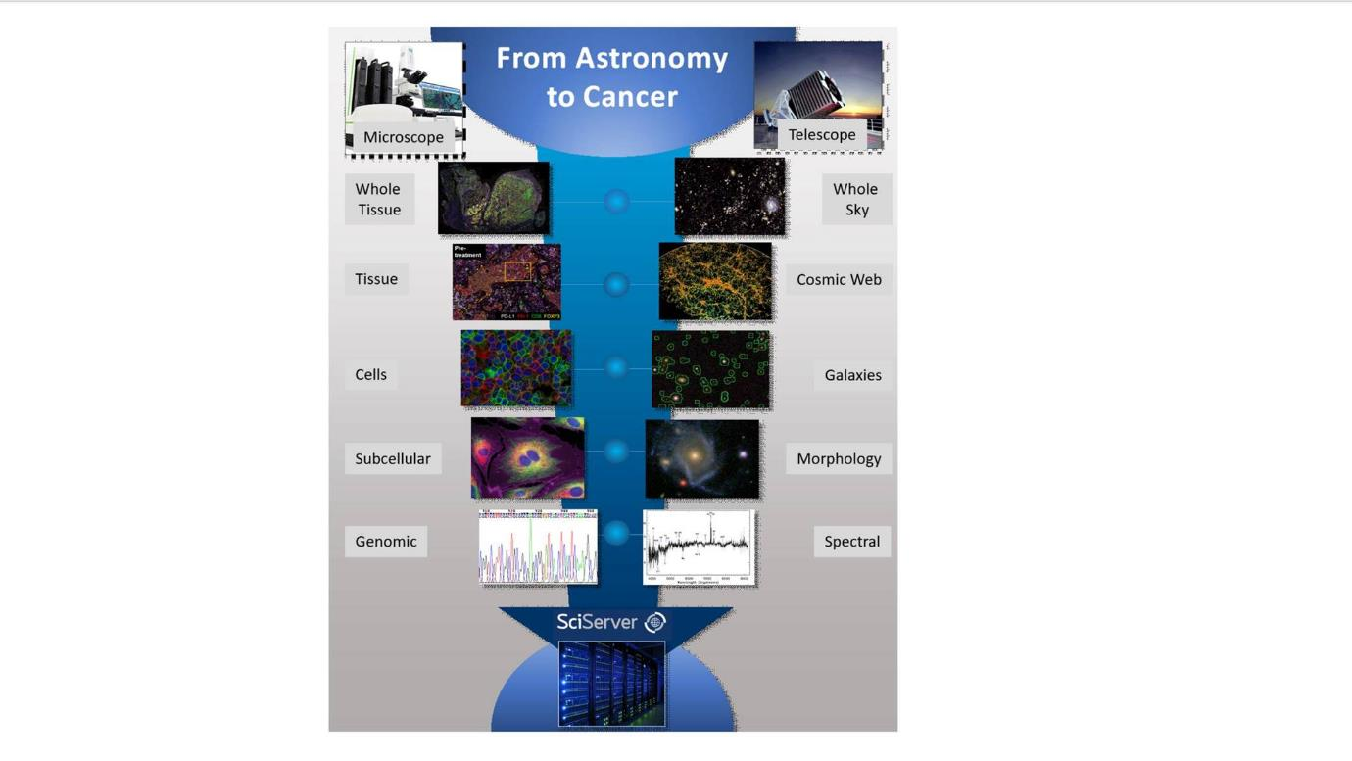

Slide 34
✅

Slide 35
✅
✅

Slide 36
✅
✅
✅

Slide 37
✅
✅
✅
✅

Slide 38
✅
✅
✅
✅
✅

Slide 39

Acknowledgements
Taube Lab members
Nicholas Giraldo, MD, PhD
Sneha Berry, MS
Liz Engle, MS
Haiying Xu
Peter Nguyen, MS
Aleksandra Ogurtsova
Benjamin Green
Tricia Cottrell, MD, PhD
Julie Stein, MD
Joshua Doyle
Department of Radiology
Seyoun Park, PhD
JHU Homewood Campus
Alex Szalay, PhD
Allan Yuille, PhD
BKI collaborators
Evan Lipson, MD
Drew Pardoll, MD, PhD
Suzanne Topalian, MD
Robert Anders MD, PhD
Akoya Biosciences collaborators
Cliff Hoyt, MS
Chi Wang
*NIH/NCI Funding*

Slide 40
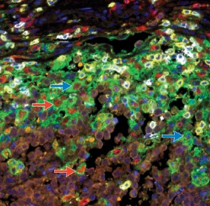
Evaluating Predictive Biomarkers for Immunotherapies
Biomarker Analysis
PD-(L)1 Monotherapy
Survival %
Time
PD-L1
Immunohistochemistry (IHC)
Gene Expression Profiling (GEP)
Biomarker strategies/ Assay Modalities
Tumor Mutation Burden (TMB)
Multiplex IF/IHC
Multimodality
Notes:
With the success of aPd-1 therapies, Substantial effort is ongoing to identify predictors of response to anti-PD-(L)1 immunotherapy.
Numerous different biomarker assay modalities have been proposed and several have been ASSOCIATED with response to anti-PD-(L)1 when tested on pre-treatment tumor tissue
however the relative sensitivity and specificity of these approaches have yet to be systematically established.
Look at studies that have used multiplex IF/IHC to quantify multiple proteins within the tumor microenvironment
And also instances with investigators have combined multiple of these approaches which I will call multimodality.
KEY QUESTION:
What is the relative efficacy of different biomarker approaches for predicting response?

Slide 41
Meta-analysis: Extracted sensitivity and specificity for each study
(55 studies, 10 tumor types, >8000 patients)
Ideal test
Sensitivity (True Positive Rate)
PD-L1 IHC
TMB (DNA)
GEP (RNA)
mIHC/IF
Dot size represents 50 patients
1- Specificity (False Positive Rate)
Lu S, et al SITC 2018
Notes:
To compare the relative diagnostic performance of PD-L1 immunohistochemistry (IHC), tumor mutational burden (TMB), gene expression profiling (GEP) and quantitative and/or spatial assessment of multiple proteins by multiplex IHC/immunofluorescence (mIHC/IF) for predicting response to anti-PD-(L)1.

Slide 42
Two sROC Approaches: Weighted studies by study size or equal weight
Weighted
Unweighted
p < 0.001
p < 0.001
Sensitivity (True Positive Rate)
Sensitivity (True Positive Rate)
Modality | AUC
PD-L1 IHC | 0.656
TMB (DNA) | 0.694
GEP (RNA) | 0.652
mIHC/IF | 0.802
Modality | AUC
PD-L1 IHC | 0.669
TMB (DNA) | 0.716
GEP (RNA) | 0.742
mIHC/IF | 0.879
1- Specificity (False Positive Rate)
1- Specificity (False Positive Rate)
Lu S, et al SITC 2018
Notes:
Where the size of the study is taken into account
Specifically, the AUC for mIF/IHC was significantly higher than the AUC for PD-L1 IHC, GEP, and TMB, and the AUCs for PD-L1 IHC, TMB, and GEP were not statistically different from each other

Slide 43
Multimodality: Combining multiple platforms to predict response
TMB + GEP + PD-L1 IHC
TMB + GEP
TMB + GEP + PD-L1 IHC
TMB + PD-L1 IHC
Sensitivity (True Positive Rate)
TMB + PD-L1 IHC
GEP + CD8 IHC
Modality | AUC
mIHC/IF | 0.802
Multimodality | 0.733
1- Specificity (False Positive Rate)
Lu S, et al SITC 2018
Notes:
Ease of implementing PD-L1 IHC within practice
New approaches, especially incorporating multiple tests, must cheaper, faster, and better in order to be practical

Slide 44
Multimodality: Combining multiple platforms to predict response
The mIHC/IF studies included in this meta-analysis test an average of 2-3 markers
Emerging technologies claim ability to test 10-50 markers
TMB + GEP + PD-L1 IHC
TMB + GEP
TMB + GEP + PD-L1 IHC
TMB + PD-L1 IHC
Sensitivity (True Positive Rate)
TMB + PD-L1 IHC
GEP + CD8 IHC
Modality | AUC
mIHC/IF | 0.802
Multimodality | 0.733
1- Specificity (False Positive Rate)
Lu S, et al SITC 2018
Notes:
Ease of implementing PD-L1 IHC within practice
New approaches, especially incorporating multiple tests, must cheaper, faster, and better in order to be practical

