Slide 1
Transcriptomic biomarkers for lung cancer detection and intereception
Marc Lenburg, PhD
BU-UCLA Biomarker Discovery Lab
September 10th 2019
EDRN Scientific Workshop

Slide 2
Financial Disclosures
Consulting:
Allegro Diagnostics / Veracyte
Johnson & Johnson
Numera Bioscience
Metera Pharmaceuticals
Research Funding:
Johnson & Johnson
Astra Zeneca
Genentech
Novartis

Slide 3
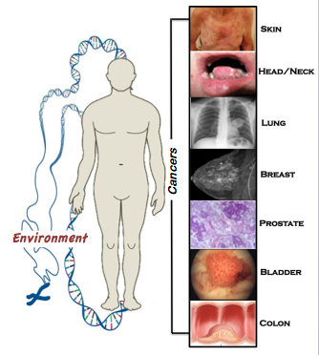
The “field effect” as an early detection approach for many cancer types
Most cancers arise in a “field” of molecular alterations from exposure to cancer-causing agents (smoking, hormones, UV light etc…)
  gene x environment interaction
Measuring the physiological response of the host to exposure within the “field of injury” could provide:
Early markers of individualized cancer risk in relatively accessible proximate tissue

Slide 4
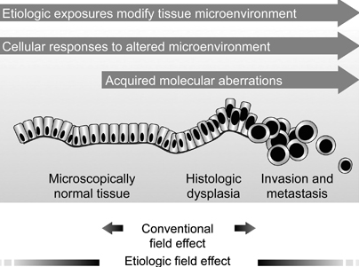
There is more than one “field”: field cancerization vs. field of injury
Lochhead et al. Modern Pathology 2015

Slide 5
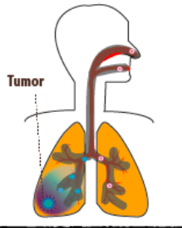
The airway ‘field of injury’/‘field cancerization’ in lung cancer
Smoking (and other inhaled toxins) alters epithelial cell gene expression throughout the respiratory tract
Aberrant airway epithelial genomic response to and damage from smoking creates a susceptible microenvironment for cancer initiation: etiologic “field of injury”
Abnormal
cells
There are molecular changes in cytologically normal cells that may reflect clonal expansion of cells from which the tumor ultimately develops or may be related to direct effects of the tumor on surrounding tissue: “field cancerization”
Billatos et al. Clinical Cancer Research 2018

Slide 6
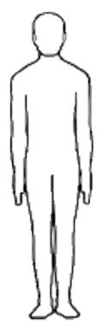
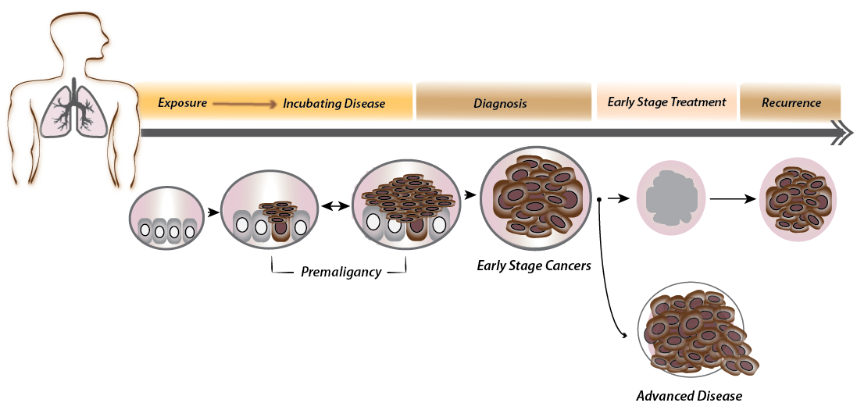
Clinical opportunities for leveraging the “field” for intercepting lung cancer
Identify those at highest risk for developing lung cancer who should undergo screening
Identify those with aggressive premalignant lesions for interception
Distinguish benign vs. malignant pulmonary nodules, avoiding unnecessary procedures
in those with benign disease
Exposures
PREVENTION
INTERCEPTION
DIAGNOSIS
TREATMENT
Heredity
Microbiome
Normal
Recurrence
Modified from Beane et al. Lancet Oncology 2017

Slide 7
DIAGNOSTIC BIOMARKERS
Distinguish benign vs. malignant pulmonary nodules, avoiding unnecessary procedures
in those with benign disease
1
Exposures
PREVENTION
INTERCEPTION
DIAGNOSIS
TREATMENT
Heredity
Microbiome
Normal
Recurrence
Modified from Beane et al. Lancet Oncology 2017

Slide 8

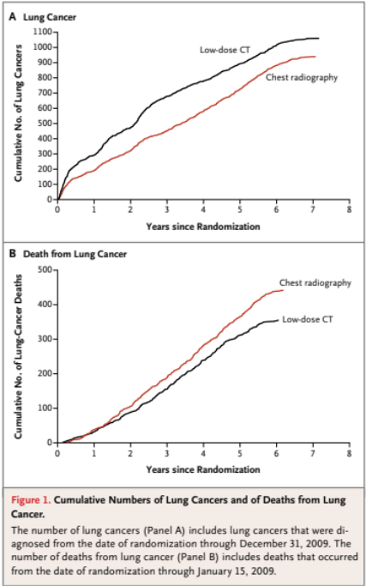
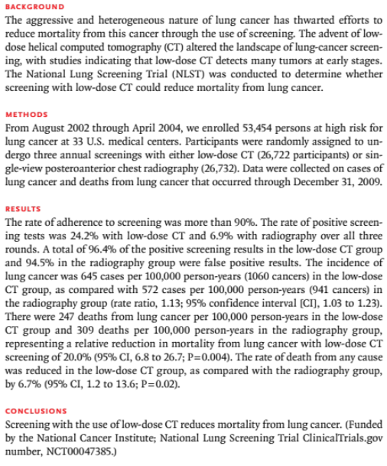
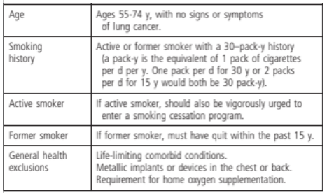
Lung cancer screening reduces mortality

Slide 9

CT Scans of the Chest as a Lung Cancer Detection Tool: the “nodule epidemic”
DIAGNOSTIC BIOMARKERS
Estimated CHEST ct scanS IN US
(n = 4.8 million)
No Nodule
Nodule Identified
3.2 M
(67%)
1.6 M
(33%)
1.5M are benign
The nodule epidemic will only grow larger with uptake in annual CT screening for lung cancer
(among high-risk smokers) based on NLST and recent results from NELSON trial
Gould MK, et al. AJRCCM 2015

Slide 10
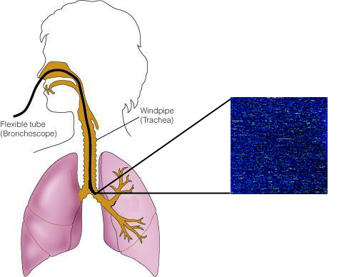
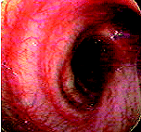
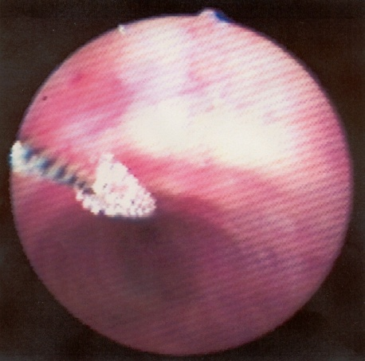
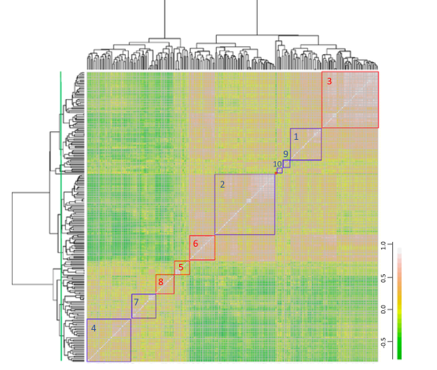
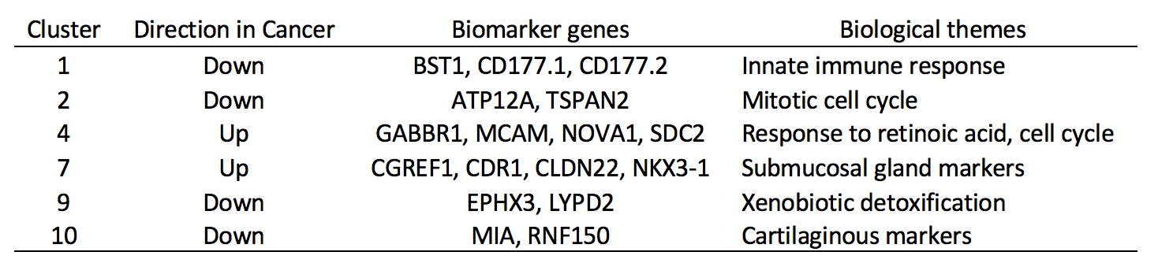
Bronchial airway gene expression as a biomarker of smoking and lung disease
DIAGNOSTIC BIOMARKERS
Smoking impacts airway and microRNA gene expression
PNAS 2004; NAR 2005; PNAS 2009
Subset of changes persist following cessation
Genome Biology 2007
Airway gene expression can serve as an early diagnostic biomarker for lung cancer
Nature Medicine 2007; CaPR 2008; BMC Med Genomics 2015; NEJM 2015
RNA-Whole genome gene-expression profiling
Sensitivity -89%
Specificity -48%
NPV- 91% (intermed risk)

Slide 11
The Bronchial Airway Genomic Biomarker was developed to address a specific clinical unmet need
DIAGNOSTIC BIOMARKERS
Lesion on CT Scan
Intermediate Risk of Cancer
CT Surveillance
Transthoracic or surgical lung biopsy
Bronchoscopy¹
250,000
Inconclusive
100,000
Malignant/Benign
Bronchial Genomic Classifier
Treatment
Sensitivity 89%
Specificity 48%
NPV 91%
Low Risk
(<10% risk)
Intermediate Risk
(10-60% risk)
Imaging Surveillance
Standard Management
1. Centers for Medicare and Medicaid Services, Hospital Outpatient Standard Analytical Files

Slide 12


Slide 13
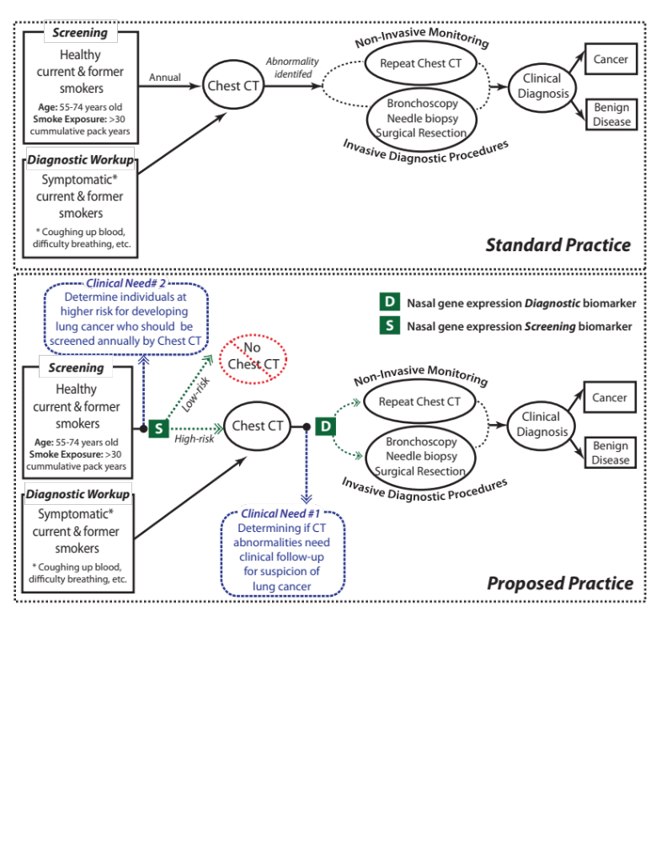
Potential clinical applications for a nasal biomarker
SCREENING BIOMARKERS

Slide 14
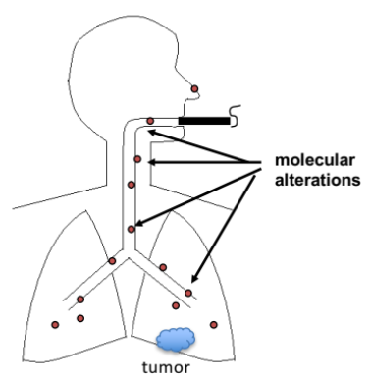
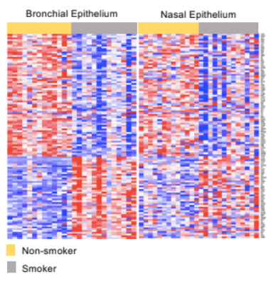
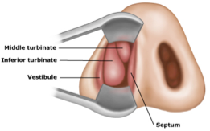
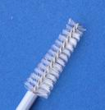
Rationale for a nasal epithelium biomarker
SCREENING BIOMARKERS
A biospecimen that is collected less invasively than bronchial epitheium but reflects the same biology

Slide 15
Development of a clinicogenomic biomarker in the AEGIS-1 nasal training set (n=375)
Rabbit: an R Package for Biomarker Discovery
Components of Gould Model
Cancer-Associated Gene Expression
Smoking Status
(Current, Former)
Time Since Quit
(<15, >=15)
Mass Size
(<3, >=3)
Age
Linear model picks
top 535 genes
30-gene predictor
Clinicogenomic Biomarker
Validate Model in AEGIS-2 samples
Joseph Perez-Rogers, JNCI 2017

Slide 16
Nasal Gene Expression is an Independent Predictor of Lung Cancer Status
Comparison of Biomarker Performance in Independent AEGIS-2 Cohort (n=130)
Clinicogenomic Model
AUC
0.74
0.81
Clinical Model
*
Sensitivity
0.79
*
0.91
Specificity
0.52
0.58
Negative Predictive Value
0.73
0.85
*
0.0
0.2
0.4
0.6
0.8
1.0
*p < 0.05
Joseph Perez-Rogers, JNCI 2017

Slide 17
Nasal Gene Expression May Have Utility in Patients with Small Nodules
Comparison of Biomarker Performance in Patients with Nodules <3cm (n=54)
Clinicogenomic Model
AUC
0.58
0.70
Clinical Model
Sensitivity
0.50
0.75
Specificity
0.47
0.50
Negative Predictive Value
0.77
0.85
0.0
0.2
0.4
0.6
0.8
1.0
Joseph Perez-Rogers, JNCI 2017

Slide 18
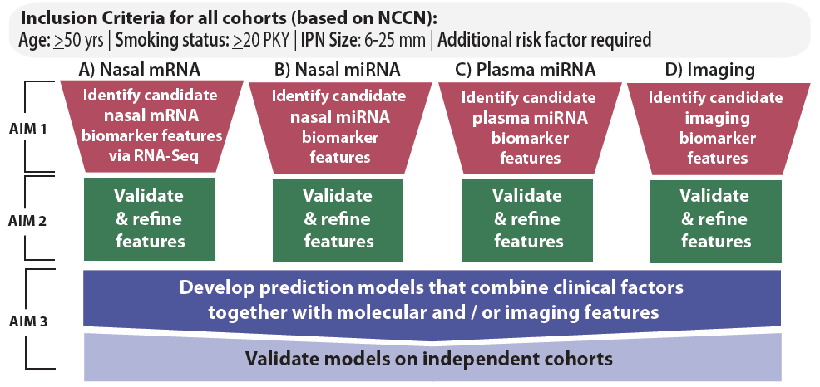
DIAGNOSTIC BIOMARKERS
BU-UCLA BDL: Developing integrated diagnostic biomarkers for lung cancer
Goal: Develop predictive models that integrate clinical, molecular and imaging-based data for lung cancer detection in older smokers with nodules 6-25 mm who are at elevated risk for lung cancer as a result of meeting eligibility criteria for screening.
Incorporating single-cell RNAseq and circulating tumor DNA via SU2C and J&J

Slide 19
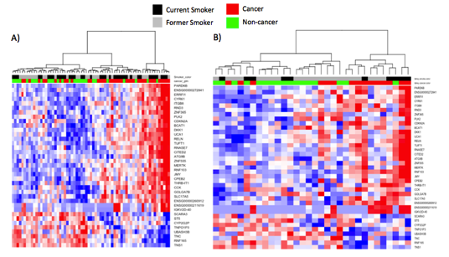
Nasal epithelial gene expression signature associated with lung cancer diagnosis in the indeterminate nodule setting
DIAGNOSTIC BIOMARKERS
DECAMP Cohort (n = 84)
Lahey Screening Cohort (n = 38)
Benign disease
Lung Cancer
Benign disease
Lung Cancer
37 differentially
expressed genes
FDR q<0.1
J. Zhang, BU
K. Christ, Lahey

Slide 20
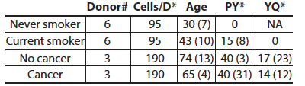
DIAGNOSTIC BIOMARKERS
DIAGNOSTIC BIOMARKERS
SCREENING BIOMARKERS
Lung adenocarcinoma associated immune and epithelial cell shifts in former smokers
1140 cells total
190/subject
1000-2000 genes/cell
26 cell clusters/23 gene clusters
J.Beane, BU
X.Shi, BU

Slide 21
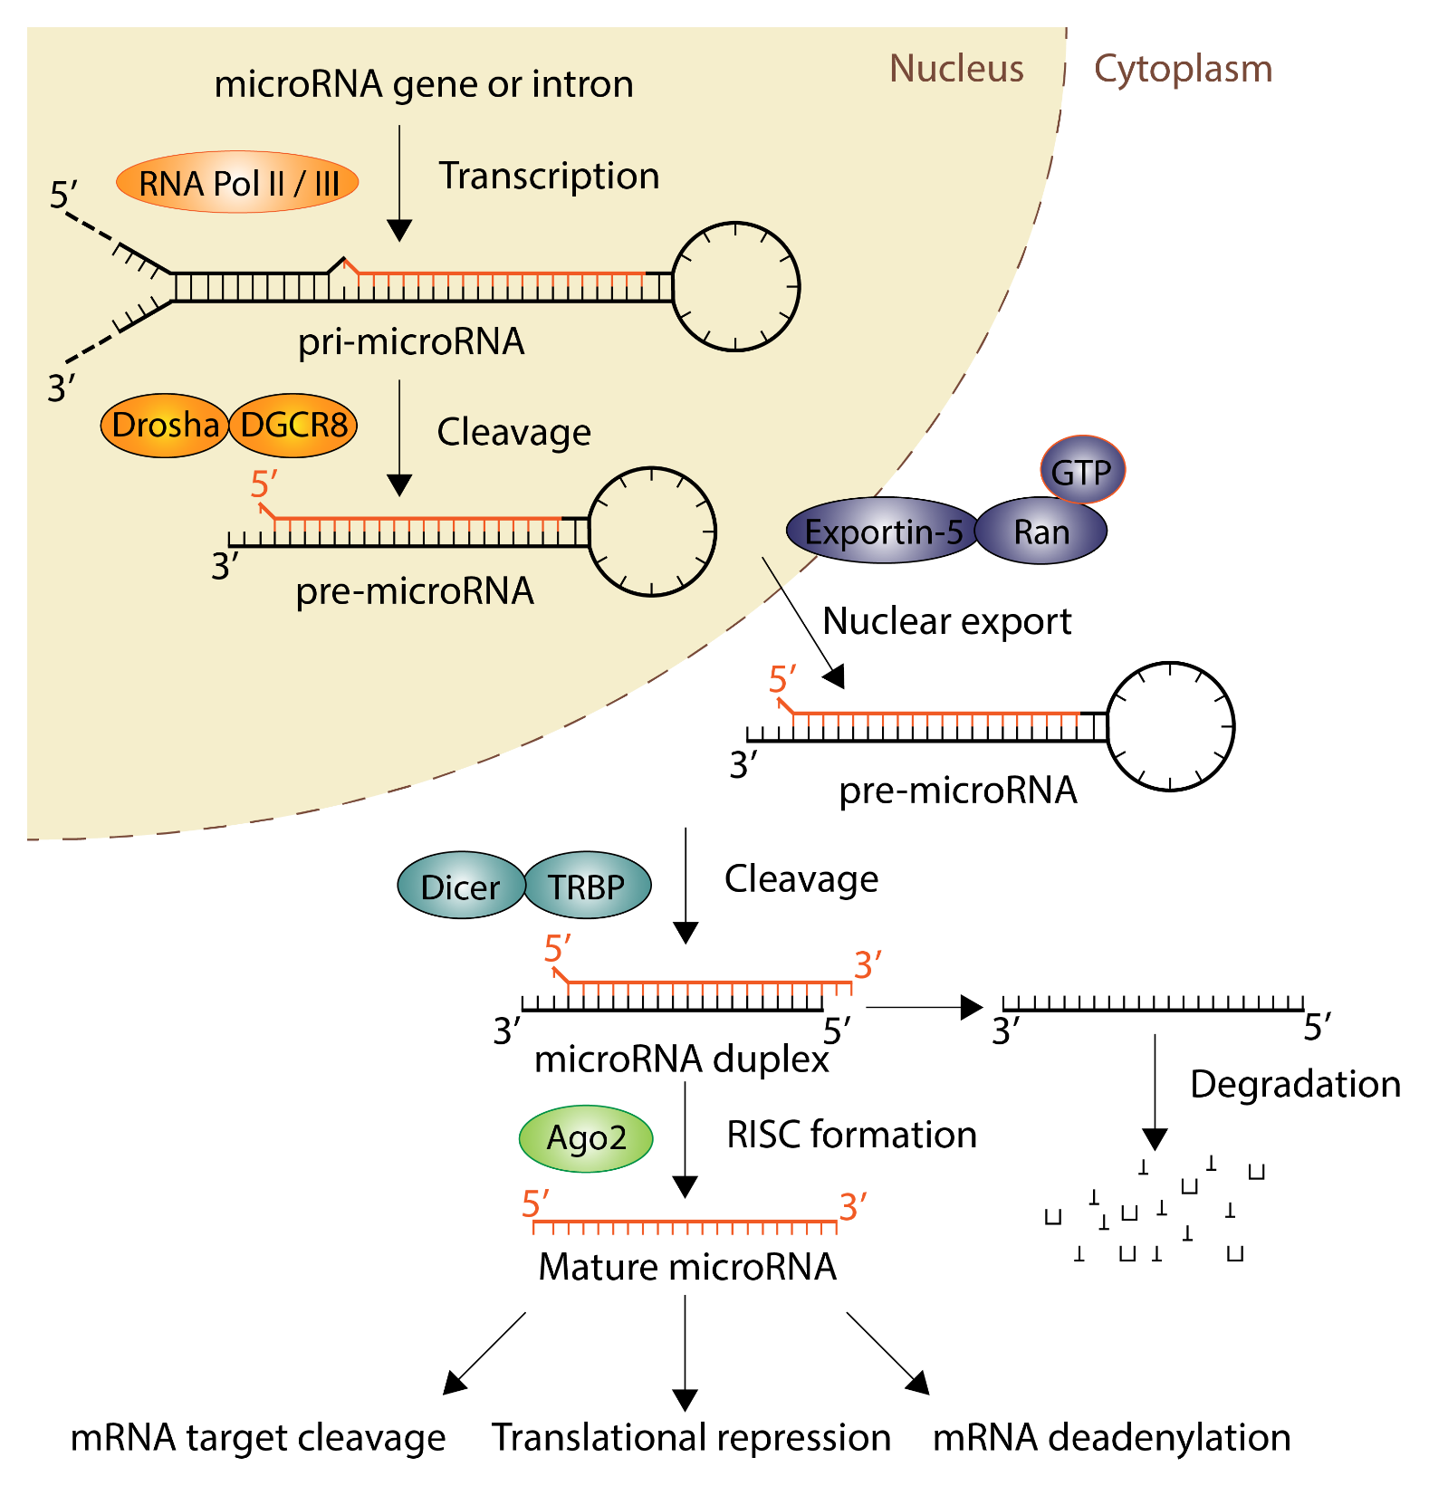
miRNAs & Lung Gene Expression
SCREENING BIOMARKERS
DIAGNOSTIC BIOMARKERS
F Schembri et al (2009) PNAS
  miR-218 levels modulate the airway epithelial gene expression in response to cigarette smoke
C Perdomo et al (2013) PNAS
  miR-4423 regulate epithelium differentiation; lost of miR-4423 contributes to lung carcinogenesis
A Pavel et al (2017) Cancer Prevention Research
  miRNAs expression altered in the normal bronchial epithelium and could improve gene-based biomarker performance
S. Lin, et al (2015) Nature Reviews Cancer
Notes:
Biogenesis
Advantages: Target + correlation; key regulators;
Lab early results (miR-218, miR-4423, AEGIS)

Slide 22
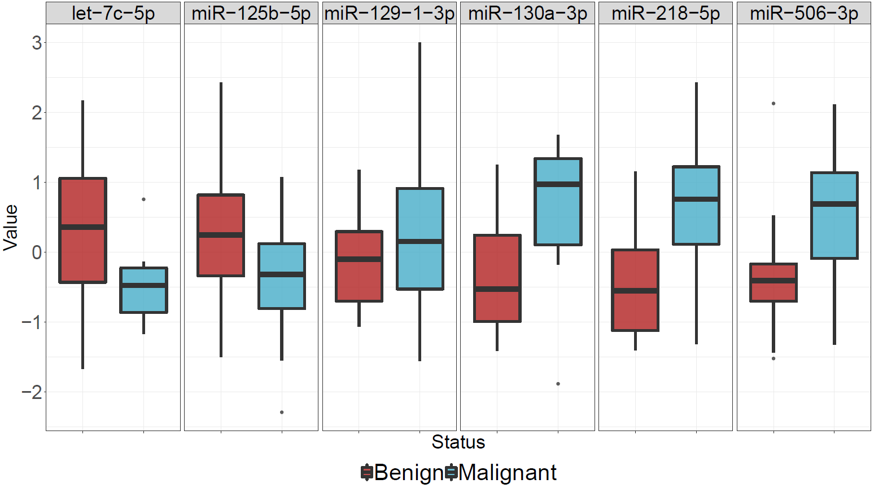
miRNA differentially expressed in nasal epithelium of patients with malignant vs benign pulmonary nodules
SCREENING BIOMARKERS
DIAGNOSTIC BIOMARKERS
*
*
*
*
*
*
B. Ning, BU

Slide 23
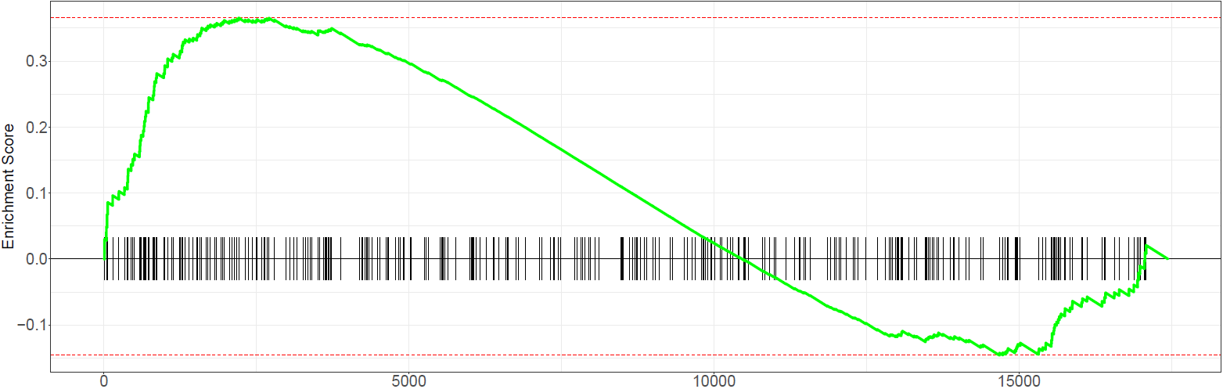
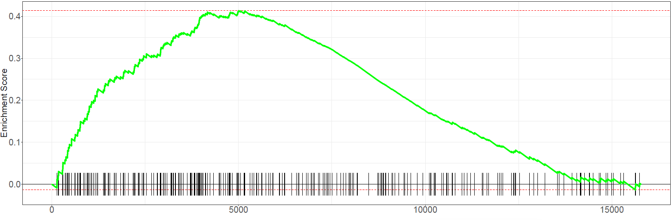
miR-125b-5p targets are enriched among the genes with increased airway expression in cancer patients
SCREENING BIOMARKERS
DIAGNOSTIC BIOMARKERS
NES = 1.49
P value = 0.0005
Ranklist:
Nasal Brushings from DECAMP-1 cohort
NES = 1.74
P value = 0.0001
Ranklist:
Bronchial Brushings from AEGIS cohort
B. Ning, BU

Slide 24
Potential clinical applications for a nasal biomarker
SCREENING BIOMARKERS

Slide 25
PREMALIGNANT BIOMARKERS
Identify those with aggressive premalignant lesions for interception or screening
Distinguish benign vs. malignant pulmonary nodules, avoiding unnecessary procedures in those with benign disease
2
1
Exposures
PREVENTION
INTERCEPTION
DIAGNOSIS
TREATMENT
Heredity
Microbiome
Normal
Recurrence
Modified from Beane et al. Lancet Oncology 2017
Notes:
Try to highlight the 3 types of early detection biomarkers we are working on using the airway “Field”. If this figure looks good, we can use as outliner for figure for each of the 3 sections

Slide 26
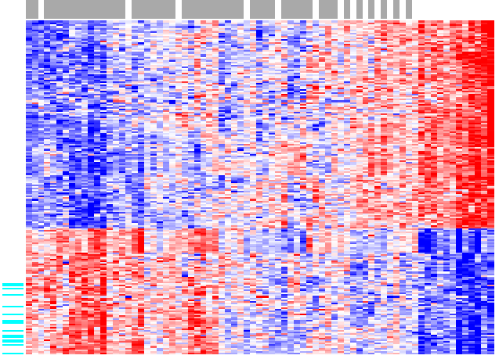
Extending the “field” to premalignancy (PML):
Gene expression alterations associated with PML presence
PREMALIGNANT BIOMARKERS
RNA-seq on airway epithelium from 75 smokers with dysplastic lesions vs. 25 without apparent dysplasia (Stephen Lam UBC)
Subjects w/ Premalignant Lesions
Subjects w/o Lesions
206 genes differentially expressed at FDR<0.001
Beane et al. Clinical Cancer Res 2017

Slide 27
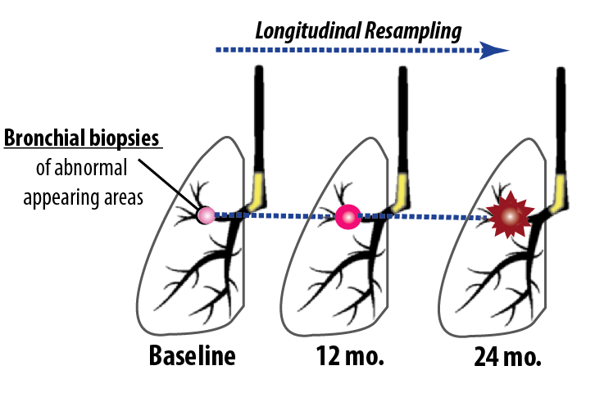
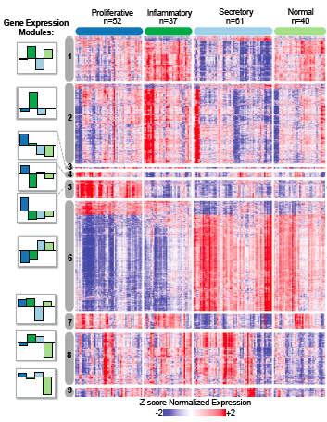
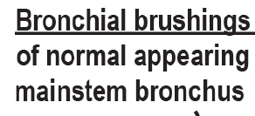
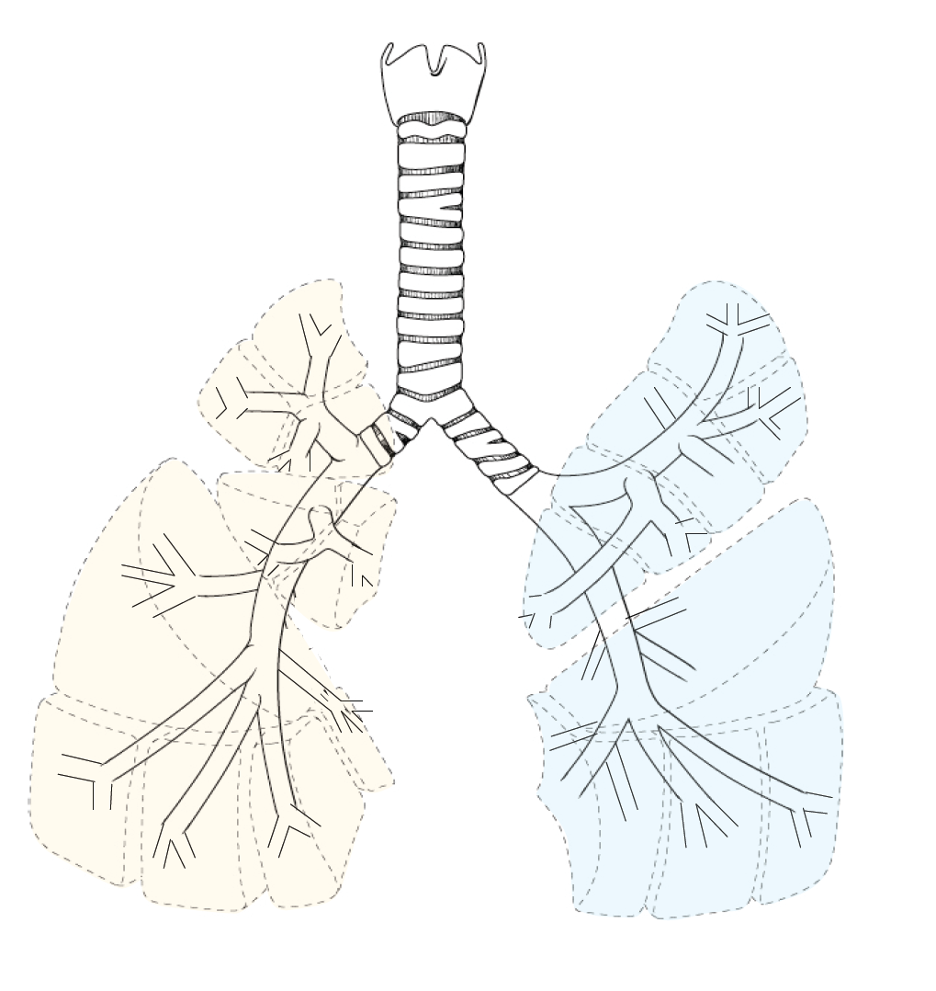
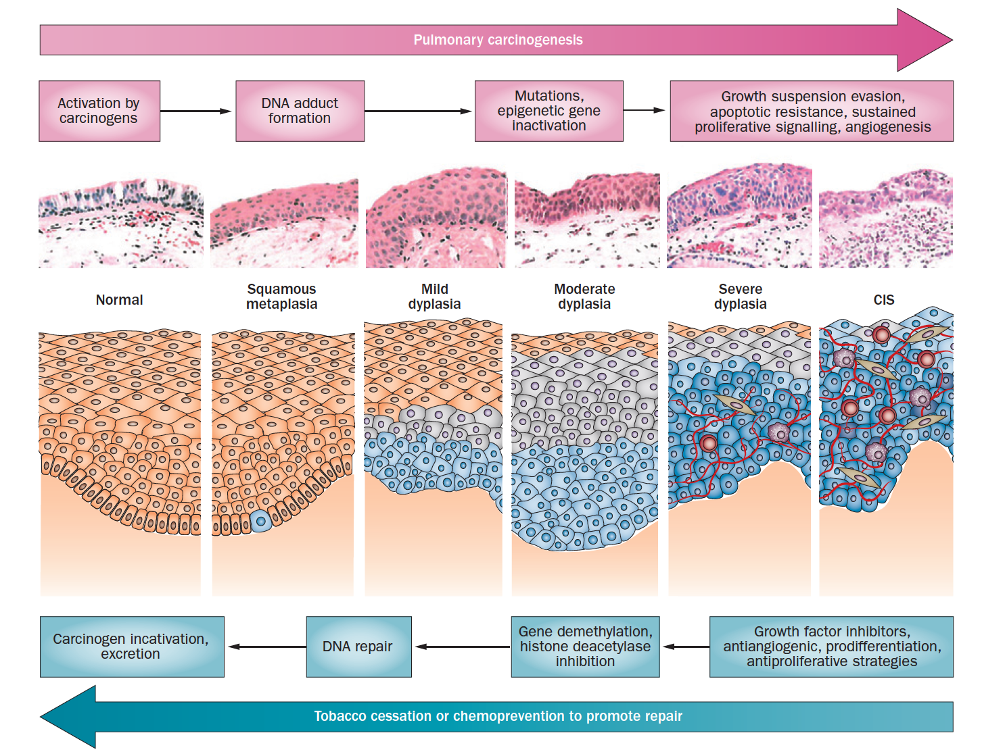
PREMALIGNANT BIOMARKERS
Linking the “field” to the premalignant lesion via the
Lung Pre-Cancer Atlas
(SU2C Dream Team; NCI PCA; JNJ)
Study Design
Biopsy-derived
Molecular Subtypes
Bronchial Brushes Reflect Lesion
Proliferative Subtype
Brush
Severe Dysplasia
Carcinoma in situ
Invasive SCC
Biopsies
32% Sens.
91% Spec.
Beane et al. Nature Communications. 2019.

Slide 28
Squamous Lung Carcinogenesis (accessible via airway)
Normal
Squamous
metaplasia
Mild dysplasia
Moderate
dysplasia
Severe dysplasia
Carcinoma in situ
Only a subset of airway premalignant lesions progress to invasive tumor
Many airway premalignant lesions will regress without intervention
Keith, R. L. & Miller, Y.E. Nat. Rev. Clin. Oncol. 2013
Breuer et al, Clin Cancer Res., 2005
van Boerdonk, AJRCCM, 2015

Slide 29
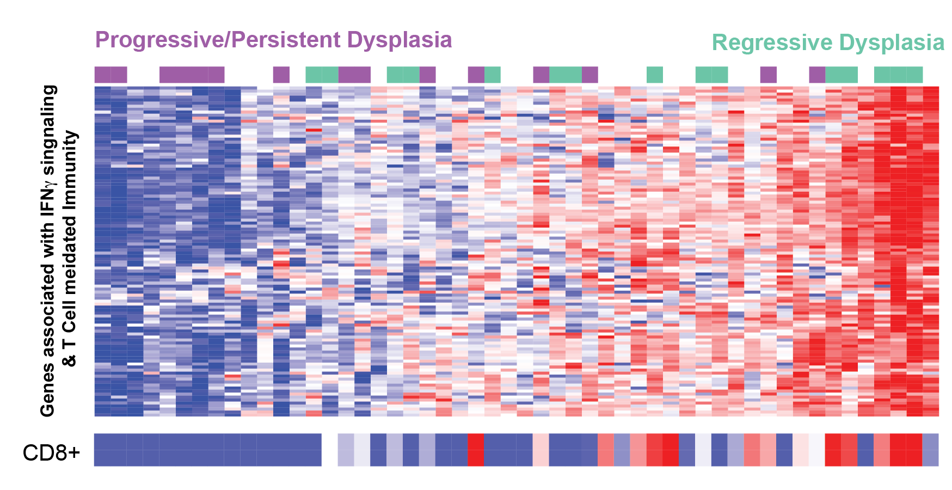
Immune-associated gene-expression module linked to progression in high-grade sqPML subtype
Potential to serve as a biomarker to predict indolent vs. aggressive lesions
Beane et al. Nature Communications. 2019.

Slide 30
Premalignancy biomarkers for assessing cancer risk
Biomarker for detecting PML
Biomarker for detecting high-grade PML subtype
Biomarker for detecting progressive high-grade PML
Molecular characterization of PML also provides insights into carcinogenesis and therapeutic targets

Slide 31
PREMALIGNANT BIOMARKERS
Identify those with aggressive premalignant lesions for interception or screening
Distinguish benign vs. malignant pulmonary nodules, avoiding unnecessary procedures in those with benign disease
2
1
Exposures
PREVENTION
INTERCEPTION
DIAGNOSIS
TREATMENT
Heredity
Microbiome
Normal
Recurrence
Modified from Beane et al. Lancet Oncology 2017
Notes:
Try to highlight the 3 types of early detection biomarkers we are working on using the airway “Field”. If this figure looks good, we can use as outliner for figure for each of the 3 sections

Slide 32
Potential clinical applications for a nasal biomarker
SCREENING BIOMARKERS

Slide 33

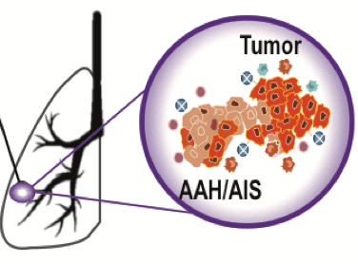
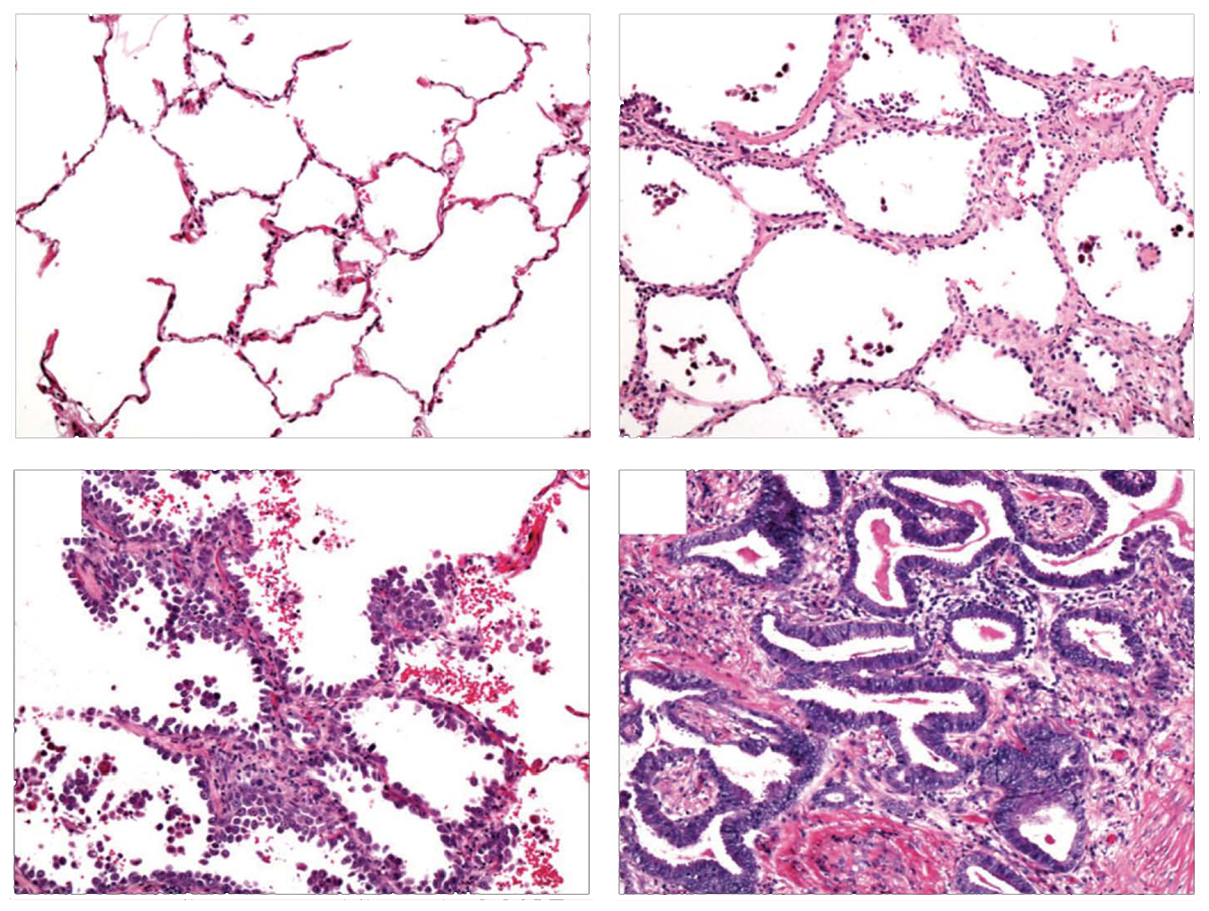
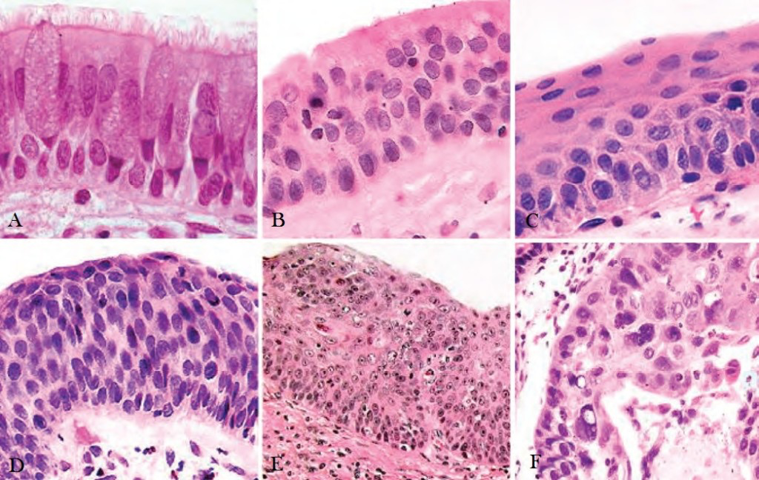
The NCI Moonshot HTAN Lung Precancer Atlas
Squamous Cell Carcinoma
Adenocarcinoma
Resection
of tumor & surrounding PMLs
Normal
AAH
Severe Dysplasia
Carcinoma in situ
Invasive SCC
AIS
ADC
+ Cross-sectional resection cohorts
Subject lung pre-cancers to temporal/spatial cellular and molecular profiling
Bulk RNA/DNA Seq
Single Cell RNA/DNA Seq
Single Nucleus RNA-seq
Multiplex IF
CODEX & CODEX/ Ce3D
Extending this to the PML field of injury with SU2C and J&J

Slide 34
Summary
Able to use field of injury in the nose as an aid for lung cancer diagnosis.
Exploring synergies between multiple analytes (e.g. multiomics) and non-molecular data (e.g. imaging)
Able to use field of injury to non-invasively detect squamous premalignancy, its severity and its prognosis
Potential for precision, molecularly guided, lung cancer screening (and therapeutic lung cancer interception)

Slide 35


Acknowledgments
Funding:
NCI (EDRN, MCL, HTAN), DOD, SU2C-Lungevity-ALA, J&J
Boston University
Avi Spira
Jennifer Beane
Joshua Campbell
Sarah Mazzilli
Grant Duclos
Jiarui Zhang
Boting Ning
Xingyi Shi
Xu Ke
Eric Burks
Elizabeth Moses
Dana-Farber Cancer Institute
Matthew Meyerson
Stanford University
Sam Gambhir
UBC
Stephen Lam
Johns Hopkins University
Julie Brahmer
Patrick Forde
Victor Velculescu
David Feller-Kopman
Edward Gabrielson
University College of London
Charles Swanton
Sam Janes
Kate Gowers
Chris Abbosh
University of California
Los Angeles
Steve Dubinett
Denise Aberle
David Elashoff
William Hsu
Matthew Brown
Michael Fishbein
Kostyantyn Krysan
Linh Tran
Bin Liu
Roswell Park Cancer Institute
Mary Reid
Sai Yendamuri
Mark Hennon
Lahey Clinic
Carla Lamb
Kimberly Reiger-Christ
Travis Sullivan
MD Anderson Cancer Center
Ignacio Wistuba
Humam Kadara
Junya Fujimoto
Beatriz Sanchez Espiridion
NCI
Sudhir Srivastava
Lynn Sorbara
Sharmistha Ghosh-Janjigian
Eva Szabo
Curt Harris
J&J
Chris Stevenson
Duncan Whitney
Jessica Vick

