Slide 1
Lung collaborative group report
Pierre P. Massion, MD
Sept 11, 2019
11th EDRN workshop Bethesda, MD

Slide 2

Lung Collaborative Group
Biomarker Development Laboratories
Avi Spira, Steve Dubinett, Marc Lenburg, Deni Aberle | BU, UCLA and Lahey Clinic
Louise Showe, Qihong Huang | Wistar Institute
Jim Herman, Jeff Wang, David Wilson, Brenda Hoegaarde | U of Pittsburgh, Hopkins
Harvey Pass, Haining Yang | NYU
Biomarker Reference Laboratory
Sanford Stass, Feng Jiang | University of Maryland
Clinical Validation Centers
Pierre Massion, Kim Sandler, Eric Grogan, Steve Deppen | Vanderilt
Bob Gillies, Matt Schabath | Moffitt CC
DMCC
Margaret Pepe, Jackie Dahlgren, Tracey Marsh | Fred Hutchinson CC
Program Officers
Lynn Sorbara | NCI DCP
Karl Krueger | NCI DCP
Notes:
8 institutions, 6 BDLs, 2 CVCs, 2 BRLs.

Slide 3
Lung collaborative group
What is the intended use
  IPNs diagnosis of cancer, Screening for lung cancer, Mesothelioma diagnosis,
What is the type of biomarker panel.
  Proteins, (mi-)RNAseq, DNA methylation Imaging, autoantibodies, ctDNA, PET
What is the type of specimens.
  Serum, plasma, buffy coat, nasal epithelium, urine, sputum, imaging
What is the added value?
  Everyone attempts to demonstrate added value to current standards.
What the metrics of accuracy.
  AUC, DLR, NRI

Slide 4
Lung Collaborative projects
Nashville Lung cancer screening trial (Massion, Aldrich)
LTP2 (entire Lung collaborative group)
Lung cancer screening in underserved population (Aldrich, Massion, Huerta)
Asbestosis related diseases biomarkers (Harvey Pass, Haining Yang)
Evaluation of fungal biomarkers for the management of IPNs in combination with serum cancer biomarker and radiomics. (Grogan, Deppen)
miRNA and LncRNA in sputum of patients at risk for lung cancer (Stass, Jiang, Massion)
Early detection of metastatic disease in US Veterans following surgery for early stage lung cancer (Dubinett, Keith, Massion)

Slide 5
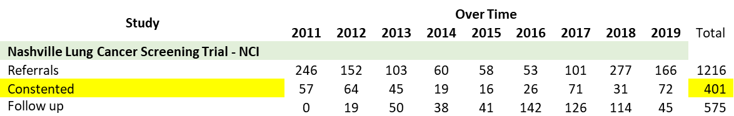
Nashville Lung Cancer Screening Trial
Full Clinical annotation
Images 1.25 mm thin sections
Blood, sputum, urine, bronchial brushings, nasal brushings.
15 cancers detected

Slide 6
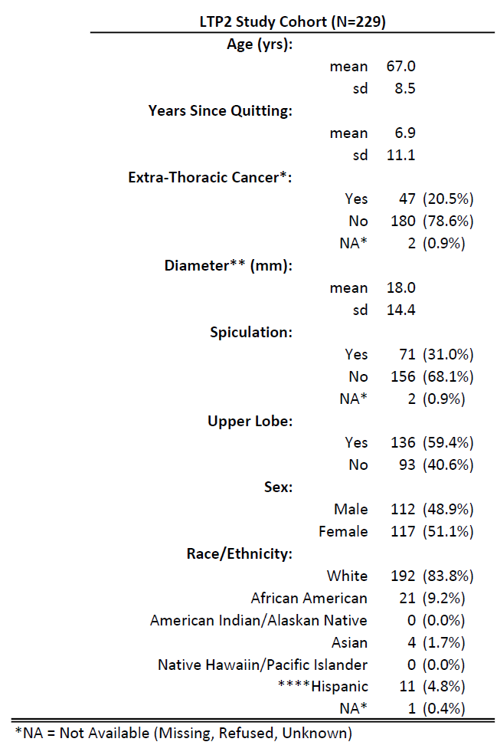
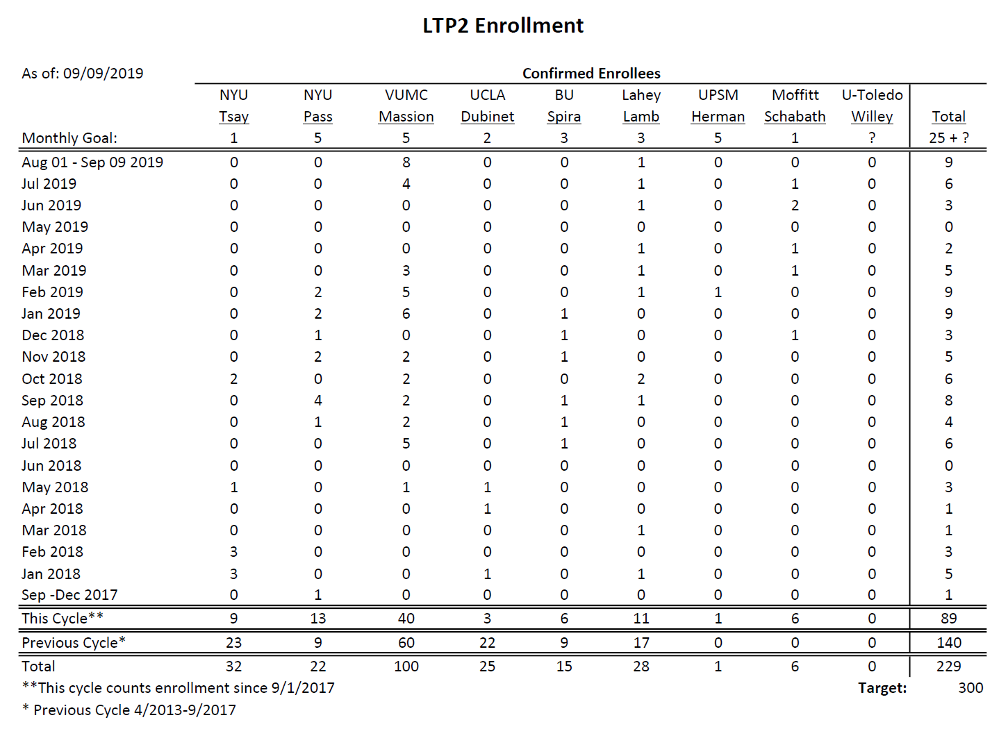
LTP2: Validation of BM for Indeterminate Pulmonary nodules
Enrolled 64 patients in the last year and should meet goals of enrollment for 2020.
Curating lung nodules as malignant or benign over time.
Plan to Start sharing biospecimens and images

Slide 7
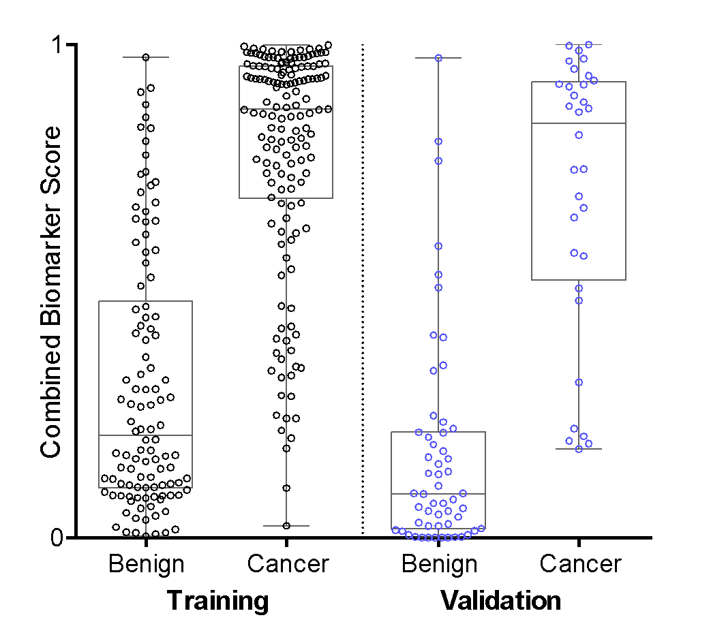
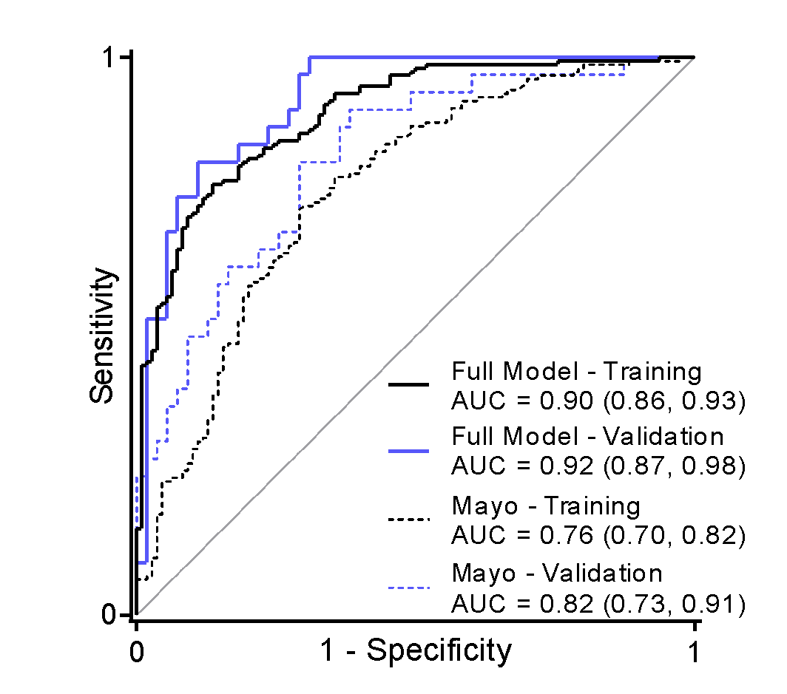
The Combined Model Risk Reclassification
Clinical, Radiomics and CYFRA-21-1
Vanderbilt
Moffitt
Pittsburgh
DECAMP
 |  | Training |  | Validation
 | Rule Out | Youden | Rule In | Rule Out | Youden | Rule In
 | 0.15 | 0.64 | 0.80 | 0.15 | 0.64 | 0.80
PPV | 0.70 | 0.86 | 0.92 | 0.62 | 0.88 | 0.89
NPV | 0.96 | 0.73 | 0.64 | 1.00 | 0.84 | 0.78
DLR+ | 1.65 | 4.29 | 8.57 | 2.75 | 12.60 | 14.61
DLR- | 0.03 | 0.27 | 0.41 | 0.00 | 0.33 | 0.49

Slide 8


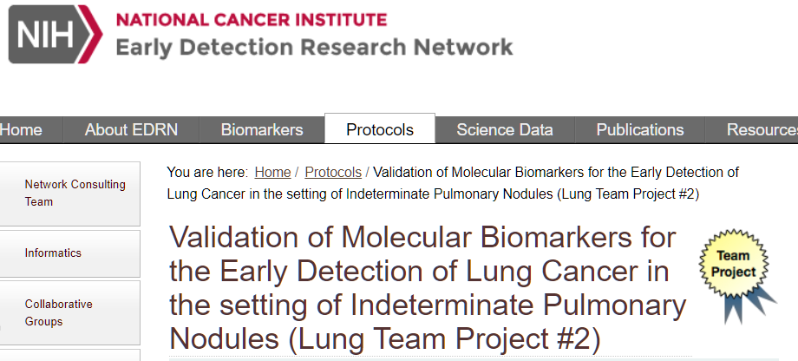
Validation studies
NLST
DECAMP
EDRN LTP2
VA

Slide 9
Early detection of metastatic disease in US Veterans following surgery for early stage lung cancer
Aim 1: Identify molecular and cellular profiles that predict aggressive disease resulting in lung cancer metastasis following surgery.
A. Identify and characterize somatic mutations that differ between aggressive vs indolent lung cancers (WES).
B. Develop tumor gene expression signatures associated with important driver mutations
C. Characterize the immune cell phenotypes found within the TME
Aim 2: Develop a novel highly sensitive approach for Minimal Residue Disease (MRD) and cancer recurrence detection
A. Identify truncal mutations from pre-surgery plasma cell-free DNA (cfDNA) samples.
B. Detect MRD/recurrence using post-surgery plasma cfDNA samples.
C. Assess the statistical significance of the MRD predictive score in the determination of recurrence.
UCLA: Dubinett, Zhou Colorado: Keith, Miller Vanderbilt: Massion, Grogan

Slide 10
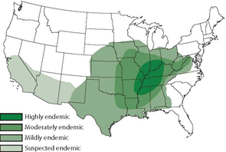
Problem: Histoplasmosis often mimics cancer – poor lab studies exist for IPNs and Histo
Endemic Histoplasmosis
Lung Cancer Mortality Rates- 2015

Slide 11
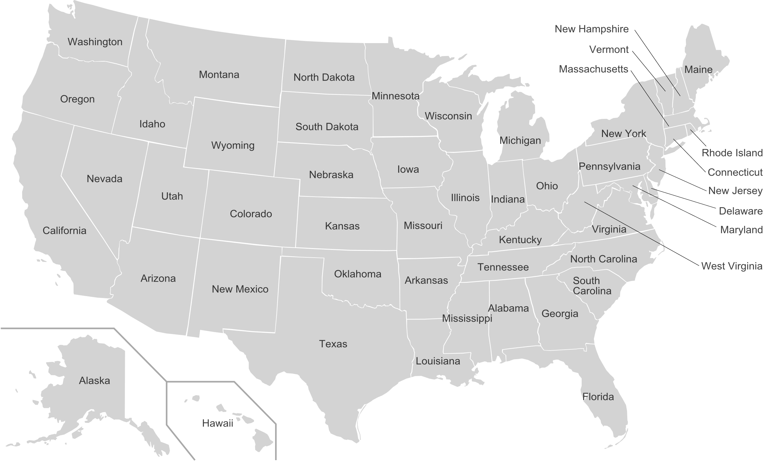
New sites added with supplement funding and recent core funds (CanVFun Consortium)
LTP2 sites
New CanVFun
sites
(Cincinnati in process)
Vanderbilt University Medical Center

Slide 12
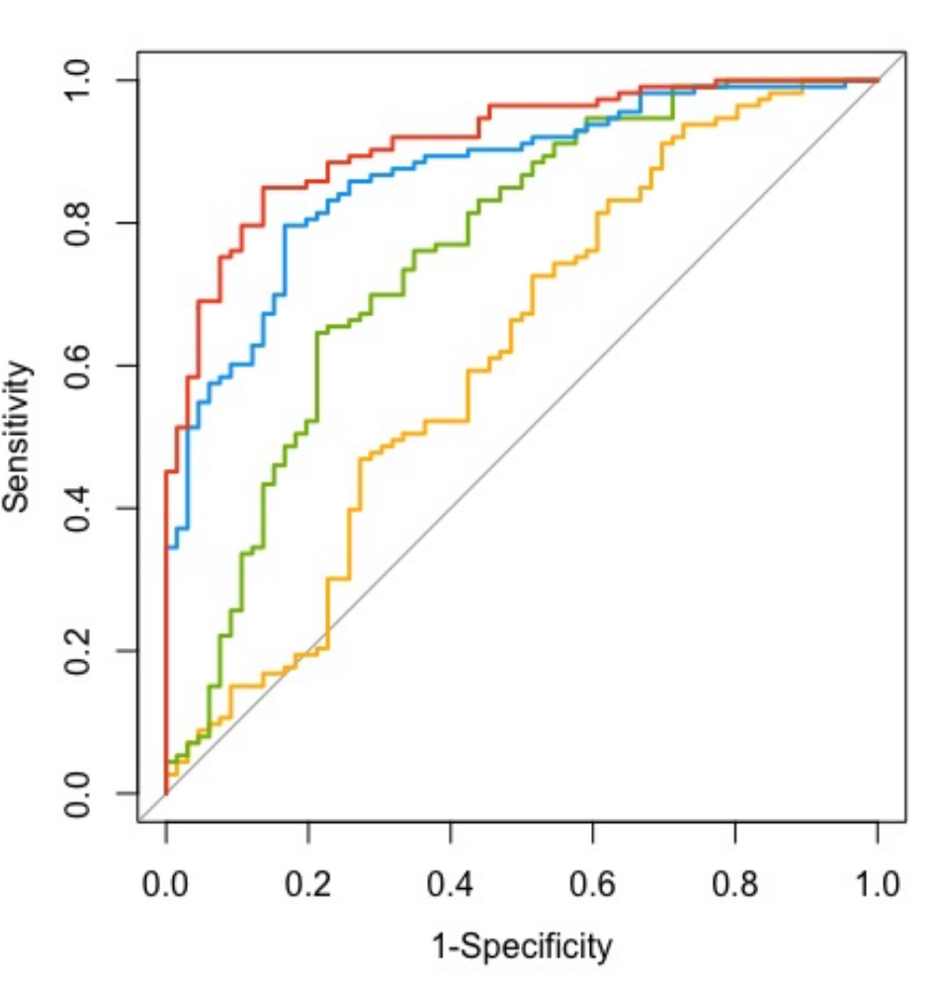
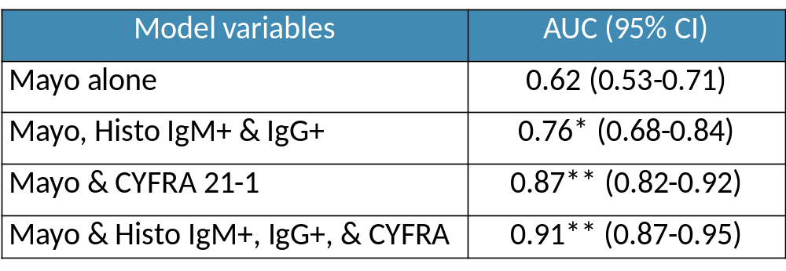

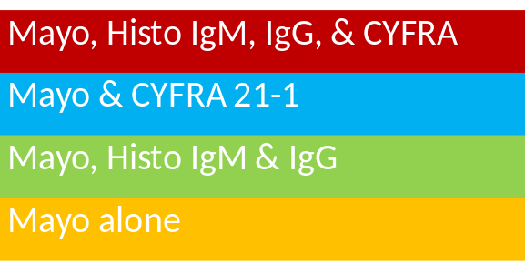
Evaluation of fungal biomarkers for the management of IPNs
N=183
External validation ongoing
University of Pittsburgh (James Herman, MD)
University of Cincinnati (Sande Starnes, MD)
Grogan, Deppen Kammer, Massion
Notes:
Please code the colors the same or change the legend

Slide 13
Evaluation of fungal biomarkers for the management of IPNs : Enrollment in CanVFun Consortium
 | Total | Wash U | U of K
Number of participants (Withdraw or exclude) | 24 (2) | 21 (1) | 3 (1)
Mean Age* | 65 | 64 | 71
Caucasian (%)* | 16 (73) | 14 (64) | 2 (100)
Diagnosed (result)* | 5 | 4 CA^{A} 1 benign | 0
Nodule Size mm (mean)* | 11.4 | 11.5 | 10.5
Ever smoker* | 91 | 90 | 100
* Statistics include only those not excluded or withdrawn
^{A} Stage IA adenocarcinoma
Evaluating adding University of Cincinnati as additional site

Slide 14
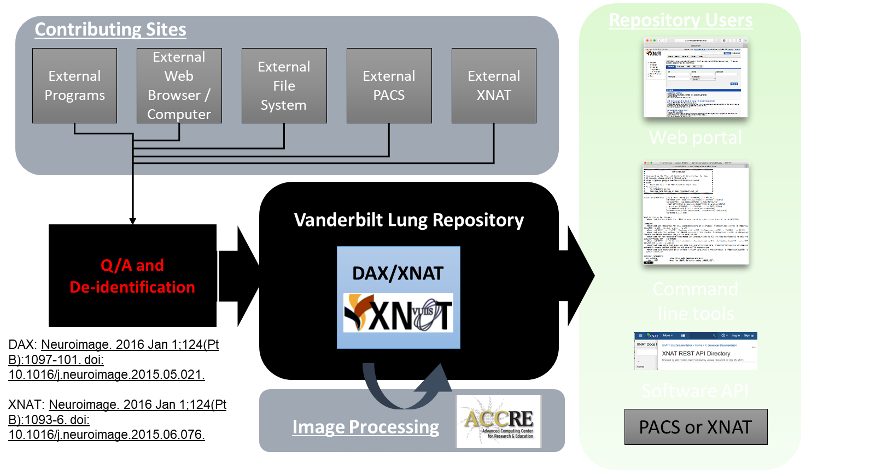
Thoracic Imaging Repository
2000 annotated IPNs

Slide 15
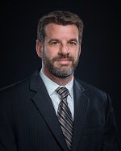
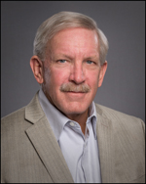
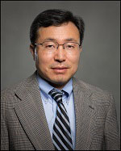
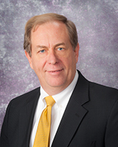
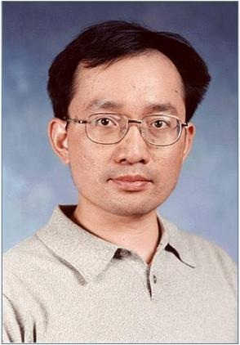
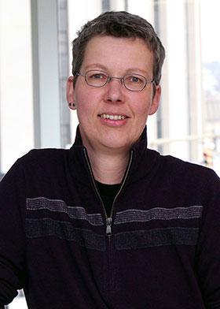

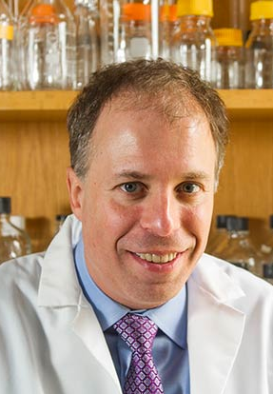
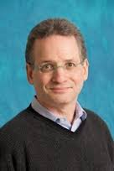
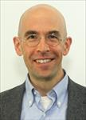
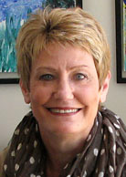
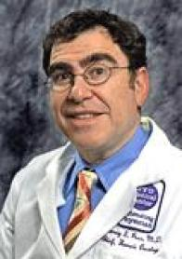
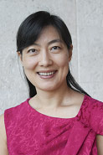
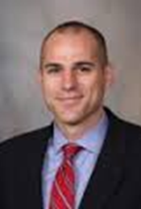

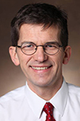
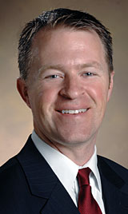
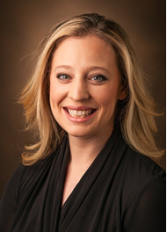
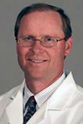
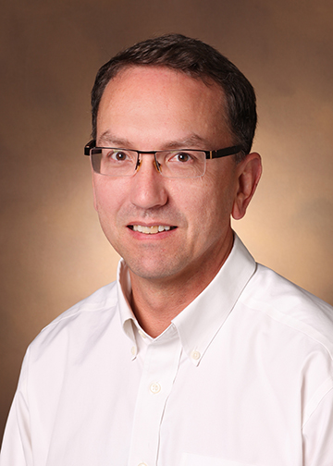
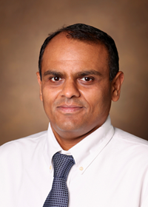
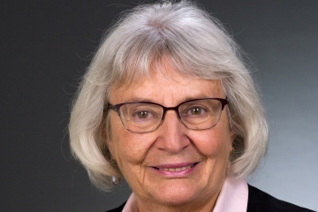
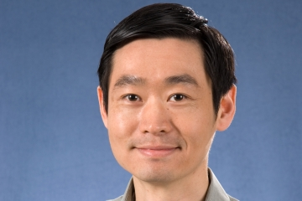

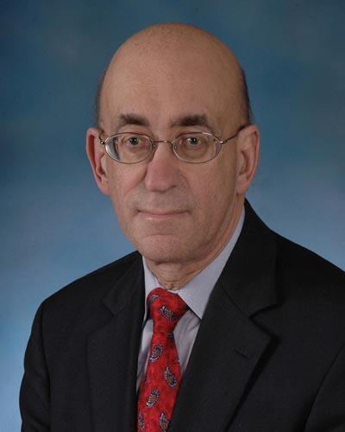
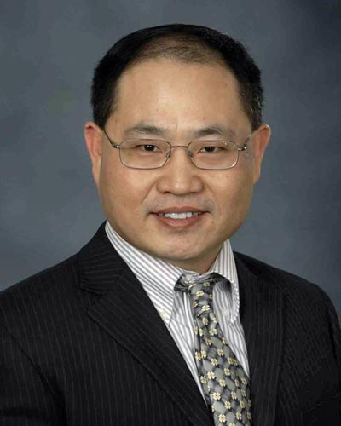
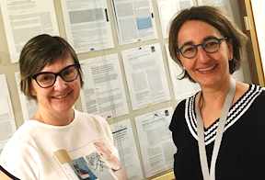
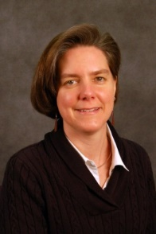
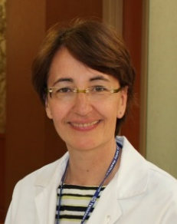
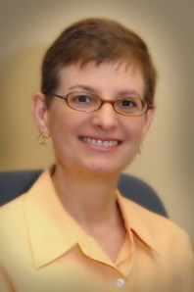
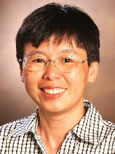
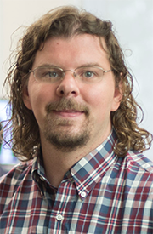
Matt Schabath, PhD
Bob Gillies, PhD
Jae Lee, PhD
Jim Herman,
MD
Jeff Wang, PhD
Brenda Diergaarde,
PhD
Lynn Sorbara, PhD
Avi Spira MD
Steve Dubinett, MD
Marc Lenburg, PhD
Deni Aberle, MD
Harvey Pass, MD
Haining Yang, MD, PhD
Karl Krueger, PhD
Louise Showe, PhD
Qihong Huang, MD, PhD
Pierre Massion
Eric Grogan
Kim Sandler
Gary Smith
Steve Deppen
Chirayu Shah
Tracey Marsh, PhD
Margaret Pepe, PhD
Sandy Stass
Feng Jiang
Sophie Jouan
Sanja Antic
Rosana Eisenberg
Heidi Chen
Bennett Landman
Melinda Aldrich

