Slide 1

FDA Regulatory Requirements for Successful Biomarker Applications
Early Detection Research Network
September 9, 2019
Anand Pathak, M.D., Ph.D., M.P.H.
Division of Molecular Genetics and Pathology
Molecular Genetics Branch
OHT7(OIR)/CDRH/FDA

Slide 2
Disclosures and Disclaimers
No financial relationship to disclose.
The views expressed during this presentation are preliminary and do not reflect the final policy or position of the US FDA or the US government.

Slide 3

Outline
Brief Overview of Diagnostic Regulations
Biomarkers and In Vitro Diagnostics
Case Example: Cologuard
    Clinical Validation Study
    Analytical Studies
Conclusions

Slide 4
Risk-Based IVD Classification
Class I
Low Risk
Class II
Moderate Risk
Class III
High Risk
Dependent upon the Intended Use
Associated with risks of false results
Not based on technology

Slide 5
Intended Use (not test complexity) determines device classification
Class II
(moderate risk)
Class III
(high risk)
Traditional
510(k)
De novo 510(k)
(no predicate)
Pre-market
Application
(PMA)
FDA Clearance
Device shows
substantial
equivalence
to a legally
marketed
predicate
FDA
Classification
Device
Demonstrates
Safety and
Effectiveness
With Special
Controls
FDA Approval
Device Demonstrates
Safety And
Effectiveness

Slide 6
Premarket Risk Based Regulation
Class I: low risk devices
  Differentiation markers such as keratin, that are used as adjunctive tests to subclassify tumors
    Most exempt from premarket submission
    General controls
Class II: moderate risk
  prognosis, monitoring in patients already diagnosed with cancer
    De Novo or Premarket Notification [510(k)]
    General & Special controls
Class III: high risk
  cancer screening (e.g. Cologuard), cancer diagnostics
    Premarket Application [PMA]

Slide 7

Key Components of FDA
Evaluation of Tests
Tests should demonstrate:
  Analytical validity – does the test detect and measure what it claims to detect correctly and reliably?
  Clinical validity – does the test result correlate with the target condition of interest in a clinically meaningful way?
  Do the benefits outweigh the risks?

Slide 8

Labeling/Instructions for Use/Package Inserts Provide Key Information
Patients and Physicians should know:
How to interpret the information
Clinical value of the information
Limitations of the information

Slide 9
Q-submissions
A Q-submission is a formal way for your to interact with FDA early in your test development, ask us questions about your assay, and help shape your analytical and clinical validation studies in a way that facilitates clearance or approval. FDA feedback is provided by day 70. It is free!

Slide 10
Q-submissions
Early Interaction to Reduce Sponsor Uncertainty
Can address many types of sponsor questions, the more specific the better
  Solicit comments and feedback on features of upcoming submissions, such as analytical studies, clinical study design, intended use, statistical analysis approaches and regulatory path
Early interaction can be very valuable. Work towards a win/win.
Can be useful at different stages of development.
Future submission can be a PMA, 510(k), De Novo, or IDE
Interaction with the FDA is voluntary

Slide 11
Outline
Brief Overview of Diagnostic Regulations
Biomarkers and In Vitro Diagnostics
Case Example: Cologuard
    Clinical Validation Study
    Analytical Studies
Conclusions

Slide 12
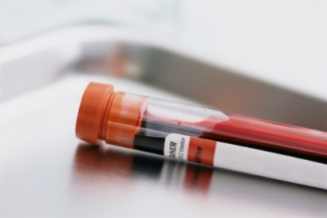

Biomarker
Definition: A biological molecule found in blood, other body fluids, or tissues that is a sign of a normal or abnormal process, or of a condition or disease. A biomarker may be used to see how well the body responds to a treatment for a disease or condition. Also called molecular marker and signature molecule.
Source: NCI Dictionary of Cancer Terms
https://www.cancer.gov/publications/dictionaries/cancer-terms/def/biomarker

Slide 13

Defining a Biomarker
What is the Biomarker/Analyte?
  DNA
    E.g.: Mutations (FFPE-SNVs, Indels), CNV, Fusions, Methylation
    (Blood) ctDNA (SNVs, indels, fusions, CNVs)
  RNA
    Gene expression Profiles
  Protein Levels
  Immunohistochemistry/Immunofluorescences
    E.g.: PD-L1 staining, Multiplex Immunofluorescence
  Molecular Signatures
    E.g.: MSI/MMR, TMB

Slide 14
In Vitro Diagnostic Device (IVD)
Definition
In vitro diagnostic products are those reagents, instruments, and systems intended for use in diagnosis of disease or other conditions, including a determination of the state of health, in order to cure, mitigate, treat, or prevent disease or its sequelae. Such products are intended for use in the collection, preparation, and examination of specimens taken from the human body. [21 CFR§809.3]

Slide 15
Outline
Brief Overview of Diagnostic Regulations
Biomarkers and In Vitro Diagnostics
Case Example: Cologuard
    Clinical Validation Study
    Analytical Studies
Conclusions

Slide 16
Cologuard ®
Example of FDA Approved Colorectal Cancer Screening Test
Summary of Safety and Effectiveness
https://www.accessdata.fda.gov/cdrh_docs/pdf13/P130017b.pdf

Slide 17
Cologuard
Intended Use:
Cologuard is intended for the qualitative detection of colorectal neoplasia associated DNA markers and for the presence of occult hemoglobin in human stool. Cologuard is for use with the Cologuard collection kit and the following instruments: BioTek ELx808 Absorbance Microplate Reader; Applied Biosystems® 7500 Fast Dx Real-Time PCR; Hamilton Microlab® STARlet; and the Exact Sciences System Software with Cologuard Test Definition.
Indications for Use:
Cologuard is intended for the qualitative detection of colorectal neoplasia associated DNA markers and for the presence of occult hemoglobin in human stool. A positive result may indicate the presence of colorectal cancer (CRC) or advanced adenoma (AA) and should be followed by diagnostic colonoscopy. Cologuard is indicated to screen adults of either sex, 50 years or older, who are at typical average-risk for CRC. Cologuard is not a replacement for diagnostic colonoscopy or surveillance colonoscopy in high risk individuals.

Slide 18
Contraindications
CONTRAINDICATIONS
Cologuard is intended for use with patients, age 50 years and older, at average risk who are typical candidates for CRC screening. Cologuard was not clinically evaluated for the following types of patients:
• Patients with a history of colorectal cancer, adenomas, or other related cancers.
• Patients who have had a positive result from another colorectal cancer screening method within the last 6 months.
• Patients who have been diagnosed with a condition that is associated with high risk for colorectal cancer. These include but are not limited to:
• Inflammatory Bowel Disease (IBD)
• Chronic ulcerative colitis (CUC)
• Crohn’s disease
• Familial adenomatous polyposis (FAP)
• Family history of colorectal cancer
• Patients who have been diagnosed with a relevant familial (hereditary) cancer syndrome, such as Hereditary non-polyposis colorectal cancer syndrome (HNPCCC or Lynch Syndrome), Peutz-Jeghers Syndrome, MYH-Associated Polyposis (MAP), Gardner’s syndrome, Turcot’s (or Crail’s) syndrome, Cowden’s syndrome, Juvenile Polyposis, Cronkhite-Canada syndrome, Neurofibromatosis, or Familial Hyperplastic Polyposis.

Slide 19
Device Description
Stool based test in which patient collects stool into preservatives and mails the specimen to test lab.
Laboratory measures the following:
  DNA analytes:
    Methylated DNA (NDRG4, BMP3)
    Specific DNA mutations (KRAS)
    Total human DNA (ACTB)
  Protein analyte:
    Hemoglobin
Aggregate of these individually weighted markers determines the composite score (0-1000).
  If composite score ≤ 183, then negative. Only the qualitative result is included in the final report.

Slide 20
Cologuard
Hemoglobin
Methylated NDRG4
Test Positive
Methylated BMP3
Algorithm
KRAS Mutations
Test Negative
Total Human DNA (ACTB)

Slide 21
Algorithm Development and
Cut-off Determination
Algorithm development included 953 samples including 794 normal samples, 73 advanced adenomas and 86 cancers.
Derived sensitivity for the training set was 98% for cancer and 57% for advanced adenoma, respectively.

Slide 22
Review Challenges
1. Lock down your assay before you begin your analytical and clinical validation studies
2. Lock down includes EVERYTHING from how analytes are measured to the algorithm, to biomarker status (Biomarker (+) vs (-) cutoffs).
Clinical trial specimens/patients are precious.
Patients whose samples were used for assay development can’t be included in your final pivotal study.
Making modifications to an assay after testing specimens of patients from your pivotal studies could result in all of them being considered exploratory.
Some changes are unavoidable (i.e. clinical trial assay versus final assay), and may require bridging studies. Details should be discussed before testing.

Slide 23
Clinical Validation Study: DeeP-C Study
The pivotal study was the “Multi-Target Colorectal Cancer Screening Test for the Detection of Colorectal Advanced Adenomatous Polyps and Cancer: DeeP-C Study”

Slide 24
Clinical Validation Study
Prospective, cross-sectional, multi-center study of subjects between ages 50-84 who were at average risk for the development of colorectal cancer. Samples collected between June 2011 and Feb 2013.
  12,776 patients were enrolled
    10,023 in primary analysis
    2,753 excluded due to unusable data (e.g., no colonoscopy, untestable stool sample)
  90 sites in the US and Canada, including colonoscopy centers and primary care sites

Slide 25

Clinical Validation Study
  Subjects were provided with a collection kit, which they used to collect stool samples for Cologuard and FIT testing.
  Subjects subsequently underwent colonoscopy within 90 days of study enrollment.
  Cologuard testing was performed at one of three laboratories while the stool samples for the FIT were sent to a single laboratory for testing
  Cologuard technicians blinded to the results of colonoscopy and the FIT testing.

Slide 26
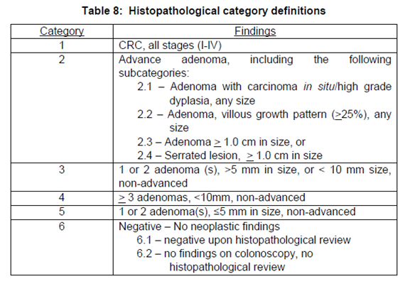
Clinical Validation Study
Results from Cologuard and the FIT test were compared to the results of an optical colonoscopic examination, and histopathologic diagnosis for all significant lesions discovered during the colonoscopy and either biopsied or removed.
There were 6 histopathological categories as outlined below.

Slide 27
Primary Effectiveness Results
Cologuard | CRC Category 1 | AA Category 2 | Categories 3-6
Negative | 5 (7.7) | 438 (57.6) | 7967 (86.6)
Positive | 60 (92.3) | 322 (42.4) | 1231 (13.4)
Category 1: CRC stages 1-4
Category 2: Advanced Adenoma
Category 3-6: non-advanced adenoma and negative colonoscopy
Cologuard CRC Sensitivity: 92.3% (60/65)
95% lower confidence interval bound was 84.5%*.
Study goal of ≥ 65% was met.
Cologuard Specificity: 86.6% (7967/9198)
95% lower confidence interval bound is 86.0%.*
Study goal of ≥ 85% was met.
*1-sided

Slide 28
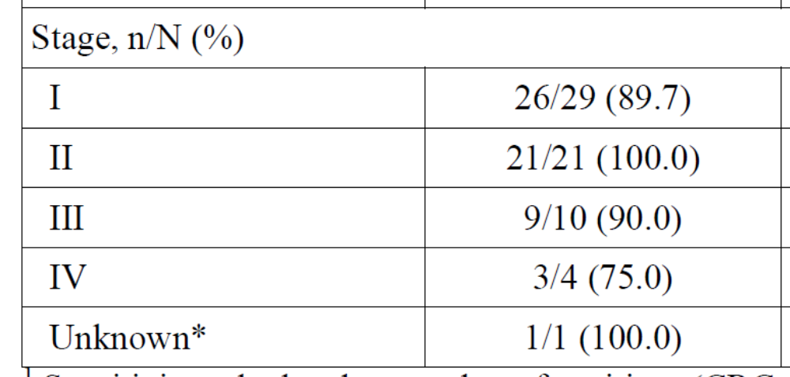
CRC Sensitivity of Cologuard By Stage

Slide 29
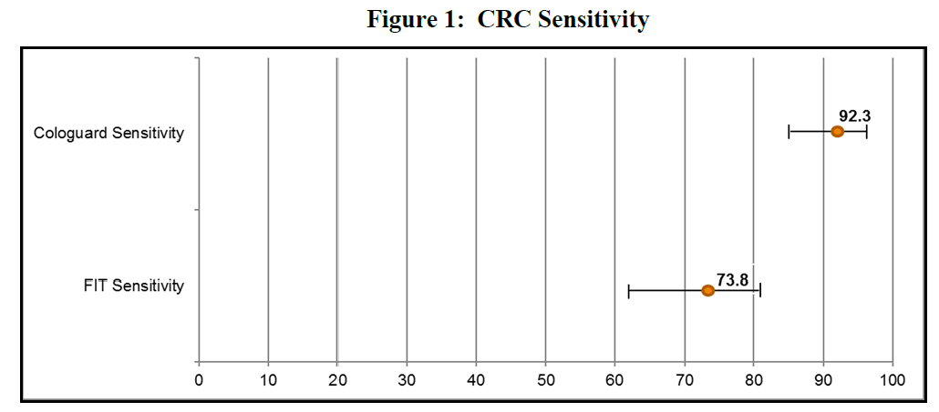
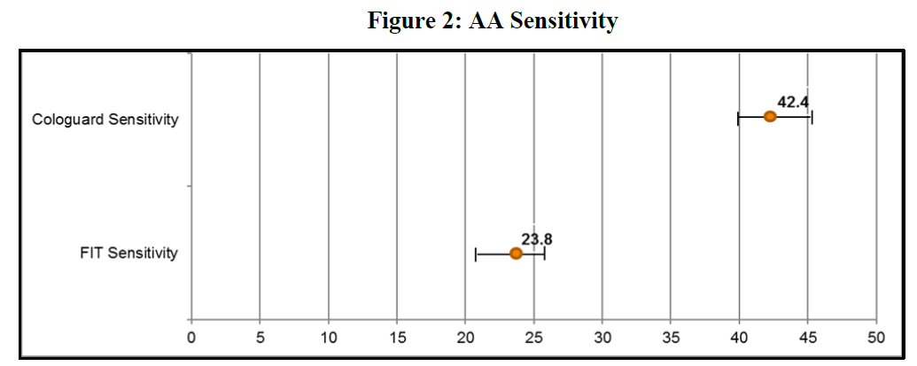
Secondary Effectiveness:
Comparison to FIT test

Slide 30
Secondary Effectiveness:
Comparison to FIT test
For subjects without CRC (categories 2-6), the specificity (fraction of subjects called negative) was smaller for Cologuard (84.4%, 8372/9924) than for FIT (93.4%, 9272/9924).
In summary, the Cologuard sensitivity for CRC (92.3%) together with its specificity for CRC (84.4%) formed a complementary pair spanning the entire study population. By comparison, the FIT sensitivity for CRC was lower (73.8%) than for Cologuard and the FIT specificity for CRC (93.4%) was higher.

Slide 31
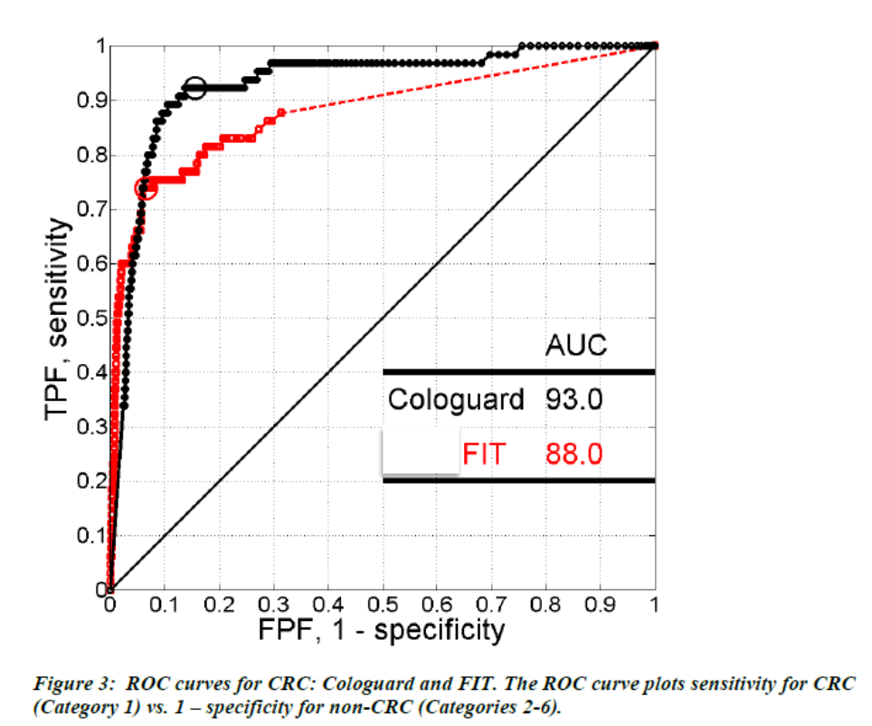
ROC Curves for CRC: Comparison of Cologuard to FIT
For Cologuard the AUC was 93.0%, indicating that a probability is 93.0% that a randomly chosen CRC subject has a higher underlying Cologuard composite score than a randomly chosen non-CRC subject. For FIT this probability was 88.0%.

Slide 32
Summary of Analytical Studies
Analytical Sensitivity
  Limit of Detection
  Limit of Quantitation
  Limit of Blank
  Linear Range, Linearity
Analytical Specificity
  Double KRAS mutation
  Partially Methylated Targets
  WT KRAS
  Cross-Reactivity
Interfering Substances, Carry-Over, and Cross Contamination
Development and Validation of the Cologuard Algorithm and Cut-Off
Precision and Reproducibility (lab-to-lab and lot-to-lot)
Robustness
Analytical Specificity to Other Cancers
Shelf-Life and Packaging Testing

Slide 33
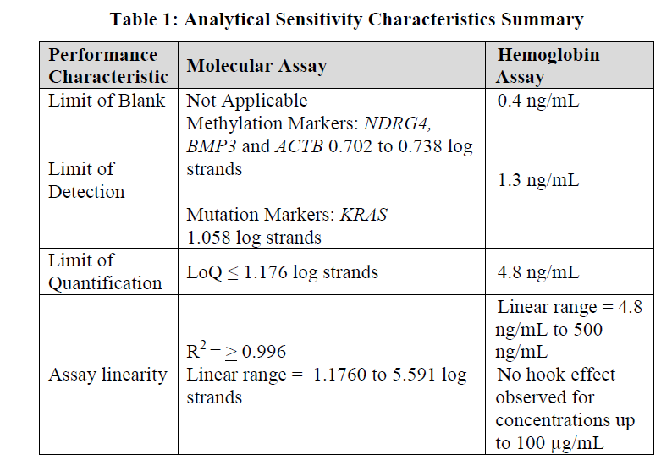
Sensitivity (LoB, LoD, LoQ and Linearity)
Analytical sensitivity data provided on a per analyte basis as applicable

Slide 34
Specificity
For KRAS mutation detection: Evaluated for specificity using wild type KRAS DNA.
For Methylation of BMP3 and NDRG4: Evaluated for specificity using partially methylated BMP3 and NDRG4.
For Hemoglobin: Evaluated for cross-reactivity with animal hemoglobin and myoglobin.

Slide 35
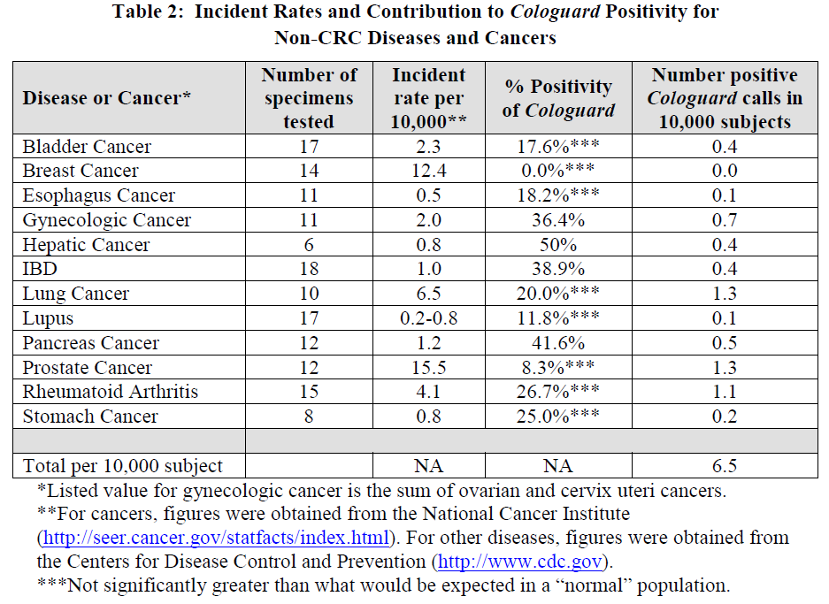
Cross-reactivity with Non-Colorectal Cancer

Slide 36
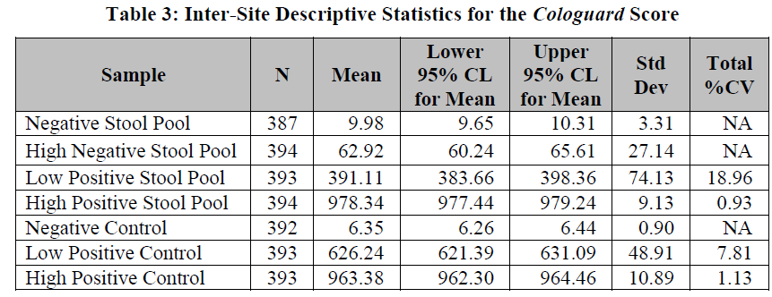
Precision and Reproducibility
Precision/Reproducibility: samples should span the range of values (including those close to the cutoff(s))
Study design based on CLSI EP15-A2.
  3-sites, with 2 operators per site
  22 runs per site (11 per operator)
Samples for study:
  Stool pools were representing negative, high negative, low positive and high positive were generated by pooling residual stools samples for molecular and adding human blood to normal patients stool for hemoglobin.

Slide 37
Outline
Brief Overview of Diagnostic Regulations
Biomarkers and In Vitro Diagnostics
Case Example: Cologuard
    Clinical Validation Study
    Analytical Studies
Conclusions

Slide 38
Conclusions
Utilizing the Q-sub process can be helpful.
It is important to carefully lock down assay cutoffs and the device before clinical and analytical validation studies are begun.
There should be well conducted analytical and clinical validation studies to support a successful FDA device application.
Ideally, prospectively conducted studies in the intended use population are looked-for to support the clinical validity of cancer screening assays.
However, novel biomarker strategies and supporting clinical studies bring novel regulatory challenges
FDA has adapted a nimble regulatory framework to support evidence development for safe and effective devices

Slide 39

Thank You!
Anand.Pathak@fda.hhs.gov
Division of Molecular Genetics and Pathology
Molecular Genetics Branch
OHT7(OIR)/CDRH/FDA

Slide 40
Useful Links
  In Vitro Diagnostics
  In Vitro Diagnostic (IVD) Device Studies- Frequently Asked Questions: http://www.fda.gov/downloads/MedicalDevices/DeviceRegulationandGuidance/GuidanceDocuments/ucm071230.pdf
Cologuard Summary of Safety and Effectiveness Data:
https://www.accessdata.fda.gov/cdrh_docs/pdf13/P130017b.pdf
  Q-submission Program
The Q-Submission Guidance
    Requests for Feedback and Meetings for Medical Device Submissions: The Q-Submission Program
    Issued May 7, 2019.
    https://www.fda.gov/media/114034/download
eCopy Program
    The page contains links to Guidance, video, FAQ, and tools, including a validation module
    https://www.fda.gov/MedicalDevices/DeviceRegulationandGuidance/HowtoMarketYourDevice/ucm370879.htm
Optional form 3514
    Be clear about what you’re submitting, who you are, and whom we should contact – optional because a good cover letter can have all this
    https://www.fda.gov/downloads/AboutFDA/ReportsManualsForms/Forms/UCM080872.pdf

