Slide 1






Developing Knowledge Environments for Consortium-based Clinical Cancer Biomarker Studies
Daniel Crichton¹, Heather Kincaid¹, Kristen Anton², Luca Cinquini¹, Maureen Colbert², David Liu¹, Sean Kelly¹, Ashish Mahabal³, Alphan Altinok¹, Christos Patriotis⁴, Natalie Abrams⁴, Sudhir Srivastava⁴
¹NASA Jet Propulsion Laboratory, Pasadena, CA
²University of North Carolina, Chapel Hill, NC
³California Institute of Technology, Pasadena, CA
⁴National Cancer Institute, Rockville, MD
September 10, 2019

Slide 2
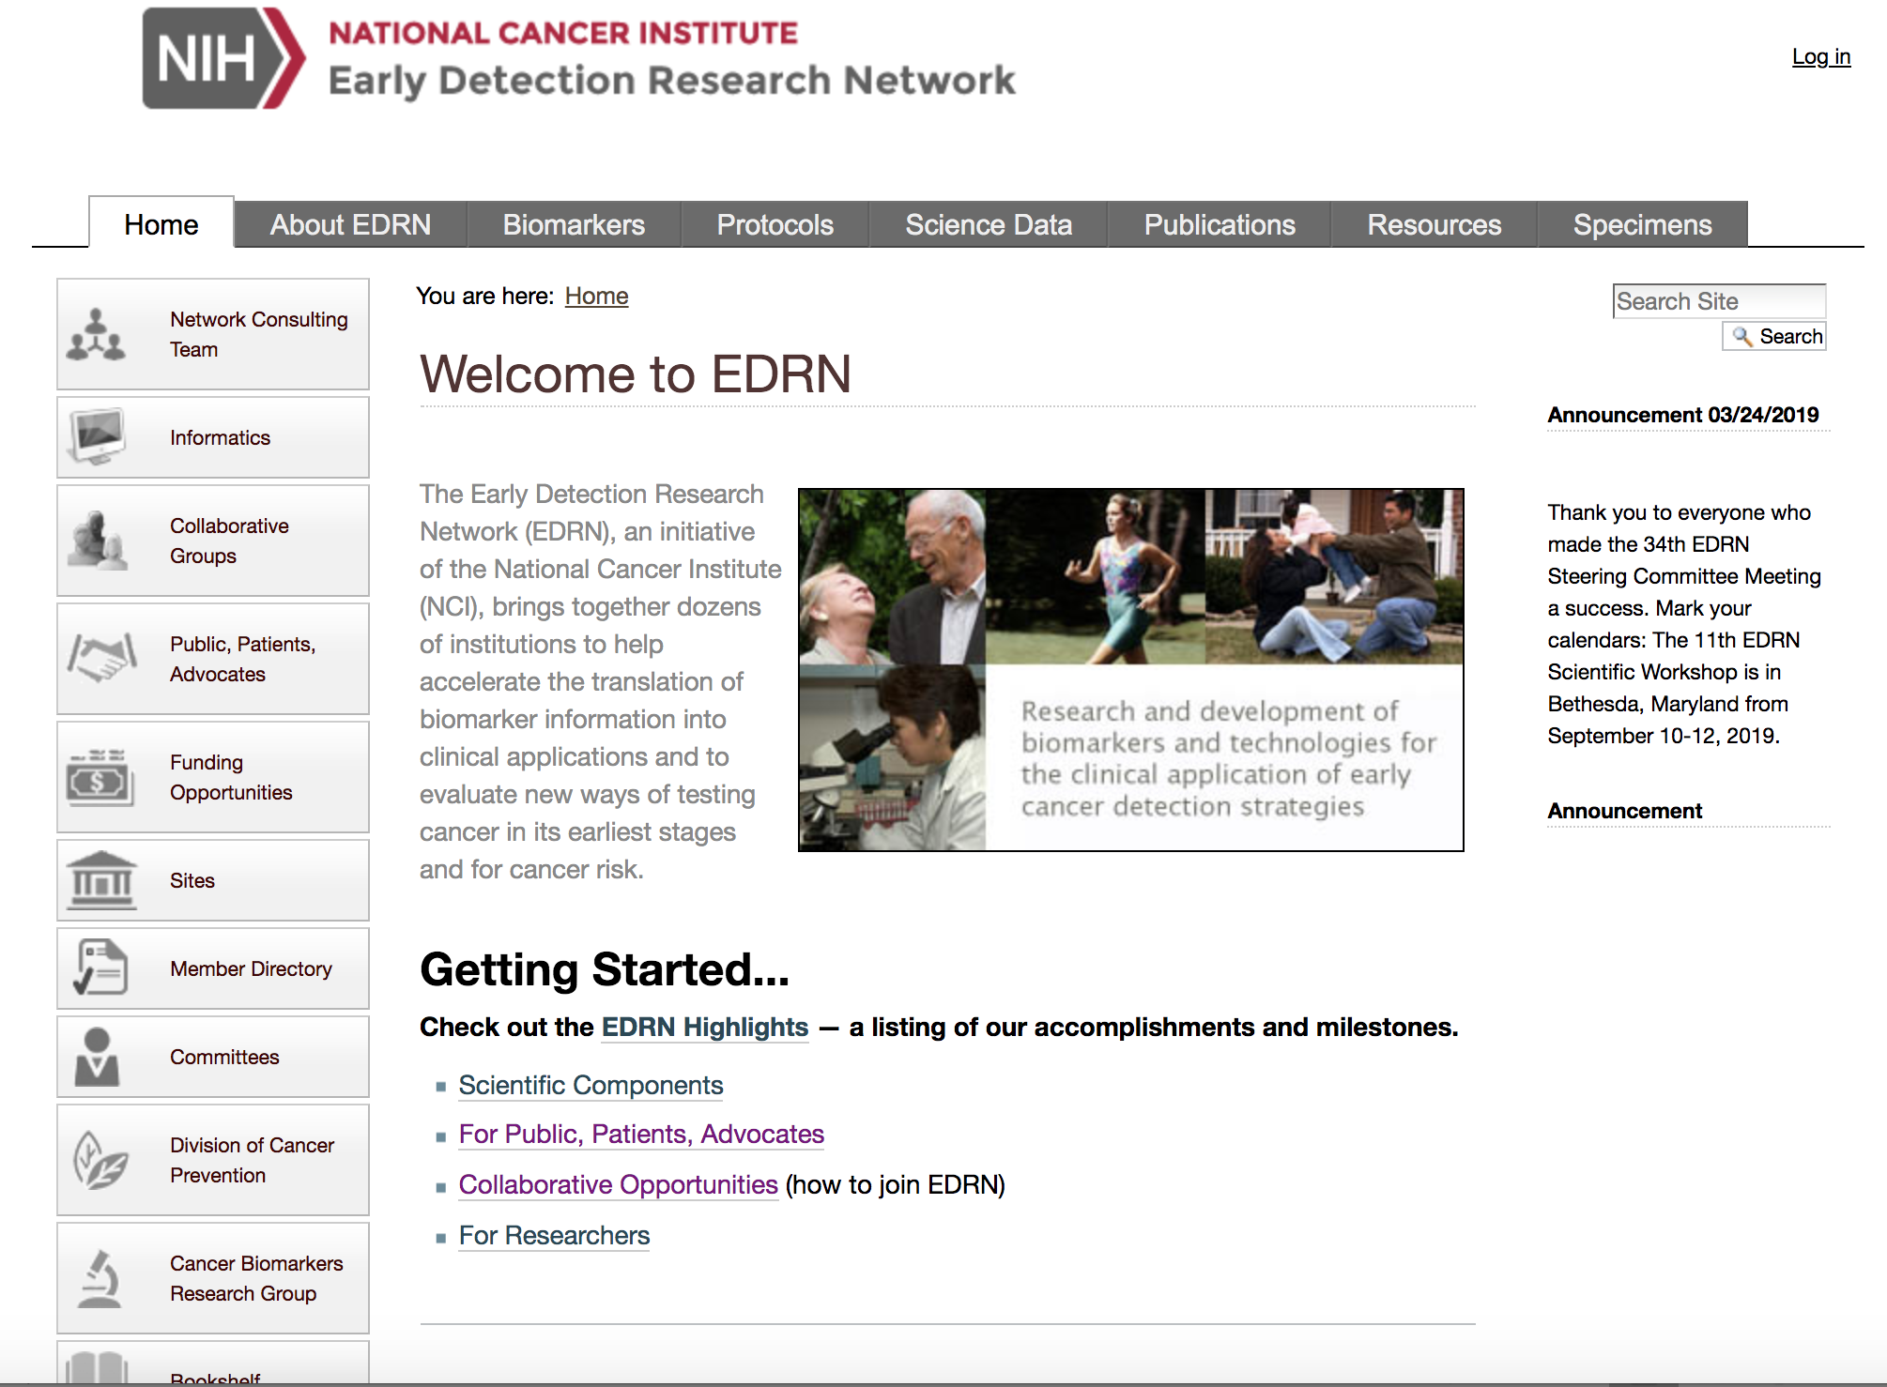
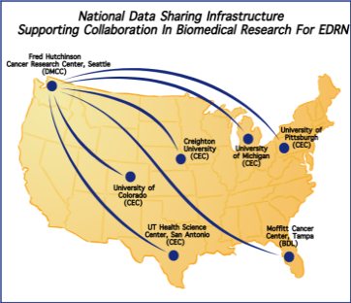
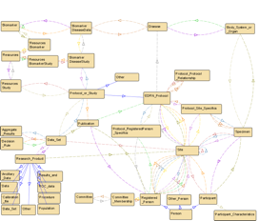
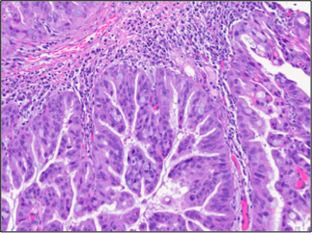

EDRN Knowledge Environment: A National Infrastructure
Enabling Data-Driven Research for Cancer Biomarkers
Heavily leveraged cloud computing-based capabilities to support the capture, sharing, and analysis of data for EDRN and other consortiums
Integrated within the EDRN portal, provides secure, multi-layer access to data for EDRN, NCI, research, and public communities, that link biomarkers, studies, and data together
Built on a set of biomarker common data elements to enable common annotation and linking
Nearly a thousand annotations of cancer biomarkers linked to terabytes of imaging, genomics data and analysis results, in the EDRN data commons, known as “LabCAS”.
Multiple discovery and access methods – from integrated tools to APIs
Scalable analytical pipelines supporting AI, biostatistics, and other algorithms for analyzing genomics, imaging, and other complex data types
  Deep learning methods for feature detection and classification
  Data pipelines
  Visualization tools
  Virtual Reality
Portal Access to Biomarkers Data
National Data Sharing Architecture
Common Data
Elements
& Models
Integrated Visualization Tools & Techniques

Slide 3
Future Directions
Apply data-driven techniques and tools such as machine learning
Enable machine learning through VR (virtual reality)
Deploy data processing pipelines in LabCAS to support automated image alignment
Generate clean datasets using defined workflows and crowdsourcing for machine learning
Support collaborative analysis that scales for big data
Unify consortium data into a data commons
Support the NIH Data Science Strategic Goals
Crowdsourcing and Machine Learning
VR Analysis of Multi-dimensional data

Slide 4








Informatics Center Team
  NCI
  University of North Carolina at Chapel Hill
  Caltech
  JPL
Dan
Crichton - PI
Kristen Anton
(UNC)
Luca Cinquini
Maureen Colbert
(UNC)
Sean Kelly
Heather Kincaid
David Liu
Ashish Mahabal
Alphan
Altinok
Asitang
Mishra
Santiago
Lombeyda
Notes:
As Dan discussed earlier – an interagency agreement was formed between NCI and JPL allowing us to leverage the systems already developed in planetary and earth science to create an advanced knowledge system to capture and share biomarker data for EDRN.

