Slide 1
Imaging-related considerations for early detection of pancreatic cancer
Eugene J. Koay, MD, PhD
Associate Professor
Dept. of Radiation Oncology
Sheikh Ahmed Center for Pancreatic Cancer Research
The University of Texas MD Anderson Cancer Center

Slide 2
General steps for imaging
Acquisition
Reconstruction/post-processing
Visualization/interpretation/analysis

Slide 3
Acquisition
Accounting for motion artifacts
Imaging technologies

Slide 4
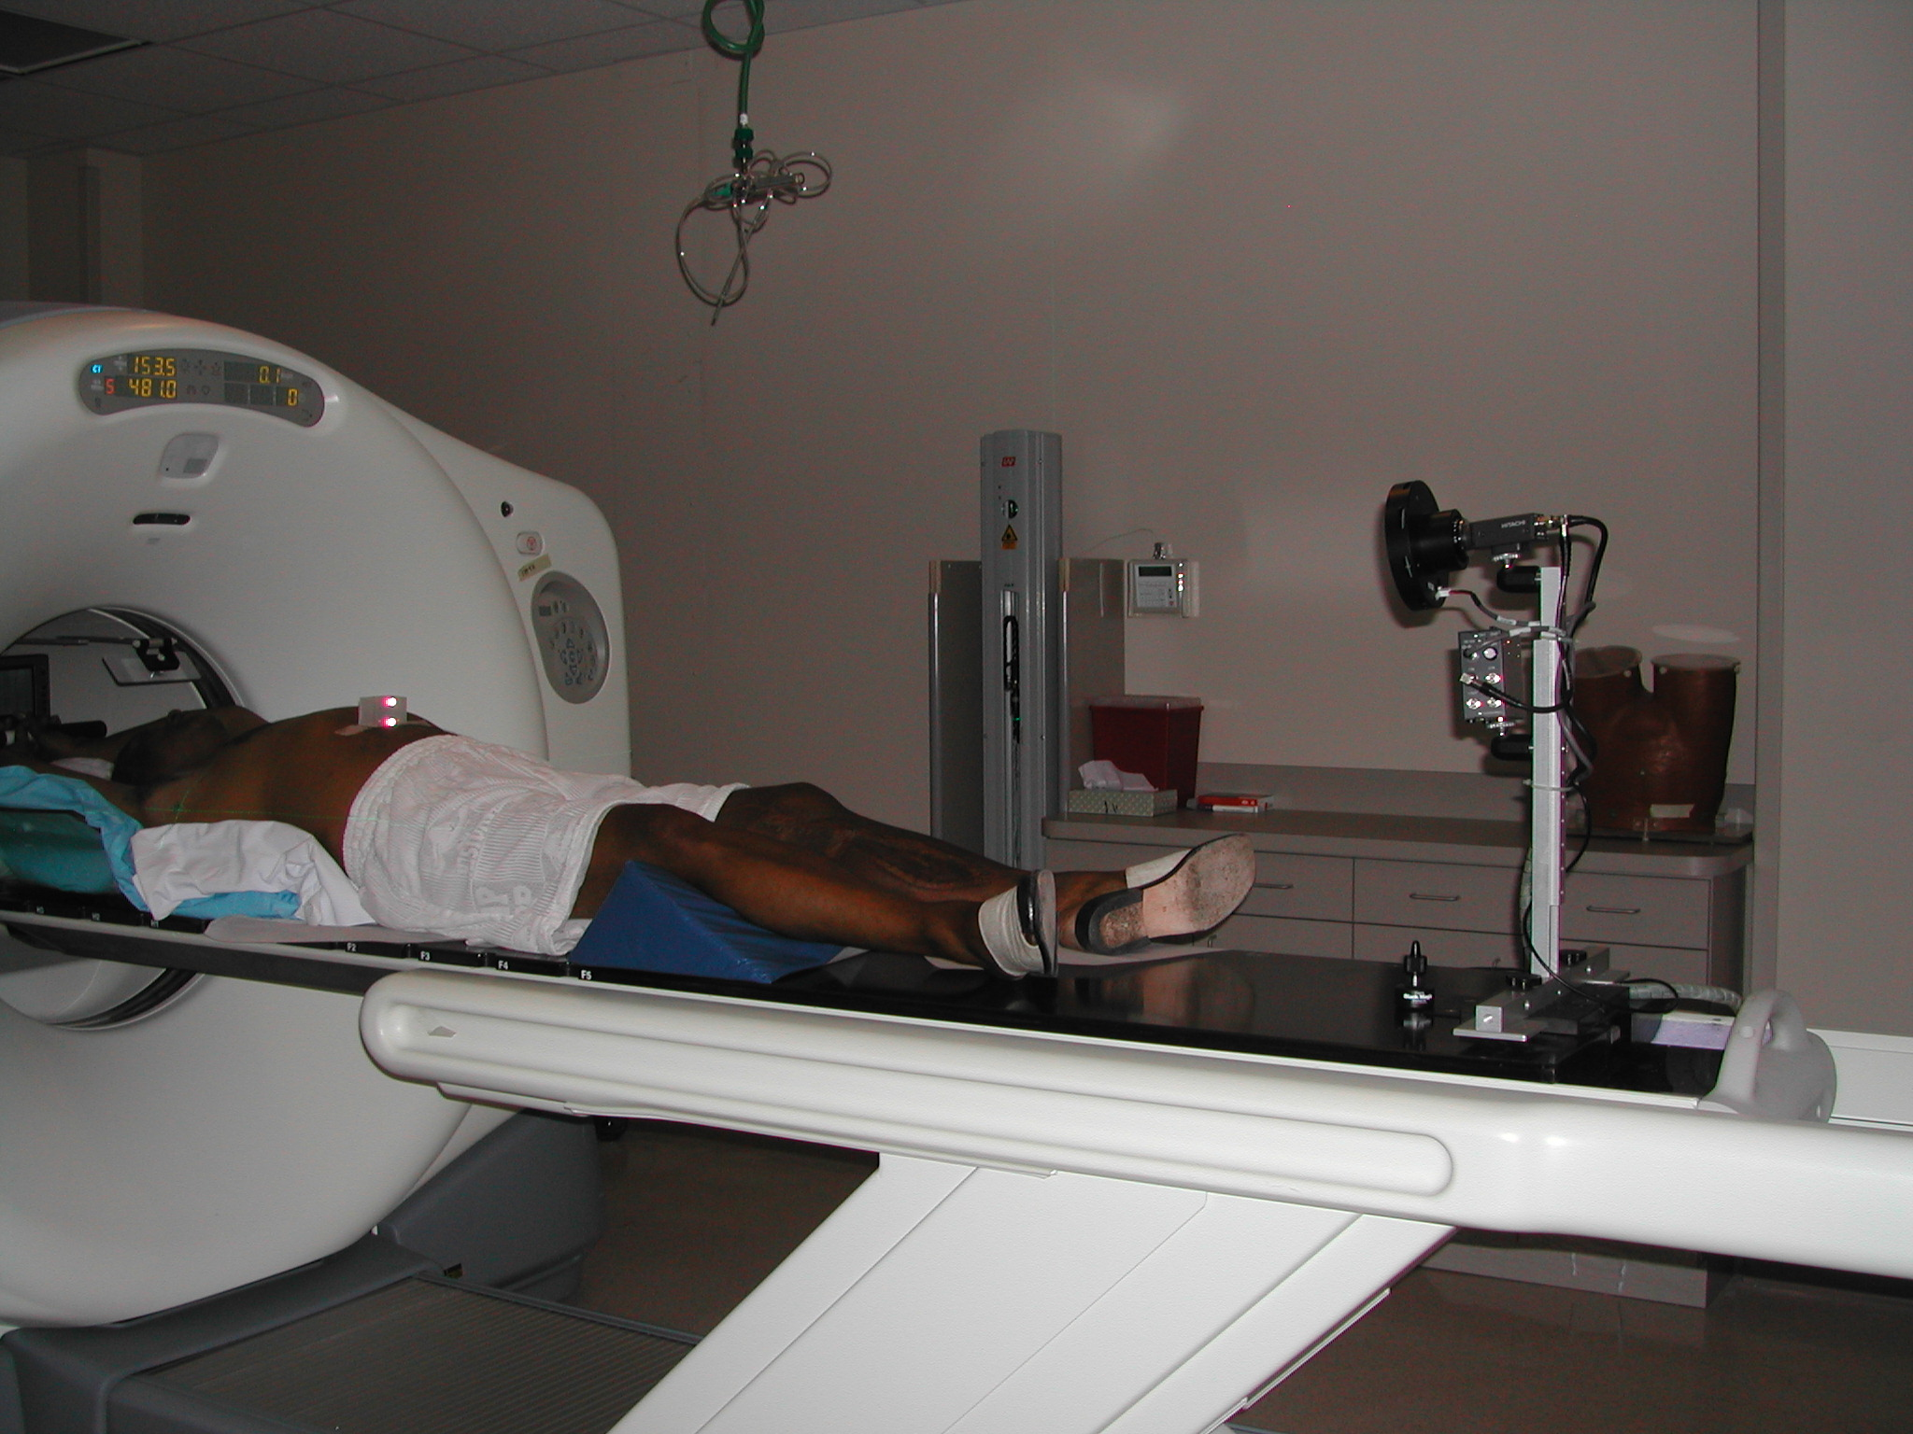
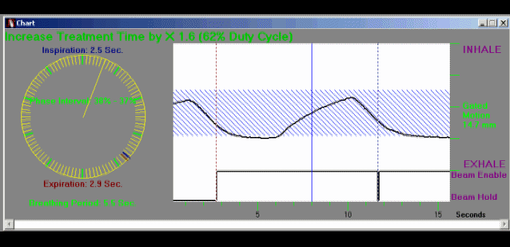
4D CT scan
Infrared Camera
Infrared Reflector

Slide 5

4D-CT Data Acquisition
X-ray tube
PET det.
CT det.
PET det.
Animation by: Tinsu Pan, Ph.D
Notes:
One question we often get asked is how is the data taken, so his is a great illustration showing how the data is taken in order to have sets to convert into a 4D set. The scanner is used in axial mode but data collection is more analogous to spiral acquisition. Each couch position (2 cm) is sampled for greater than the one respiratory cycle. Showing inspiration

Slide 6
4D-CT Data Acquisition
X-ray tube
PET det.
CT det.
PET det.
Notes:
Patient starts breathing out

Slide 7
4D-CT Data Acquisition
X-ray tube
PET det.
CT det.
PET det.
Notes:
Full expiration is reached

Slide 8
4D-CT Data Acquisition
X-ray tube
PET det.
CT det.
PET det.
Notes:
Inspiration starts again

Slide 9
4D-CT Data Acquisition
X-ray tube
PET det.
CT det.
PET det.
Notes:
Full inspiration

Slide 10
4D-CT Data Acquisition
X-ray tube
PET det.
CT det.
PET det.
Notes:
Couch moves and CT is off for a moment

Slide 11
4D-CT Data Acquisition
X-ray tube
PET det.
CT det.
PET det.
Notes:
CT is on at about complete expiration

Slide 12
4D-CT Data Acquisition
X-ray tube
PET det.
CT det.
PET det.
Notes:
Expiration

Slide 13
4D-CT Data Acquisition
X-ray tube
PET det.
CT det.
PET det.
Notes:
Starting to inhale

Slide 14
4D-CT Data Acquisition
X-ray tube
PET det.
CT det.
PET det.
Notes:
Full inspiration

Slide 15
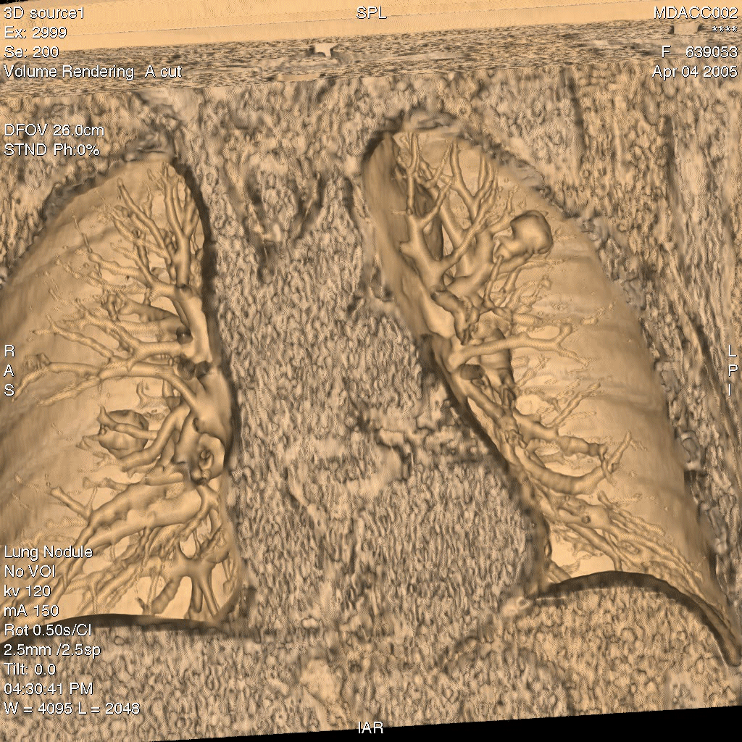
Balter

Slide 16
Dual energy CT: improving CNR
Iodine map
70 keV
Patient 1
Patient 2
Gupta et al, Abd Imaging 2018

Slide 17
MRI: multiple anatomical and functional sequences
T1
T2
FSE/TSE
DCE
DWI
TRUFI
FIESTA
Many more

Slide 18
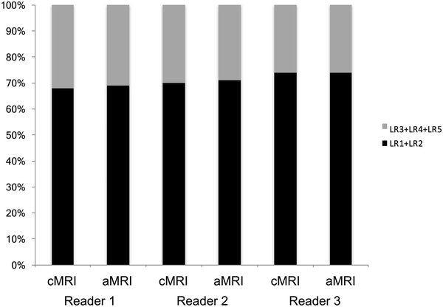
Considerations with MRI
Time
Cost
Anatomical
Functional
Lee et al, Abdominal Radiology, 2018
What can we learn from other early detection programs?

Slide 19
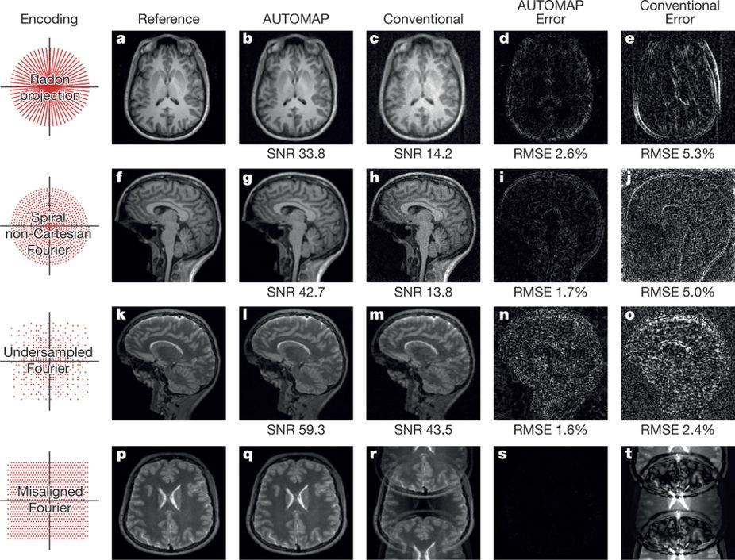
Reconstruction
Proprietary methods from vendors
Emerging methods us AI
Zhu et al, Nature, 2018

Slide 20
High and low delta PDAC
Baseline image processing

Slide 21
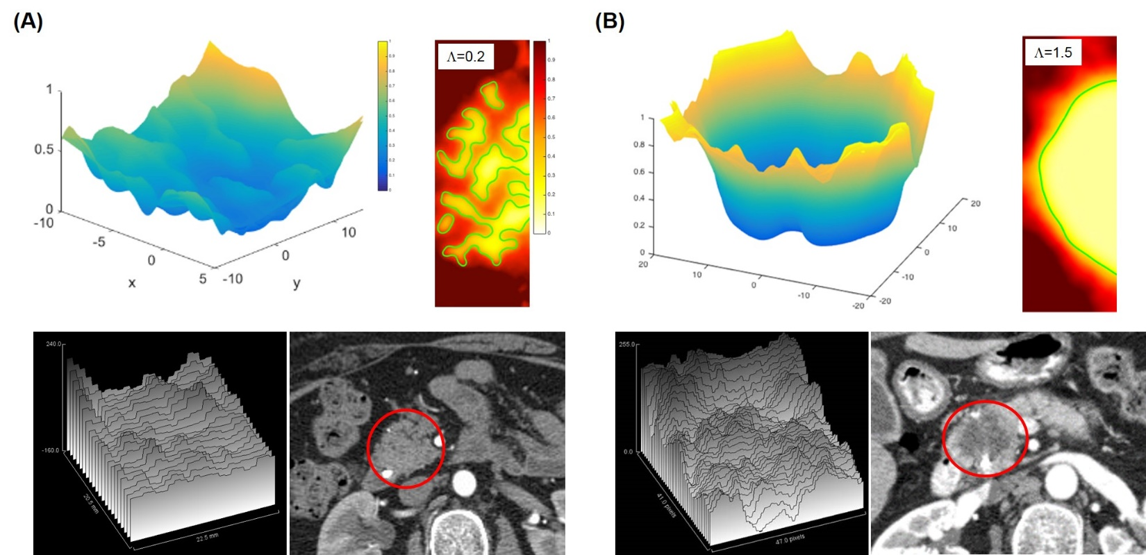
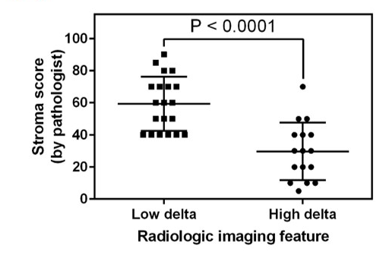
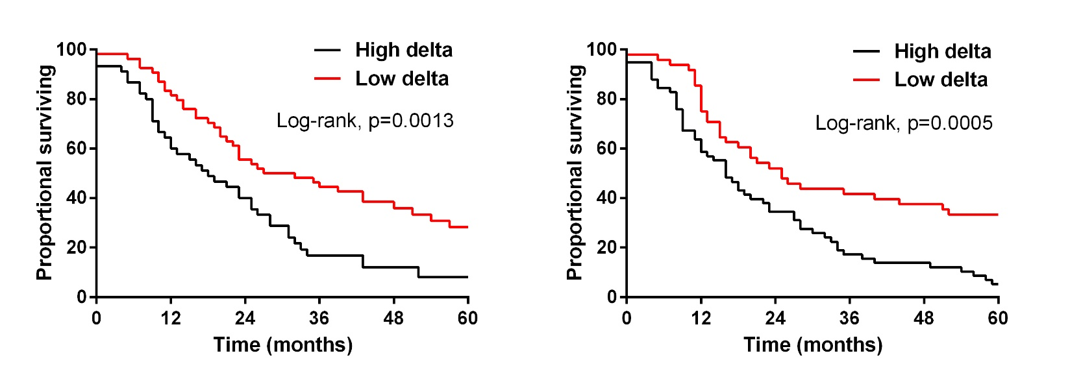
Simulations of tumor growth to identify biophysical subtypes
Koay et al, CCR 2018

Slide 22
CT-based morphological
subtypes of PDAC

Slide 23
CT-based biomarker outcomes

Slide 24
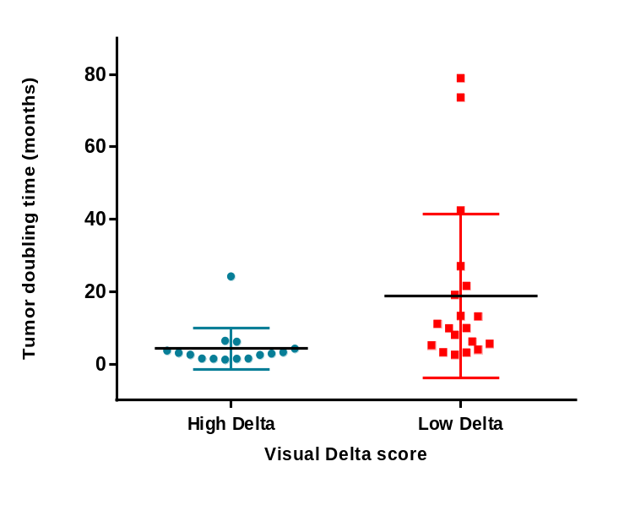
Imaging-based subtypes and relevance to early detection strategies
Tumor doubling time (months)
Distribution of high and low delta PDAC differs in those with early stage and late stage disease
The doubling time of high delta PDAC is faster than low delta PDAC
High delta
Low delta

Slide 25
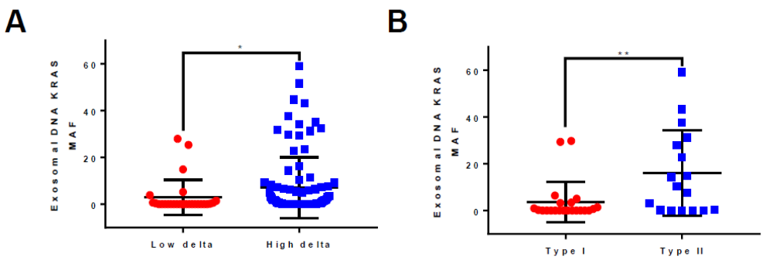
Combining imaging-based biomarkers with liquid biopsies
Elganainy, Koay, et al, unpublished

Slide 26
Multi-parametric enhancement pattern mapping (EPM)
Image processing for early detection and further characterization of liver and pancreatic lesions

Slide 27
Concept for Enhancement Pattern Mapping

Slide 28
Challenges and potential solutions with multiparametric image processing
Organ motion – CT acquisition with immobilization
Image overlay error – Deformable registration techniques
Comparison models – Quantitative models on patient-specific and population-based data

Slide 29
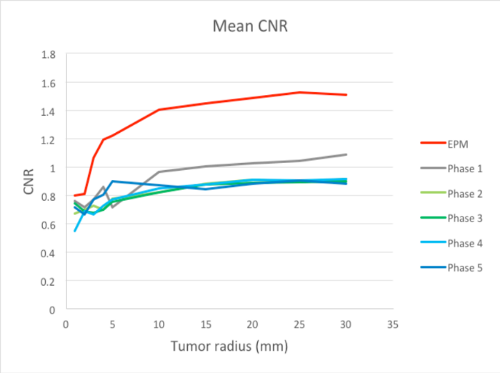
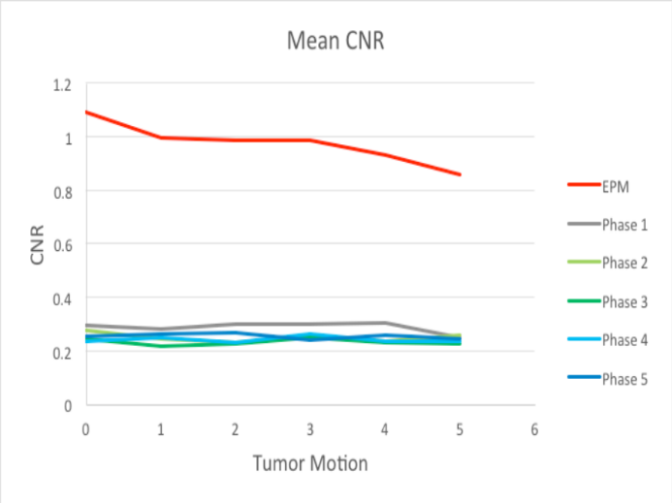
CNR improved across a range of noise levels and tumor sizes using EPM
Park, Koay et al, Med Phys 2019

Slide 30
CNR improved in cholangiocarcinoma, HCC, and colorectal liver metastases
Park, Koay et al, Med Phys 2019

Slide 31
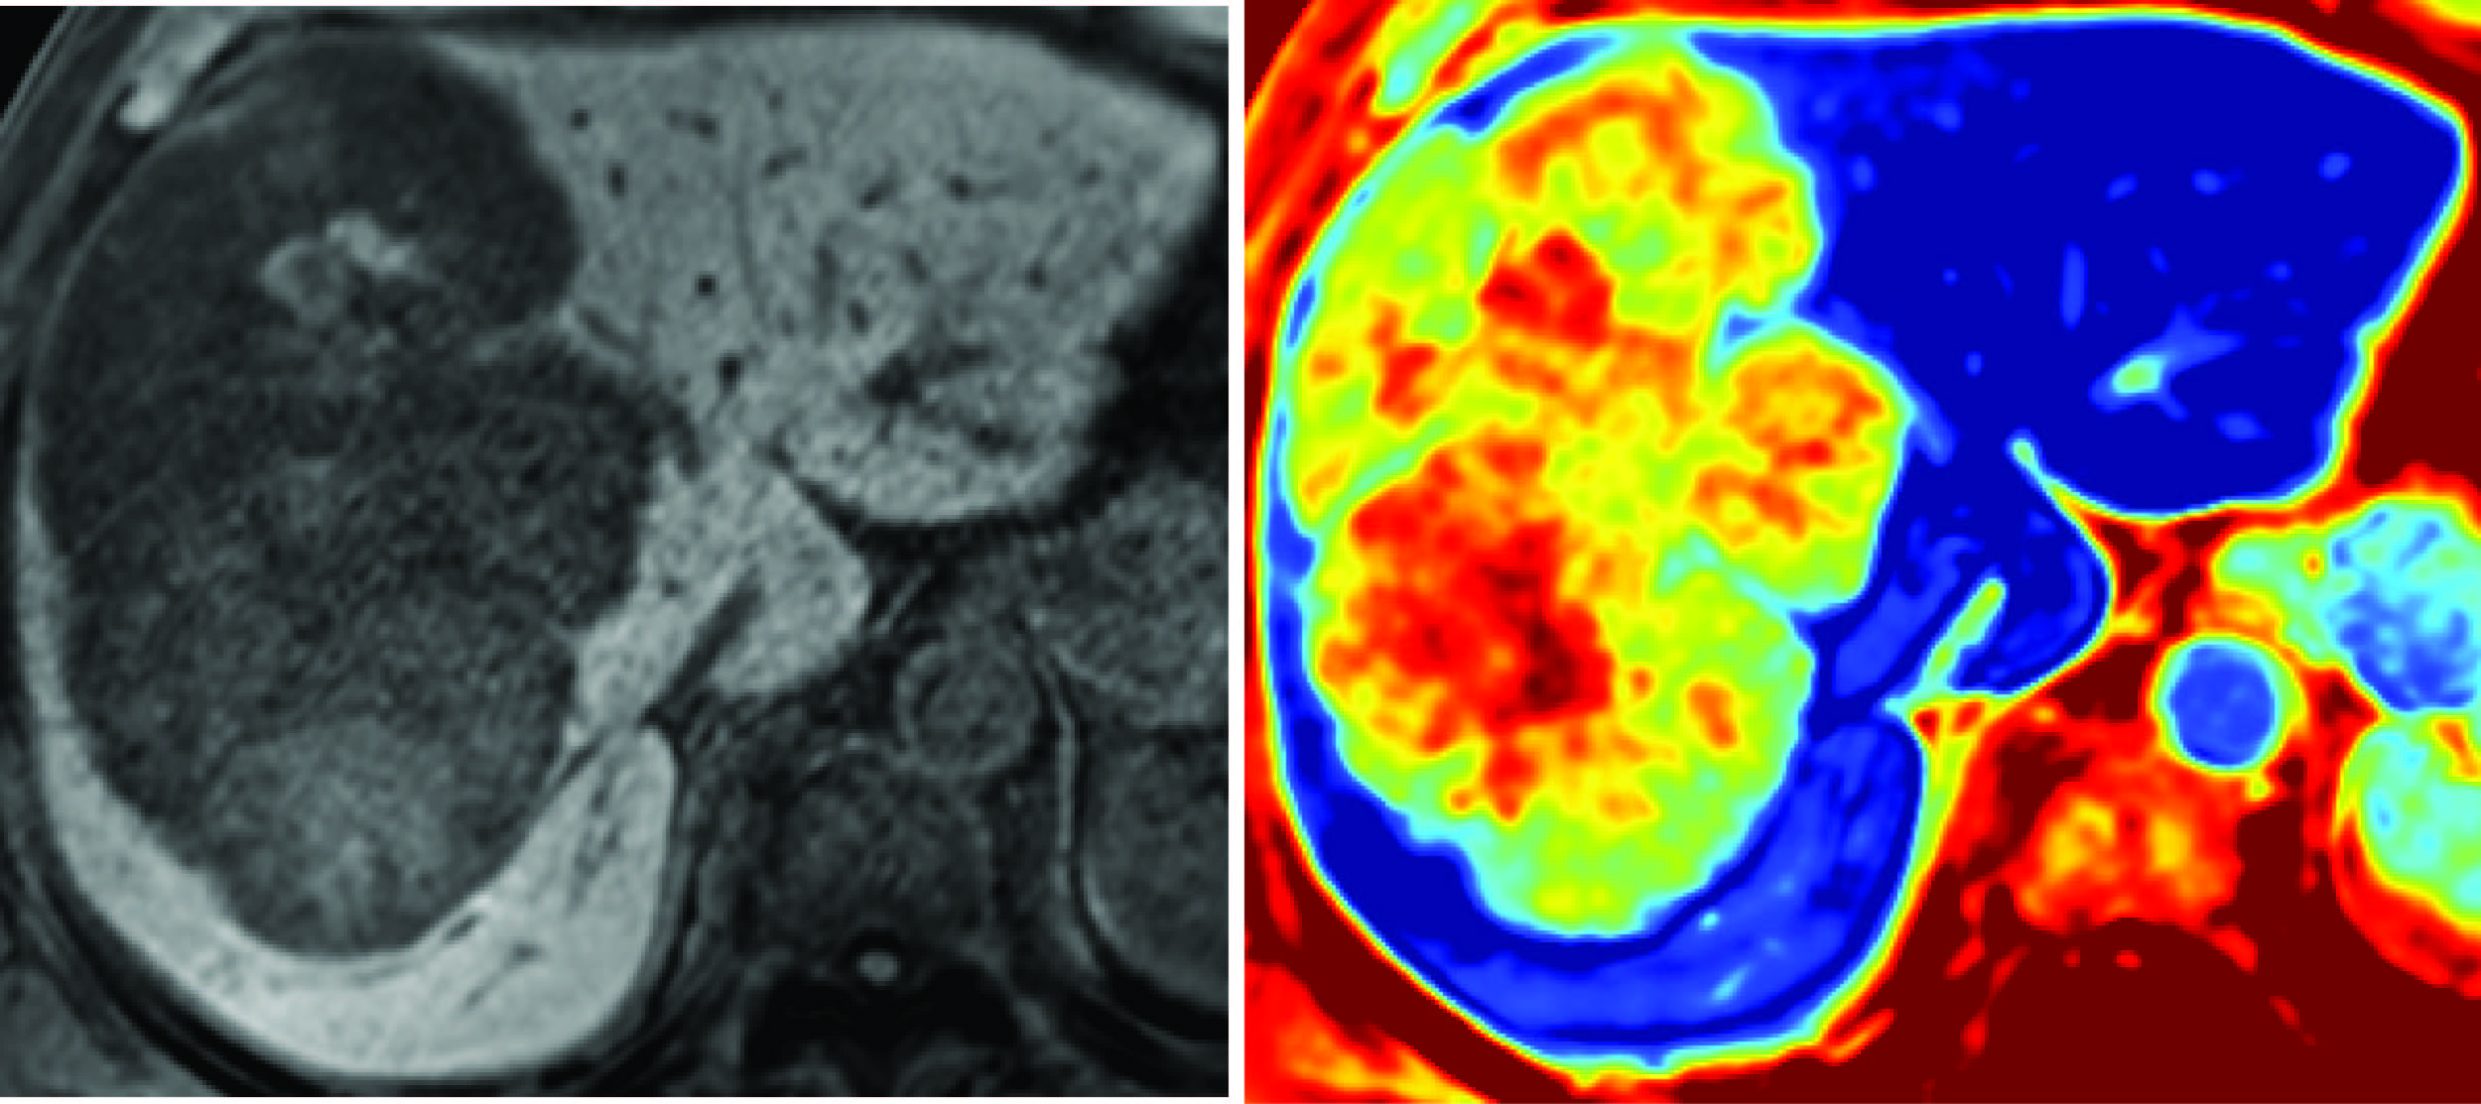
Intratumoral heterogeneity with EPM
Peter Park, Danyal Smani

Slide 32
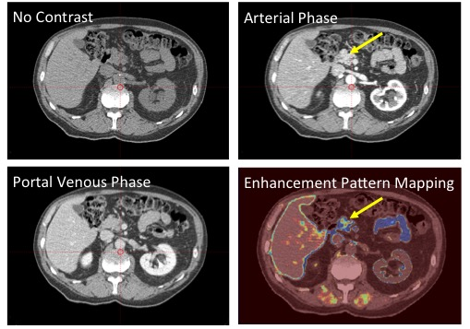
Identifying the physical location of disease in the pancreas
81 y/o male with multifocal IPMN and increasing CA19-9
Peter Park

Slide 33
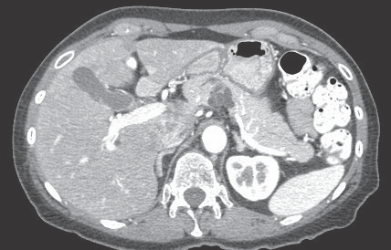
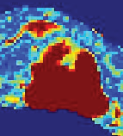
EPM applied to IPMNs
Dalia Elganainy

Slide 34
Auto-contouring of the pancreas using deep learning
Prediction
Ground truth
Brian Anderson, Kristy Brock

Slide 35
Image processing for single contrast phase
Not all scans are amenable to EPM
Most imaging exams do not have a non-contrast phase
The textures of solid tumors are often noticeably different from parenchyma

Slide 36
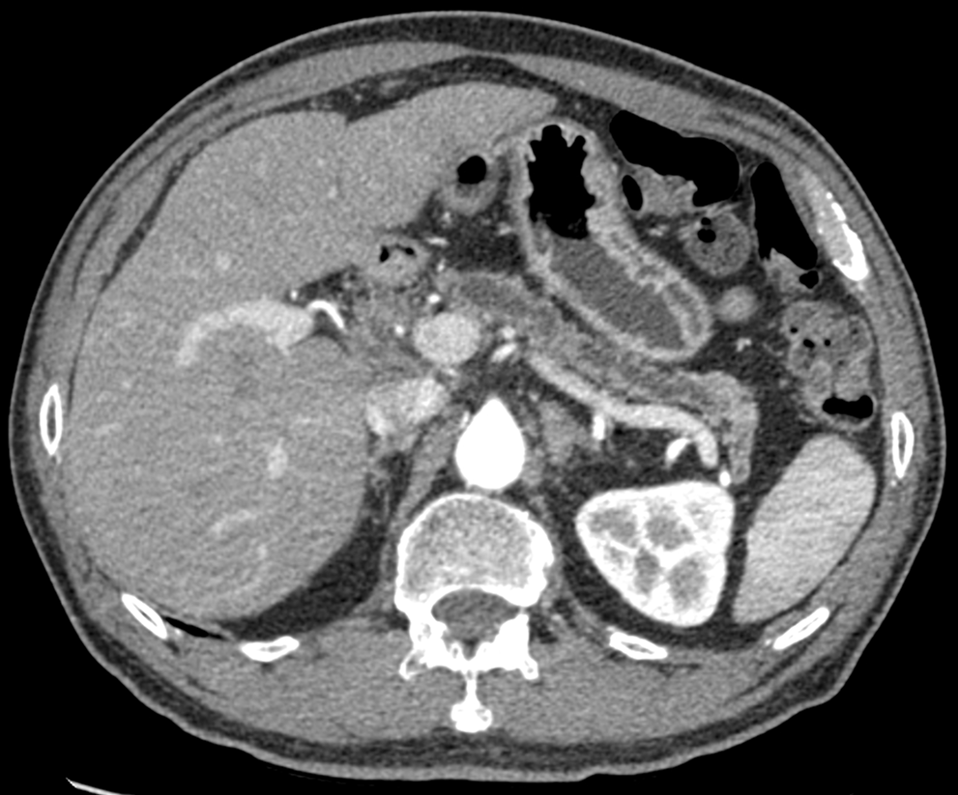
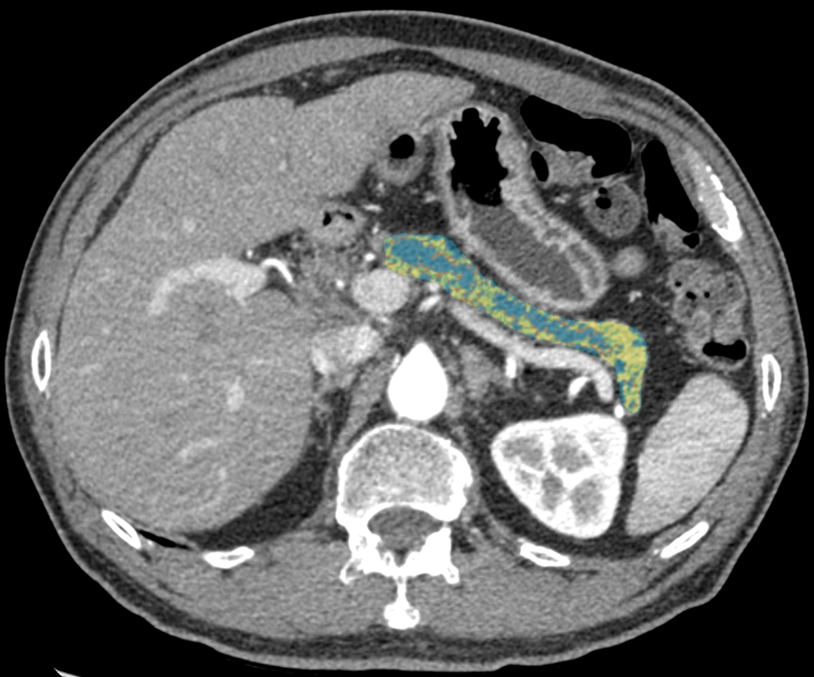
Gaussian Mixture Model:
Pancreatic duct and normal pancreas
Dalia Elganainy

Slide 37
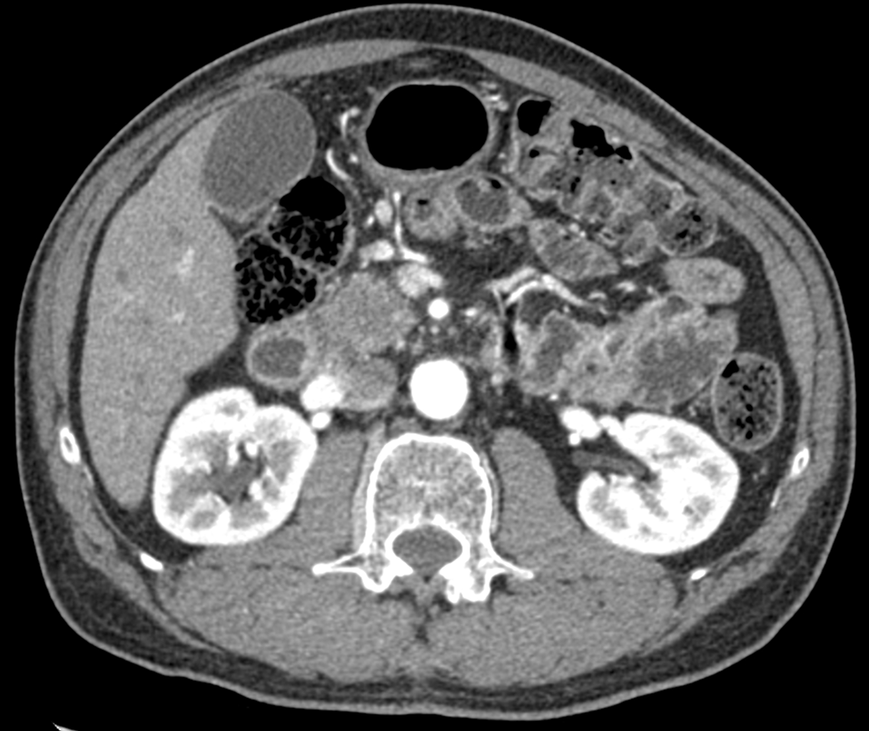
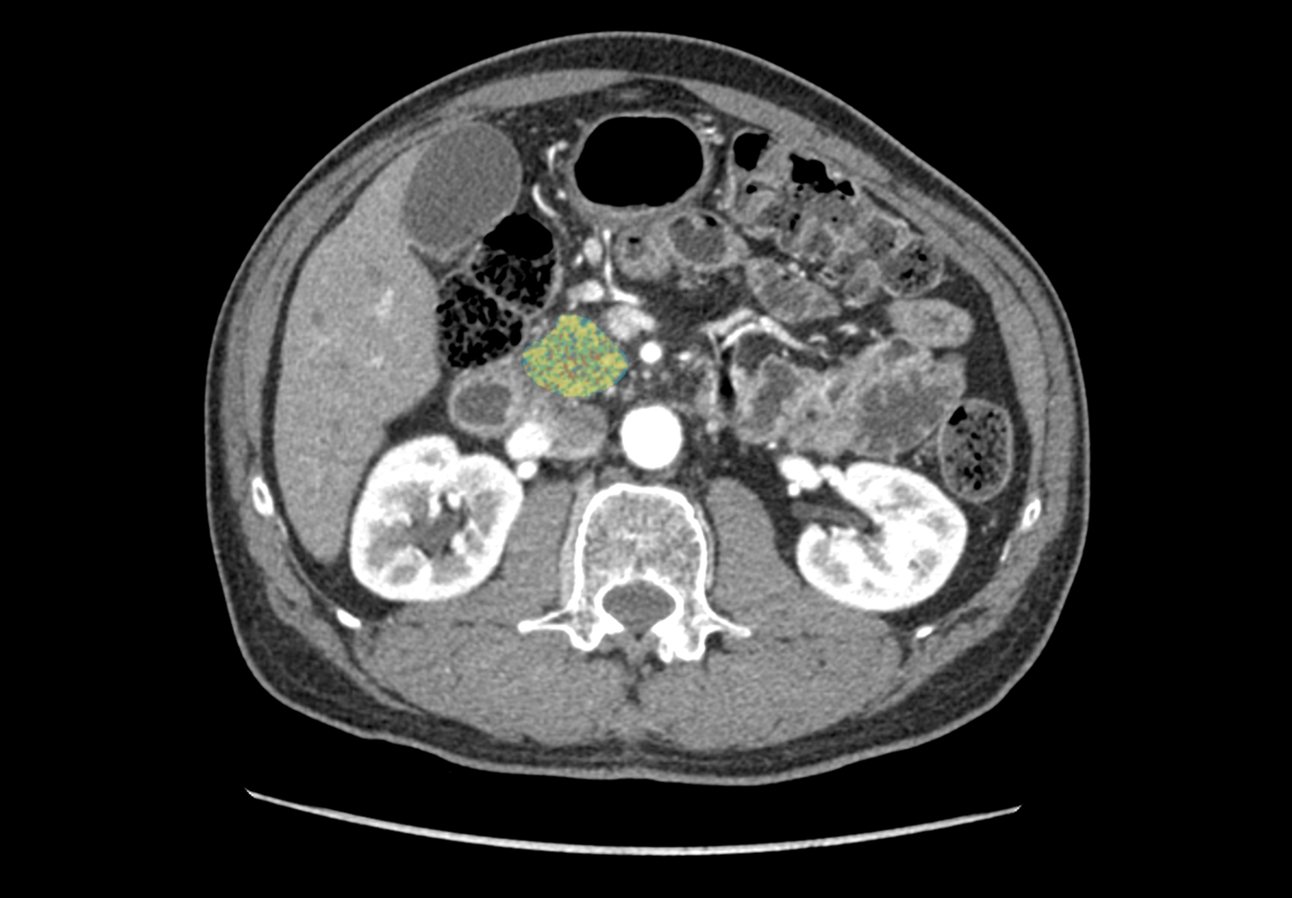
Gaussian Mixture Model:
Pancreatic adenocarcinoma
Dalia Elganainy

Slide 38
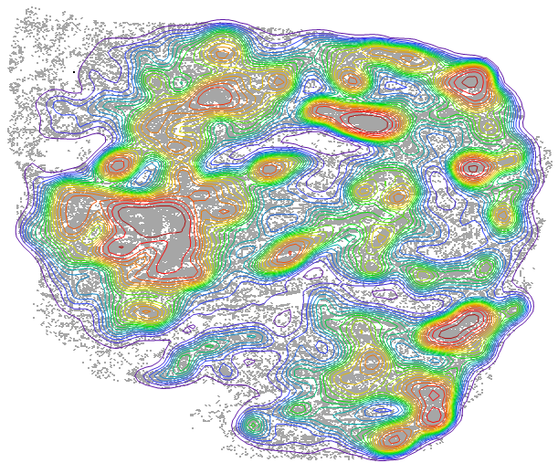
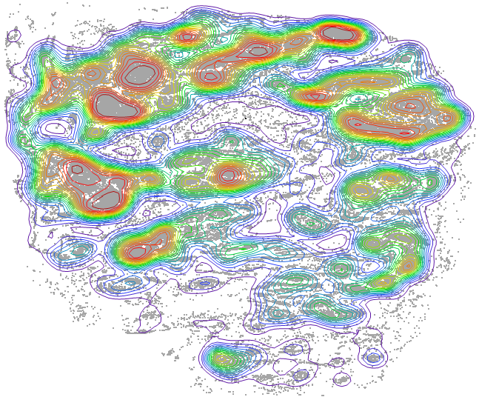
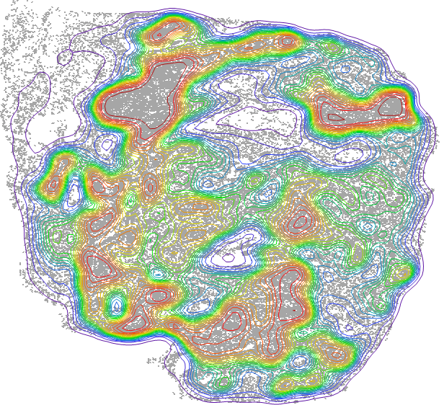
Ongoing work: Correlating EPM with detailed pathology analyses
Tumor Cells
Lymphocytes
Fibroblasts
Mohamed Zaid

Slide 39
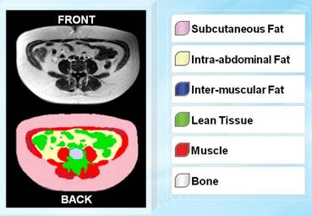
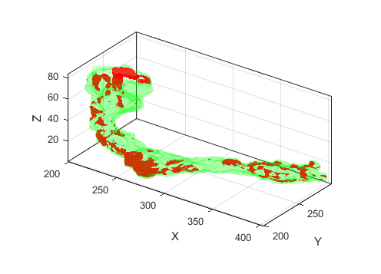
Future directions
Pancreas
EPM applied to
Multifocal IPMN
Multi-institutional Imaging repository
Pancreas and body composition measurements

Slide 40
Summary: Multiple considerations for imaging for early detection applications
Acquisition:
  Motion
  Imaging technologies
Reconstruction/post-processing:
  Artifacts
  Motion correction
  AI
Visualization/interpretation/analysis:
  Single phase
  Multiple phases
  Radiomics
  AI

Slide 41

Acknowledgments
Mohamed Zaid
Dalia Elganainy
Ezgi Kirimli
Eric Tamm
Anirban Maitra
Subrata Sen
Ann Killary
NIH:
  EDRN
  MCL
  PCDC
  PSON
Project Purple
Khalifa Foundation
Sabin Family Fellowship
Pancreatic Cancer Action Network
SU2C and Lustgarten Foundation

