Slide 1
Panel Discussion:
Biology of Liquid Biopsy
Jasmine Zhou
University of California Los Angeles
Kenneth Kinzler
Ludwig Center at Johns Hopkins
11th EDRN Scientific Workshop
September 12th 2019

Slide 2
COI Disclosure: Jasmine Zhou
Co-founder: EarlyDiagnostics, Inc
presentation:

Slide 3
COI Disclosure
Kenneth Kinzler
Advisory Role: Sysmex, Eisai-Morphotek
Stockholder/Advisory Role: PGDx, Thrive, NeoPhore, CAGE, Phoremost
Patents and Royalties: Sysmex, PGDx, Thrive and other companies have licensed technologies from Johns Hopkins University, on which KWK is an inventor. These licenses and relationships are associated royalty payments to KWK. The terms of these arrangements are being managed by Johns Hopkins University in accordance with its conflict of interest policies.

Slide 4
Discussion Topics
Does biology support PanCancer (multiple or all cancers) detection?
How would tumor heterogeneity and population risk heterogeneity affect this (PanCancer) effort? What is needed to address this challenge?
How do mutations in benign tissues affect liquid biopsy analysis?

Slide 5
Discussion Topics
Does biology support PanCancer (multiple or all cancers) detection?
How would tumor heterogeneity and population risk heterogeneity affect this (PanCancer) effort? What is needed to address this challenge?
How do mutations in benign tissues affect liquid biopsy analysis?

Slide 6
Does biology support PanCancer (multiple or all cancers) detection?
Do multiple or all cancer types share a set of common molecular signatures?
If not, can we still develop a test to detect PanCancer?

Slide 7
Do multiple or all cancer share a set of common molecular signatures?
Across all TCGA datasets (methylation, gene expression, CNV, SNV, etc), we did not find a molecular alteration that is shared by all cancer patients.
The TCGA pan-cancer studies (Hoadley et al, Cell 2018) revealed that Cell-of-Origin patterns dominate the molecular classification of 10,000 Tumors from 33 types of cancer, yet tumors of different origins are occasionally cluster together.

Slide 8
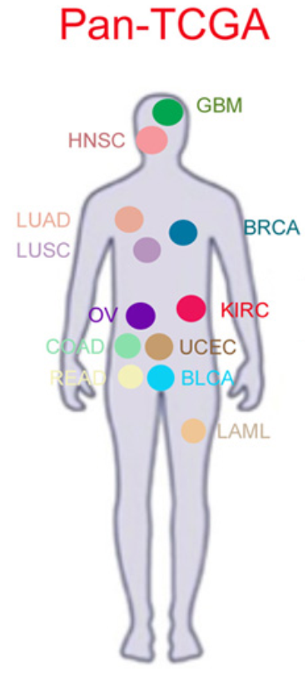
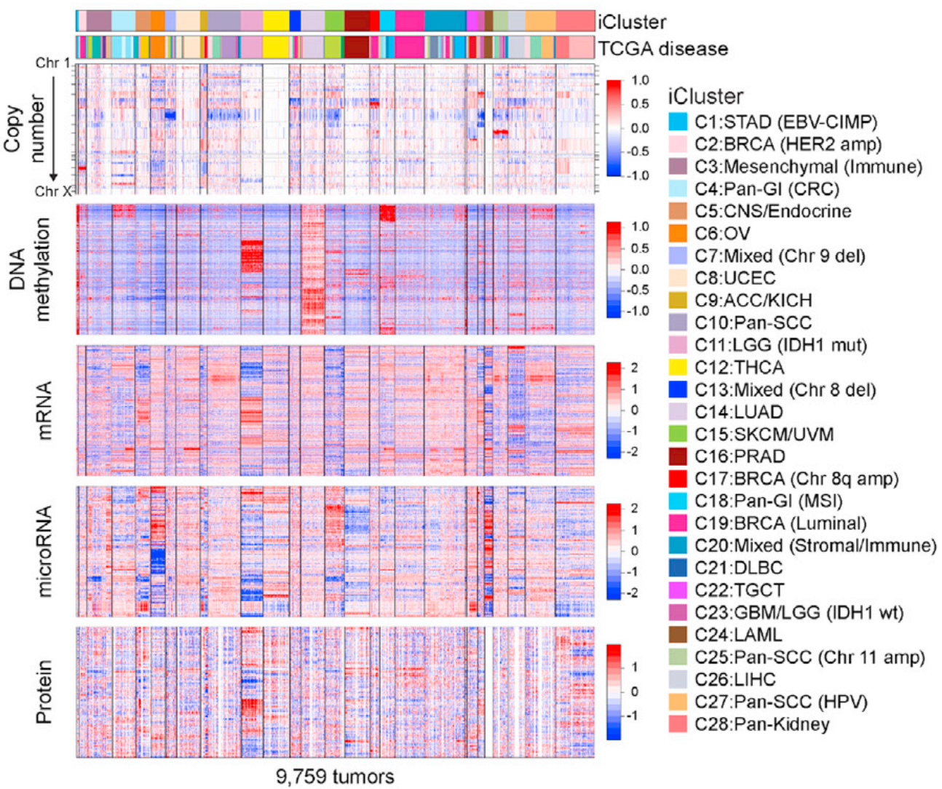
While a third of iClusters were mostly homogeneous for a single tumor type, the other two-thirds showed varying degrees of heterogeneity.
Most of the heterogeneous iClusters, contained tumor types that fell within four major cell-of-origin, or organ system, patterns: pan-GI, pan-gyn, pan-squamous, and pan-kidney
Hoadley et al, Cell 2018

Slide 9
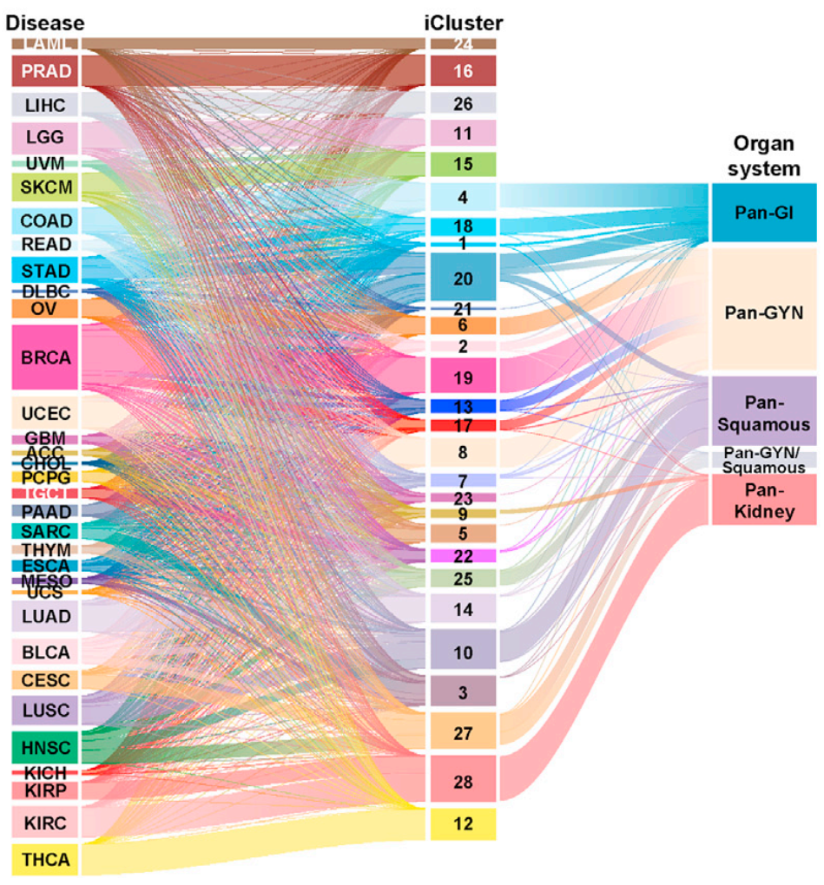
The correspondence between molecular-based iclusters and tissue-based cancer disease types

Slide 10
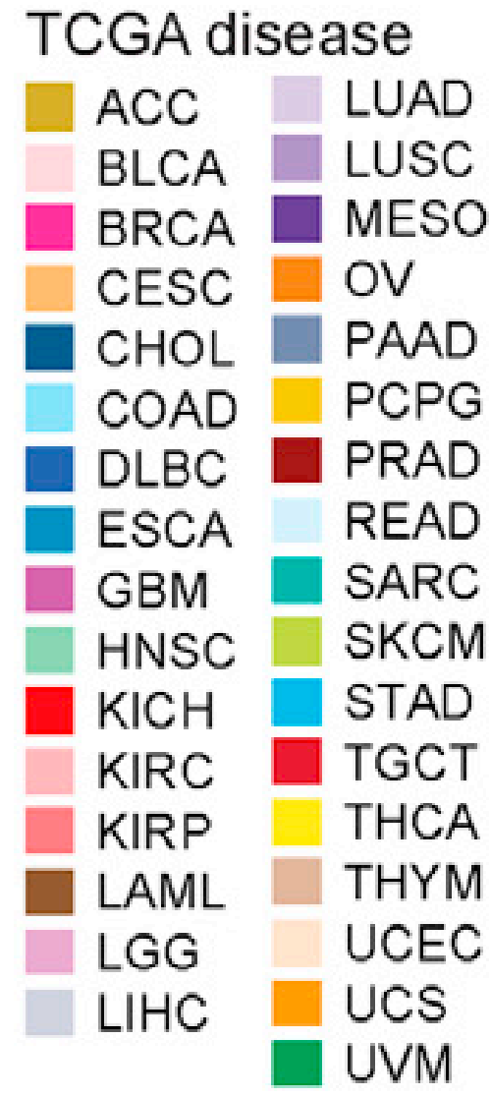
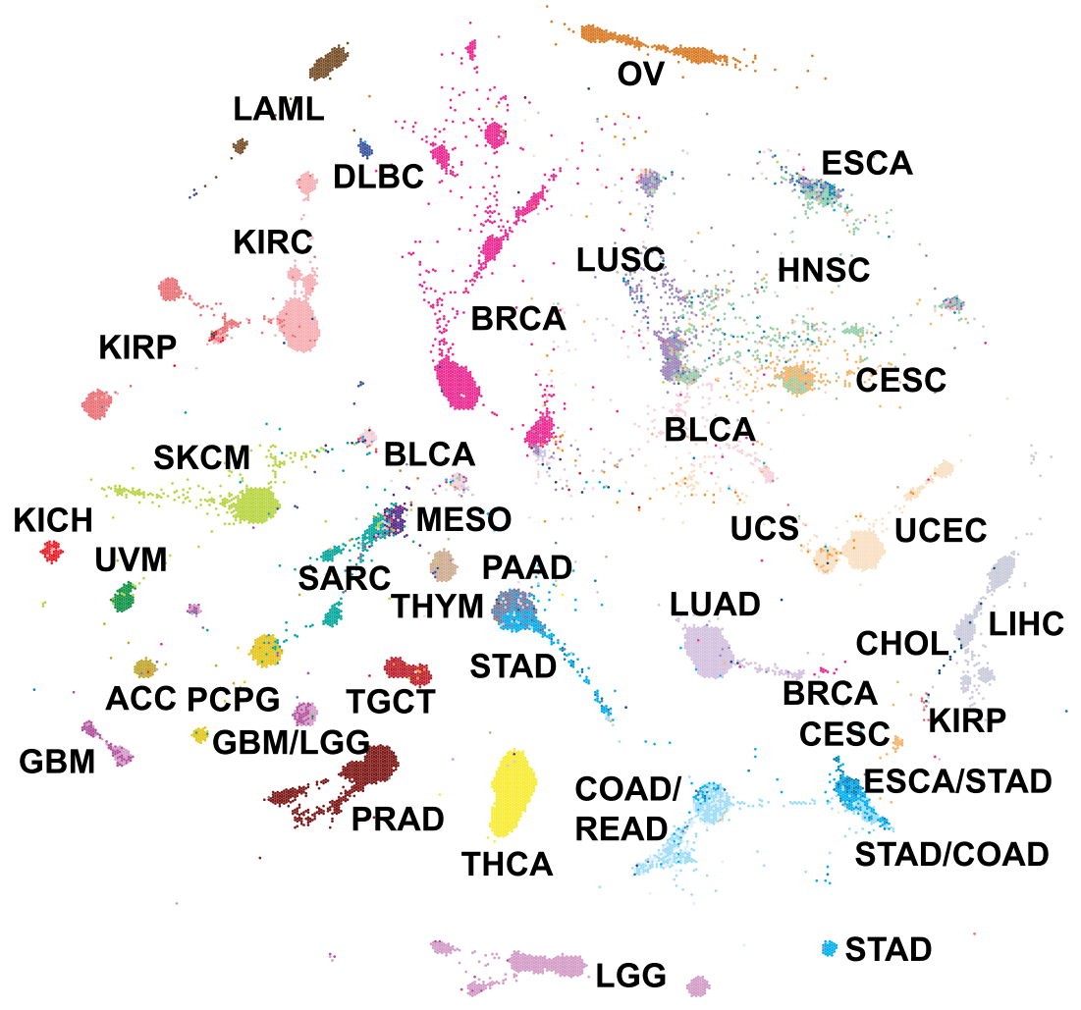
Tumor Map: Similar samples with omics characterization (dimension reduction) are positioned in close proximity to each other.

Slide 11
Do multiple or all cancer share a set of common molecular signatures?
Across all TCGA datasets (methylation, gene expression, CNV, SNV, etc), we did not find a molecular alteration that is shared by all cancer patients.
The TCGA pan-cancer studies (Hoadley et al, Cell 2018) revealed that Cell-of-Origin patterns dominate the molecular classification of 10,000 Tumors from 33 types of cancer, yet tumors of different origins are occasionally cluster together.
Molecular alterations, such as TP53 mutations, occur in many cancer patients, but they also occur in many non-cancer individuals.
Implication: it is hard to find a small panel of molecular biomarkers that can detect all cancers.

Slide 12
Can we detect PanCancer?
We need a large panel of biomarkers by possibly aggregating the biomarker panels of many types of cancers
Or simply genome-wide approach

Slide 13
The advantage of the genome-wide approach
Robust capture of a very low amount of tumor cfDNA (major challenge for the early cancer detection)
1ml plasma -> 5 ng cfDNA -> ~15,000 genome
If the tumor cfDNA fraction is 0.02%, only 3 tumor genomes are present.
Given the efficiency of most capture kits, capturing tumor cfDNA fragments from 3 genomes that exactly cover a small gene panel risks false negatives.

Slide 14
The advantage of the genome-wide approach
Comprehensive coverage of heterogeneous patient populations: The large number of biomarkers can encompass the large molecular aberration landscape of diverse cancer etiologies.
The diagnostic test can be continually refined and expanded to accommodate more ethnic populations and cancer subtypes, because the validation cohort data can be repeatedly used to validate new biomarkers.
All-in-one test allows multi-purpose diagnosis and prognosis: the test and training/validation data can be repurposed to develop other applications.

Slide 15
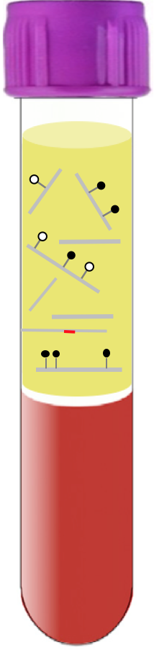
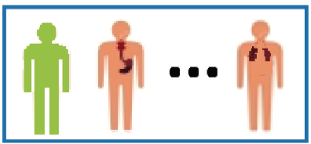

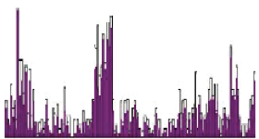

Our methylome-based diagnostics
cfDNA methylome
profile
Tumor fraction and
cancer type prediction
Healthy or cancerous?
Location?
“All-in-One” blood test
Low cost

Slide 16
Biology and PanCancer (multiple or all cancers) detection
For multi-cancer:
  Some mutations (TP53) and Aneuploidy are shared across many cancer types
Against Pan-cancer:
  No single marker or feature is PanCancer
  Cancers differ in the amount of ctDNA they release
  Early Stage Cancers Release less ctDNA

Slide 17
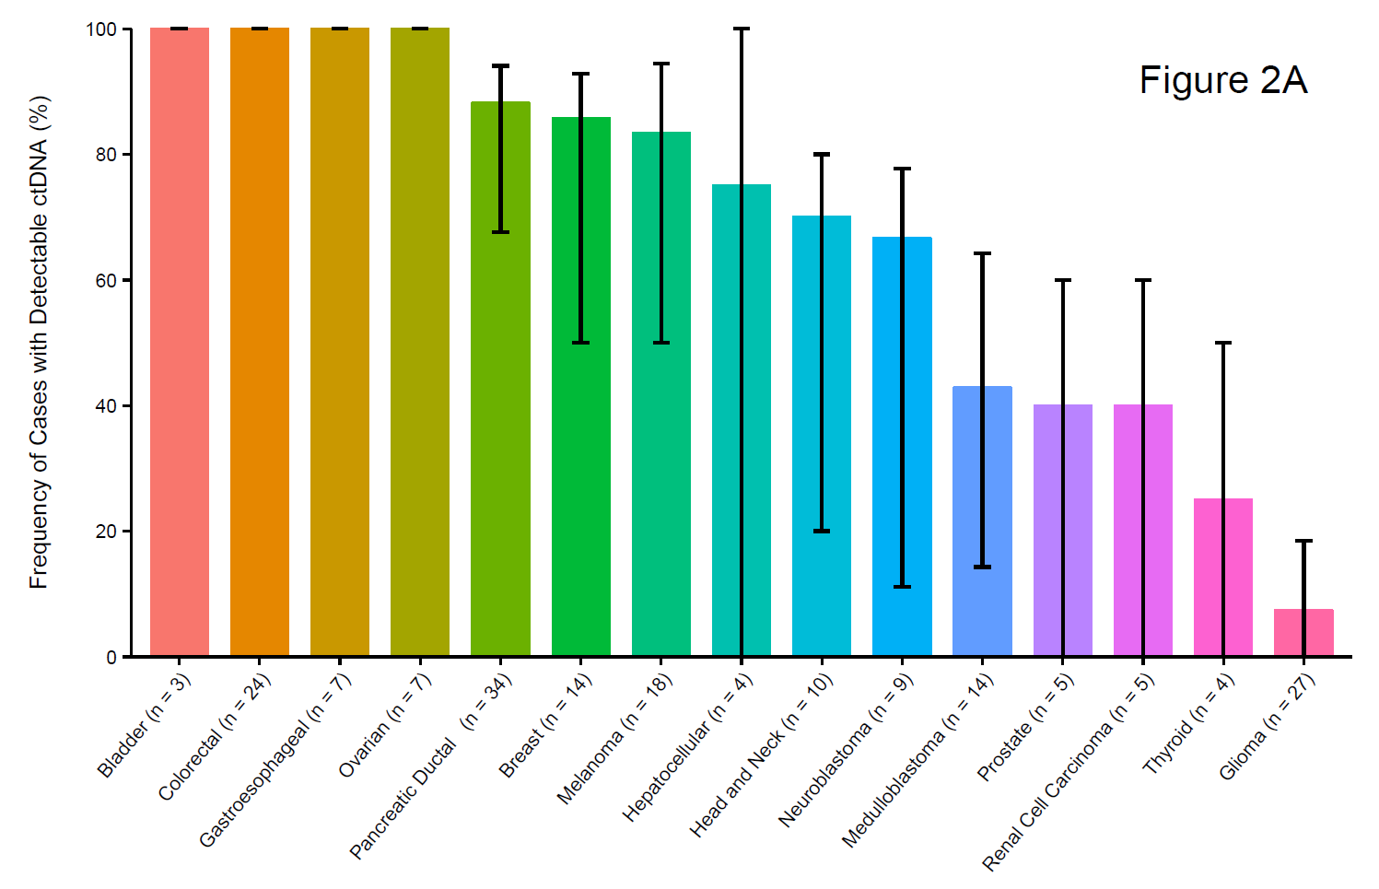
Cancer Types vary in the extent they release ctDNA
Frequency of Stage 4 Cancer and Brain Tumors
With Detectable ctDNA (%)
Bettegowda et al.
Sci Transl Med. 2014 Feb 19;6(224):224ra24.
Notes:
Across 15 cancer Types

Slide 18
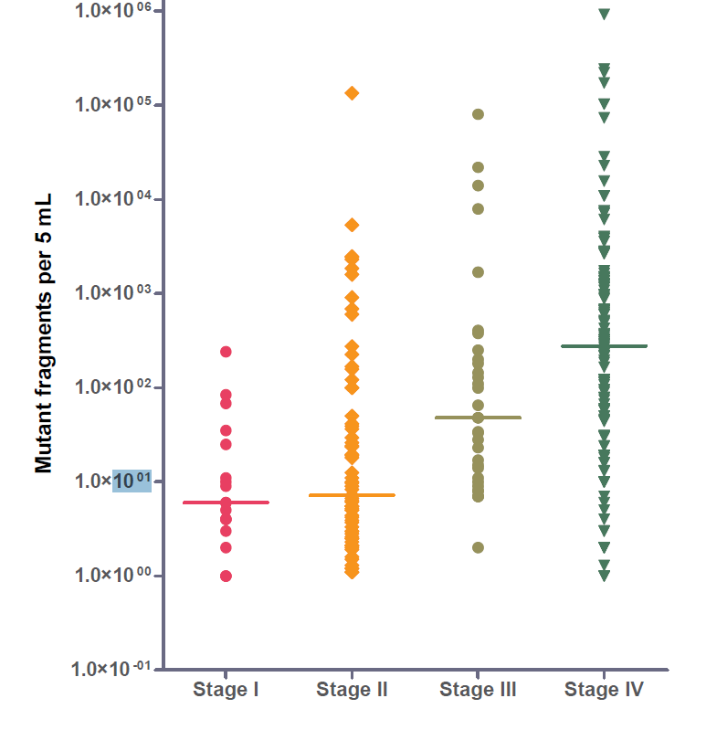
Early Tumors Release Less ctDNA
ctDNA versus Stage
Bettegowda et al.
Sci Transl Med. 2014

Slide 19
Multi-Analyte
Circulating Tumor Cells (CTCs)
Mutations
Aneuploidy
Translocations
Methylation changes
Protein Biomarkers
Size differences
cfDNA Levels
Exosomes
RNAs and MicroRNAs

Slide 20
Discussion Topics
Does biology support PanCancer (multiple or all cancers) detection?
How would tumor heterogeneity and population risk heterogeneity affect this (PanCancer) effort? What is needed to address this challenge?
How do mutations in benign tissues affect liquid biopsy analysis?

Slide 21
Tumor Heterogeneity and Population Risk Heterogeneity
Genetic Heterogeneity Slides
  Epigenetic and genetic heterogeneity
  Minimal functional driver gene heterogeneity
Population Heterogeneity
  PPV
  NNTS

Slide 22
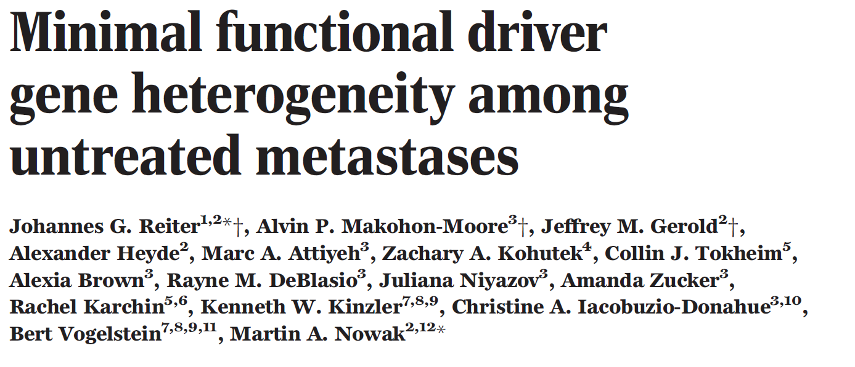
Driver Gene Heterogeneity
Reiter et al., Science 2018

Slide 23
Discussion Topics
Does biology support PanCancer (multiple or all cancers) detection?
How would tumor heterogeneity and population risk heterogeneity affect this (PanCancer) effort? What is needed to address this challenge?
How do mutations in benign tissues affect liquid biopsy analysis?

Slide 24
Mutations in Benign Tissues
Depends on the Clinical Sample
Examples
  Blood and CHIP
  Stool and Adenomas

Slide 25
Begin Extra Slides

Slide 26
Genetic Heterogeneity – Past 1
A necessary consequence of human cell division
6 billion bases per human genome
~1 mutation/10 billion bases per division
~0.5 mutations per cell division

Slide 27
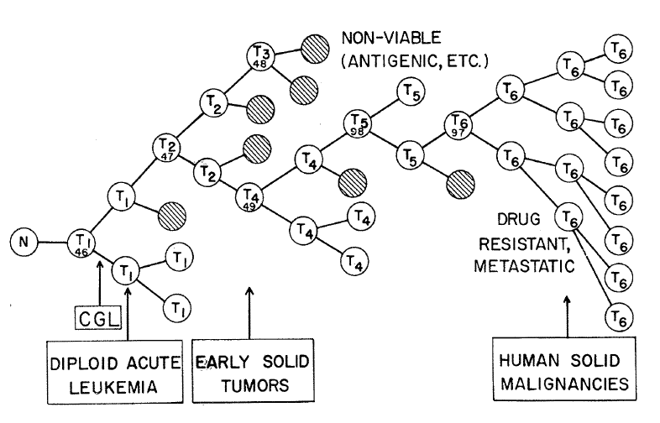
Genetic Heterogeneity – Past 2
A necessary consequence of human cell division.
The fuel of Peter Nowell’s clonal evolution model
Peter Nowell, Science 194:23 1976

Slide 28
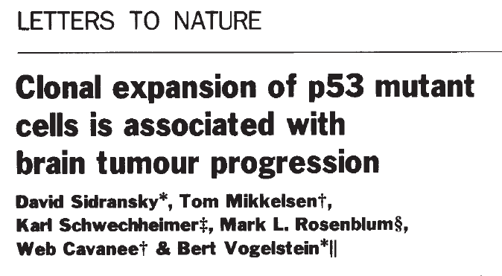
Genetic Heterogeneity – Past 3A
A necessary consequence of human cell division.
The fuel of Peter Nowell’s clonal evolution model
Experimental Demonstrations – TSGs
Sidransky et al., Nature 355:846 1992

Slide 29
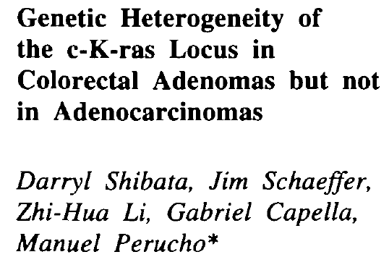
Genetic Heterogeneity – Past 3B
A necessary consequence of human cell division.
The fuel of Peter Nowell’s clonal evolution model
Experimental Demonstrations – Oncogenes
Shibata et al., JNCI 7:1058 1993

Slide 30
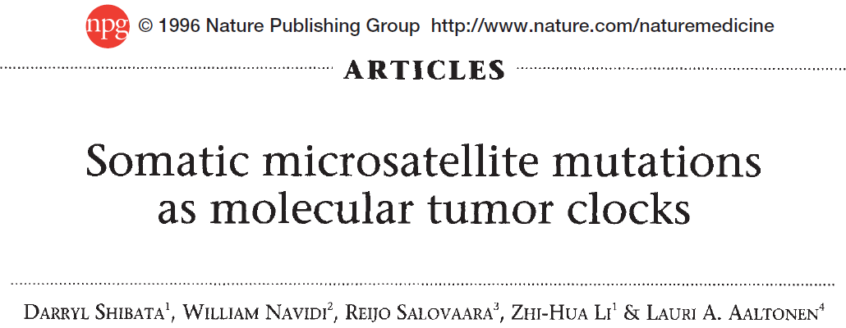
Genetic Heterogeneity – Past 3C
A necessary consequence of human cell division.
The fuel of Peter Nowell’s clonal evolution model
Experimental Demonstrations – Passengers
Shibata et al., Nat Med 2:676 1996

Slide 31
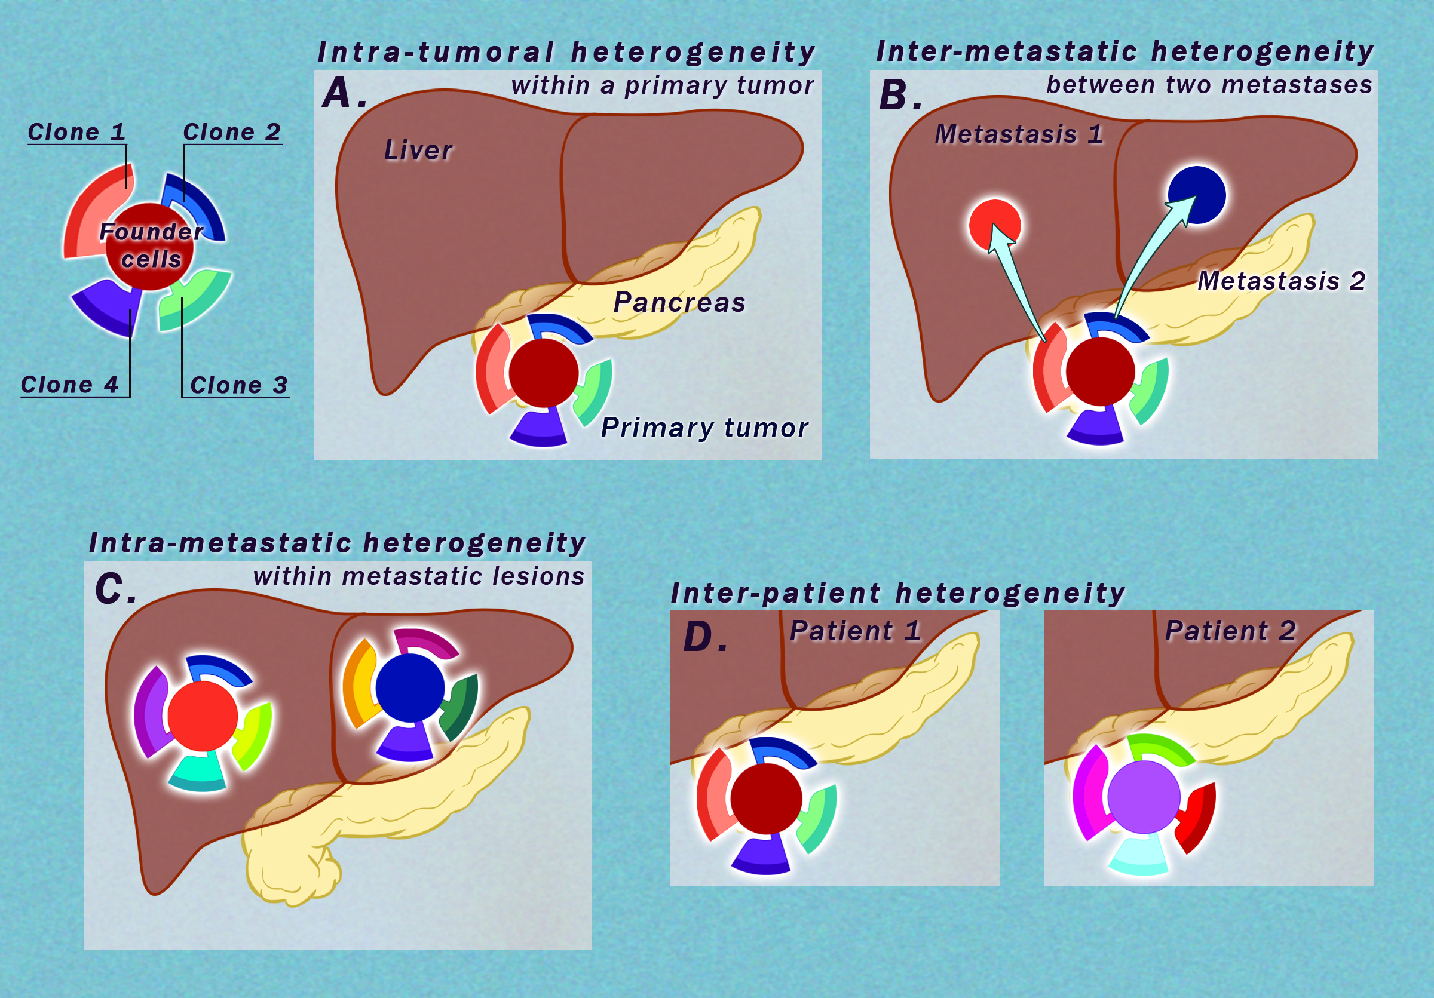
Four Types of Genetic Heterogeneity
Importance: LIMITED

Slide 32
Four Types of Genetic
Heterogeneity
Importance: LIMITED

Slide 33
Four Types of Genetic Heterogeneity
Importance: HIGH

Slide 34
Four Types of Genetic Heterogeneity
Importance: HIGH

