Slide 1
TAKING COLOGUARD FROM CONCEPT TO CLINIC AND BEYOND
Graham Lidgard, PhD
Tuesday Sept 10 2019

Slide 2


Our first mission:
to partner with patients, payers and providers to help eradicate colorectal cancer
EXACT SCIENCES
2

Slide 3
From Concept to Patient
Sales Team
Marketing Plan
Lab & IT Infrastructure
Guidelines
Reimbursement
FDA Approval
Commercialization
Clinical Trial
Product Development
Regulatory Approvals
Build Team
Research
Product Development
Clinical Need

Slide 4

Cancer is detected
too late
We are determined to use
our expertise and determination
to change lives by detecting
cancer earlier.
4

Slide 5
Colorectal cancer: America’s second deadliest cancer
51,020
Annual deaths

Slide 6
Detecting colorectal cancer early is critical
Diagnosed in Stages I or II
Diagnosed in Stage IV
9 of 10
1 of 10
Survive 5 years
Survive 5 years

Slide 7
CRC Screening Effective but Participation Suboptimal
80%
in Every Community
NCCRT CRC
screening goal^{2,}*
2012¹
2014¹
2016¹
NCCRT=National Colorectal Cancer Roundtable.
*The NCCRT has established the goal of 80% of adults ages ≥50 being regularly screened for CRC.³
CDC BRFSS Data for CRC Screening 2012 to 2016.
Working Toward the Shared Goal of 80% Screened for Colorectal Cancer by 2018. NCCRT website. http://nccrt.org/what-we-do/80-percent-by-2018/. Accessed February 5, 2019
Quick Facts: CRC Screening in US—Behavioral Risk Factor Surveillance System, 2016. CDC website. https://www.cdc.gov/cancer/colorectal/pdf/QuickFacts-BRFSS-2016-CRC-Screening-508.pdf. Accessed February 5, 2019..

Slide 8
Clinical Need
Choice
Increased non-invasive sensitivity
Patient Navigation

Slide 9
Research background
No one marker class can achieve desired sensitivity and specificity
Identify orthogonal markers that that have additive sensitivity without too much loss in specificity

Slide 10
Modeling Sensitivity/Specificity for Colon Cancer
Marker | Sensitivity | contribution | Additive Sensitivity | Specificity | Contribution to false pos | Subtractive Specificity
Actin, BMP3, NDRG4 | 70% | 70% | 70% | 98% | 2% | 98%
Hemoglobin | 70% | 21% | 91% | 94% | 6% | 92%
KRAS | 35% | 3% | 94% | 95% | 5% | 87%
BRAF | 6% | 0.4% | 94.4% | 98% | 2% | 85%
Cologuard |  |  | 92% |  |  | 87%

Slide 11
Methylation
  Identification of aberrant methylation as an early feature in pre-cancer and cancer
  In tissue small panel gives high sensitivity and specificity for cancer
  In body fluid and stool, normal background dilutes sensitivity to cancer
  Identified over 30 marker with high methylation on pre-cancer and cancer tissue and low background
  Test markers on over 500 normal and 100 cancer and pre-cancer stool samples
  Select smallest panel with maximum differentiation between normal and cancer
  Eliminate markers with age correlations in normal
  Panel with Sensitivity approx. 70% at 95-98% specificity

Slide 12
Mutations and Fecal Hemoglobin
  Identification of cancer mutations –databases and previous work
  Evaluation of individual mutation frequency
  Selection of highest frequency with smallest panel
  KRAS – 7 mutations with 30%-40% positivity
  Bleeding into colon well documented for colon cancer
  Porphyrin based assays
  Immunoassays
  Immuno-based have highest sensitivity
  Hb assay 60-70% sensitivity at > 93% specificity

Slide 13
Development
  Development collection devices, assays and platform
  Robust, capable of millions of tests per year
  Test combined assay on over 600 samples
  Complete Pilot manufacturing
  Algorithm setting study of approximately 1000 samples
  Locked algorithm
  DeeP-C clinical validation with 10,000 asymptomatic subjects

Slide 14
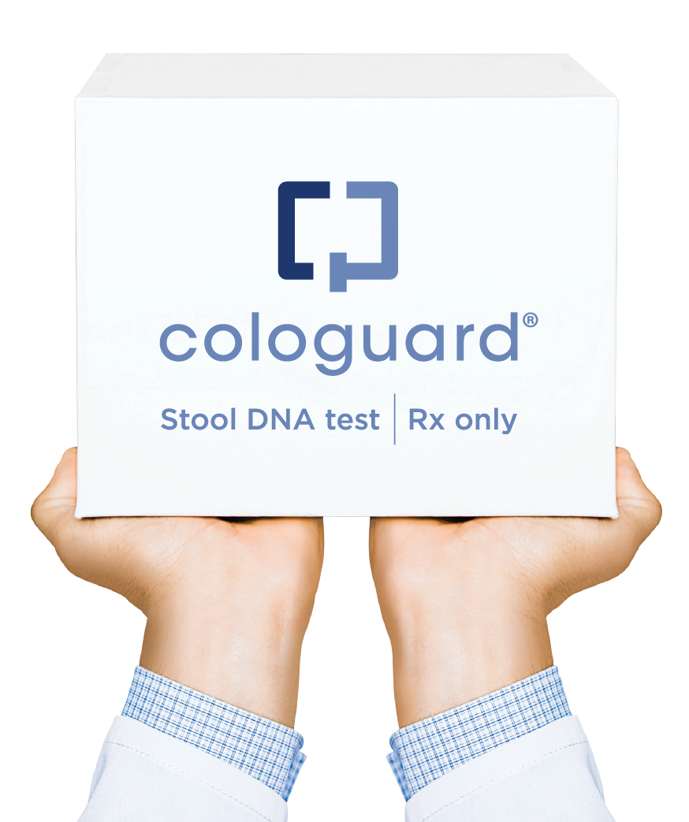

Cologuard: addressing the colorectal cancer challenge
94%
Early-stage cancer sensitivity*
Easy to use
Non-invasive
No preparation
No sedation
No time off work
24/7 customer support
For adults 50 years or older and at average risk
Developed with

Slide 15


Cologuard becoming standard of care
Additional coverage driven by data, guidelines, and quality measures
DeeP-C results published in NJEM
recommended by USPSTF
~90%
insurance
coverage
1M people screened
2M people screened
developed with Mayo Clinic
HEDIS®
quality measures
FDA approval
& CMS coverage
10,000 patient DeeP-C trial
Mayo Clinic Proceedings
reconfirmed performance
NCCN guidelines
CMS Medicare Star Ratings
ACS guidelines
2009-2013
2014
2015
2016
2017
2018
2019

Slide 16



Successful Screening Tests…
Address a defined Clinical Opportunity through:
Performance
Adherence
Access
Notes:
MJP 7.18

Slide 17
Offering Choice Increases Screening Rates
69%
“The common practice of universally recommending colonoscopy may reduce adherence to CRC screening,”
– Inadomi, et al 2012
38%
Source: Inadomi JM, Arch Intern Med (2012)
Notes:
MJP 7.18

Slide 18





Importance of CRC Screening Options
ACS 2018 Colorectal Cancer Screening Guidelines¹
US MSTF 2017 Colorectal Cancer Screening Recommendations²
USPSTF Colorectal Cancer Screening Recommendation 2016³
“An intervention as simple as offering a choice of screening test to improve uptake—as emphasized in this guideline—is expected to further the goal of improving screening rates and reducing the burden of suffering from CRC.”
We suggest that sequential offers of screening tests, offering multiple screening options, and risk-stratified screening are all reasonable approaches to offering screening.
“With this recommendation, the USPSTF acknowledges that there is no “one size fits all” approach to colorectal cancer screening and seeks to provide clinicians and patients with the best possible evidence about the various screening methods to enable informed, individual decision making.”
1. Andrew M.D. Wolf MD, Elizabeth T.H. Fontham MPH, DrPH, Timothy R. Church PhD, et al; for American Cancer Society. Colorectal cancer screening for average‐risk adults: 2018 guideline update from the American Cancer Society. CA, A Cancer Journal for Clinicians. 2018;68(4):250-281
2. Douglas K. Rex , MD, C. Richard Boland , MD, Jason A. Dominitz , MD, MHS, et al. Colorectal Cancer Screening: Recommendations for Physicians and Patients from the U.S. Multi-Society Task Force on Colorectal Cancer. American Journal of Gastroenterology.2017 112(7):1016–1030
3. Bibbins-Domingo K, Grossman DC, Curry SJ, et al; for US Preventive Services Task Force. Screening for colorectal cancer: US Preventive Services Task Force recommendation statement. JAMA. 2016;315(23):2564-2575

Slide 19

NCCRT &
ACS Highlight
Barriers to
CRC Screening
Rationalized avoidance
Lack of affordability
No symptoms or family history
Negative connotation
No doctor recommendation
No personal connection
Low levels of healthy behavior
Notes:
We checked this against the NCCRT/ACS communications guide and it is correct.

Slide 20






Performance characteristics of mt-sDNA
Strong
Sensitivity for Colorectal Cancer¹
Superior
Sensitivity to FIT for SSP¹
24/7 national support system
Strong for proximal colon¹
Home delivery
1. Imperiale TF et al., N Engl J Med (2014)
Notes:
As per Sandi – changed Stage I-II to ‘colorectal cancer’
Delineated the points from Imperiale with footnote

Slide 21






Impact of patient navigation service on compliance
Phone Calls
Letters
24/7 Support
Emails
Texts
FIT/FOBT¹
Colonoscopy²
Notes:
Cologuard is helping screen previously unscreened populations because it is a complete solution
- A highly sensitive test AND a patient compliance program that helps take weight off providers

Slide 22

Improving access to Cologuard
Make a version of previous slide
94%
Of Cologuard patients have no out-of-pocket cost*
In-network contracts include:

Slide 23


Cologuard Enhances Diagnostic Yield and Quality of Subsequent Colonoscopy
+
Source: Johnson DH et al., Gastrointest Endosc (2017)
Notes:
MJP 7.18

Slide 24

Cologuard Enhances Diagnostic Yield and Quality of Subsequent Colonoscopy
19
Increased Time to Colonscope Withdrawal
13
Source: Johnson DH et al., Gastrointest Endosc (2017)
Notes:
MJP 7.18

Slide 25

Impact of Cologuard
2.6M
People screened since launch
12K
84K
Early-stage cancers detected
Pre-cancerous polyps detected

Slide 26
Increasing America’s screening population
Screening history of Cologuard users
48%
never screened before
Screening history of Cologuard users: Exact Sciences Laboratories patient satisfaction survey, Oct. 2017-Sep. 2018, n = 5,377
Note: excludes prior users of Cologuard

Slide 27

Advance Liquid Biopsy

Slide 28
Liquid biopsy: a growth area for cancer diagnostics
Exact Sciences focusing on early detection and recurrence
Hereditary testing
Screening
Diagnosis
Recurrence
monitoring
Therapy
selection
Response
monitoring

Slide 29
Biomarker discovery across 15 cancers
Lung
Uterine
Ovarian
Breast
Liver
Kidney
Bladder
Cervical
Esophageal
Stomach
Pancreatic
New
cancer test
development
Prostate
Colorectal
Melanoma
Lymphoma

Slide 30



Proven partnership
10-year collaboration with Mayo Clinic
Biomarker discovery & validation
Access to samples & clinical trials
Leading researchers & clinicians
Liquid biopsy for top 15 cancers

Slide 31
Lessons Learned
Case control samples are not the same as prospective samples
You can never have enough samples
Understand where your samples come from and how they were diagnosed and collected
For Biomarkers that are products of the tumor – concentration in body fluids correlate with tumor mass
Distribution of tumor stage and mass varies by population screened
The greater the number of markers you have the greater the chance of overfitting

Slide 32

DETECTING CANCER EARLIER, WHEN
IT MATTERS MOST.

Slide 33
Acknowledgements
Mayo Clinic
All the Clinical Collaborators
for Cologuard clinical studies
Exact Employees
Patients

Slide 34
THANK YOU

Slide 35

Notes:
Thank you.

