Slide 1
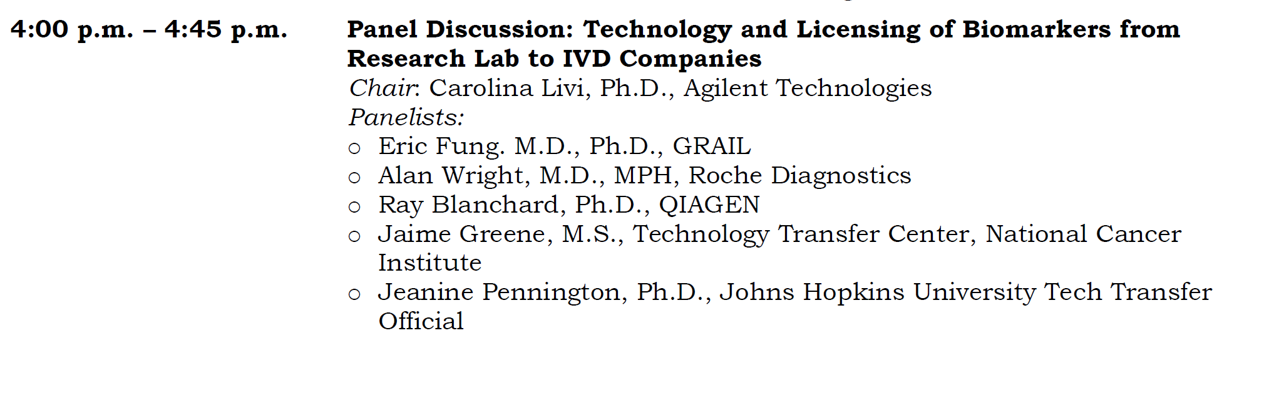

Slide 2
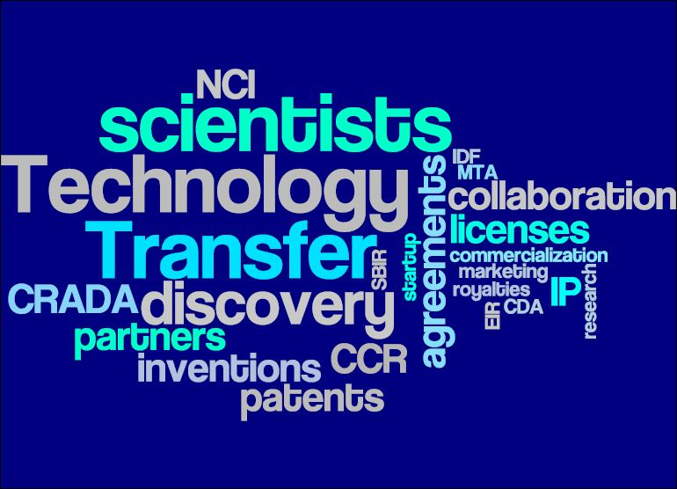
EDRN and the NCI Technology
Transfer Center
September 9, 2016
Jaime M. Greene, M.S.
NCI Technology Transfer Center

Slide 3
Background: NCI Technology Transfer Center (TTC)
Technology transfer office for all NCI intramural laboratories and some extramural programs
Also a service center for 9 smaller NIH institutes and centers
Mission: To enable and guide collaboration, invention development, and licensing to advance today's discoveries into tomorrow's medical care

Slide 4
NCI TTC and EDRN
In accordance with the Bayh-Dole Act and its implementing regulations, NCI-funded institutions
  Retain IP rights to inventions of EDRN investigators
  Independently negotiate licenses for IP rights generated under the funding agreement
How NCI TTC facilitates EDRN activities
  Confidentiality Agreements
  Material Transfer Agreements
  Collaborations

Slide 5
NCI TTC and EDRN
NCI TTC
  Licenses NCI and service center IC-generated Intellectual Property (IP)
  Can manage and license government-funded IP only when the institution opts to waive its rights back to the government (iEdison)

Slide 6
Licensing at NCI
TTC Licenses Patented and Unpatented inventions
  Unpatented
    Biological Materials
  Patented
    Non-exclusive
    Exclusive
  Both
    Commercial Evaluation
    Inter-Institutional Agreements

Slide 7
Exclusive Licensing at NCI
Commercial development plan must meet the requirements of 37 CFR 404.7
  Exclusive licensing serves the best interests of the public;
  Practical application of the invention is not likely to be achieved under a nonexclusive license;
  An exclusive or partially exclusive license is a reasonable and necessary incentive to promote the investment of risk capital to bring the invention to practical application;
  Exclusive or partially exclusive license terms and conditions are not broader than necessary;
  Exclusive licensing will not lessen competition;
  Preference for "equally as likely" small business.
Because of the high bar, diagnostic/biomarker technologies are not typically eligible for exclusive licensing
Exceptions are made if there are extra regulatory hurdles, for example if the company intends to seek FDA review and clearance/granting/approval for the test

Slide 8
Diagnostic Technologies
Diagnostics Technologies
  NCI Technology Transfer Center has approximately 110 technologies classified as diagnostics
    Out of ~863 total active technologies
  Not all are biomarkers

Slide 9
Diagnostic/Biomarker
Licensing Challenges
E-215-2008 Gene Expression Signature of Genomic Instability in Breast Cancer
  Typical genetic biomarker technology
  An optional set of twelve genes that links changes in gene expression level to genomic instability in breast tissue as a indication of prognosis
  Licensed to MPEG, LA, but never commercialized
E-025-2009 Ratio Based Biomarkers for the Prediction of Cancer Survival
  Clever use of a ratio of biomarkers to predict cancer prognosis/survival
  This is being challenged heavily at the USPTO, and because it’s been limited to specific biomarkers, rather than to the method, it’s been difficult to attract commercial interest
Changes in 101 case law have also negatively impacted our ability to protect genetic biomarkers tests

Slide 10
Diagnostic Biomarker
Licensing Successes
Typically, diagnostics fields of use that are successfully licensed are in combination with therapeutics
Exceptions are biomarker-based diagnostic tests that give a clear positive/negative result, such as:
  HIV diagnostic tests
  BRCA gene mutation tests
  Dihydropyrimidine dehydrogenase (DPD), enzyme involved in pyrimidine degradation, deficiency test to determine if 5-FU treatment is appropriate

Slide 11
Contact Information
Jaime M. Greene, M.S.
Senior Technology Transfer Manager
greenejaime@mail.nih.gov
9609 Medical Center Drive, Rm 3W-132
Rockville, MD 20852
240-276-6633

Slide 12
ERDN Meeting – September 9, 2019

Slide 13
Our mission statement
The Johns Hopkins Technology Ventures’ mission is to maximize the impact of JHU excellence in research by facilitating the translation and commercialization of discoveries into accessible technologies, products, and services for the benefit of society.

Slide 14

JHTV is organized to support all paths to commercialization
Tech Transfer
Corporate Partnerships
Research
↓
Invention
↓
License
Industry Relationship
↓
Industry-Sponsored Research
↓
Invention
↓
License
Invention
↓
Business Idea
↓
Startup
↓
License
Discoveries become products in the market
Notes:
So how does JHTV manage these processes?
Three key divisions.

Slide 15
JHTV FY18 results: Tech Transfer

Slide 16

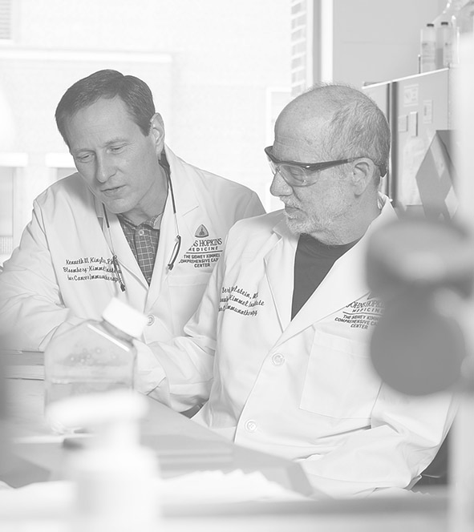
Commercial Success Story: Thrive
Cancer
Screening
Founded in 2017 by three Hopkins researchers
Developed a single lab test that screens for 8 common cancer types - CancerSEEK
Marcus Foundation is funding a $50 million 5-year study in collaboration with Geisenger Health
Lab located on Hopkins East Baltimore campus
Raised $110M in Series A funding - Third Rock Ventures lead syndicate
Baltimore & Boston
25
jobs

Slide 17

Commercial Success Story: PGDx
Cancer
Genomics
Founded in 2010 by two Hopkins researchers in cancer genomics
Simplifying testing so that early, treatment informing genetic testing becomes truly accessible in labs throughout the world
Initially located on Hopkins East Baltimore campus, now located in Canton, MD
Total equity funding in excess of $100M
Canton
300
jobs

Slide 18
Stay connected with JHTV wherever you are
Twitter
Facebook
@JHTechVentures
@JohnsHopkins
TechnologyVentures
ventures.jhu.edu
Newsletter
Subscribe
tiny.cc/o7sgvy
LinkedIn
Join Us
www.linkedin.com/
groups/2460244
JHTV News
View
ventures.jhu.edu/news/

Slide 19
Thank you!
Jeanine Pennington
jpennin5@jhu.edu
410-614-0679

