Slide 1
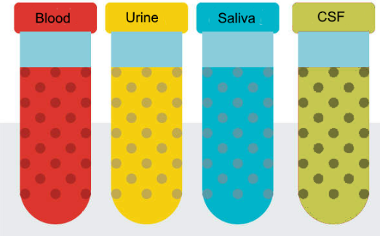
Johns Hopkins
MGH
MGH
U Miami
UCLA
Yale

Slide 2
11th EDRN Scientific Workshop
Bethesda MD
September 11, 2019
Advances In Liquid Biopsies
NCI-Liquid Biopsy Consortium (NLBC)
Precompetitive Collaboration on Liquid Biopsy for Early Cancer Assessment (U01)
S

Slide 3
David Wong is consultant to GlaxoSmithKlein, Wrigley, Absolutys and Colgate-Palmolive
S

Slide 4
S

Slide 5


Bob S. Carter MD, PhD,
Advancing Liquid Biopsy for Glioma Patients
Professor of Neurosurgery
Massachusetts General Hospital
Boston, MA
Notes:
Optimization of liquid biopsy assays of the IDH1.R132H and EGFRvlll mutations for the early detection of gliomas prior to surgical/therapeutic intervention, validation of the sensitivity and specificity of the assay developed in Aim 1 in initial patient cohorts, and performance of CLIA validation of the final assay.

Slide 6
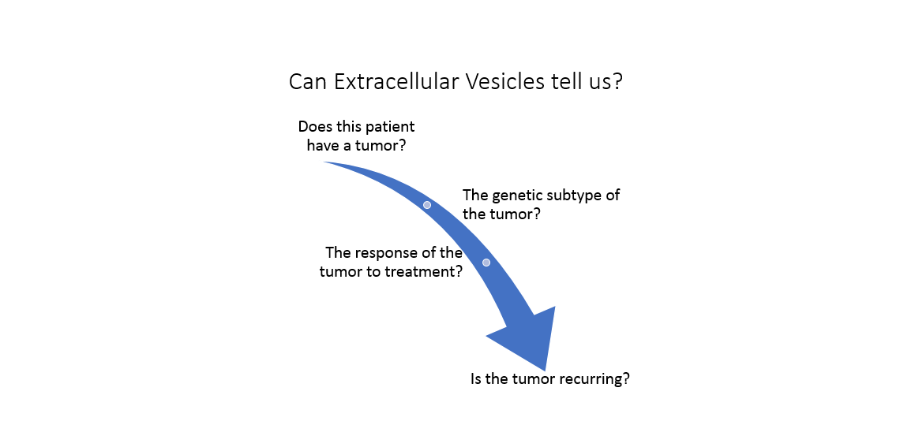
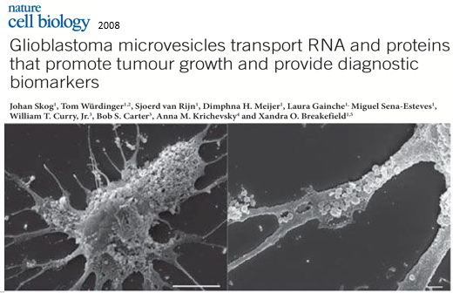
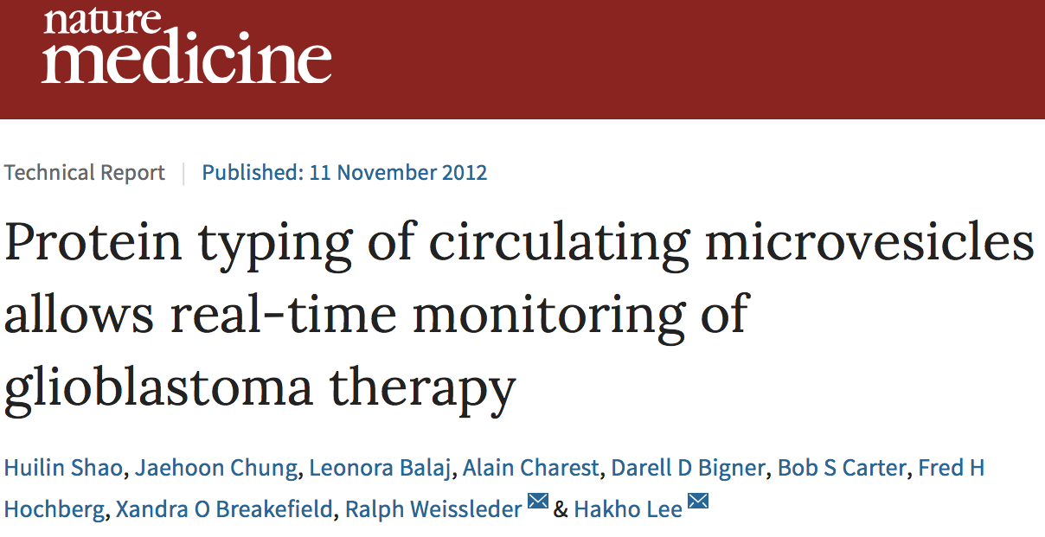
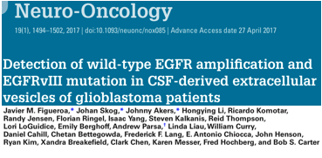
Extracellular Vesicles as biomarkers for Gliomas
Notes:
Optimization of liquid biopsy assays of the IDH1.R132H and EGFRvlll mutations for the early detection of gliomas prior to surgical/therapeutic intervention, validation of the sensitivity and specificity of the assay developed in Aim 1 in initial patient cohorts, and performance of CLIA validation of the final assay.

Slide 7



A Comprehensive Liquid Biopsy Platform for
Detection and Prognostication in
Early Stage Breast Cancer
Dr. Richard J. Cote
Dr. Ashutosh Agarwal
Dr. Sid Rawal
Dr. Susan Kesmodel
Dr. Steven Chen
Dr. Changhuei Yang
Dr. Dorraya El-Ashry
Dr. Richard J. Cote
Dr. Sid Rawal
Dr. Philip Nelson
Notes:
Developing and validating platforms for capturing, enumerating and analyzing circulating tumor cells (CTCs) and associated cancer fibroblasts (CAF) from blood in patients with early stage cancer, acquiring CTC/CAF images using FPM (Fourier ptychographic microscope) and evaluate the images with a deep learning algorithm, and utilizing the data to predict recurrence/survival in early stage breast cancer patients

Slide 8
Notes:
Developing and validating platforms for capturing, enumerating and analyzing circulating tumor cells (CTCs) and associated cancer fibroblasts (CAF) from blood in patients with early stage cancer, acquiring CTC/CAF images using FPM (Fourier ptychographic microscope) and evaluate the images with a deep learning algorithm, and utilizing the data to predict recurrence/survival in early stage breast cancer patients

Slide 9
Notes:
Addresses the technical challenges in extracellular vesicle (EV) analyses, rigorously evaluate EVs’ clinical value for early detection of ovarian cancer through the OCEAN system (Ovarian Cancer Exosomal Analysis with Nanoplasmonics), and establish standard methodology for total EV isolation and enrichment
Screen EVs from novel genetically engineered mouse models that closely mimic human ovarian cancer pathology

Slide 10
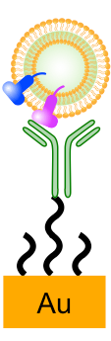
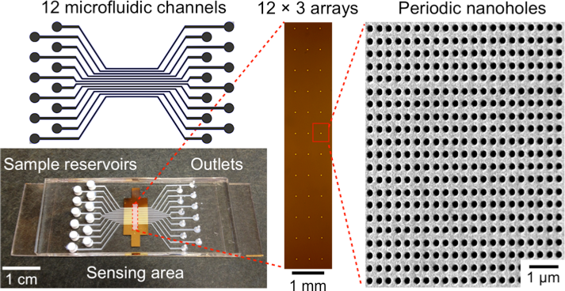
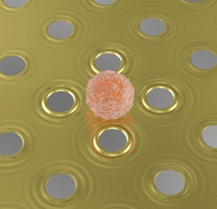
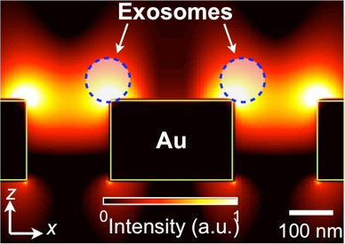
nPLEX detection is ideally suited for EV profiling.
500 nm
Label-free detection
Sensing range comparable to EV size
Potential for high throughput detection
Nat Biotechnol 32:490 (2014)
z
x
Notes:
Addresses the technical challenges in extracellular vesicle (EV) analyses, rigorously evaluate EVs’ clinical value for early detection of ovarian cancer through the OCEAN system (Ovarian Cancer Exosomal Analysis with Nanoplasmonics), and establish standard methodology for total EV isolation and enrichment
Screen EVs from novel genetically engineered mouse models that closely mimic human ovarian cancer pathology

Slide 11


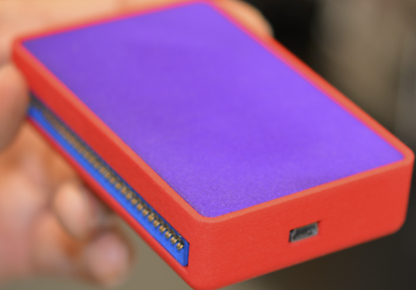
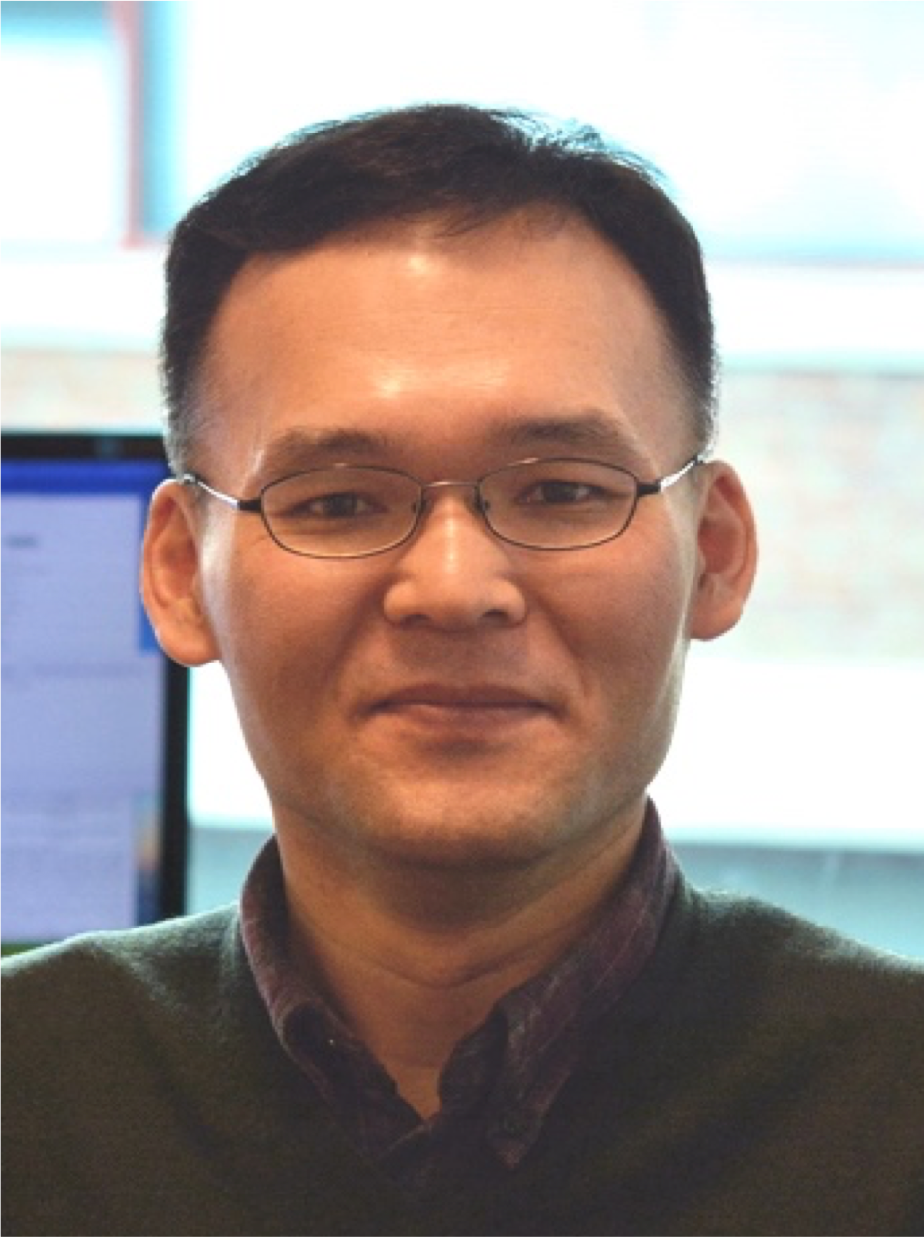
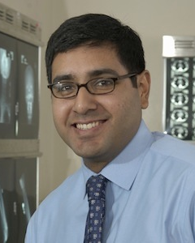
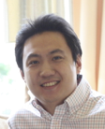
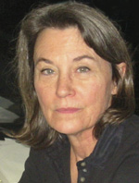




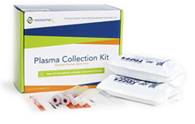

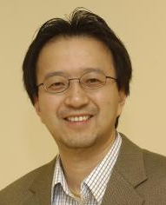


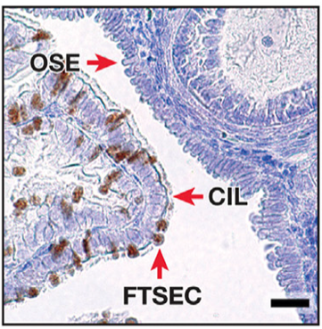
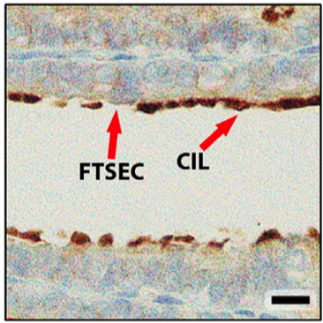
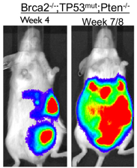

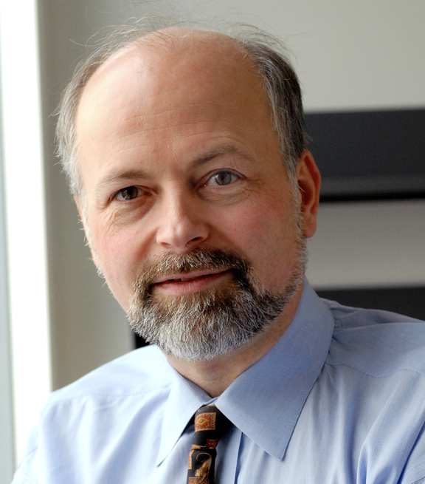


We formed a powerful academia-industry team.
Massachusetts General Hospital
Center for Systems Biology
Novel EV-biosensors and clinical applications
Site PIs: Lee and Castro
Lee
Castro
Im
Breakefield
Zheng
Industry leader in EV liquid biopsy
Site PI: Skog
Skog
Yu
Roberts
Division of Women’s and
Perinatal Pathology
Novel animal model for ovarian cancer
Site PI: Dinulescu
Advisory Committee
Dinulescu
Weissleder
Spriggs
Crum
Notes:
Addresses the technical challenges in extracellular vesicle (EV) analyses, rigorously evaluate EVs’ clinical value for early detection of ovarian cancer through the OCEAN system (Ovarian Cancer Exosomal Analysis with Nanoplasmonics), and establish standard methodology for total EV isolation and enrichment
Screen EVs from novel genetically engineered mouse models that closely mimic human ovarian cancer pathology

Slide 12
Lung Cancer Screening via Ultrasensitive and Cost-efficient Analysis of Tumor DNA Signatures in Blood
Abhi Patel, MD, PhD
Yale University,
New Haven, CT
Steven Skates, PhD
MGH/Harvard,
Boston, MA
David Zhang, PhD
Rice University, Houston, TX
Andrew Phillips, PhD
Microsoft Research, Cambridge, UK
Notes:
Optimizing an NGS-based ctDNA assay with rigorous error suppression, high-yield library conversion, and broad coverage of genomic alterations found in early-stage lung cancer and integrating methods to deplete wild-type molecules from sequencing libraries to reduce NGS costs
Developing and training a machine learning algorithm to distinguish individuals with early-stage lung cancer from heavy smokers without cancer based on analysis of genomic alterations in cell-free DNA

Slide 13
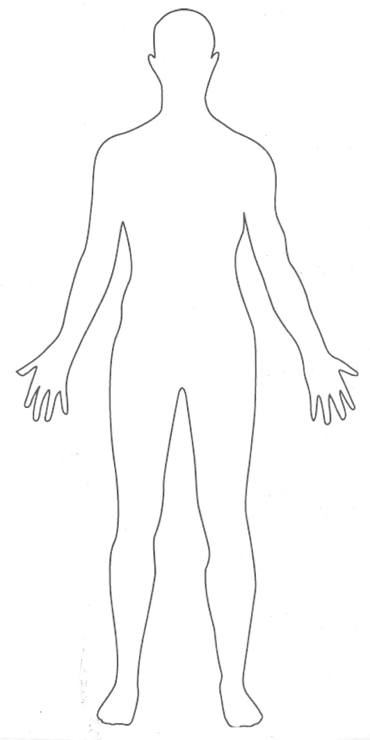

Promise of ctDNA for Early Detection in an asymptomatic general population
Most protein biomarkers:
Circulating tumor DNA:
tumor-derived
All tumor-derived
background
Near-zero physiologic background

Slide 14
Project Aims
Optimize an NGS-based ctDNA assay with:
  rigorous error suppression
  high-yield library conversion
  broad coverage of genomic alterations
2. Develop and train a machine learning algorithm to distinguish individuals with early-stage lung cancer from heavy smokers without cancer.
Evaluate assay performance on:
  patients with known early-stage lung cancer
  subjects undergoing CT-based lung cancer screening

Slide 15
Earlier Detection of Cancer Using Non-Plasma Based Liquid Biopsies
Nick Papadopoulos and Chetan Bettegowda
Johns Hopkins School of Medicine
Overall goal
To develop minimally invasive tests in body fluids for the earlier detection of cancer.
A combination of aneuploidy and a well curated gene panel should be an efficient set of biomarkers
Clinical Need and Focus of the proposal
CSF for the detection of CNS tumors
Saliva for the detection of Head & Neck cancers
Stool for early stage cancer and adenomas
Notes:
Optimizing a set of genetic markers for aneuploidy and somatic mutations, to be used in a test for the detection of rtDNA (release tumor DNA) in CSF, saliva and stool.
Analysis of the biofluids of individuals with pre-malignant and malignant lesions will be performed to achieve high sensitivity for detecting the specific tumor types in concert with CLIA

Slide 16
Rational for Non-plasma based liquid biopsies
Plasma:
  Advantages:
    Universal body fluid for detecting cancer
    Easily obtainable sample with great compliance
  Disadvantages:
    Not all tumor types, especially early stage tumors, “shed” their DNA in the circulation
    Stochastic events due to limited molecules and to small amount of sample
Other fluids:
  Advantages:
    Provide opportunity for early detection of tumor-types not easily detectable in plasma
    Higher nuclei acid yield – use of both the liquid and the cell fraction of the sample
    Ideal for special clinical needs (target in this application) and high risk groups
  Disadvantages:
    In same cases obtaining the fluid is more invasive
    Not universal

Slide 17
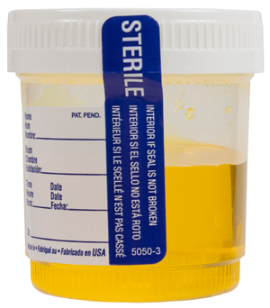
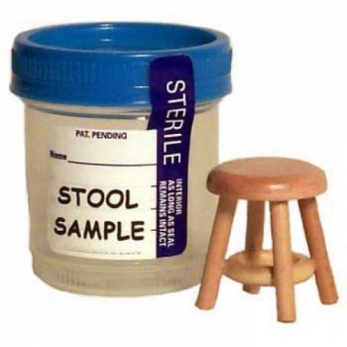
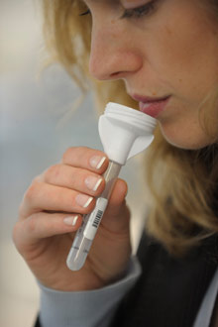
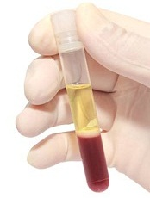
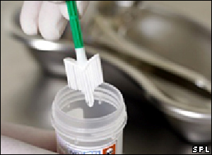
Future of Screening – Combinations of Analytes and Fluids
Multi-Analyte
Assays

Slide 18
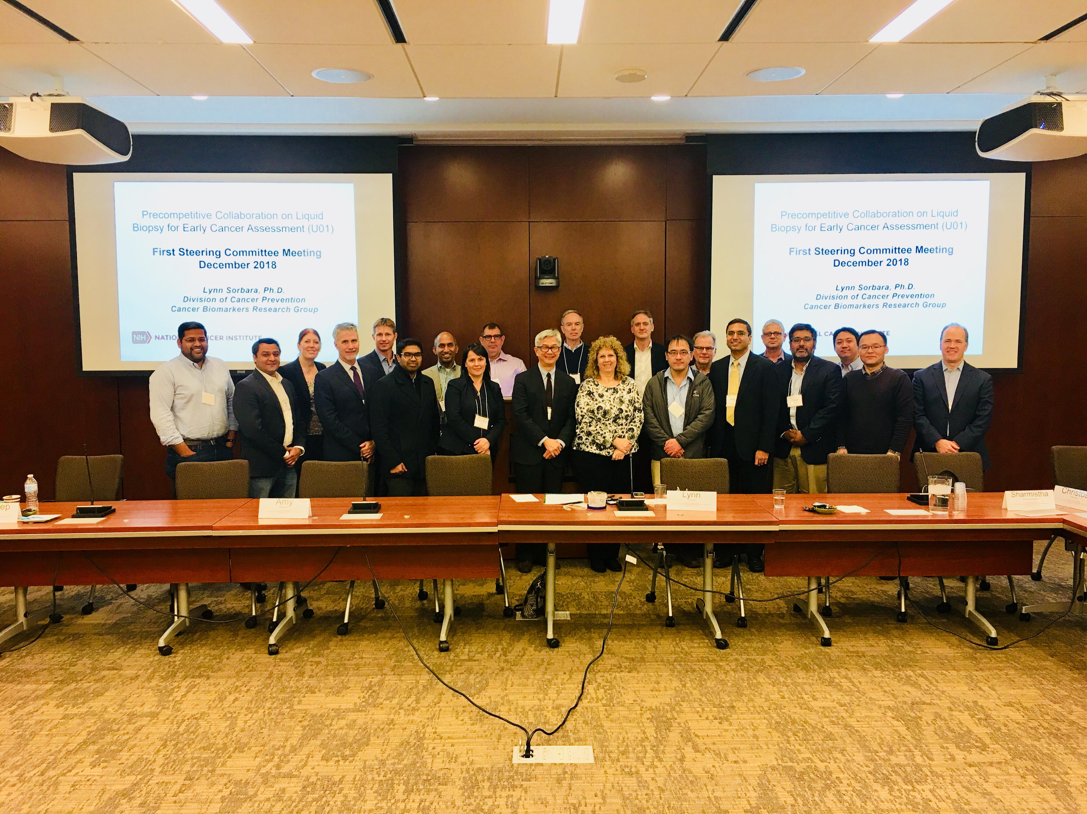

Slide 19
EFIRM Liquid Biopsy (eLB):
Malignancy Assessment in Indeterminate Pulmonary Nodules (IPN)
S
UCLA

Slide 20
Notes:
PSN= Part-Solid Nodule; GGN= Ground Glass Nodule
The overall objective for this Aim is to develop diagnostic models for discriminating patients with malignant vs. benign indeterminate pulmonary nodules. The “locked down” models developed here will then be directly tested the validation subjects. The plan for sample allocation will be to use stratified random sampling to choose approximately 2/3 of each of the cohorts for model building in this and use the remainder for model testing. The sampling will be stratified by diagnosis to ensure that the model building and validation sets are balanced. Using logistic regression, we will build 1) a model that includes clinical and imaging factors alone (C), 2) a model with molecular features alone and 3) the clinical features together with the ctDNA and miRNA features. The clinical factors will be operationalized using either the NLST model (preliminary data), Gould model or the McWilliams model (21).
Our overall research proposition in this consortium is that blood-based biomarkers using the eLB-LCDP platform will inform the classification of nodules as benign or malignant. We will be able to compare eLB-LCDP with other lung cancer-associated liquid biopsy platforms to be developed in this consortium as well as within the EDRN and MCL consortia to determine the highest performing biomarkers and platforms that can move to clinical translation, whether alone, in combination, or as part of models that exploit clinical and imaging variables routinely acquired as part of patient management.
The broad, unmet need for early diagnosis is the lack of an inexpensive test that can be applied at the point-of-care to individuals with screen- or incidentally-detected lung nodules to discriminate between nodules that are malignant or benign.
To be both effective and cost-effective, such testing must involve readily accessible biospecimens, should inform the biology of the IPN, and could be used either independently or in integrated models with other clinical and imaging data to differentiate benign from malignant lesions. Indeed, there is growing recognition that risk-based mathematical models outperform current rule-based approaches to determine who should be screened (19, 20) as well as which patients with IPNs have high risk of lung cancer (21). The performance of such models in discriminating between benign and malignant nodules could be dramatically improved by the incorporation of molecular-based biomarkers of lung cancer. Combined, multiparametric modeling is one aim of our research plan.

Slide 21
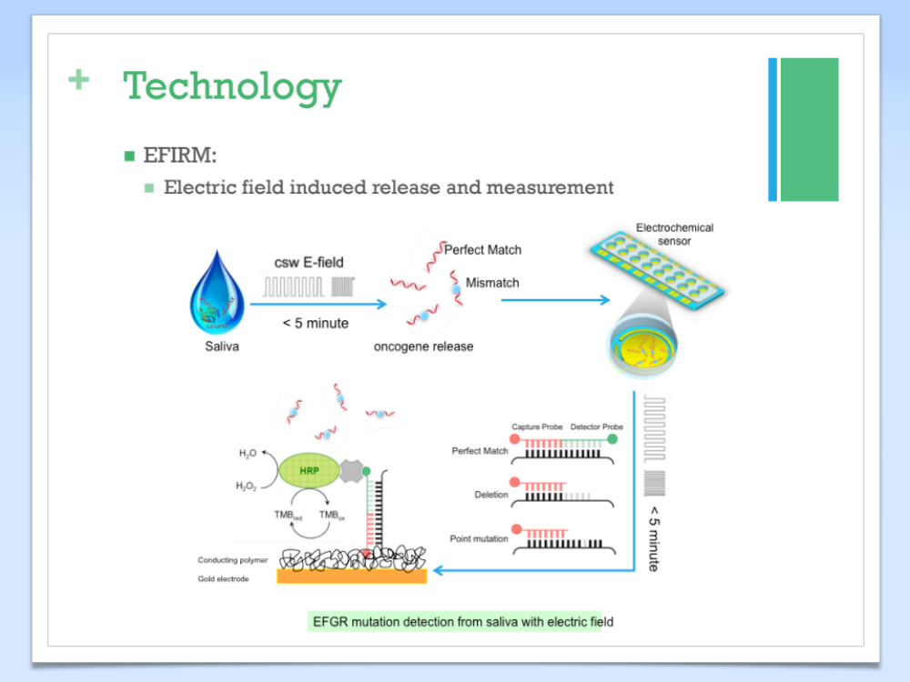
1
Plasma/ Saliva
2
3
Wei F, Lin CC, Joon A, Feng Z, Troche G, Lira ME, Chia D, Mao M, Ho CL, Su WC, Wong DT. Noninvasive saliva-based EGFR gene mutation detection in patients with lung cancer. Am J Respir Crit Care Med. 2014;190(10):1117-26. doi: 10.1164/rccm.201406-1003OC. PubMed PMID: 25317990.

Slide 22
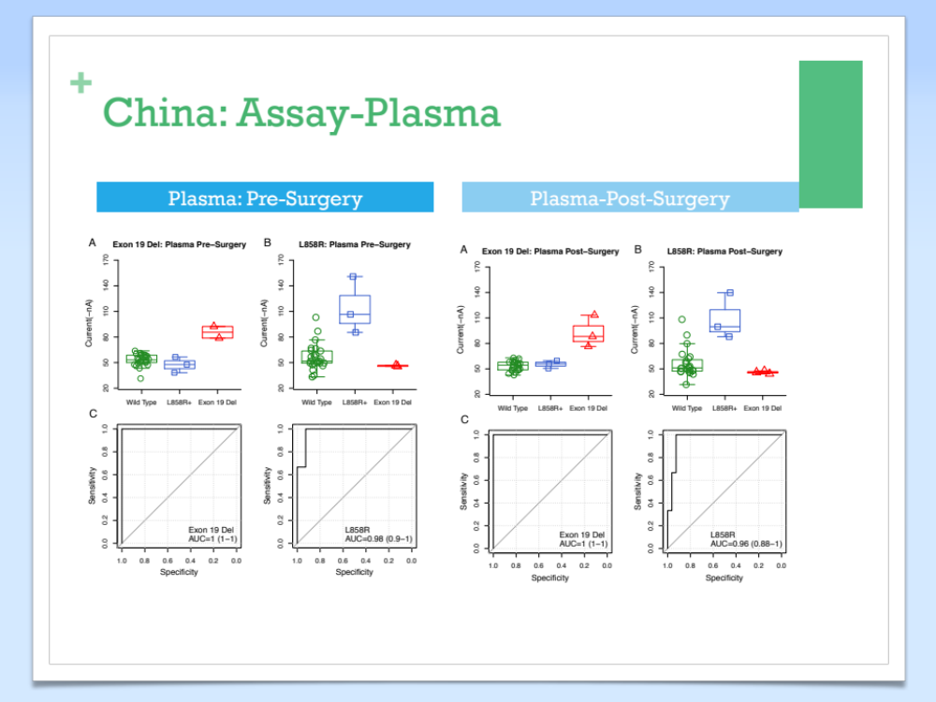
Wei F, Lin CC, Joon A, Feng Z, Troche G, Lira ME, Chia D, Mao M, Ho CL, Su WC, Wong DT. Noninvasive saliva-based EGFR gene mutation detection in patients with lung cancer. Am J Respir Crit Care Med. 2014;190(10):1117-26. doi: 10.1164/rccm.201406-1003OC. PubMed PMID: 25317990.

Slide 23
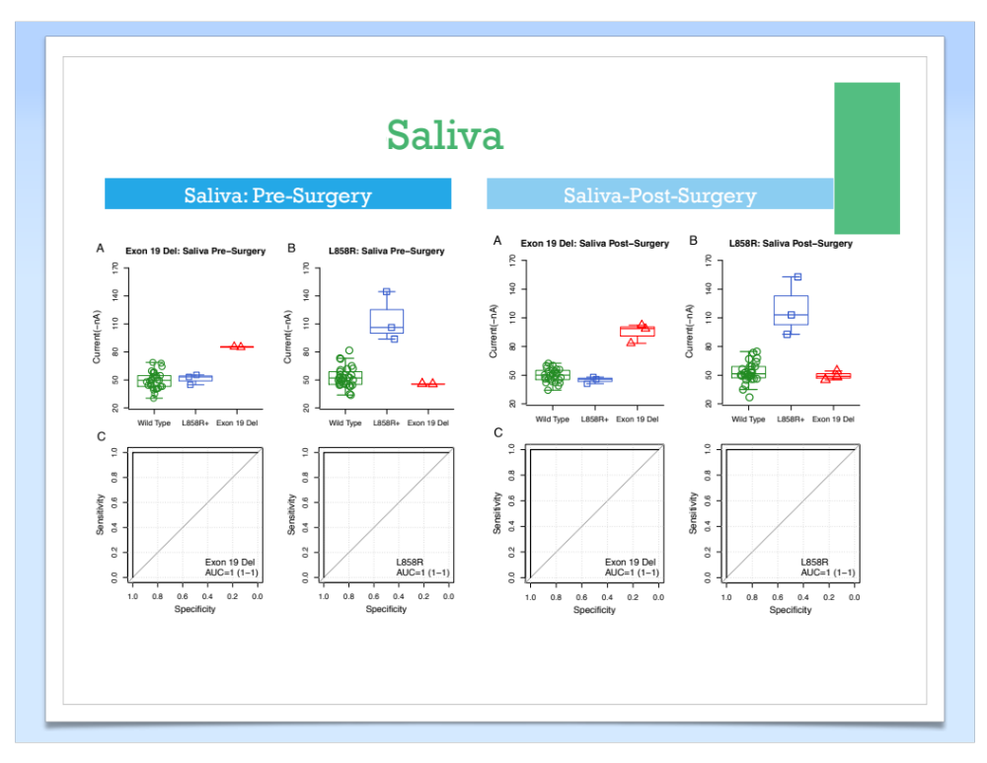
Wei F, Lin CC, Joon A, Feng Z, Troche G, Lira ME, Chia D, Mao M, Ho CL, Su WC, Wong DT. Noninvasive saliva-based EGFR gene mutation detection in patients with lung cancer. Am J Respir Crit Care Med. 2014;190(10):1117-26. doi: 10.1164/rccm.201406-1003OC. PubMed PMID: 25317990.

Slide 24
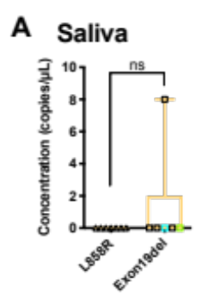
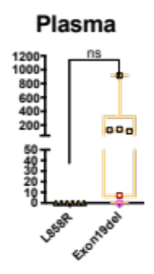
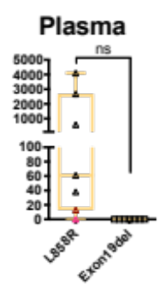
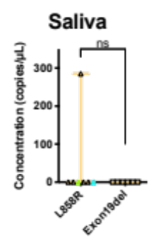
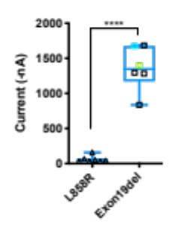
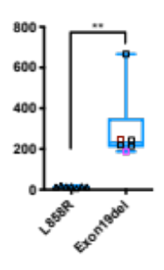
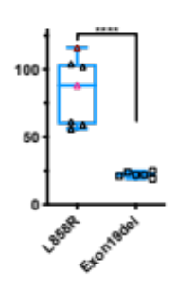
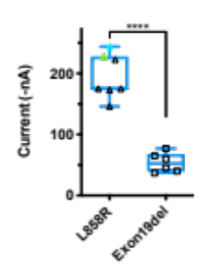
Detection of EGFR ctDNAs in NSCLC Plasma and Saliva with ddPCR and EFIRM
ddPCR
ddPCR
ddPCR
ddPCR
1/6= 17%
5/6= 83%
5/7= 71%
1/7= 14%
EFIRM
EFIRM
EFIRM
EFIRM
6/6= 100%
6/6= 100%
7/7= 100%
7/7= 100%
Ex19del assays
L858R assays

Slide 25
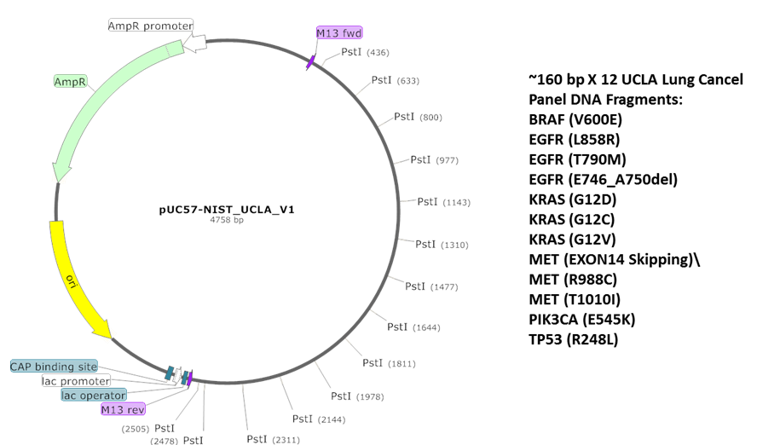
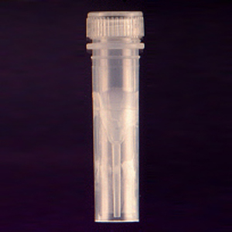

Produce Mixtures for Candidate Lung Cancer Panel Reference Materials
Restriction Enzyme
Plasmid Sequence
Synthetic Plasmid
Calibrator test mixtures
Nuclease
Mix at desired ratios
and concentrations
GM24385
Size from 100 to 200 bp
Fragmented genomic DNA
Hua-Jun He PhD and Kent Cole PhD

Slide 26
Notes:
Figure 1. The EFIRM liquid biopsy (eLB) assay is fragment length and “heat-shock” dependent. NIST samples of various fragment sizes (50, 100, 160bp) and concentrations (0.02, 0.0066, 0.00067ng/uL) were analyzed with the eLB T790M assay without (A) and with (B) ”heat-shock” treatment (two cycles of temperature incubation @95ºC for 5 mins then @4ºC for 5 mins). The heat-shock treatment is designed to denature dsDNA targets into ssDNA targets. A) Without heat-denaturation, the sensitivity of the eLB assay shows poor differentiation amongst concentrations. Compared to the larger fragment sizes, the 50bp NIST target demonstrates the best titratability. B) With heat-shock, the signal intensity and sensitivity of the eLB assay is vastly improved compared to non-heat-shocked samples and all three fragment sizes are titratable. The 50bp fragment remains the target with the best sensitivity. The observation that eLB is enhanced by prior heat-shock of samples suggests that eLB assay “prefers” ssDNA targets over dsDNA targets. Interestingly, non-heat-denatured 50bp NIST target is still detectable by eLB without heat-shock and even shows good sensitivity at higher concentrations. Additionally, a shorter fragment size target is associated with greater eLB assay signal intensity/sensitivity which is indicative of length-dependent affinity to the 14bp-eLB capture probe.

Slide 27
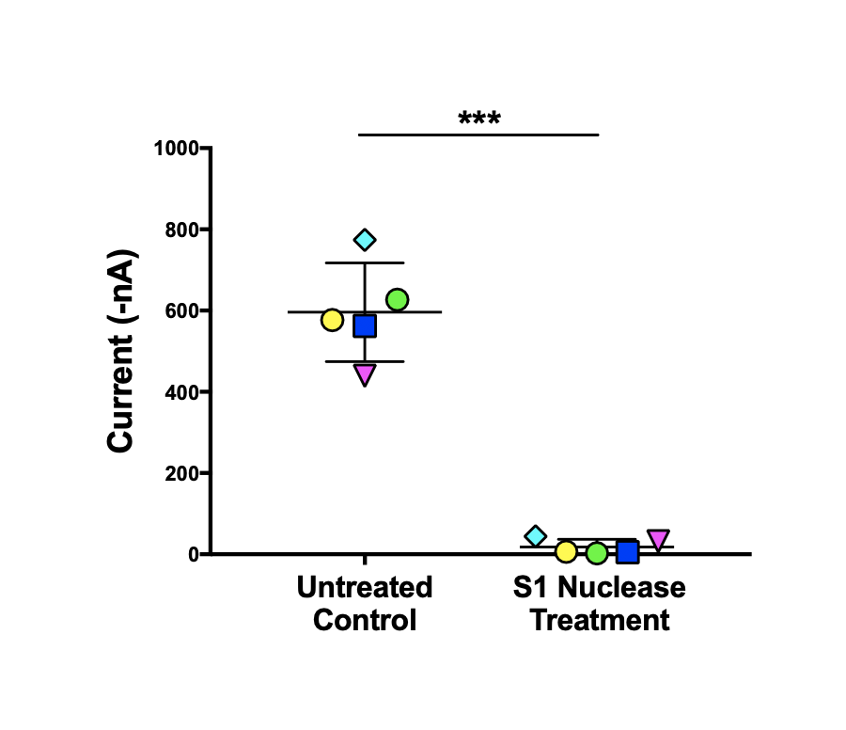
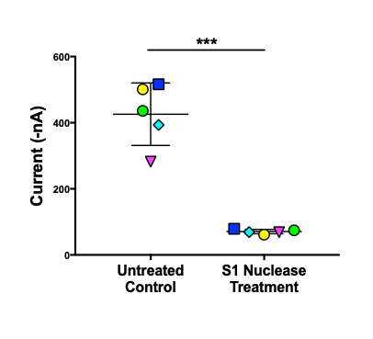
S1 Nuclease/ Exo VII
T790M
L858R

Slide 28
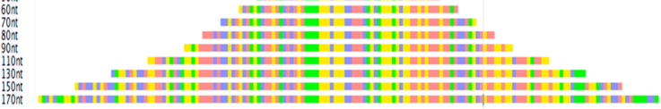
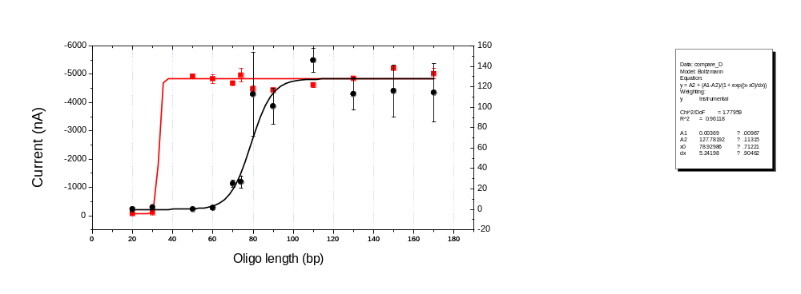
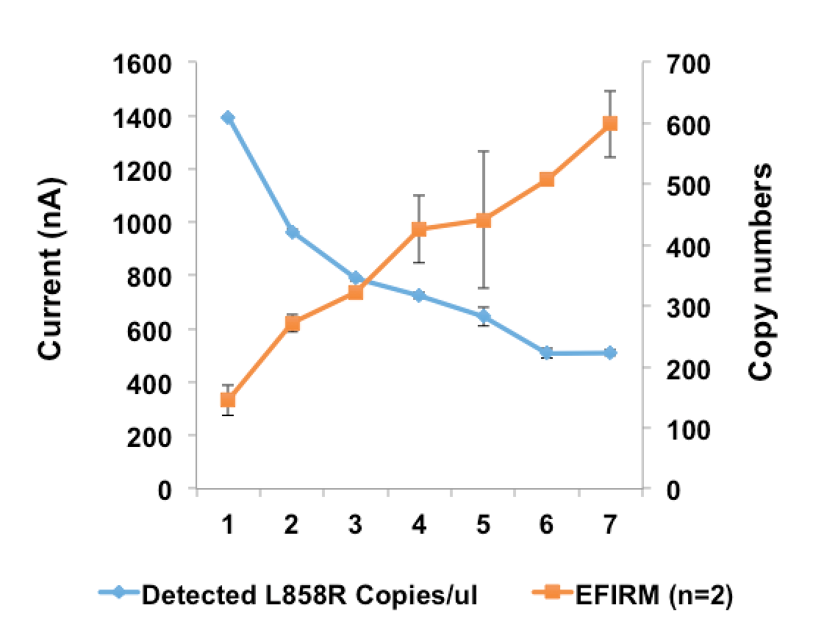
Size dependency of EFIRM and ddPCR platforms
A
C
# of shearing cycles
150 bp
100 bp
50 bp
B
D
EFIRM
ddPCR
Figure 2

Slide 29
EFIRM signal
EFIRM signal
Affinity
Conductance
Ultra short fragment(uctDNA) favorable (< 80 bp)
Enhanced electron transfer for uctDNA
Sensitivity
LOD: <10 cps
HRP/TMB-based
electron amplification
Surface hybridization
Electron transfer efficiency

Slide 30
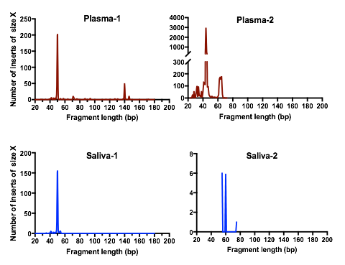
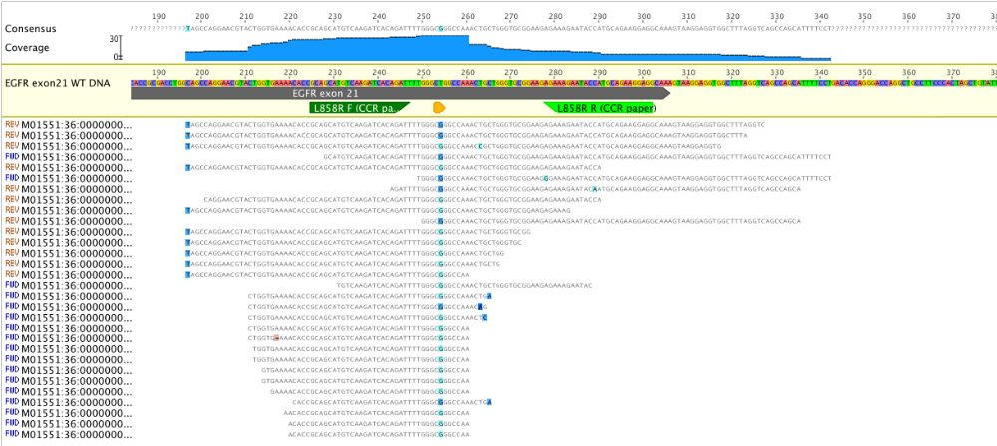
A.
B.

Slide 31
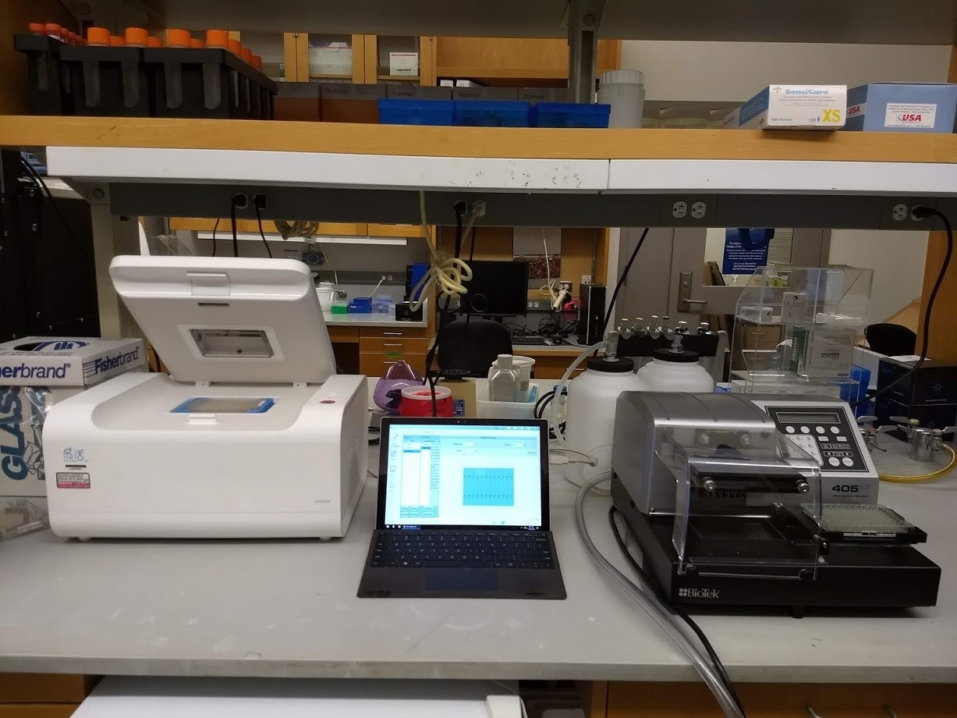

Slide 32
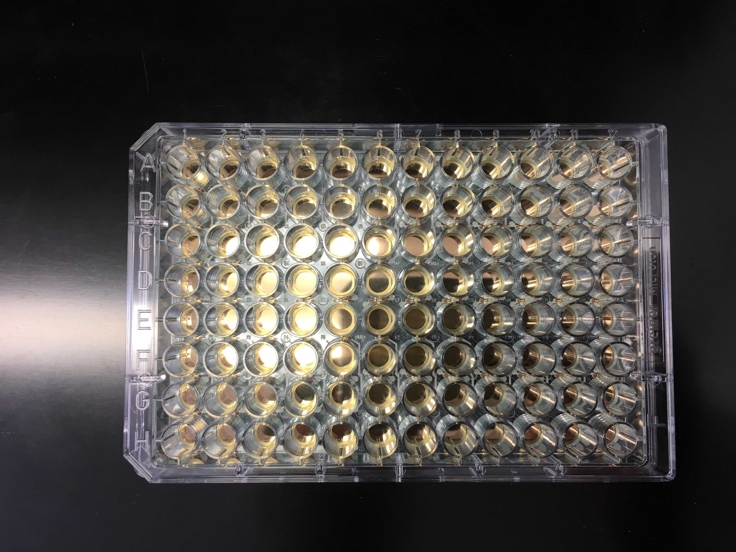

Slide 33
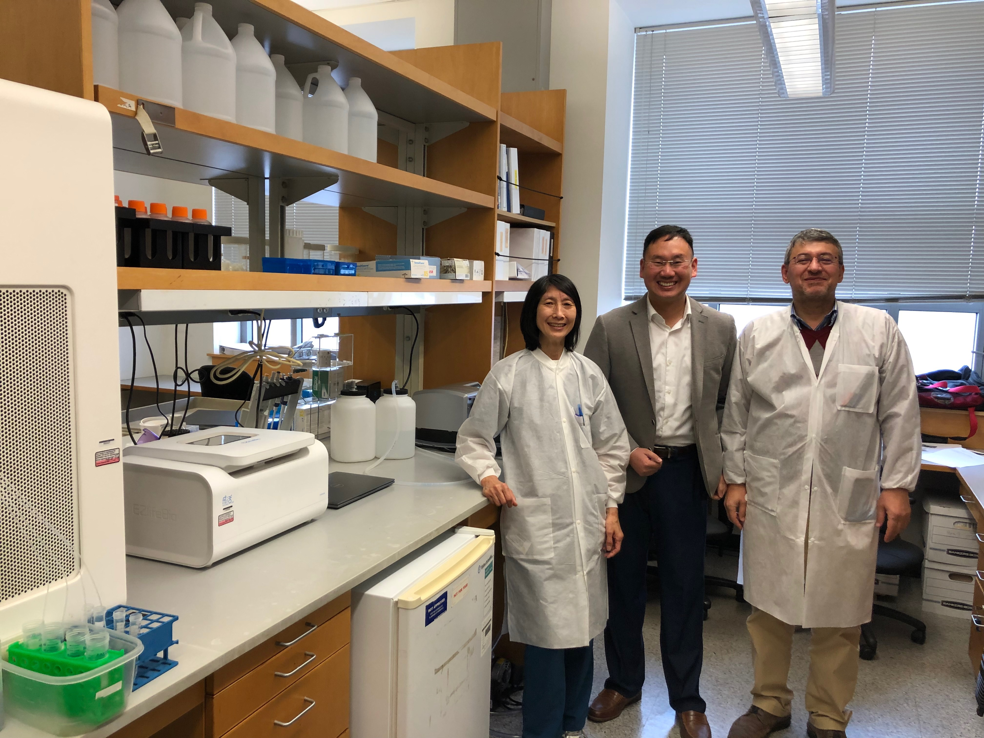
CLAICLIA-Qualified by UCLA Molecular Pathology Laboratory March 22, 2019

Slide 34



Multiplexing
Electrode grid 12x10
- 120 electrodes
- Electrode spacing 1000 µm vertical, 1500 µm horizontal
- Electrode diameter 30 µm
Total reaction volume: 200 – 1000 µL for 120 assays

Slide 35
EFIRM Readouts for Exon 19Del in Plasma
Threshold@100% specificity: 99(-nA)
EFIRM ROC for Exon 19Del in Plasma (AUC=1)
Performance:
80% and 95% early/late stage (I & II) NSCLC concordance
Sample Volume: 40µl
Direct Detection: No Sample Processing, No target attrition
TAT: 1.5 hour
Point-of-care
Multiplexible
Biofluid agnostic
CLIA-Qualified

Slide 36



Denise Aberle MD
Kostyantyn Krysan PhD
Steven Dubinett, MD
Fang Wei PhD
David Elashoff PhD
Charles (Buck) Strom MD, PhD
Michael Tu PhD
Johns Hopkins
MGH
MGH
Washington U
Yale
Hua-Jun He PhD
Kenneth Cole PhD
CA U01 233370
Lynn Sorbara PhD
Sudhir Srivastava PhD, MPH

