Slide 1

Overview of Collaborative Studies in the EDRN Pancreatic Cancer Collaborative Group
Anirban Maitra, M.B.B.S.
On behalf of
Brian Haab, Ph.D. (Van Andel Res Inst), Randall Brand, M.D. (UPMC), Surinder Batra, Ph.D. (UNMC), Maneesh Jain, Ph.D. (UNMC), Paul Lampe, Ph.D. (Fred Hutch), Anna Lokshin, Ph.D. (UPMC), Samir Hanash, Ph.D. (MDACC), Johannes Fahrmann, Ph.D., Ziding Feng, Ph.D. (Fred Hutch DMCC), Ying Huang, Ph.D. (Fred Hutch DMCC)

Slide 2
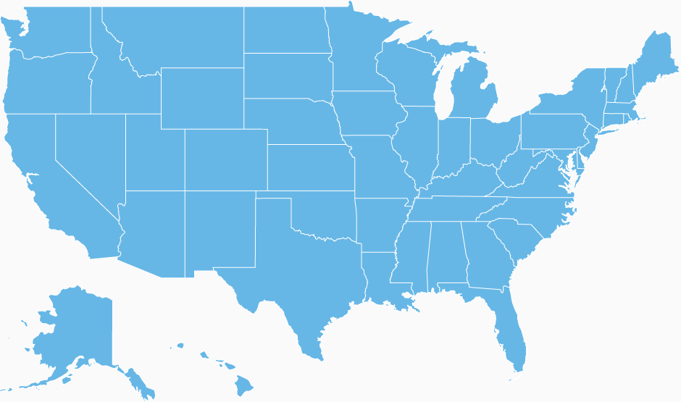
EDRN Pancreatic Cancer Research Network
Paul Lampe
FHCRC*
Brian Haab
VARI B.D.L.
Surinder Batra
UNMC*
Randall Brand
UPMC C.V.C.
Sean Mulvihill
Univ of Utah*
C. Max Schmidt
Indiana U*
Anirban Maitra
MDACC C.V.C.
* = Sub-contract sites

Slide 3
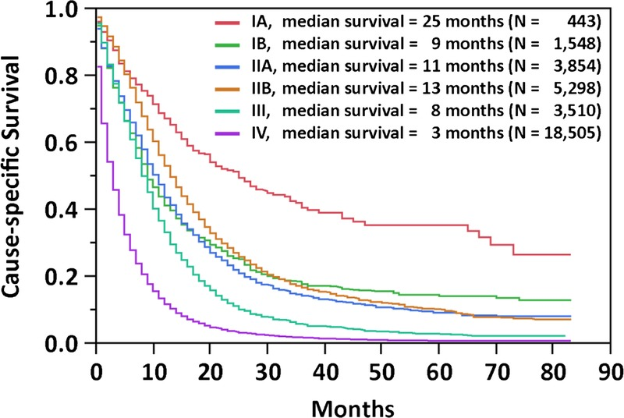
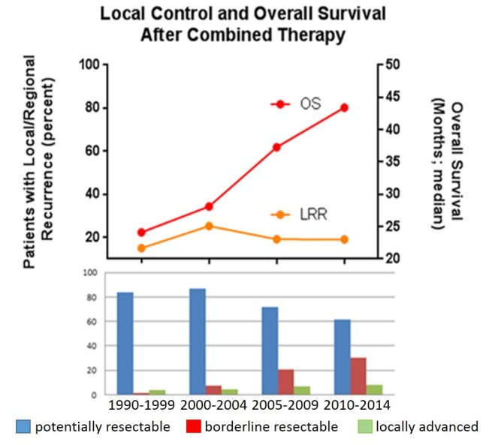
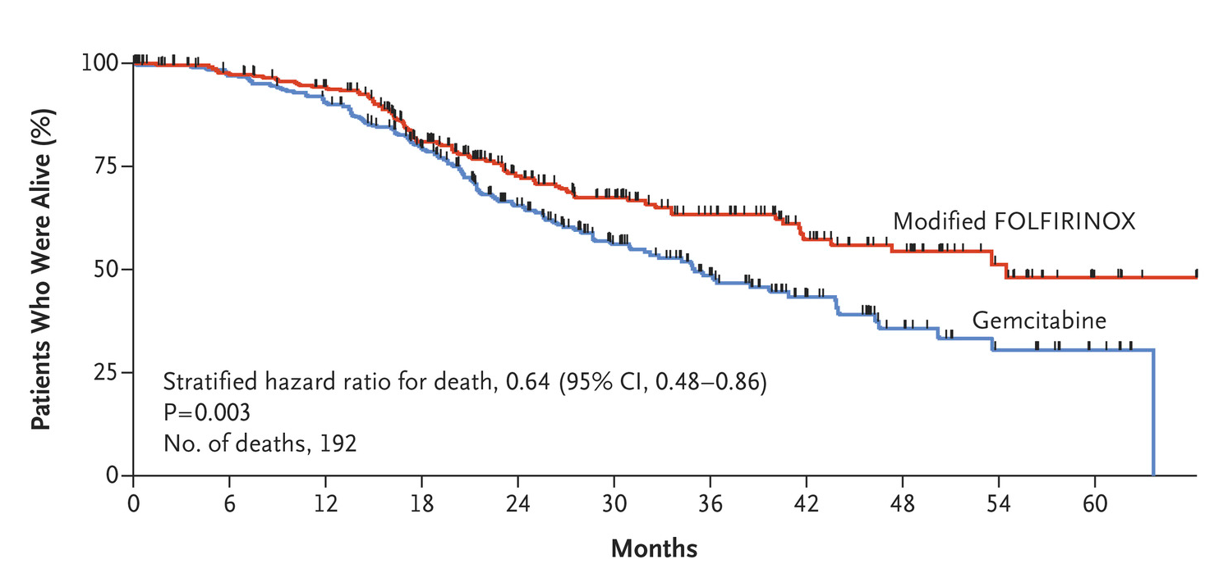
The benefits of improved therapies have been mostly restricted to early stage patients
Median survival for overall resected patients at MDACC = 43 months
PRODIGE 24
Adjuvant mFOLFIRINOX v Gemcitabine in resected pancreatic cancer
NEJM 2019
Only 15-20% of patients can undergo surgery

Slide 4

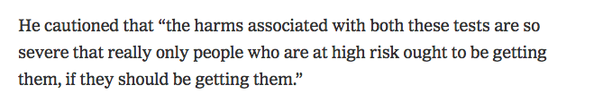


Otis Brawley, JHU on CA19-9 and CT scans
NY Times August 2018
EDRN Pancreas collaborative group

Slide 5
Screening for pancreatic cancer in the general population
Age-adjusted incidence rate for PDAC is ~15.0 per 100,000 men and women per year
Screen 100,000 asymptomatic individuals
Apply a biomarker with a 100% sensitivity and 99% specificity (this biomarker does not exist)
  Detect all 15 PDAC cases
  ~1,000 false positive studies
Not feasible to screen general population, must enrich
Courtesy of Randall Brand, UPMC

Slide 6
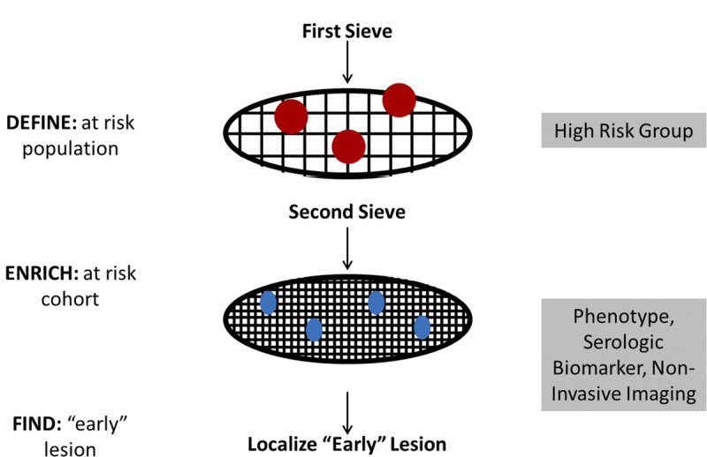
Pancreatic Cancer Surveillance
“D-E-F” Model of Sequential Sieves
Define
High risk population
Familial pancreatic cancer
Pancreatic cysts
Adult new-onset diabetes
Enrich
Biomarkers
Find
Imaging tools
Kenner, Maitra, Chari, Pancreas 2017

Slide 7
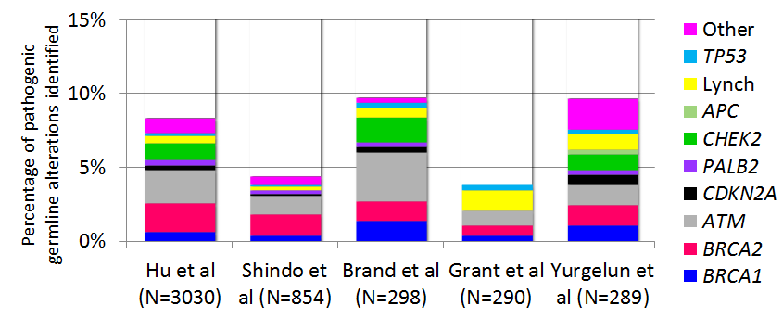
Approximately 10% of Pancreatic Cancer Patients Have an Inherited Gene Mutation (“Germline Mutation”)
Approximately half of the patients with a germline mutation will NOT have a family history

Slide 8
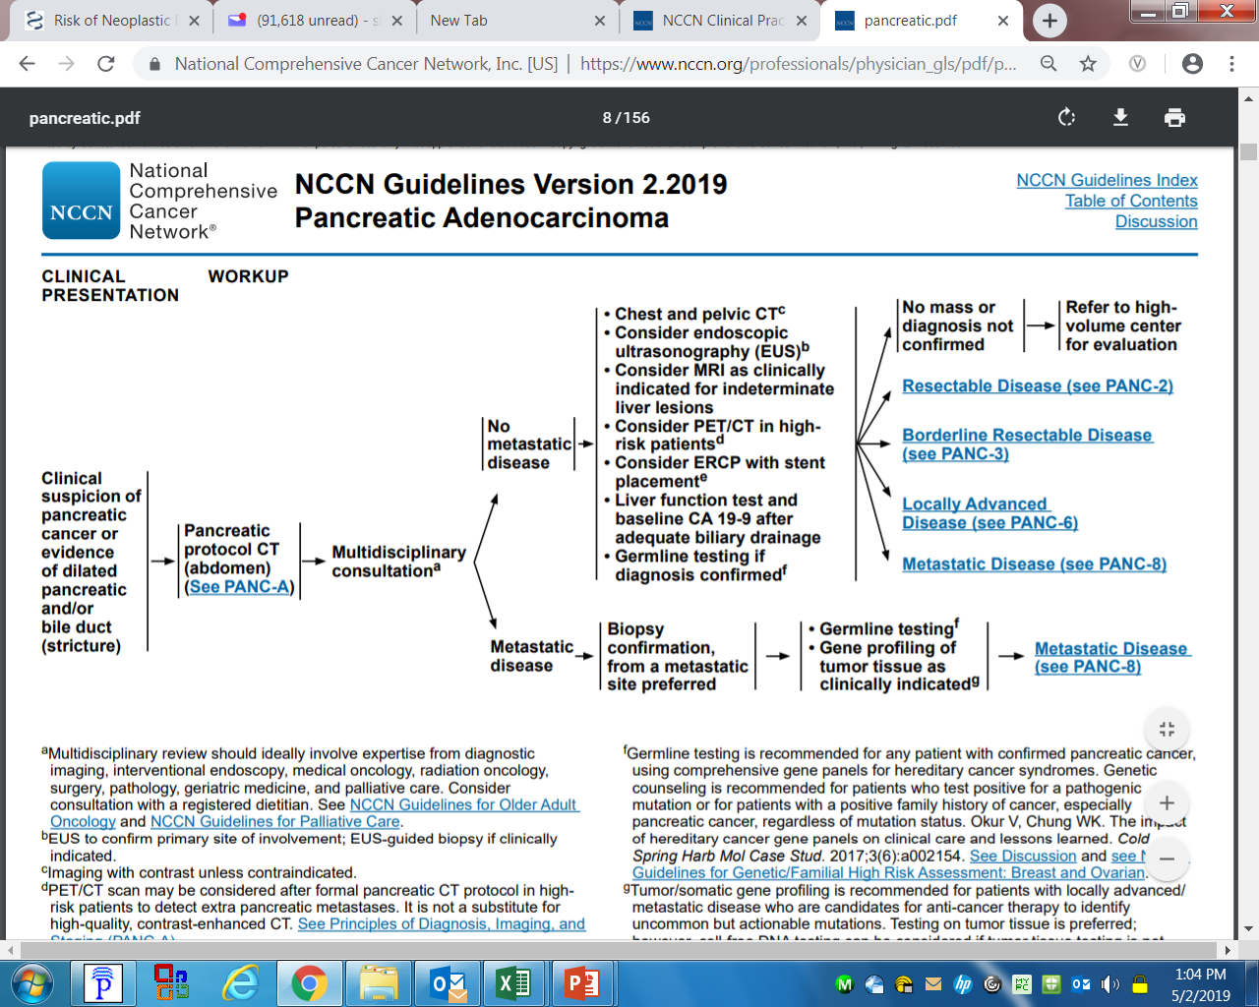
Latest NCCN Guidelines include germline testing for ANY PATIENT WITH CONFIRMED PANCREATIC CANCER.
Germline Testing is relatively inexpensive (?free)
Can guide the patient’s own therapy (POLO Trial in gBRCA)
Impact family members who carry this mutation

Slide 9
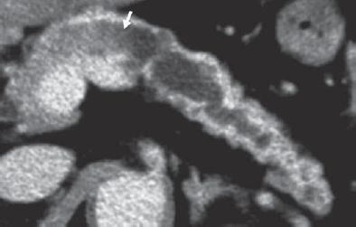
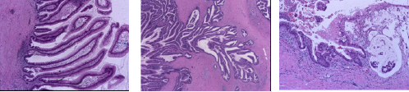
Mucinous pancreatic cysts
Example of a pancreatic cyst that progressed to pancreatic cancer
The vast majority of pancreatic cysts will NOT progress to cancer
    ~6 million individuals with “silent” cysts walking around
    ~53,000 new cases of pancreatic cancer per year
    ~8,000 arise on background of cystic lesions
Courtesy of Aatur Singhi, UPMC

Slide 10
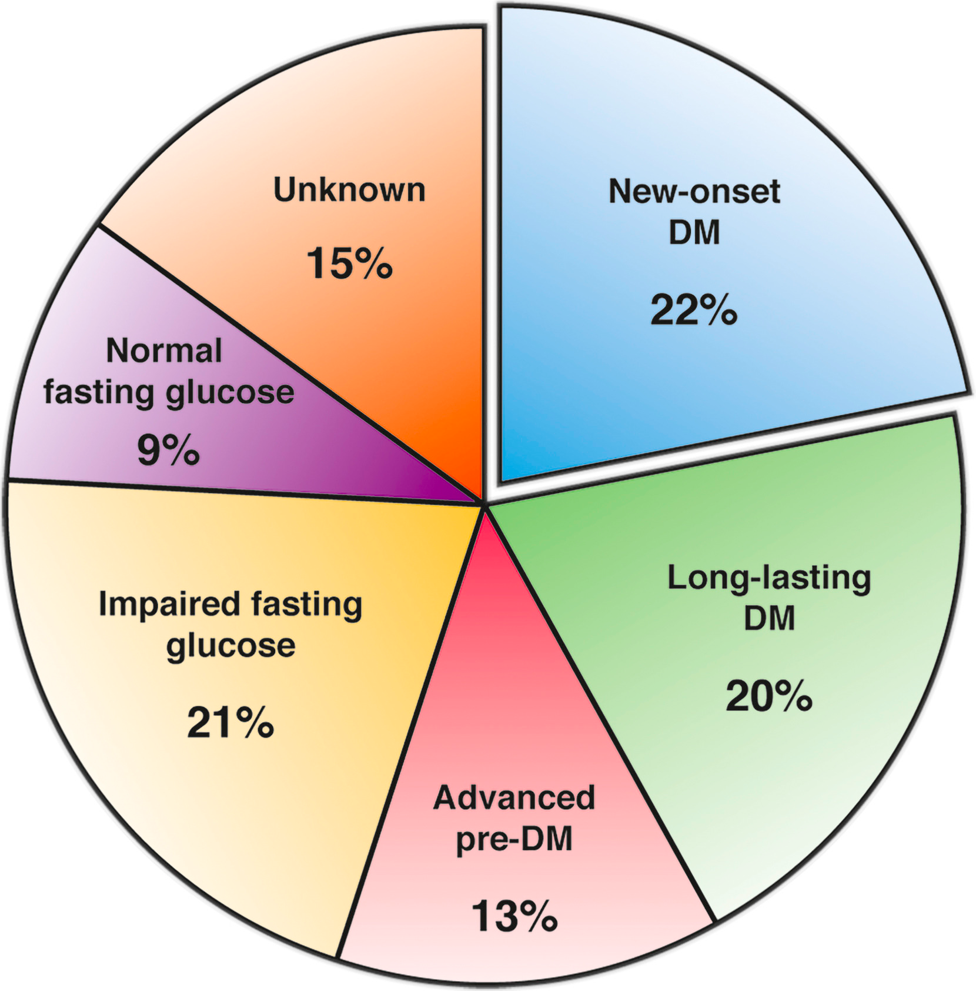
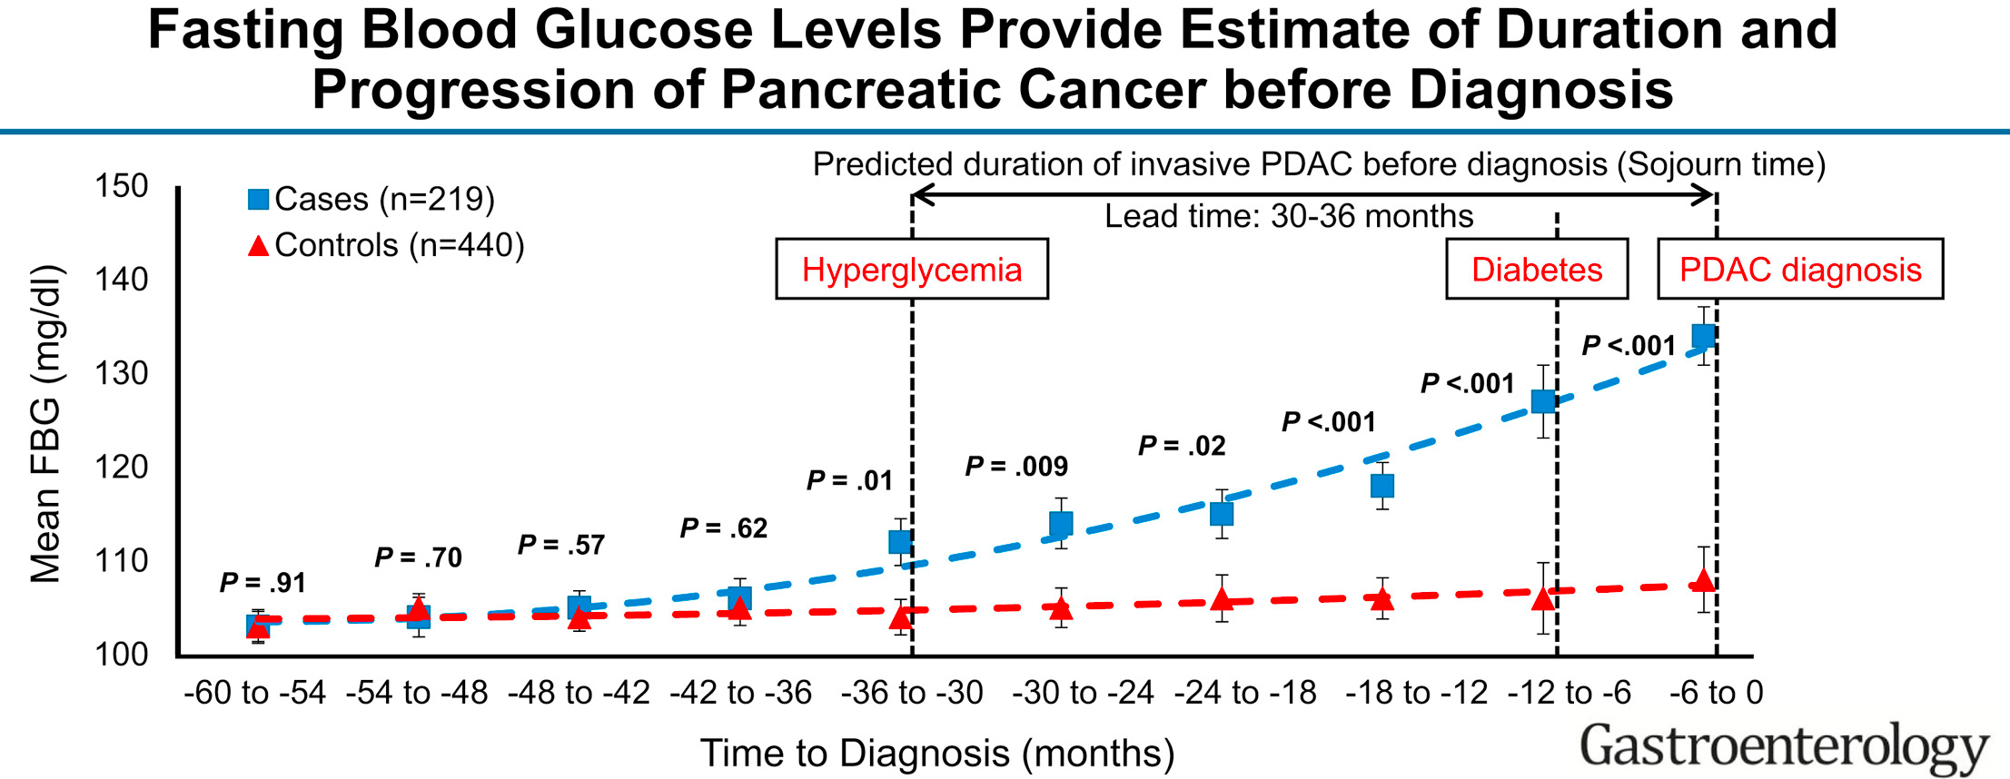
Pancreatic Cancer-associated Diabetes
~1% of new onset hyperglycemia / diabetes >50y harbor an occult PDAC
(Type 3c or “pancreatogenic” diabetes)
New onset hypergylcemia and diabetes (NOD) cohort – a prospective cohort to establish the prevalence of PDAC and conduct biomarker/imaging studies
(NCI/NIDDK/PanCAN)

Slide 11
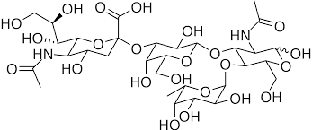
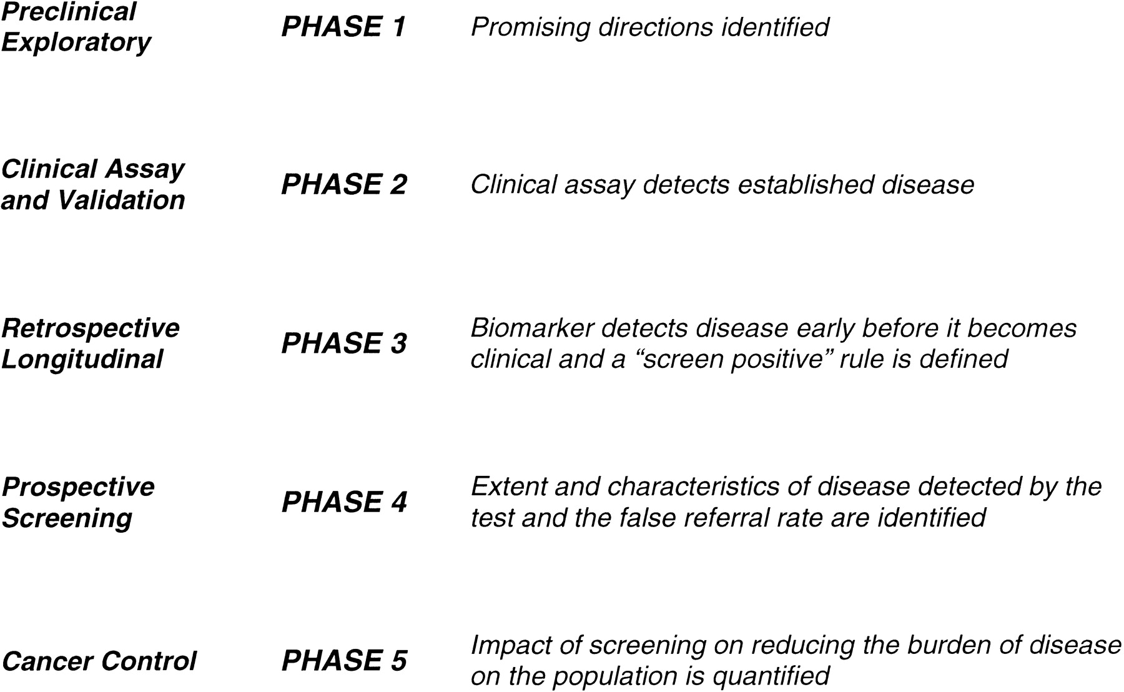
“E” in the “DEF” Model
Pancreatic Cancer Biomarkers
Proteins
ctDNA
miRNA
Methylated DNA
Exosomes
Autoantibodies
exRNA
CTCs
Modest cohort sizes
Symptomatic disease
Inappropriate controls
Not blinded
Sensitivity (overall) – 80%
Sensitivity (Stage I-II) – 25-50%
Almost all published biomarker papers
“Retro-prospective” cohorts
(PLCO, WHI, UK Biobank)
Prospective cohort
Test triggers work up

Slide 12
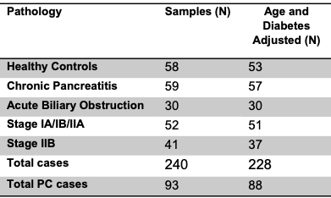
Two Stage Pancreatic Cancer Biomarker Bakeoff
Paul Lampe
FHCRC
Brian Haab
VARI
Surinder Batra
UNMC
Anna Lokshin
UPMC
Sam Hanash
MDACC
Blinded Samples from EDRN PDAC C.V.C. sites at MDACC and UPMC
Sample distribution and data analyses by FHCRC DMCC (Feng and Huang)

Slide 13
Stage One Pancreatic Cancer Biomarker Bakeoff
Site | Marker
VARI | CA19-9, CA199:sTRA, and MUC5AC:sTRA
MDACC | TIMP1, LRG1, and CA19-9
UNMC | MUC5AC, MUC4
UPMC | CA19-9, angiostatin, and thrombospondin
FHRC | PMS2 (protein) and DCD, PODXL and PAFAH1B2 (autoAb-Ag)

Slide 14







NCI EDRN: Pancreatic Cyst Biomarker Validation Study
Telomerase
Glucose
DNA Methylation Markers
PancreaSeq
Amphiregulin
Glycoproteins
Gastricsin
Das-1
Cathepsin E
Data Management Coordinating Center
Pancreatic Cyst Biomarker Alliance

Slide 15
NCI EDRN: Pancreatic Cyst Biomarker Validation Study
Mucinous vs. Non-Mucinous Cysts
PancreaSeq
Glycoproteins
Amphiregulin
Glucose
Gastricsin
Cathepsin E
Presence vs. Absence of Advanced Neoplasia
PancreaSeq
DNA Methylation Markers
Das-1
Telomerase
Telomerase
Glucose
PancreaSeq
DNA Methylation Markers
PancreaSeq
Amphiregulin
Glycoproteins
Gastricsin
Das-1
Cathepsin E
>350 Pancreatic Cysts (w/ Dx Path)

Slide 16
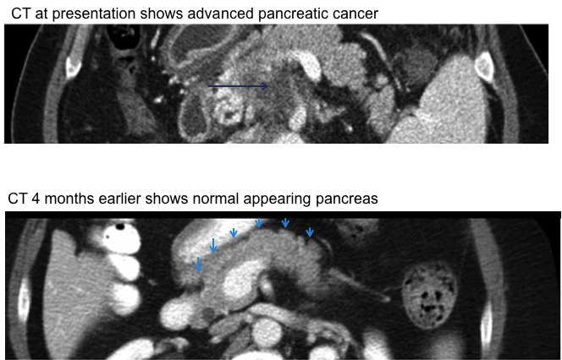
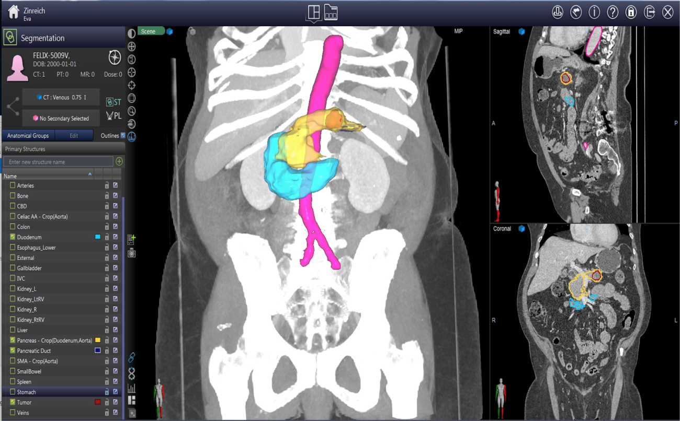
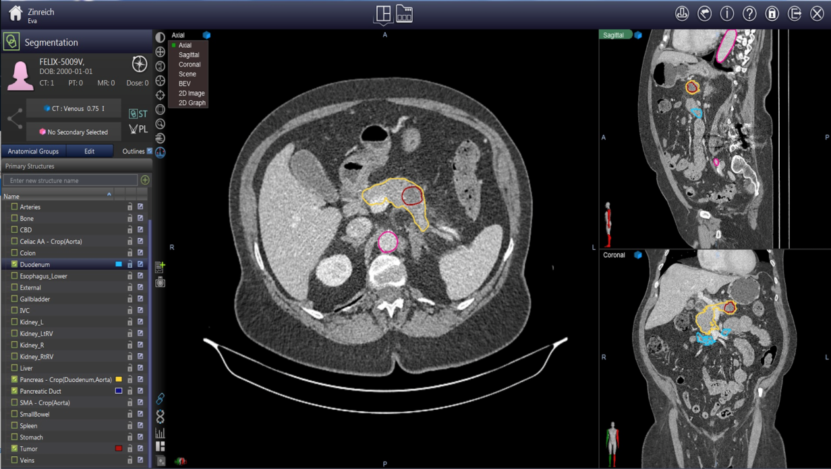
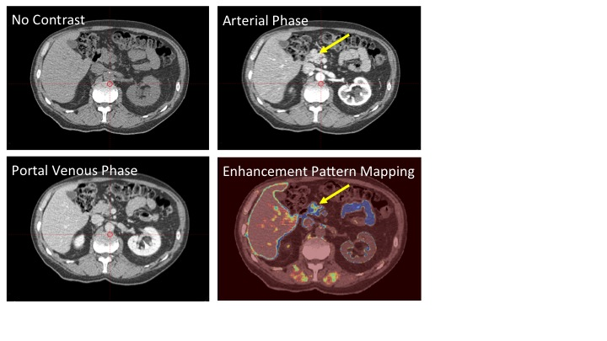
The “F” word (FIND)
Developing Imaging Tools for early detection
Courtesy of Suresh Chari at Mayo Clinic
Deep Learning Algorithm
Computer-assisted cancer demarcation
Vogelstein, Fishman et al
Enhancement Pattern Mapping
Eugene Koay, MD Anderson

Slide 17

NCI EDRN supported pancreatic imaging repository
Brian Wolpin (PCDC)
DFCI
Walter Park (CPDPC)
Stanford
Dan Von Hoff (PCDC)
TGEN
Randall Brand (EDRN)
UPMC
Ajay Goel (PCDC)
City of Hope
Natalia Khalaf
Baylor
Eugene Koay (EDRN)
MDACC
Dan Crichton
Heather Kincaid

Slide 18
EDRN As a Critical Hub for Pancreatic Cancer Biomarker Development Efforts
“Alliance of Consortia”
NCI MCL Consortium (“Overdiagnosis consortium”)
Pancreatic Cystic Lesions
NCI/NIDDK
NOD cohort
1st phase 3 biomarker and imaging validation study in PDAC
NCI PCDC
Source of prospective biospecimens
Additional biomarkers
Imaging modalities
NCI EDRN consortium efforts
Biomarker bakeoff
PCBA
PCA/HTAN

Slide 19
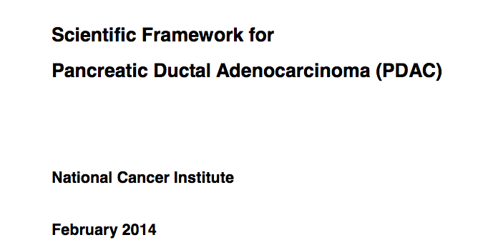
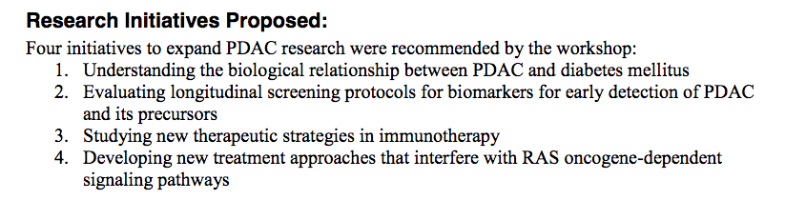
February 2014
Opportunities and Challenges:
Pre-diagnostic biospecimens and imaging repository:
  Prospective NOD cohort – to begin Q4 2018 (CPDPC)
  Prospective pancreatic cyst cohorts – ongoing (MCL/EDRN/PCDC)
  High risk genetic cohorts on surveillance – ongoing (PCDC)
Defining optimal biomarker panels for surveillance in at risk populations – “Bakeoff” studies
Defining “sporadic risk” – incorporates PRS, clinical data, family history - defining who to screen from the average risk population

Slide 20

Sudhir Srivastava
JoAnn Rinaudo
Sharmistha Ghosh-Janjigian
Christos Patriotis
Matthew Young
Jacob Kagan
Lynn Sorbara
Guillermo Marquez
Richard Mazurchuk

