Slide 1




Liquid Biopsies: Beyond Blood
11th EDRN Scientific Workshop
September 11th 2019
Kenneth Kinzler
Ludwig Center at Johns Hopkins

Slide 2
Liquid Biopsy
Liquid Biopsy – The characterization of a tumor by analysis of a fluid collected at a distance from the tumor. This is most often consider in the context of blood samples but the clinical applications of liquid biopsies are not limited to blood samples.

Slide 3
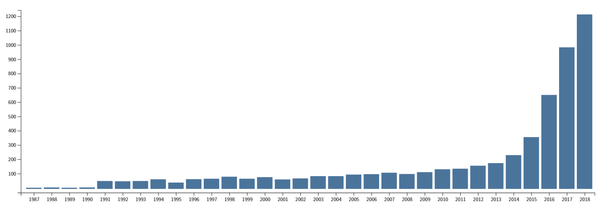
The Liquid Biopsies Explosion
Number of Publications
1991 – Somatic Mutations in LB
2011 – Safe-SeqS
1999 – Digital PCR
2003 – Beaming
Year
Notes:
Driven by the identification of somatic mutation from cancer in LB samples and the technical advances that have drive in the field.

Slide 4
Clinical Application of Liquid Biopsies
Diagnostic
Patient Management
  Prognosis
  Detection of Minimal Residual Disease
  Detection of Resistance Mutations
  Therapy Selection
Screening (Early Detection)

Slide 5
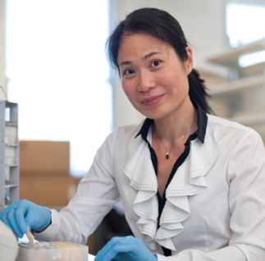
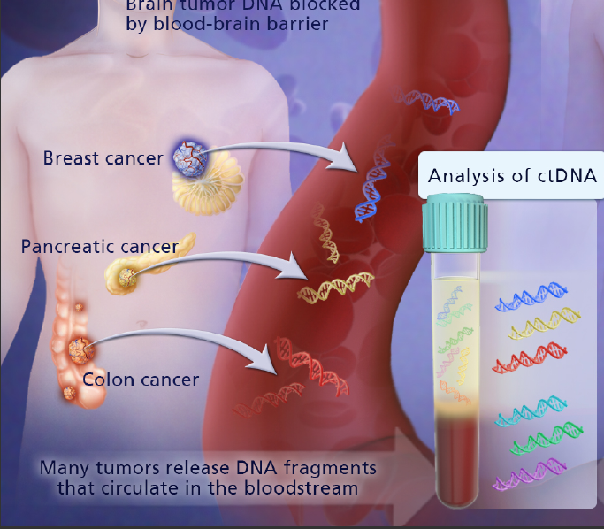


Minimal Residue Disease
Recurrence in Stage II Colon Cancer
Jeanne Tie
Tie et al., Sci Transl Med. 8(346):346ra92 2016.
Peter Gibbs
Notes:
Define MRD

Slide 6
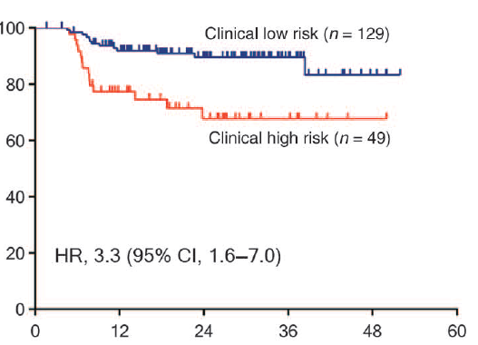
Standard of Care Criteria
(Time-to-Recurrence, Stage II CRC)
Recurrence Free (%)
Months since surgery
(All no-chemo patients)
Notes:
The high-risk group is defined as those having mismatch repair–proficient
(pMMR) tumors with at least one of the following poor prognostic features: T4, LN yield <12, lymphovascular invasion (LVI), and poor
tumor differentiation. The low-risk group is defined as those with no poor prognostic features.

Slide 7
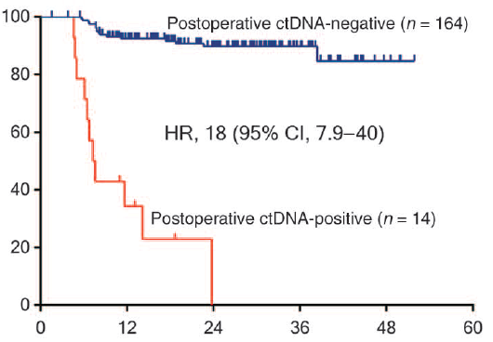
Post-op ctDNA
(Time-to-Recurrence, Stage II CRC)
ctDNA Detects Recurrence Earlier in Stage II Colon Cancer
ctDNA recurrence was a median of 167 days earlier than radiologic recurrence (IQR 81 to 179)
Recurrence Free (%)
Months since surgery
(All no-chemo patients)

Slide 8
Test Performance
Specificity
Relative Importance
Sensitivity
Screening
Patient
Management
Diagnostic
Average
Risk
High
Risk
PPV and NNTS
Notes:
In the absence of a perfect test, one must need to consider the clinical harm of a false positive or false negative
Patient centered metric like PPV important to the patient and population leveled metrics like NNTS number needed to screen which are important for health care systems and economics.

Slide 9
Test Performance Optimization
Single analyte and single sample approaches
Multi-analyte
Multi-sample
Notes:
In our case, We are not talking about multi-analyte or multi-feature machine learning discovery approaches. These are extremely powerful approaches but can be challenging to due overfitting, unanticipated artifacts such as batch affect and difficulty in defining the biological basis. We are talking about optimal combination of markers and test that individually have show value but are also individually limited.

Slide 10
Multi-Analyte
Circulating Tumor Cells (CTCs)
Mutations
Aneuploidy
Translocations
Methylation changes
Protein Biomarkers
Size differences
cfDNA Levels
Exosomes
RNAs and MicroRNAs
Notes:
Listed to what extent the changes can be linked to the neoplastic cells themselves.

Slide 11
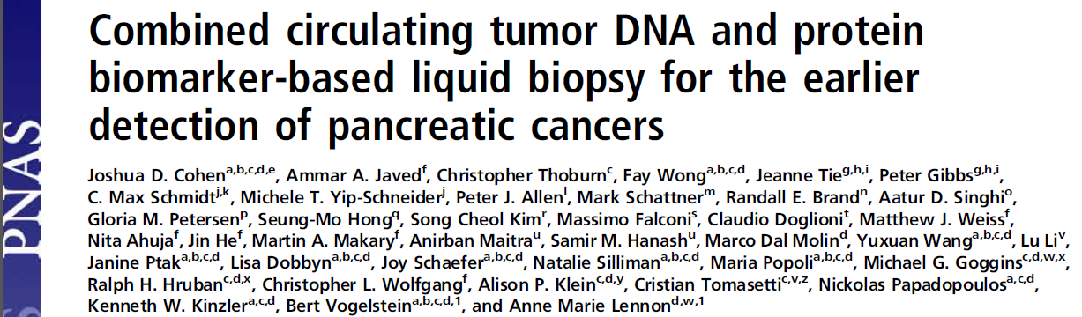
Combining ctDNA and Protein Markers for a Cancer Blood Test
Sensitivity or specificity for a single tumor type is not required.
Sensitivity of a single marker is less demanding.
Allows using thresholds with near-perfect specificity.
Proc Natl Acad Sci U S A. 2017 Sep 19;114(38):10202-10207.

Slide 12
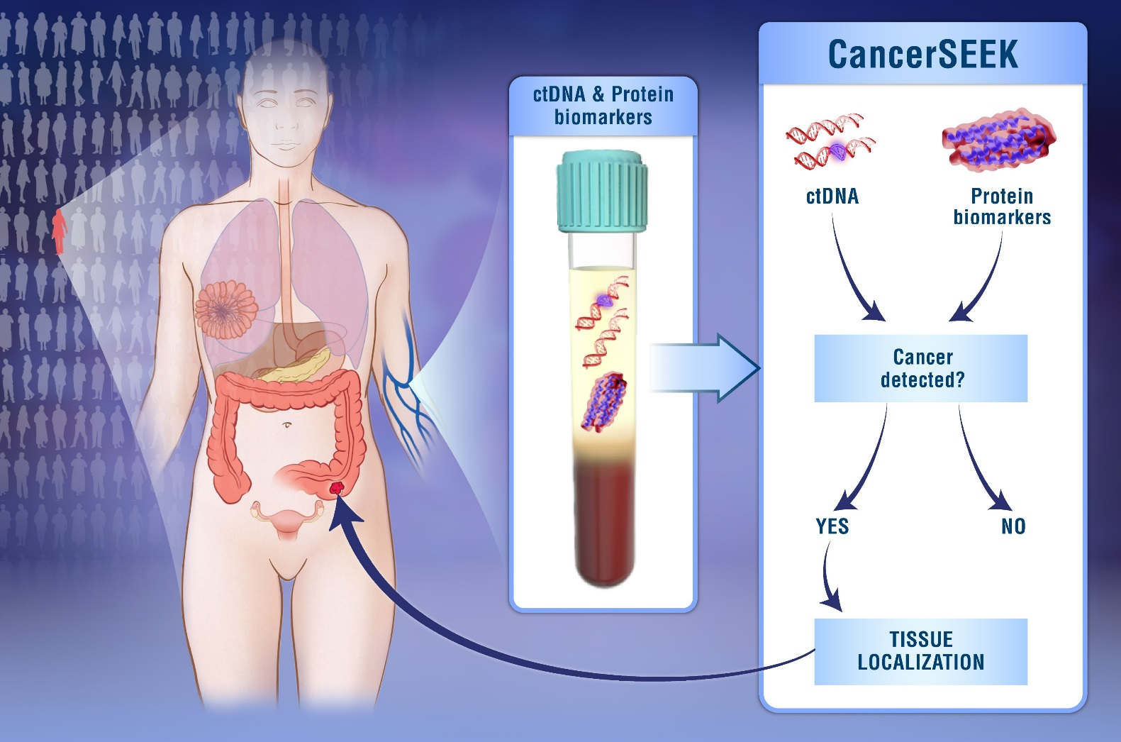


CancerSEEK Blood Test
Tumor Detection
ctDNA
8 Protein Markers
  CA-125
  CEA
  CA19-9
  PRL
  HGF
  OPN
  MPO
  TIMP-1
1,005 Cancer Patients
No Distant Metastases
  20% Stage I
  49% Stage II
  31% Stage III
Median Age 64 years
812 Healthy Contols
Josh Cohen
Nick
Papadopoulos
Cohen et al., Science 359, 926-930 (2018)

Slide 13
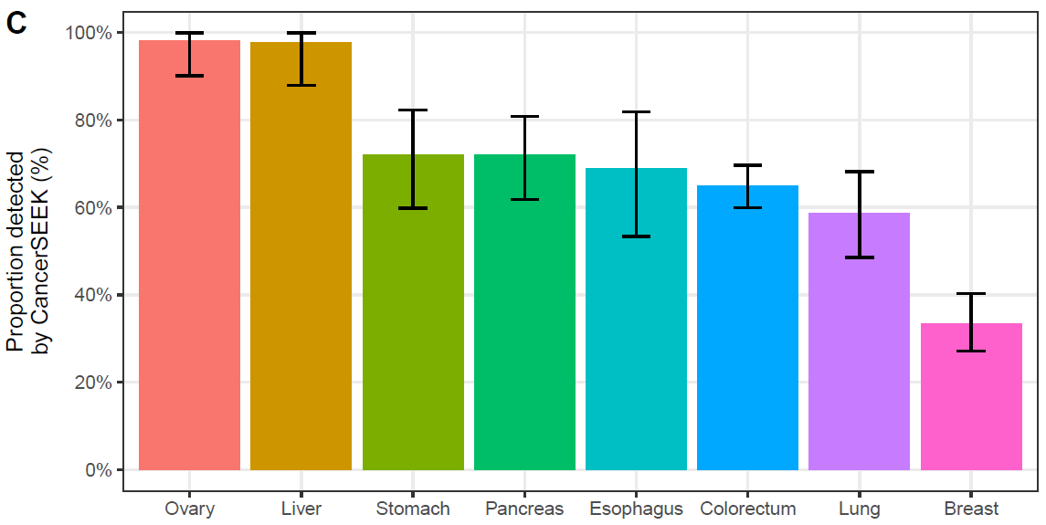
CancerSEEK Sensitivity (Blood)
69% to 98%
70% Median Sensitivity (p < 10⁻⁹⁶ one-sided binominal)
>99% Specificity (7 of 812 Healthy Controls)
Range (33% to 98%)
Ovary
Liver
Stomach
Pancreas
Eso
Colon
Lung
Breast
Notes:
62% average
55% when adjusted for tumor distributions in populations.

Slide 14
Ongoing Prospective Study:
Evaluating Clinical Applicability
Partnered with the Geisinger Health System
Average risk population
  10,000 Volunteers
  Female
  65-75 years old
  No history of cancer
One and Five-year follow-up
Subjects who test positive return for a confirmatory test; double-positive subjects undergo diagnostic work-up
A Tumor Board evaluates the results of every positive case and provides recommendations on follow-up
Enrollment completed

Slide 15
Ongoing prospective study: establishing clinical applicability
The current prospective study is threshold-based; any single mutation or protein above threshold yields a positive result.
Each analyte (mutations and nine proteins) has its own threshold established in a retrospective study to give overall 99% specificity.
Based on data collected to date:
  The specificity is as expected.
  Other tumor-types in addition to the eight evaluated in a retrospective study have been detected, supporting the cancer agnostic approach of the test.

Slide 16
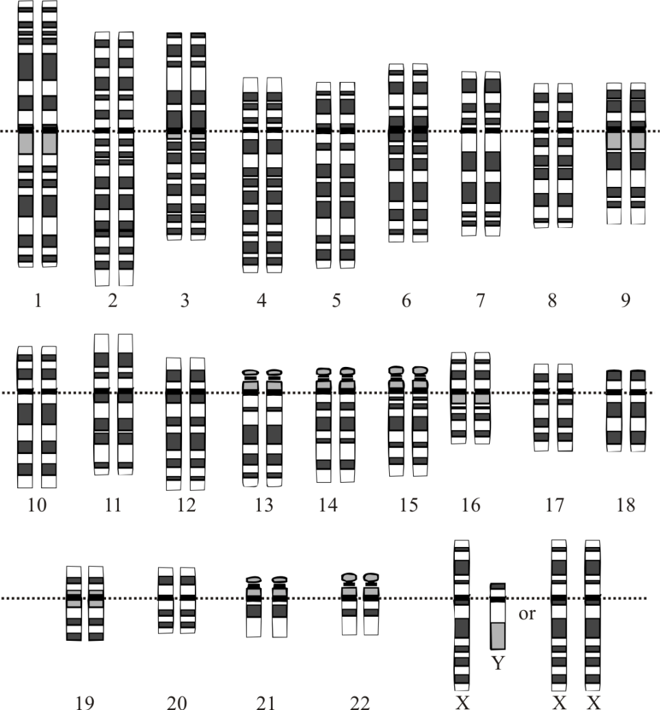
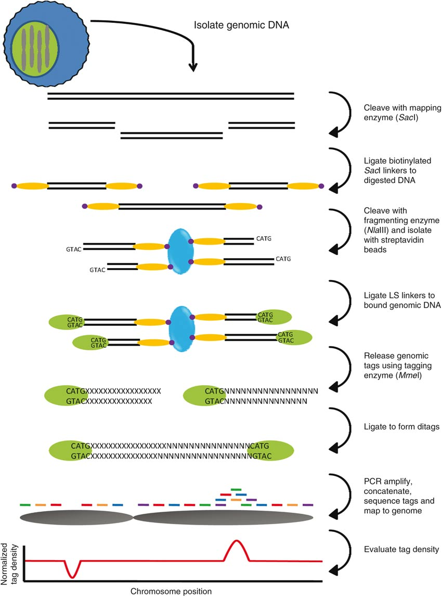
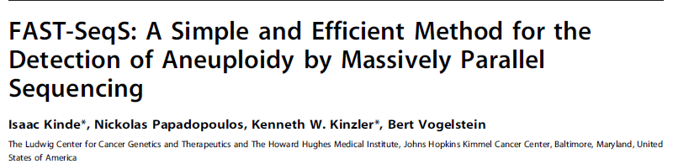
Multi-Analyte: Aneuploidy
(FAST-SeqS)
Fast Aneuploidy Screening Test-Sequencing System
Amplicon Sequencing using a single primer pair targeting Repetitive Elements
Amplicon size ~145 bp
~38,000 uniquely aligned amplicons
~1,500 heterozygous SNPs per sample
SIMPLE:Add primers
Sequence
In silico
analysis
Digital Karyotyping
PLoS One 2012

Slide 17
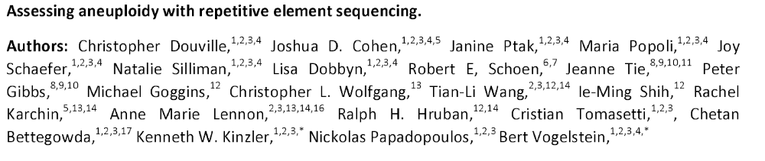

Multi-Analyte: Aneuploidy
(Real-SeqS)
Repetitive Element AneupLoidy-Sequencing System, in press 2019
Chris Douville
Amplicon size ~43 bp (optimized for cfDNA)
Amplification of ~350,000 genomic regions.
Detects variation in all 39 chromosomal arms.
Identified ~2,200 SNPs per sample
Requires less input DNA than regular ctDNA applications
Multiple Readouts
  Aneuploidy
  Allelic Imbalances
  Focal Amplification and Deletions
  Microsatellite instability
  Sample identification
  Sample QC
Notes:
Upto 745,154 unique amplicons possible but typically get ~350,000 from each samples

Slide 18
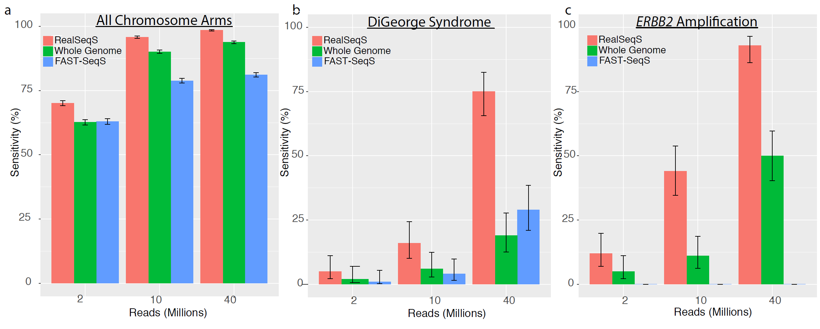
Performance Comparison
(Synthetic Samples)
Sensitivity for Monosomies and Trisomies at 5%
Notes:
Fig 2. Detection of Aneuploidy using Next Generation Sequencing Technologies. Sensitivities were calculated at 99% specificity. Error bars represent 95% confidence intervals. (a) Comparison of sensitivity for monosomies and trisomies across all 39 non-acrocentric chromosome arms at 5% cell fraction. (b) Comparison of sensitivity for the 1.5 Mb DiGeorge deletion on 22q at 5% cell fraction. (c) Comparison of sensitivity for a 20 copy ERBB2 focal amplification at 1% cell fraction.

Slide 19
Performance Comparison
(Synthetic Samples)
(1.5 Mb Deletion on 22q at 5%)
(42 Kb Application 20 copies at 1% )
Notes:
Fig 2. Detection of Aneuploidy using Next Generation Sequencing Technologies. Sensitivities were calculated at 99% specificity. Error bars represent 95% confidence intervals. (a) Comparison of sensitivity for monosomies and trisomies across all 39 non-acrocentric chromosome arms at 5% cell fraction. (b) Comparison of sensitivity for the 1.5 Mb DiGeorge deletion on 22q at 5% cell fraction. (c) Comparison of sensitivity for a 20 copy ERBB2 focal amplification at 1% cell fraction.

Slide 20
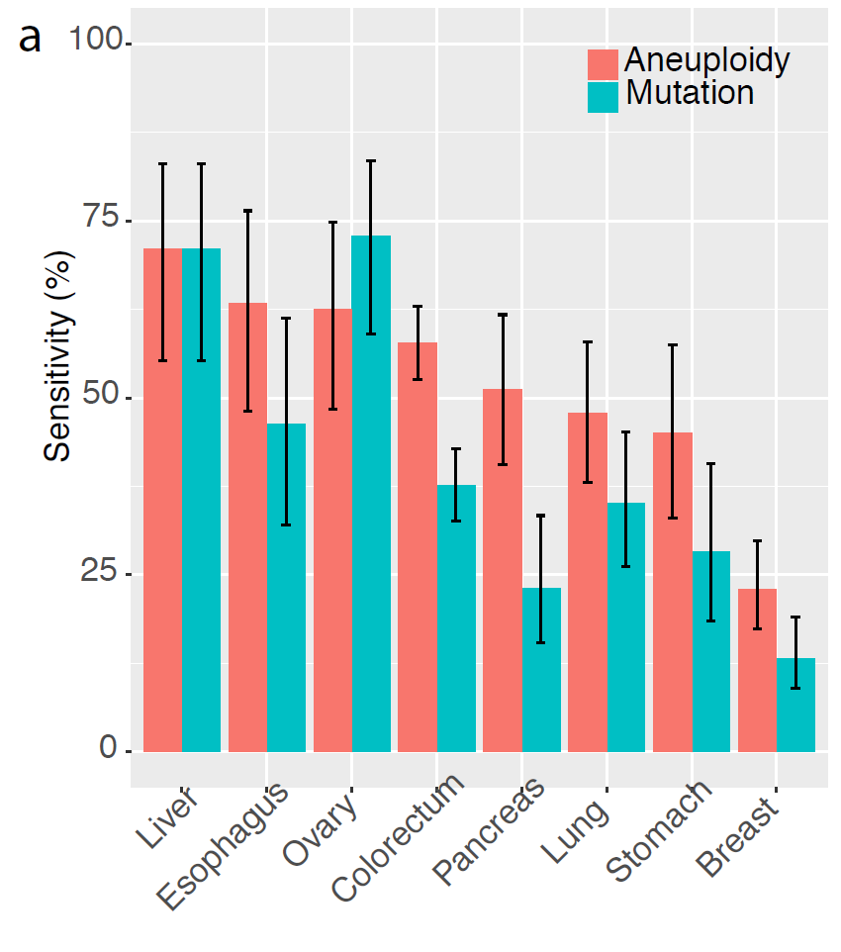
Performance on CancerSEEK Cohort
(Aneuploidy versus Mutations)
Aneu(+) & Mut(-) 242
Aneu(-) & Mut(+) 125
Aneu(-) or Mut(+) 525 (61%)
Notes:
49% overall of 883 cases
Aneuploidy was detected in 242 (42%) of the plasma samples in which no mutation were detected in the study of Cohen et al (10). Conversely, mutations were detected in 112 (25%) of the plasma samples in which aneuploidy was not detected. In combination, either aneuploidy or mutations could be detected in 525 (61 %) of the 883 plasma samples while still maintaining 99% specificity in the normal samples (Fig 5a).

Slide 21
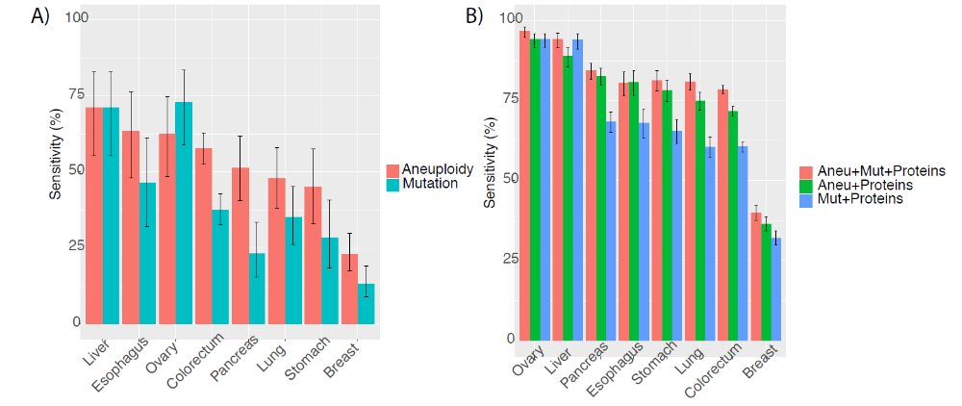
Performance on CancerSEEK Cohort
(Combinations of Markers)

Slide 22
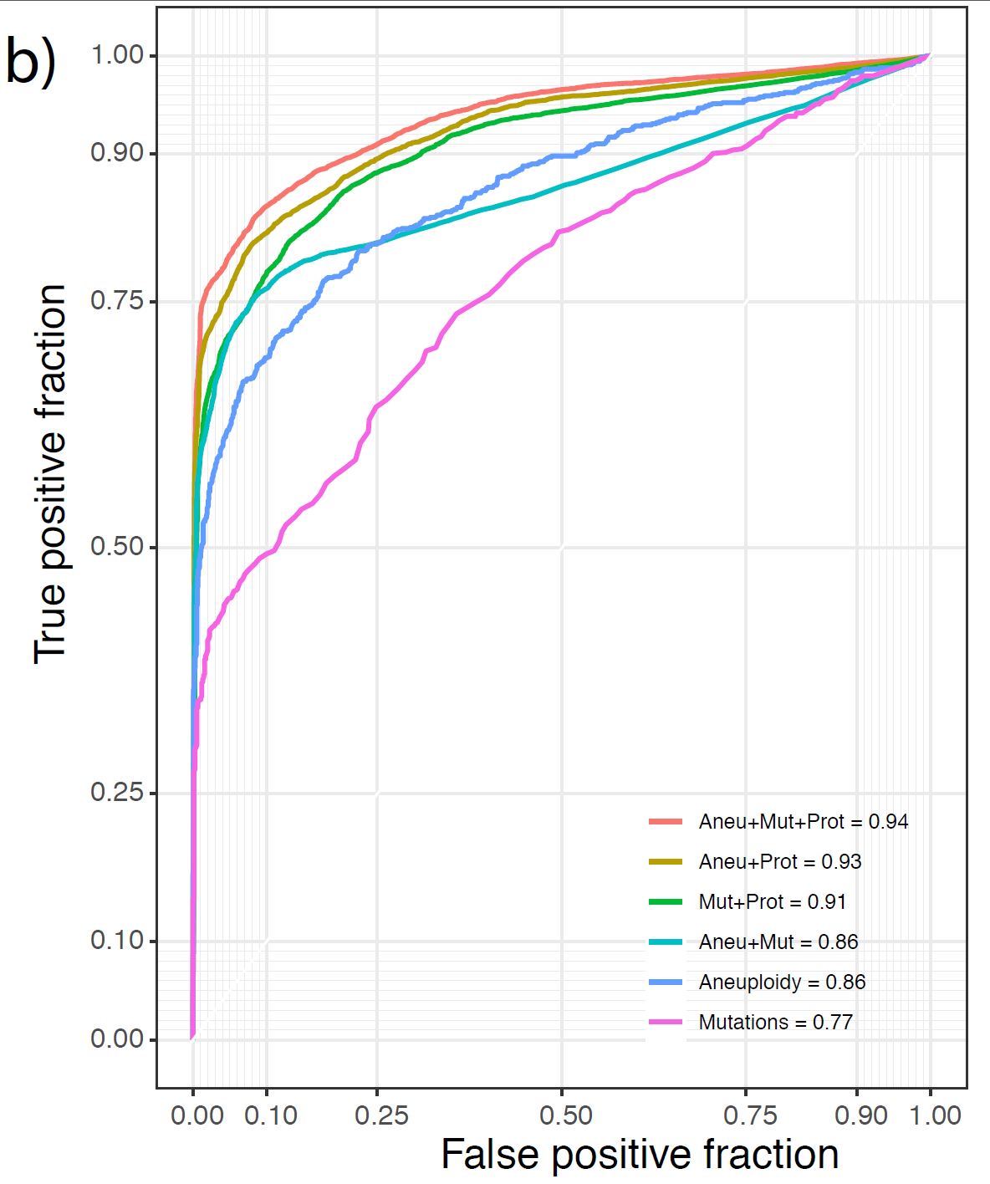
Performance on CancerSEEK Cohort
(Combinations of Markers)
Sensitivity at 99% Specificity
Aneu+Mut+Prot : 73%

Slide 23
Multi-Sample
PSA
Head & Neck
  Saliva and Blood
  Wang et al., Science Translational Medicine 2015
Ovarian and Endometrial Cancer
  Pap Smear and Blood
Notes:
Bladder and stool
HIV

Slide 24
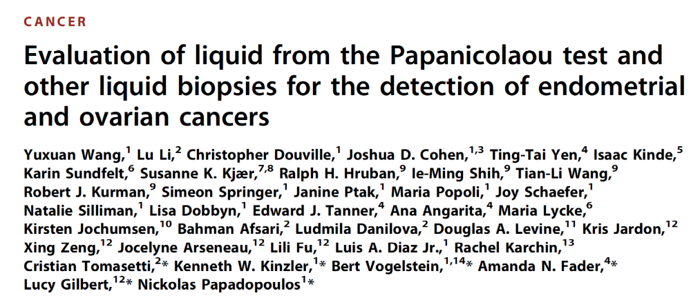
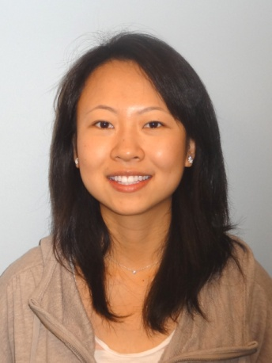
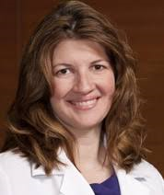

Early Detection of Ovarian and Endometrial Cancer (PapSEEK)
Yuxuan
Wang
Lucy Gilbert
McGill
Karin Sundfelt
Sweden
Susanne K. Kjær
Denmark
Science Translational Medicine, 2018
Nick
Papadopoulos
Amanda
Fader
Ie-Ming Shih

Slide 25
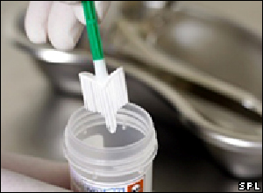
PapSEEK Test
Somatic Mutations
  Covering 9,392 bp in 18 genes commonly mutated in endometrial and ovarian cancers
Aneuploidy
  Single Primer Pair PCR of LINE repeats across the genome (FAST-SeqS)
Notes:
long interspersed nucleotide element-1 (L1 retrotransposons)
Like the CancerSEEK test this is multi-analyte but using two different genetic markers.

Slide 26
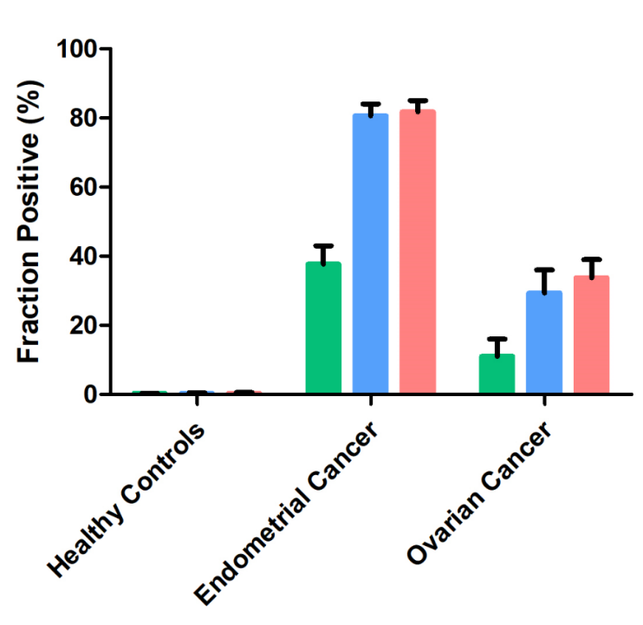
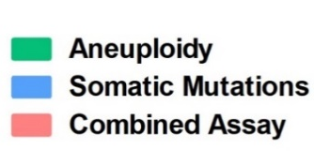
PapSEEK Test Performance
(Pap smear samples)
714 Controls
  1.4% Positive
  98.6 % Specificity
382 Endometrial Cancers
  81% Sensitivity
245 Ovarian Cancers
  33% Sensitivity
  (34% early Stage)
Notes:
Figure 2: Detection of aneuploidy and somatic mutations (PapSEEK) in Pap brush (A) and Tao brush samples (B) from healthy controls and patients with endometrial and ovarian cancers. With the combined test, 81% of endometrial cancers (n=382) and 33% of ovarian cancers (n=245) were detectable with Pap brush samples. Higher fractions, 93% of endometrial cancers (n=123) and 45% of ovarian cancers (n=51), were detectable with Tao brush samples. Error bars represent 95% confidence intervals.

Slide 27
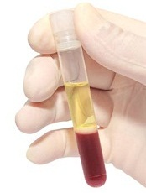
PapSEEK
(Multi-Sample)
PapSEEK

Slide 28
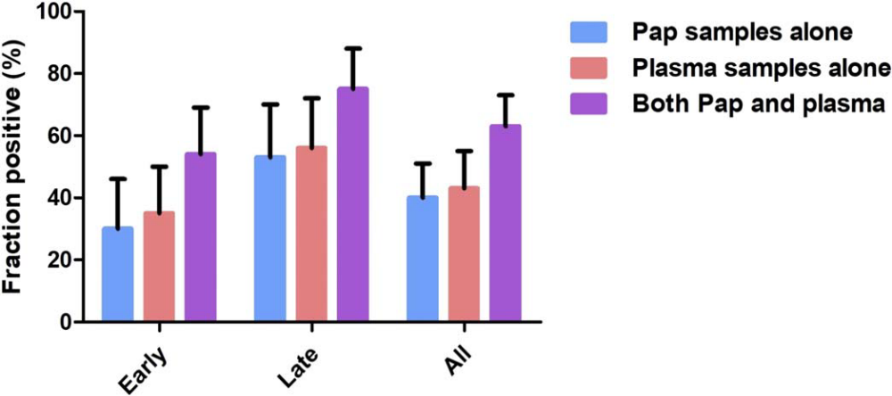
Pap SEEK Ovarian Cancer
83 Ovarian Cancer Plasma
Combined Sensitivity at 99%
  54% Early Stage
  75% Late Stage
  63% Overall
Wang et al., Science Translational Medicine 2018
Notes:
Combined test was 63% for all cancer 75% for late stage and 54% for early stage.
83 ovarian cancers
0 of 192 healthy controls were positive for at 99.4%

Slide 29
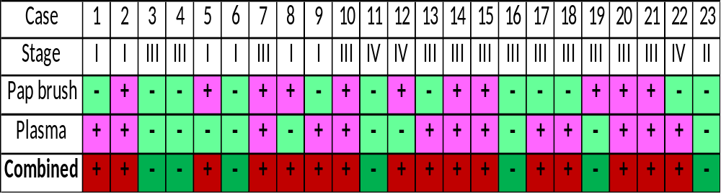
High Grade Serous Carcinoma
(Most common and most aggressive type of ovarian cancer)
Plasma and Pap brush combinations:
  Sensitivity 70%
  Specificity 99.44%
Notes:
Five of 6 Stage 1 Ovarian Cancers
Specificity is with TP53
Updated Data
-Updated data 4 out of 713 False Positive
-23 out 32 HGSC ovrains (72%)

Slide 30
Challenges to Early Detection
Social – Society and individuals tend to give priority to reactive rather than proactive solutions.
Psychological – Appropriate communication of results is important:
  Not 100% specific → Anxiety or even depression upon receipt of test results.
  Not 100% sensitive → Individuals should not made believe that they are at zero risk.
Overdiagnosis – Unnecessary clinical follow-up.
Underdiagnosis – All the individuals that present with advanced disease
Economical – Needs to be cost effective to administer across the population.
Practical – Needs to be readily deliverable across the population.

Slide 31
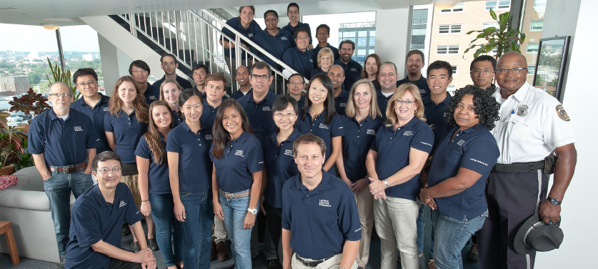



Acknowledgements
Rocky Schoen
EDRN
Schoen & Kinzler
“ctDNA for the Early Detection and Monitoring of Colorectal Cancer”
NLBC
Papadopoulos & Bettegowda
“Earlier Detection of Cancers Using Non-Plasma Liquid Biopsies”
Bert
Vogelstein
Nick
Papadopoulos
Shibin
Zhou
Notes:
NCI-Liquid Biopsy Consortium (NLBC)

Slide 32
COI Disclosure
Kenneth Kinzler
Advisory Role: Sysmex, Eisai-Morphotek
Stockholder/Advisory Role: PGDx, Thrive, NeoPhore, CAGE, Phoremost
Patents and Royalties: Sysmex, PGDx, Thrive and other companies have licensed technologies from Johns Hopkins University, on which KWK is an inventor. These licenses and relationships are associated royalty payments to KWK. The terms of these arrangements are being managed by Johns Hopkins University in accordance with its conflict of interest policies.

Slide 33
END – Thank you

