Slide 1
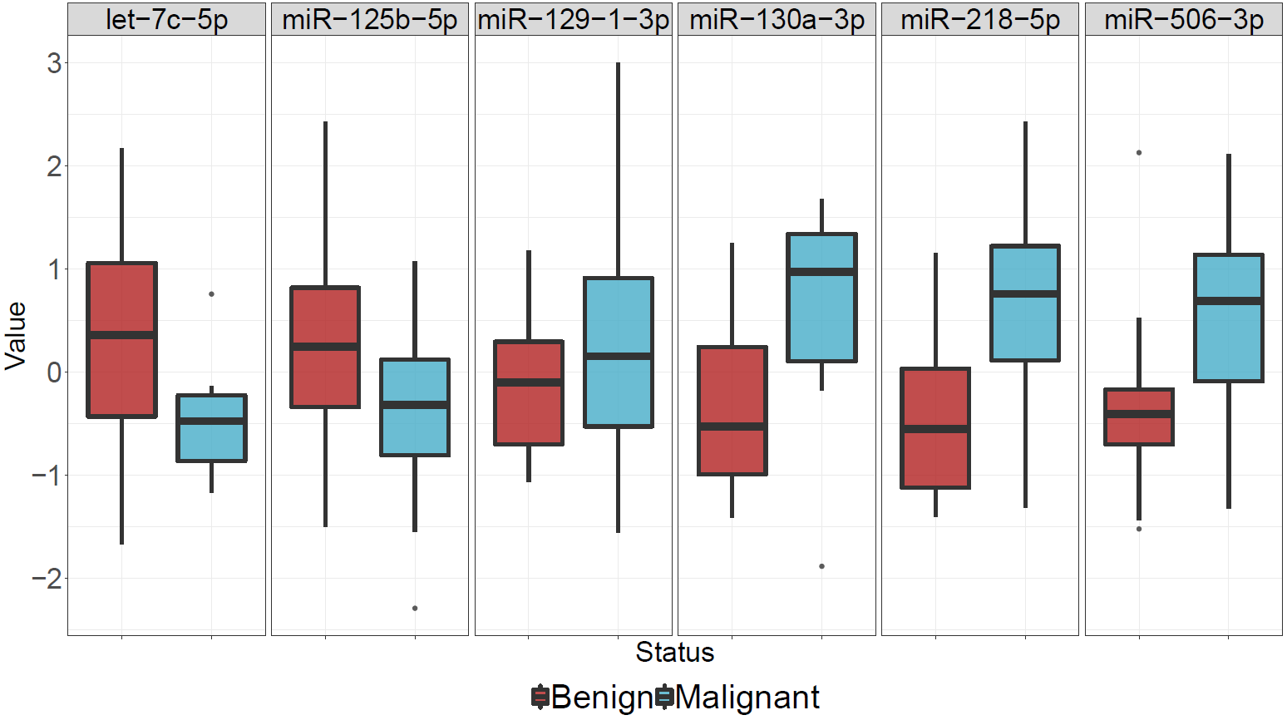
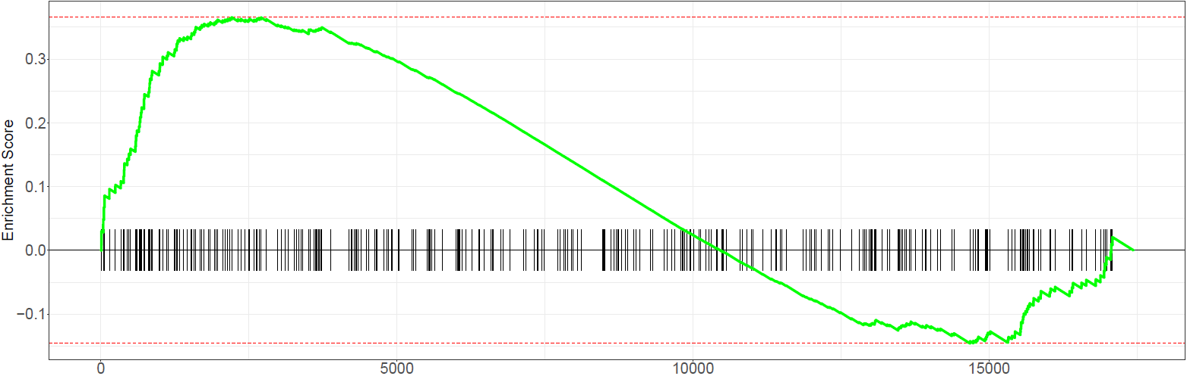
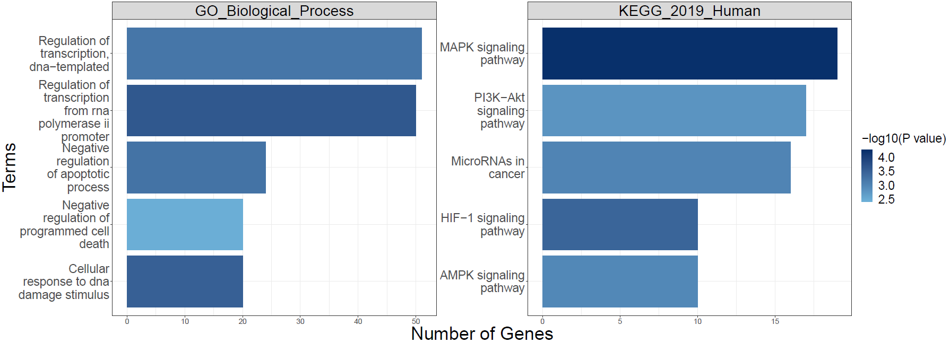




microRNA Expression Differences in Nasal Epithelium for Identifying Malignant Indeterminate Pulmonary Nodules
Boting Ning. Poster #:
*
*
*
*
*
*
Using nasal miRNA sequencing data, we have identified six miRNAs that were negatively correlated with their predicted target genes and were differentially expressed in patients with malignant IPNs
miRNAs
Using independent gene expression data, we found the target genes of miR-125b-5p were upregulated in cancer patients, suggesting the regulation of these genes during carcinogenesis process might be regulated by miR-125b-5p
NES = 1.49
P value = 0.0005
Target Genes
Functional analysis of the targets suggests that miR-125b-5p dysregulation might contribute to cancer through regulating critical cancer related pathways
Biological Function

