Slide 1
Retrospective analysis of the performance of MiPS in patients having had multi-parametric MRI
Yashar Niknafs
UofM EDRN BDL
University of Michigan

Slide 2
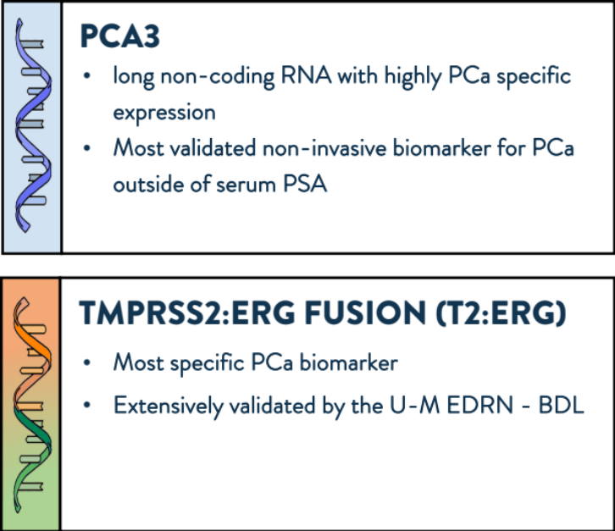
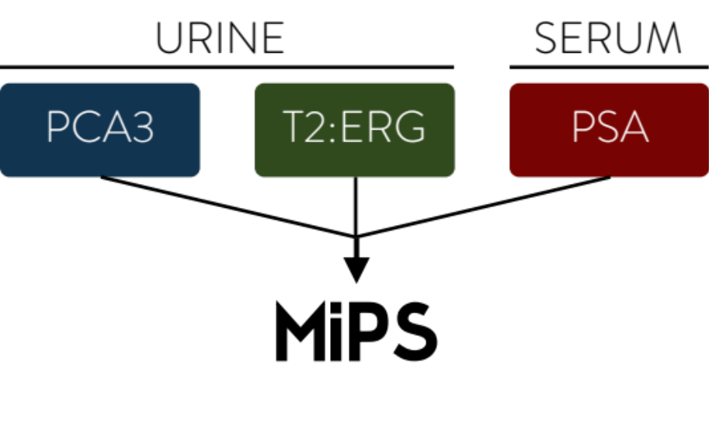
MiPS: Prostate cancer diagnostic

Slide 3
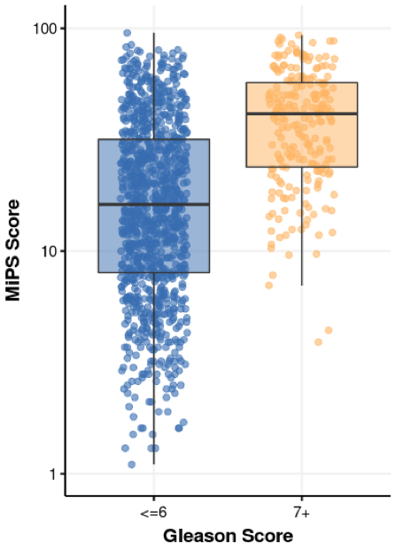
MiPS Performance
Validation Cohort:
1,244
Samples
Tomlins et al, Euro. Urol. 2016

Slide 4
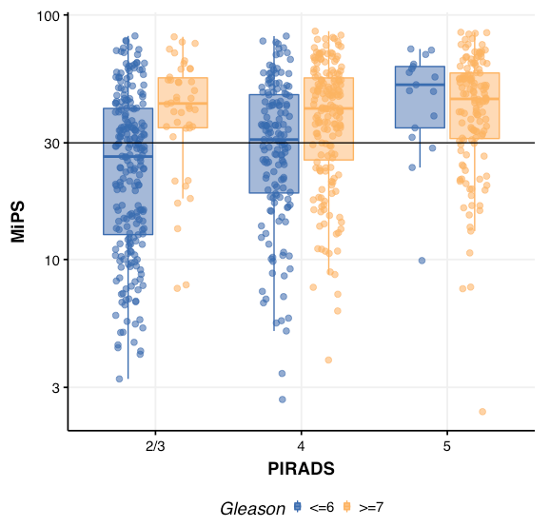
MiPS Risk Stratifies PIRADS2/3
Total:
743
PIRADS 2/3:
263
PIRADS 4/5:
475
Notes:
N =

Slide 5
MiPS Risk Stratifies PIRADS2/3
Total:
743
PIRADS 2/3:
263
PIRADS 4/5:
475
Notes:
N =

Slide 6
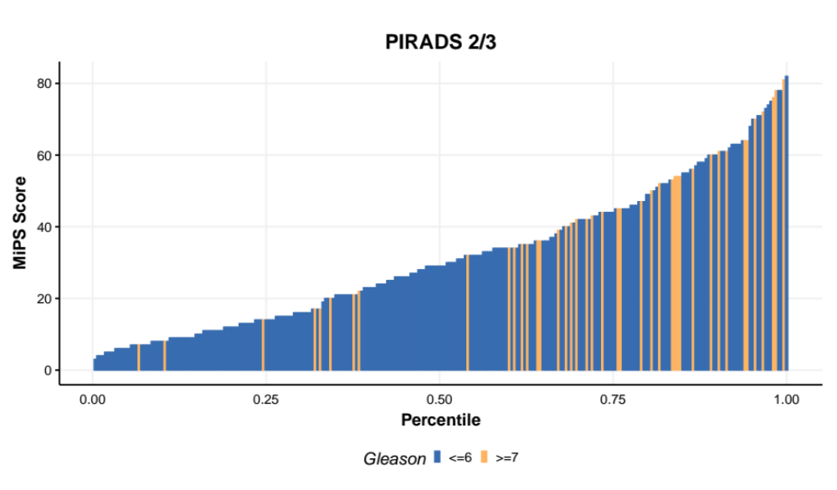
MiPS Risk Stratifies PIRADS2/3

Slide 7
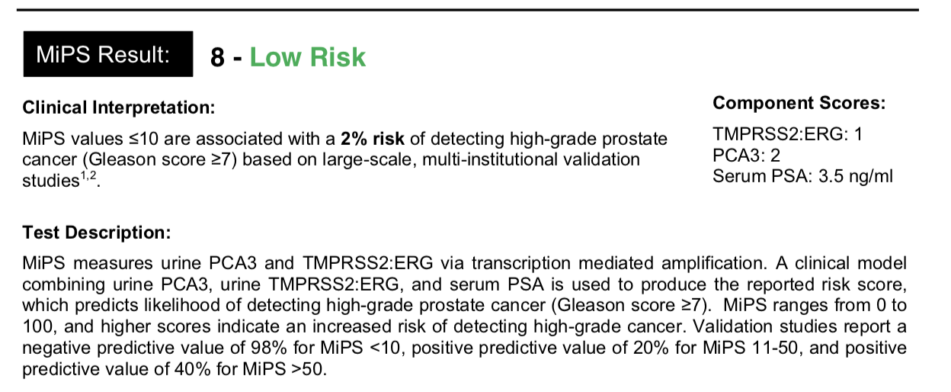
MiPS is available to order (and reimbursed)
Example clinical report:

Slide 8
Thanks
Poster #8
Poster # 50

