Slide 1
Multi-Modal Methods for Biomarker Discovery in Diseased Lung
Charmion Cruickshank-Quinn, Ph.D.
Application Scientist
EDRN Scientific Workshop
September 10, 2019
Bethesda, MD

Slide 2
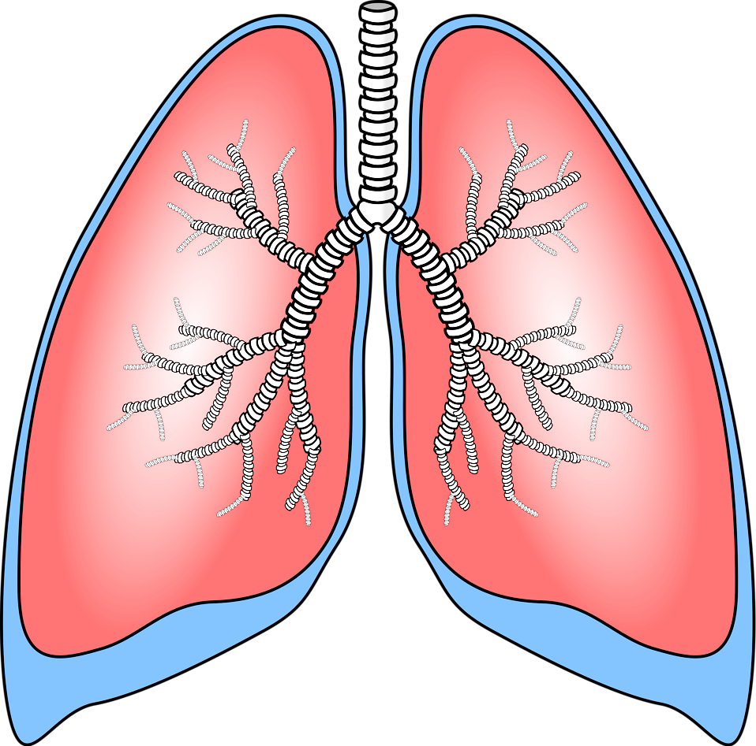
Overview
Background
Highlights From A Few Recent Multi-Modal Studies:
          What did we learn from murine models about chronic lung disease – a metabolomics and transcriptomics assessment?
          What did we learn from the COPDGene cohort – incorporating proteomics, metabolomics, transcriptomics, and whole genome expression?
          What did we learn from the SPIROMICS cohort – comparing lung lavage and plasma metabolomes?
Conclusion

Slide 3

Why Use Multiple Techniques?
July 12th in Colorado, 2018
Notes:
Here we have the option of one of 4 choices for season (spring, summer, fall, winter). The odds are in your favor. What do we all think?

Slide 4
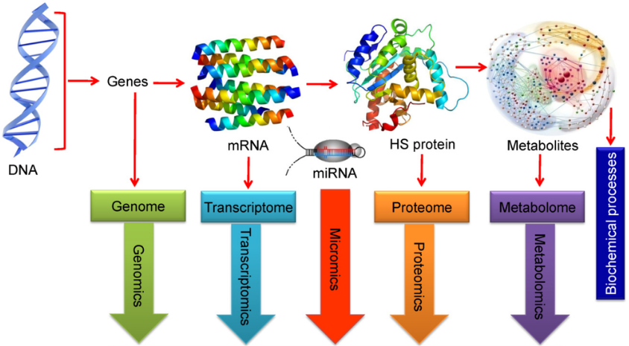
Why Use Multiple Techniques?
Research questions cannot be completely answered by using a single technique
There is cross-talk among the various –omes (e.g. genome, proteome, metabolome, microbiome…)
Increases ability to find a relationships or associations among genotype, phenotype, microbiome, environment, etc.
Gives ability to analyze complex biological data and find novel associations between biological entities
Notes:
Gene expression does not necessarily mean that we are making protein and that does not mean that we won’t see the associated metabolite changes, since metabolites are the closest that we can get the phenotype.

Slide 5
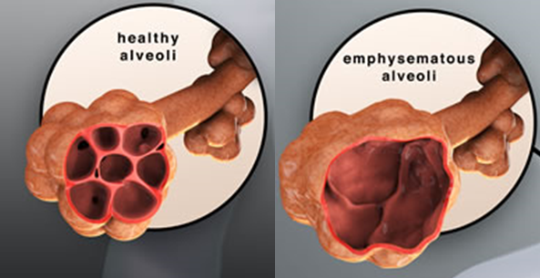
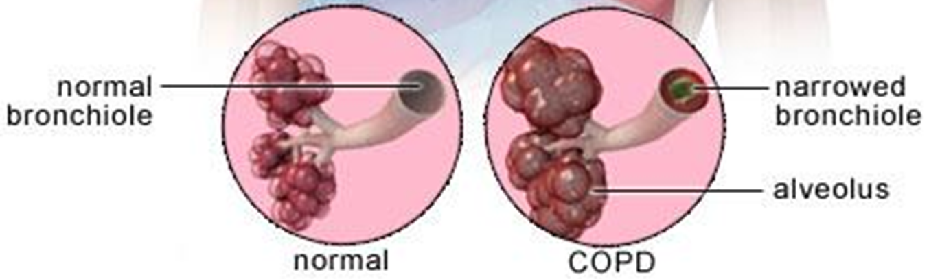
What is COPD?
Chronic Obstructive Pulmonary Disease (COPD)
Progressive and chronic lung disease
Difficulty breathing
Chest pain

Slide 6
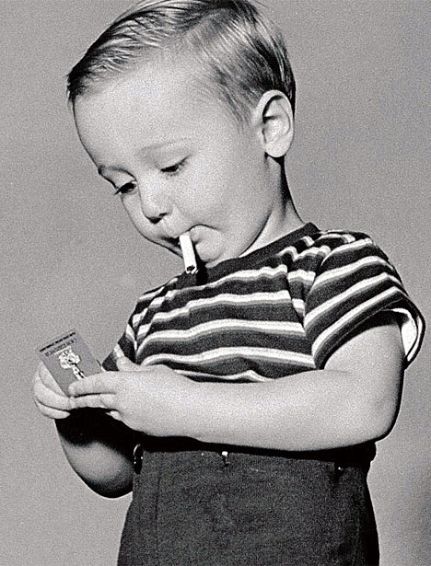
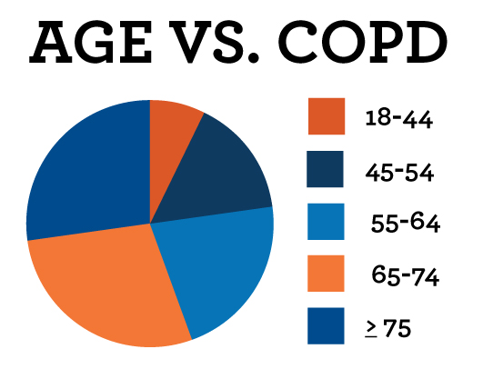
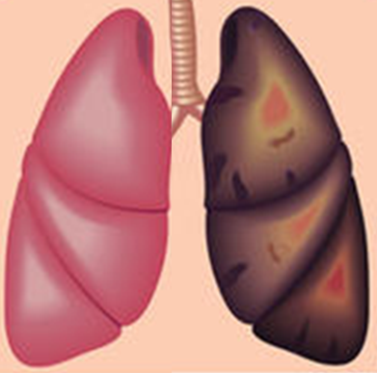


What Causes COPD and Why is it Important?
Healthy vs. Smoker
www.copdfoundation.org
$50 Billion
Notes:
20-30% of smokers develop COPD
Cigarette smoking causes more than 480,000 deaths yearly

Slide 7
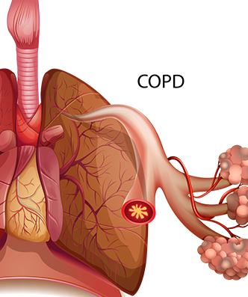

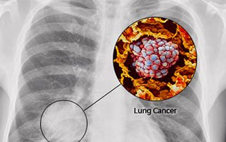
COPD is a Significant Risk Factor for Lung Cancer
80%
Detect and tease out biological markers associated with lung health
  critical to finding treatments and determine patient susceptibility to disease
Understand and distinguish between the markers of COPD versus those of lung cancer
  greatly increase our understanding of lung health and remove the cancer biomarker confounders
deaths
1%
per
year
deaths
90%
Notes:
Cigarette smoking causes more than 480,000 deaths yearly. It is responsible for 90% of all lung cancer deaths and 80% of all chronic obstructive pulmonary disease (COPD) deaths. COPD is a significant risk factor for lung cancer and the ability to detect and tease out biological markers associated with lung health is critical to finding treatments or determine patient susceptibility to disease.
- COPD is a significant risk factor for lung cancer. Approximately 1% of COPD patients develop lung cancer every year, which may be associated with genetic susceptibility to cigarette smoke.
- Approximately 1% of COPD patients develop lung cancer every year, which may be associated with genetic susceptibility to cigarette smoke.
- Understanding and distinguishing the markers of COPD with those of lung cancer will greatly increase our understanding of lung health.

Slide 8
Part 1 of 3
What did we learn from murine models?

Slide 9

Murine Model of Emphysema
n = 10 mice/group (plasma metabolomics)
n = 5 mice/group (lung tissue transcriptomics)
Miller, M. et al. Gene and metabolite time-course response to cigarette smoking in mouse lung and plasma. PLoS ONE 12, e0178281, doi:10.1371/journal.pone.0178281 (2017).
Notes:
Whole lung RNA-seq data was analyzed at transcript and exon levels

Slide 10
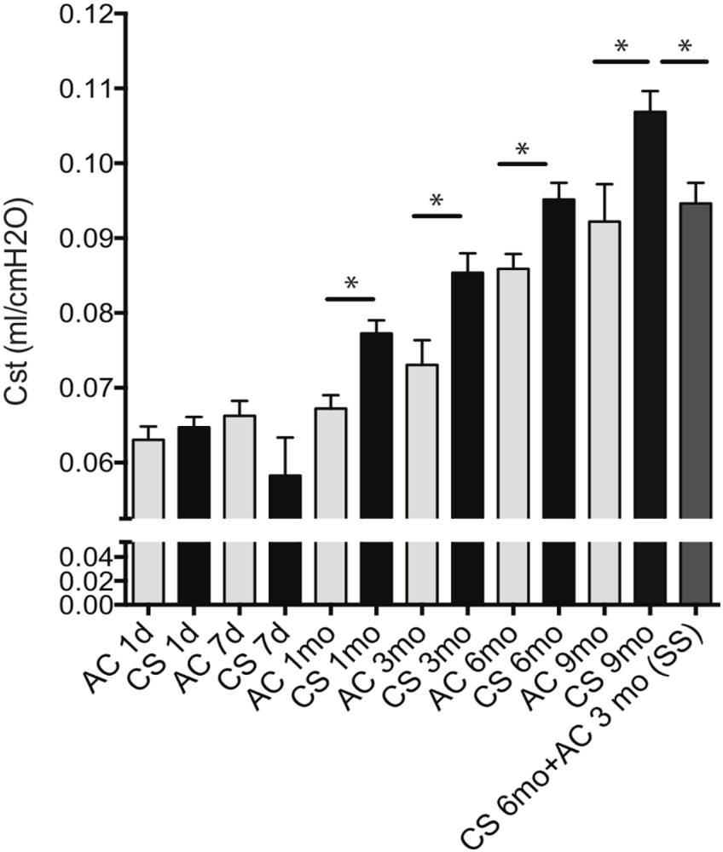

Mean Static Lung Compliance
Lung compliance (pulmonary compliance) measures the lung's ability to stretch and expand.
Static lung compliance is the change in volume for any given applied pressure.
Low compliance: a stiff lung (one with high elastic recoil) e.g. fibrosis.
High compliance: a pliable lung (one with low elastic recoil) e.g. emphysema.
Miller, M. et al. Gene and metabolite time-course response to cigarette smoking in mouse lung and plasma. PLoS ONE 12, e0178281, doi:10.1371/journal.pone.0178281 (2017).
Notes:
Here we have the clinical parameters. Cst measured by the flexiVent™ instrument for each experimental group at each time point. C57Bl/6 mice were exposed to ambient air (AC, grey bars) or chronic cigarette smoke (CS, black bars) for the indicated duration of time measured in days (d) or months (mo). In one group of mice that underwent smoking cessation (SS; stop smoking, dark grey bar), mice were allowed to recover at ambient air (AC) for 3 months following a 6 months CS exposure. N = 10 mice /group. Horizontal bars with asterisk indicate significant differences in mean static lung compliance (p<0.05). Bars represent the standard error of the mean.

Slide 11
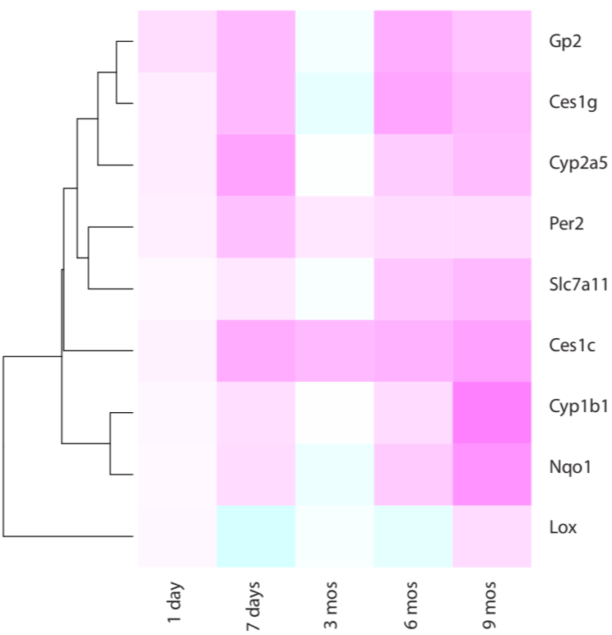
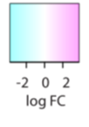
Relative Changes in Gene Expression using RNA-Seq
Differential expression of these genes required more than 1 day of CS exposure.
The persistently up-regulated genes regulate:
  xenobiotics metabolism
  metabolism of cofactors/vitamins
  lipid metabolism
  circadian rhythm
Changes are relative to the air controls at each time point.
Pink: Positive fold change ➔ up-regulation in CS-exposed mice.
Blue: Negative fold change ➔ down-regulation in CS-exposed mice.
Miller, M. et al. Gene and metabolite time-course response to cigarette smoking in mouse lung and plasma. PLoS ONE 12, e0178281, doi:10.1371/journal.pone.0178281 (2017).
Notes:
Singleread 100 bp sequencing was performed on an Illumina HiSEQ 2000 instrument
Log2 FC in CS-exposed mice compared to AC mice of the 9 genes found to statistically significantly differentially expressed at four of five time points (FDR0.10). Positive fold change (pink) indicates upregulation in CS-exposed mice; negative fold change (blue) indicates downregulation in CS-exposed mice.
Only one gene (Lox, which encodes for lysyl oxidase involved in crosslinking of collagens and elastin) was bi-directionally regulated, although upregulation was only observed at 6 months of CS exposure with most other time points showing significant downregulation (at 7 days, 3 months, and 9 months of CS exposure).

Slide 12
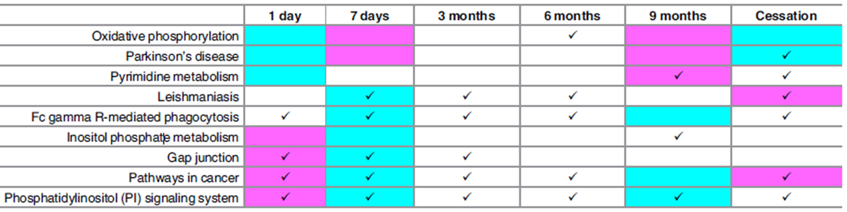

Pathway Overlap Between Lung Transcriptomics and Plasma Metabolomics
Miller, M. et al. Gene and metabolite time-course response to cigarette smoking in mouse lung and plasma. PLoS ONE 12, e0178281, doi:10.1371/journal.pone.0178281 (2017).
Notes:
Pathways overlapping between transcriptomic and metabolomic data. Checkmarks signify significant pathway perturbation in metabolomic data (p<0.05), pink shading denotes enrichment for upregulated genes in that pathway in CS-exposed mice; blue shading indicates enrichment for downregulation in CS-exposed mice (FDR0.10). Perturbations indicated by shaded fields under the Cessation column persisted following cessation when compared to AC mice.

Slide 13
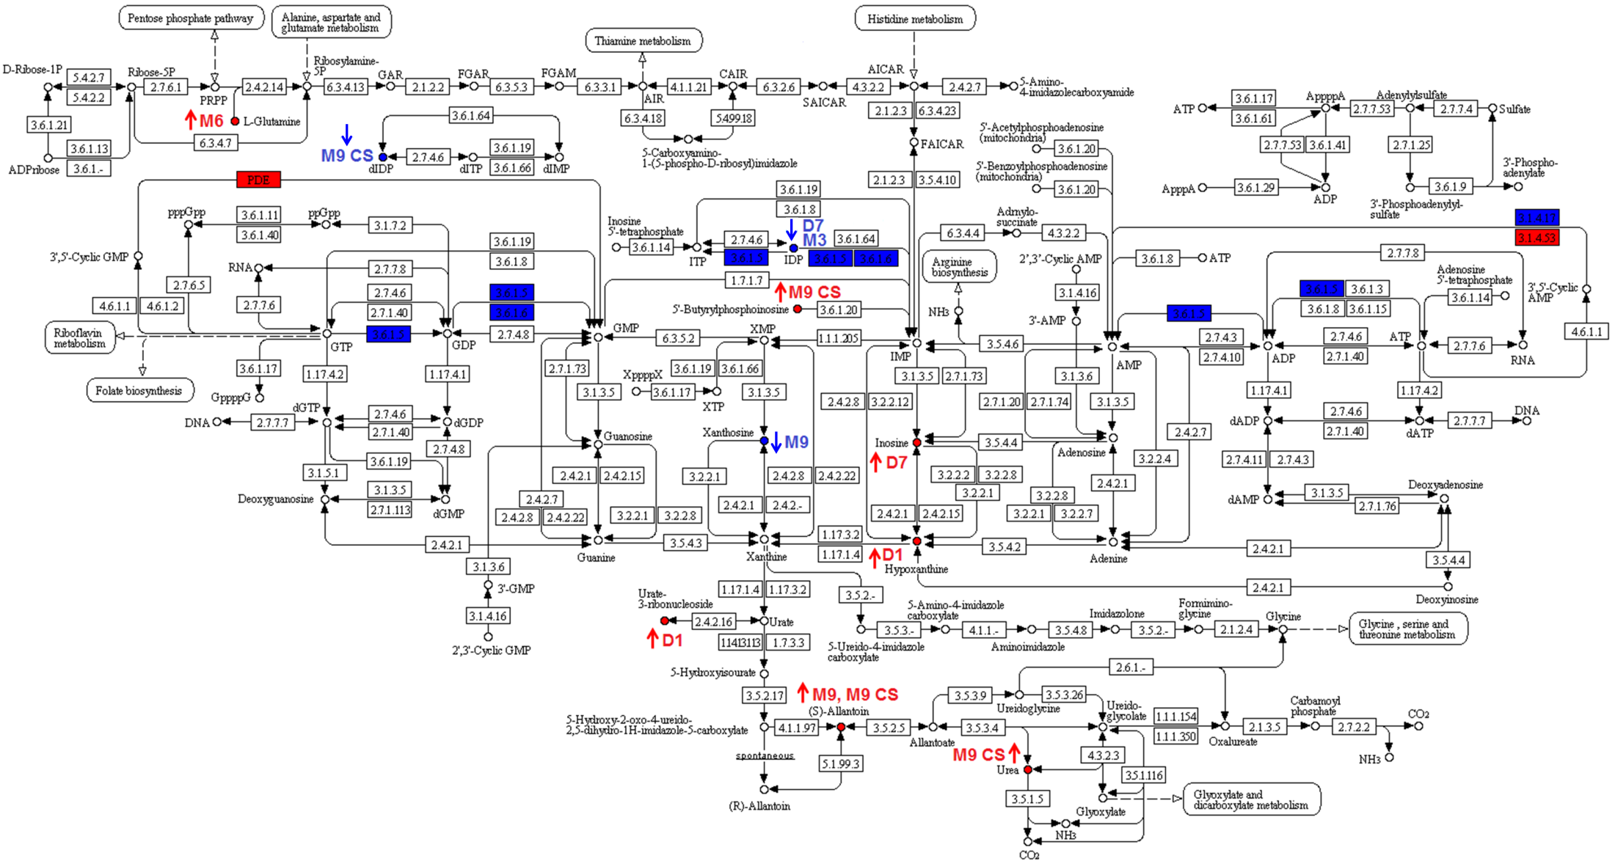
Plasma Metabolomics & Lung Transcriptomics
Pde4b: up
Pde6g: up
Cant1: down
Entpd8: down
Pde3a: down
Pde11a: down
Red indicates up-regulated with smoking
Blue indicates down-regulated in response to cigarette smoke

Slide 14


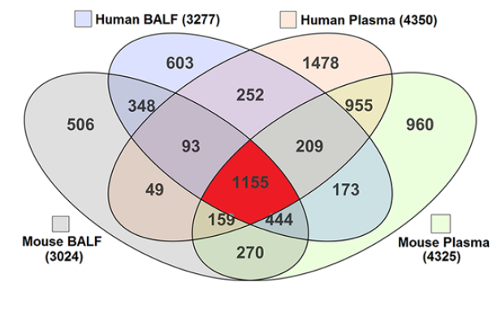
Metabolome Overlap in Mouse and Human Biological Fluids
n = 5 ambient air
n = 5 cigarette smoke
n = 5 humans
Cruickshank-Quinn, C. et al. Metabolomic similarities between bronchoalveolar lavage fluid and plasma in humans and mice. Sci Rep 7, doi:10.1038/s41598-017-05374-1 (2017).
Notes:
Samples from the previous study were then used to determine whether there was congruency between BAL and plasma, so that plasma could be used in lieu of BAL in follow up mouse and human studies.
Air control for 1 day (n=5), Cigarette smoke for 9 months (n=5).
Pretty decent overlap of compounds across the various biological fluids.

Slide 15
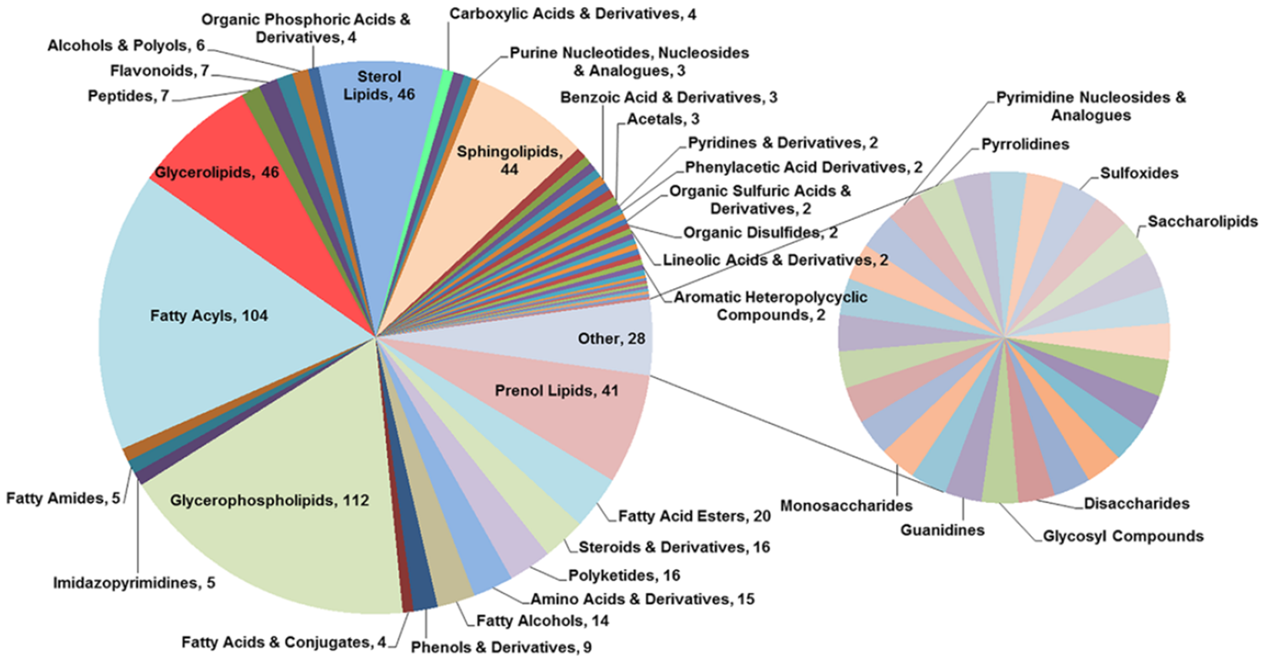
Distribution of Biochemical Classes Represented by 1155 Compounds Detected in Human and Mouse BAL Fluid and Plasma
Cruickshank-Quinn, C. et al. Metabolomic similarities between bronchoalveolar lavage fluid and plasma in humans and mice. Sci Rep 7, doi:10.1038/s41598-017-05374-1 (2017).
Notes:
Since the overlap was good, we wanted to see if there were any compounds classes that were enriched.

Slide 16
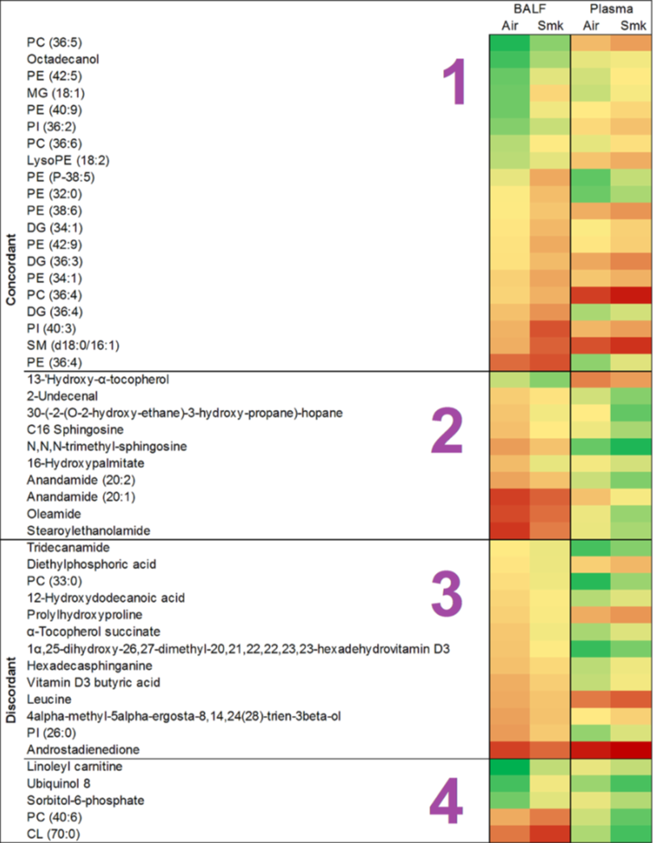

BAL Fluid and Plasma Metabolome Changes in Response to Acute Cigarette Smoke Exposure
Log2 abundance
Significant in
Plasma (124)
Significant in
BAL Fluid (380)
76
332
48
Green: low abundance
Red: high abundance
(n = 7 mice/group)
Compounds that are up-regulated in both BAL fluid and plasma
Compounds that are down-regulated in both BAL fluid and plasma
Compounds that are down-regulated in BAL fluid and up-regulated in plasma
Compounds that are upregulated in BAL fluid and down-regulated in plasma in response to CS-exposure
Cruickshank-Quinn, C. et al. Metabolomic similarities between bronchoalveolar lavage fluid and plasma in humans and mice. Sci Rep 7, doi:10.1038/s41598-017-05374-1 (2017).
Notes:
So we wanted to see if the congruent compounds were also expressed in the same direction in both BAL fluid and plasma

Slide 17
Summary
We used multi-omics approaches to study COPD using a mouse cohort comprising healthy mice and mice with emphysema.
    Identified previously unreported dysregulation of pyrimidine metabolism and phosphatidylinositol signaling pathways.
    Confirmed alterations in glutathione metabolism and circadian gene pathways.
    Almost all dysregulated pathways were reversible upon smoking cessation, except the lysosome pathway.
    Smoking-induced lung pathway changes were validated using metabolomic profiles of matched plasma samples.
We examined congruency between biological fluids in the mouse cohort as a potential non-invasive means for sampling disease.
    1155 compounds were common to all four sample types with strong overlap with fatty acyls and glycerophospholipids.
    BAL fluid metabolome appeared to be more affected by smoking than plasma.
Miller, M. et al. Gene and metabolite time-course response to cigarette smoking in mouse lung and plasma. PLoS ONE 12, e0178281, doi:10.1371/journal.pone.0178281 (2017).
Cruickshank-Quinn, C. et al. Metabolomic similarities between bronchoalveolar lavage fluid and plasma in humans and mice. Sci Rep 7, doi:10.1038/s41598-017-05374-1 (2017).
Notes:
These results gave us promise for subsequent human studies.
We identified previously unreported dysregulation of pyrimidine metabolism and phosphatidylinositol signaling pathways and confirmed alterations in glutathione metabolism and circadian gene pathways.
Almost all dysregulated pathways demonstrated reversibility upon smoking cessation, except the lysosome pathway. Chronic CS exposure was significantly linked with alterations in pathways encoding for energy, phagocytosis, and DNA repair and triggered differential expression of genes or exons previously unreported to associate with CS or COPD, including Lox, involved in matrix remodeling, Gp2, linked to goblet cells, and Slc22a12 and Agpat3, involved in purine and glycerolipid metabolism, respectively. CS-induced lung metabolic pathways changes were validated using metabolomic profiles of matched plasma samples, indicating that dynamic metabolic gene regulation caused by CS is reflected in the plasma metabolome. Using advanced technologies, our study uncovered novel pathways and genes altered by chronic CS exposure, including those involved in pyrimidine metabolism, phosphatidylinositol signaling and lysosome function, highlighting their potential importance in the pathogenesis or diagnosis of CS-associated conditions.
There were 1155 compounds in common in all 4 sample types; fatty acyls and glycerophospholipids strongly overlapped between groups. In humans and mice, more than half of the metabolites present in BALF were also present
in plasma. Mouse BALF and human BALF had a strong positive correlation with 2040 metabolites in common, suggesting that mouse models can be used to interrogate human lung metabolome changes. While power was affected by small sample size in the mouse study, the BALF metabolome appeared to be more affected by CS than plasma. CS-exposed mice showed increased plasma and BALF glycerolipids and glycerophospholipids. This is the first report cataloguing the metabolites present across mouse and human, BALF and plasma. Findings are relevant to translational studies where mouse models are used to examine human disease, and where plasma may be interrogated in lieu of BALF or lung tissue.

Slide 18
Part 2 of 3
What can we learn from the COPDGene cohort?
Notes:
The results from the mouse studies gave us promise for subsequent human studies.

Slide 19
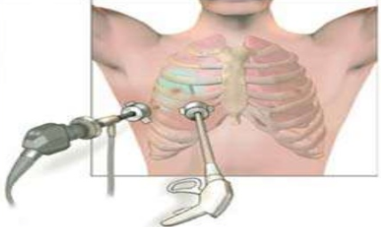
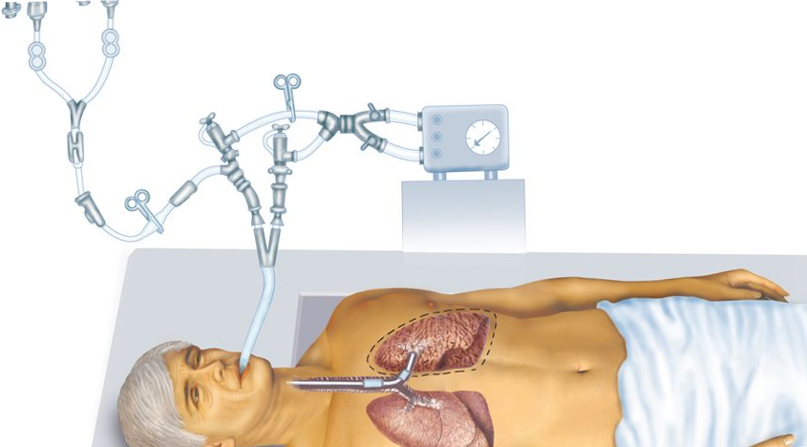
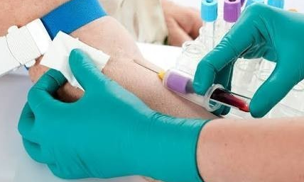
Why blood?
Bronchoscopy
Tissue Biopsy
https://www.slideshare.net/danielvhenny/test-to-be-taken-for-symptoms-of-lung-cancer
https://mesotheliomaresearchnews.com/2016/12/12/bronchoalveolar-lavage-can-also-determine-asbestos-exposure-disease-risk-study-says
https://www.indiamart.com/proddetail/blood-sample-collection-18179361512.html
Notes:
The results from the mouse studies gave us promise for subsequent human studies.
Less invasive and less time consuming than BAL fluid and lung tissue collection, especially in human studies.
Mice were shown to have similar blood metabolome profiles to lung lavage.

Slide 20

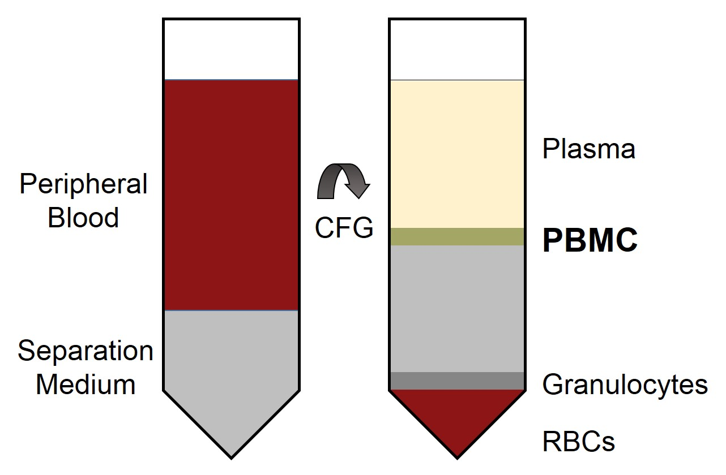
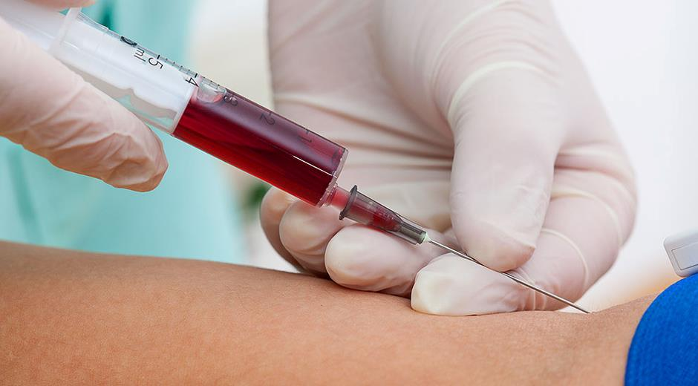
Study Design
Plasma Proteomics, PBMC Gene Expression, and Genetics
Plasma Proteomics
(n = 541)
n = 214 - 541
PBMC Whole Genome Expression
(Affymetrix or OpenArray)
(n = 214)
https://www.cellapplications.com/human-peripheral-blood-mononuclear-cells-pbmchmnc-pb
COPD cohort: Genetic Epidemiology of COPD (COPDGene)
PBMC: Peripheral blood mononuclear cells
Bowler, R. P. et al. Integrative omics approach identifies interleukin-16 as a biomarker of emphysema. OMICS : A Journal of Integrative Biology 17, 619-626, doi:10.1089/omi.2013.0038 (2013).
Notes:
COPD and controls were similar in age, gender, BMI, and smoking status (current or former). But average pack years was higher for COPD compared to controls.
IL-16 mRNA levels were measured in PBMCs
Protein levels were measured in fresh frozen plasma

Slide 21
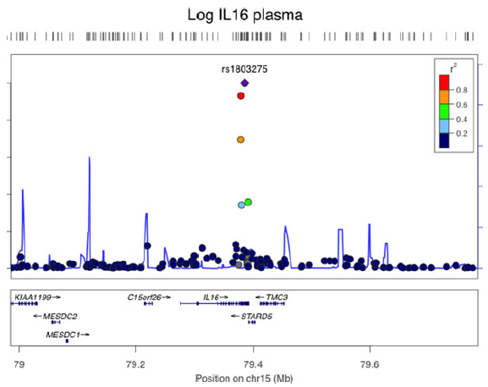
Regional plot on chromosome 15q26.3 of SNPs associated with plasma IL-16 concentrations
The purple diamond: top SNP, which has the strongest evidence of association
Each circle shows a SNP with a color scale relating the r2 value for that SNP and the top SNP from HapMap CEU (Build Hg19)
Blue lines indicate estimated recombination rates from HapMap
Bottom panels illustrate the relative position of genes near each locus. Candidate genes are indicated with directional arrows.
Bowler, R. P. et al. Integrative omics approach identifies interleukin-16 as a biomarker of emphysema. OMICS : A Journal of Integrative Biology 17, 619-626, doi:10.1089/omi.2013.0038 (2013).
Notes:
Expression quantitative trait loci (eQTL) analysis seeks to identify genetic variants that affect the expression of one or more genes: a gene-SNP pair for which the expression of the gene is associated with the allelic configuration of the SNP is referred to as an eQTL.
Whole-genome expression quantitative trait locus (eQTL) analysis identified a novel IL-16 missense SNP (rs11556218) associated with lower IL-16 in plasma

Slide 22
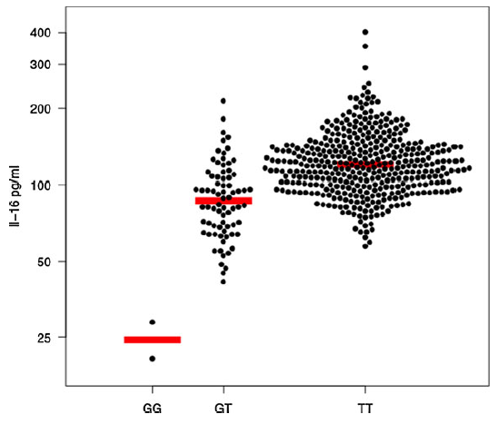
IL-16:
A Potential Candidate Biomarker for COPD & Emphysema
Plasma IL-16 concentration by genotype
Pro-inflammatory in Th1 cells
Suppressive of Th2 cytokines
Expressed in lymphocytes and in bronchial epithelium
An immune modulating protein
GG: subject has two copies of the ancestral allele
GT: subject has one copy of the minor allele
TT: subject has two copies of the minor allele
Horizontal line = median
Bowler, R. P. et al. Integrative omics approach identifies interleukin-16 as a biomarker of emphysema. OMICS : A Journal of Integrative Biology 17, 619-626, doi:10.1089/omi.2013.0038 (2013).
Notes:
- Since IL-16 has confounders such as gender and smoking status, this was adjusted for in this study.
Plasma IL-16 was negatively associated with emphysema in the upper lobes
PBMC IL-16 expression was positively associated with emphysema.

Slide 23
Summary
Whole-genome expression quantitative trait locus (eQTL) analysis identified a novel IL-16 missense SNP (rs11556218) associated with lower IL-16 in plasma.
Plasma IL-16 was negatively associated with emphysema in the upper lobes.
An integrated ‘‘omics’’ analysis
    identified an association between decreased IL-16 and emphysema
    discovered a novel IL-16 cis-eQTL
Therefore IL-16 plasma levels and IL-16 genotyping may be useful in a personalized medicine approach for lung disease.
Bowler, R. P. et al. Integrative omics approach identifies interleukin-16 as a biomarker of emphysema. OMICS : A Journal of Integrative Biology 17, 619-626, doi:10.1089/omi.2013.0038 (2013).

Slide 24
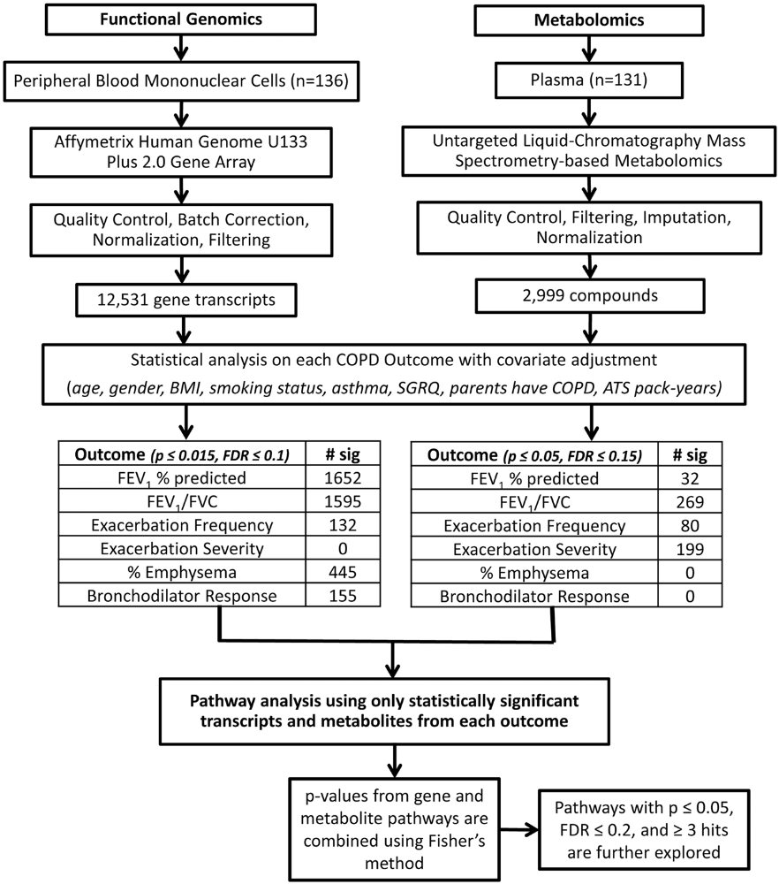
Study Design
Functional Genomics
& Metabolomics
n = 136
COPD cohort: Genetic Epidemiology of COPD (COPDGene)
Cruickshank-Quinn, C. I. et al. Metabolomics and transcriptomics pathway approach reveals outcome-specific perturbations in COPD. Sci Rep 8, 17132, doi:10.1038/s41598-018-35372-w (2018).

Slide 25
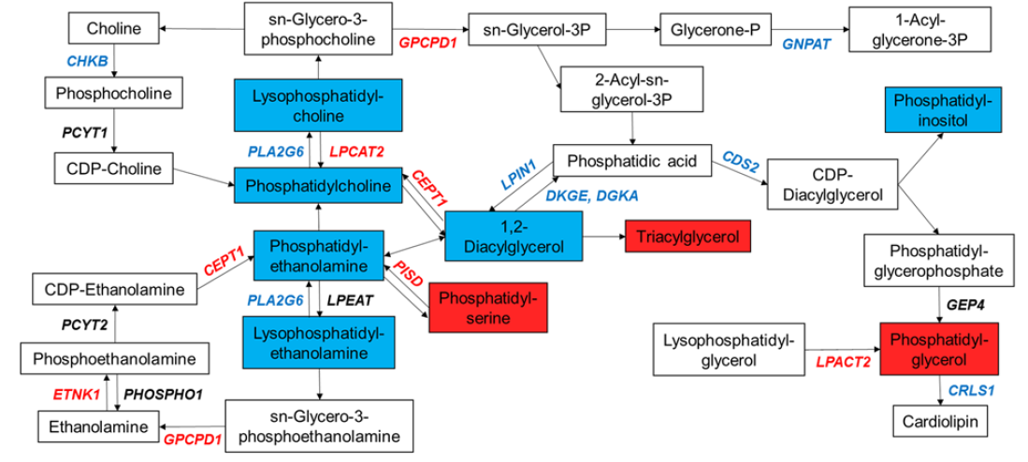
Perturbation in Glycerophospholipid Metabolism from FEV₁% Predicted Analysis
Red font and red boxes indicate associated with an increase with worsening disease
Blue font and blue boxes indicate associated with a decrease with worsening disease
Cruickshank-Quinn, C. I. et al. Metabolomics and transcriptomics pathway approach reveals outcome-specific perturbations in COPD. Sci Rep 8, 17132, doi:10.1038/s41598-018-35372-w (2018).
Notes:
Although we see some areas where the genes and metabolites are similarly regulated, we also see areas where the directions are not the same and the correlations are not all positive.
Gene expression does not mean we are making protein and therefore we may not always see the downstream phenotypic response from the metabolites. This is why multi-modal is so important, because it gives us more information that we can use to infer potential other relationships.

Slide 26
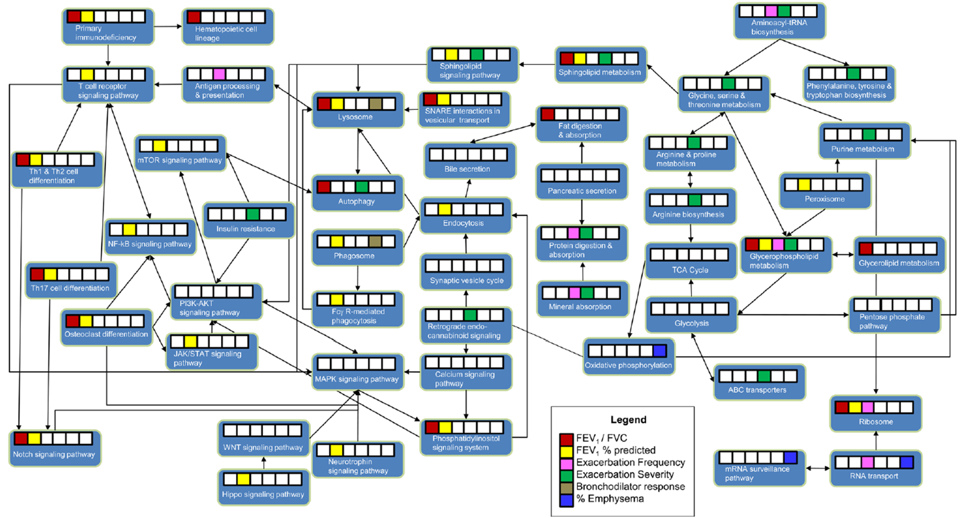
Overview of Outcome Perturbations and Pathway Relationships
Cruickshank-Quinn, C. I. et al. Metabolomics and transcriptomics pathway approach reveals outcome-specific perturbations in COPD. Sci Rep 8, 17132, doi:10.1038/s41598-018-35372-w (2018).

Slide 27
Summary
Using a more targeted approach, combining plasma proteomics, PBMC gene expression, and genetics identified IL-16 as a potential blood protein marker of emphysema
Using an untargeted pathway enrichment approach, overlapping transcriptomic and metabolomics datasets enabled phenotype-specific differences to be determined
    Glycerophospholipid metabolism was associated with worse airflow obstruction and more COPD exacerbations.
    Sphingolipid metabolism was associated with worse lung function outcomes and exacerbation severity requiring hospitalizations.
Incomplete picture if only a single platform was used. For example:
    Exacerbation severity was significant in metabolomics but not functional genomics
    Emphysema was significant in functional genomics but not metabolomics
Bowler, R. P. et al. Integrative omics approach identifies interleukin-16 as a biomarker of emphysema. OMICS : A Journal of Integrative Biology 17, 619-626, doi:10.1089/omi.2013.0038 (2013).
Cruickshank-Quinn, C. I. et al. Metabolomics and transcriptomics pathway approach reveals outcome-specific perturbations in COPD. Sci Rep 8, 17132, doi:10.1038/s41598-018-35372-w (2018).

Slide 28
Part 3 of 3
What did we learn from the SPIROMICS cohort?

Slide 29
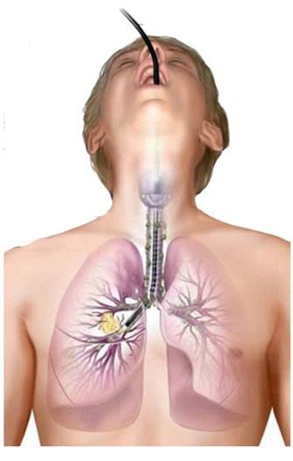





Study Design
Lung Lavage
LCMS Metabolomics
n = 115
Plasma
COPD cohort: Subpopulations and Intermediate Outcomes in COPD Study (SPIROMICS)
Halper-Stromberg, E. et al. Bronchoalveolar Lavage Fluid from COPD Patients Reveals More Compounds Associated with Disease than Matched Plasma. Metabolites 9, 157, doi:10.3390/metabo9080157 (2019)

Slide 30
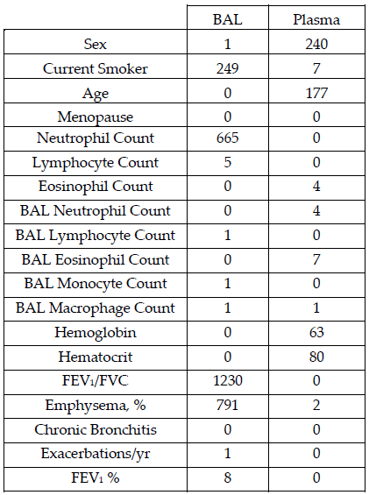
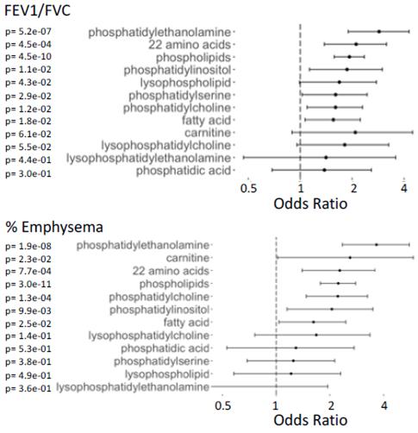
Significantly Associated Compounds with Clinical, Cell-type and COPD Sub-phenotypes Variables
Enrichment of compound classes
Halper-Stromberg, E. et al. Bronchoalveolar Lavage Fluid from COPD Patients Reveals More Compounds Associated with Disease than Matched Plasma. Metabolites 9, 157, doi:10.3390/metabo9080157 (2019)
Notes:
Emphysema was also not significant in the plasma COPDGene cohort

Slide 31
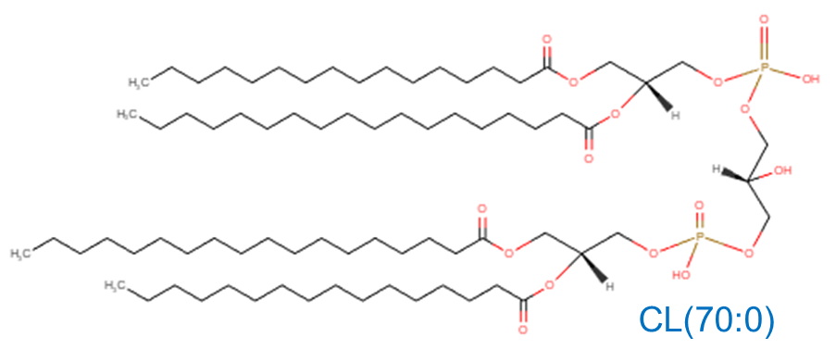
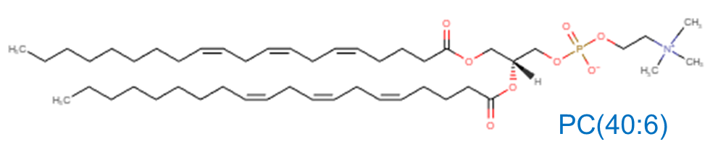
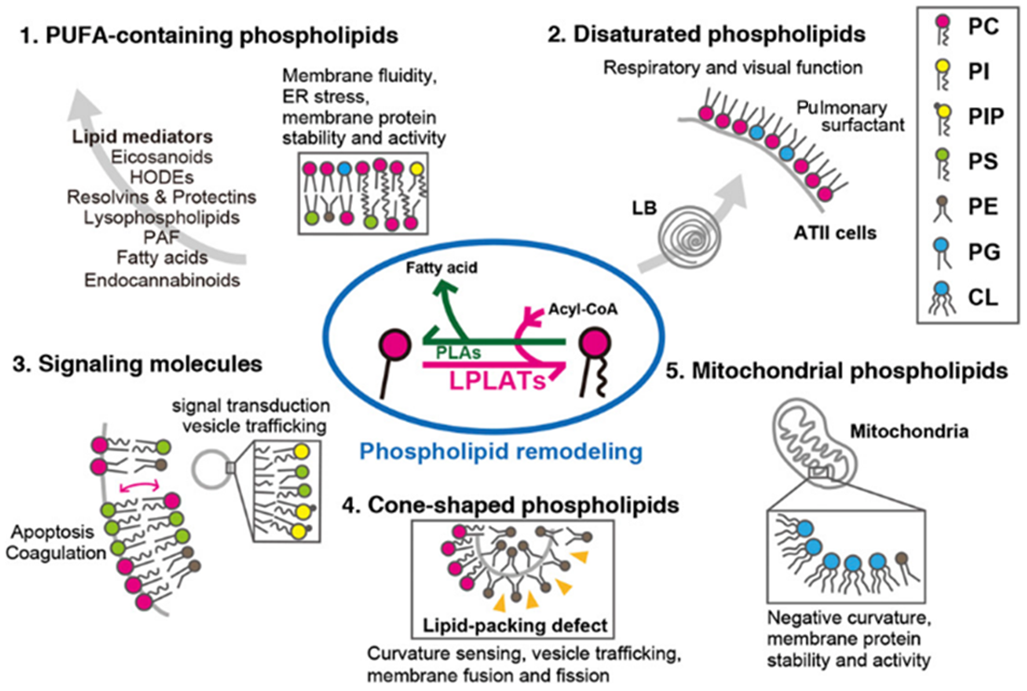
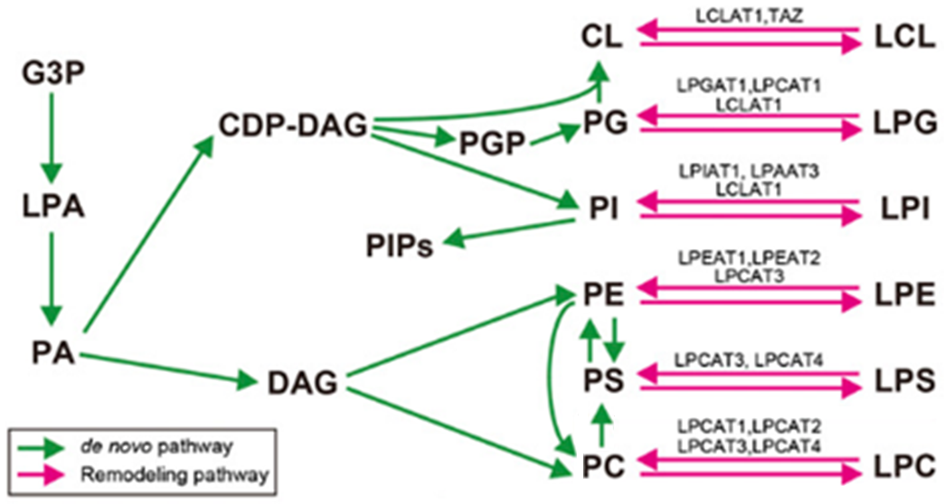
Biological Relevance of PC and CL
PC(40:6) and CL(70:0) decreased in plasma & increased in lung lavage fluid with worsening COPD for SPIROMICS, but also with emphysema for the murine model.
PC(40:6) decreased in plasma with increasing exacerbations for COPDGene.
Biosynthetic pathway of GPL
Hishikawa, D., et al. Diversity and function of membrane glycerophospholipids generated by the remodeling pathway in mammalian cells. J. Lipid Res. 55, 799-807, doi:10.1194/jlr.R046094 (2014).
Notes:
The increase in PC in lung lavage could indicate accumulation of membrane phospholipids being derived from inflammatory cells such as neutrophils. PCs can be synthesized via three different routes.
The pulmonary surfactant is composed of approximately 90% lipids, with about 85% being phospholipids, of which 70-80% are PCs. Surfactant is important for gas exchange, defense against toxins and other microorganisms, and pulmonary compliance.
While most lipids are made in the endoplasmic reticulum, cardiolipin is synthesized on the matrix side of the inner mitochondrial membrane and are important for mitochondrial respiratory capacity.
PC(40:6), C₄₈H₈₄NO₈P, is a phosphatidylcholine. Phospholipids are key components of the lipid bilayer of cells, as well as being involved in metabolism and signaling. Phospholipids continuously remodel while present in membranes.
CL(70:0), C₇₉H₁₅₄O₁₇P₂, is a cardiolipin. Cardiolipins are known to be present in all mammalian cells, especially cells with a high number of mitochondria and play an important role in the blood clotting process

Slide 32
Summary
When replicating the findings in a human cohort of 115 human subjects, there was:
    Little correlation between BAL fluid and plasma for COPD
    The majority of significant compounds were found in BAL rather than plasma
    BAL was better than plasma at distinguishing disease state
PC(40:6) and CL(70:0) were significant across multi-modal studies.
These COPD biomarkers are highly relevant to lung cancer research as they may potentially serve as early detection markers.
The association of these markers in cigarette smoke exposure may be useful markers in lung cancer intervention.
Halper-Stromberg, E. et al. Bronchoalveolar Lavage Fluid from COPD Patients Reveals More Compounds Associated with Disease than Matched Plasma. Metabolites 9, 157, doi:10.3390/metabo9080157 (2019)

Slide 33

Overall Summary
Multi-modal has provided us with a more complete understanding of disease.
This has enabled us to now focus our analyses on very specific routes in future studies.
Notes:
Keep in mind that other studies may bear entirely different results, and we won’t known unless we do the research to figure it out,
So based on what we all know, we should not assume that my husband is in a boat on the water but rather than maybe he is in a park in Nashville, TN.

Slide 34




Acknowledgements
University of Colorado Anschutz Medical Campus
National Jewish Health
Nichole Reisdorph, Ph.D.
Roger Powell, M.S.
Michael Armstrong, B.S.
Kevin Quinn, Ph.D.
Richard Reisdorph, Ph.D.
Russell Bowler, M.D., Ph.D.
Sean Jacobson, M.S.
Eitan Halper-Stromberg, M.D., Ph.D.
Lucas Gillenwater, MPH.
Katerina Kechris, Ph.D.
Michaela Miller, M.S.
Timothy Bahr, M.S.
Grant Hughes, M.S.
Irina Petrache, M.D.
Matthew Justice, Ph.D.
Kelly Schweitzer, Ph.D.
Kengo Koike, M.D., Ph.D.
Agilent
Funding
Dave Hubley, M.S.
Daniel Cuthbertson, Ph.D
Carol Ball, Ph.D.
NIH/NHLBI P20 HL113445, U01 HL089856, U01 HL089897, R01 HL 095432, R01 HL137995, R01 HL125583
NIH/NCRR UL1 RR025780, CCTSI NIH UL1 TR001082,
NIH/NCI Cancer Center Support Grant P30 CA046934

Slide 35
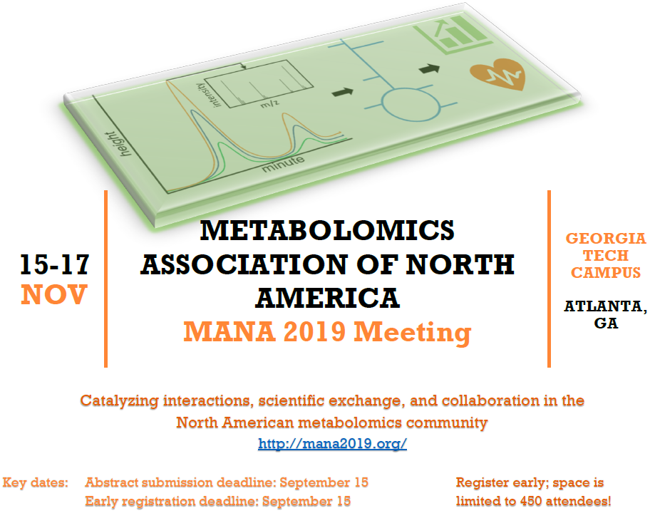
Early Career Travel Awards
Abstract Categories
Biomedical applications, from disease to exposome
Computational approaches (Bioinformatics/Cheminformatics / Modeling)
Ecology and Environmental Metabolomics
Flux profiling
Imaging
Lipidomics
Metabolite identification
Microbiome applications
Model Organisms
Multi-omics
New Experimental Methods & Technologies
Non-model systems and other applications
Nutrition, Food, Herbal Medicines
Plant metabolomics
MANA Young Investigator Award
Notes:
I am on the organizing committee. Go to this meeting and learn about metabolomics and metabolomics applications. Early career networking opportunities.

Slide 36



Thank you for your attention!!
Charmion.Cruickshank-Quinn@agilent.com

