Slide 1

Objectives of the CPDPC
Stephen Pandol (Cedars-Sinai Medical Center, Los Angeles)
Chris Forsmark (University of Florida, Gainesville)
Jo Ann Rinaudo (NCI)
Jose Serrano (NIDDK)

Slide 2
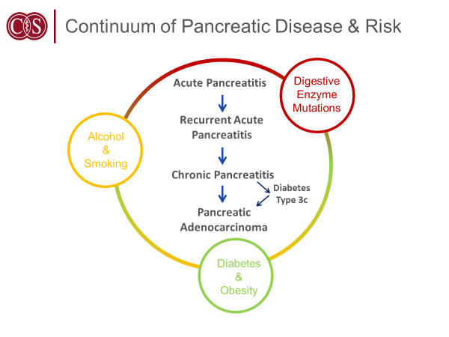

Slide 3
Dual “causality”
PDAC
CP
Type 2 and Type3c DM

Slide 4
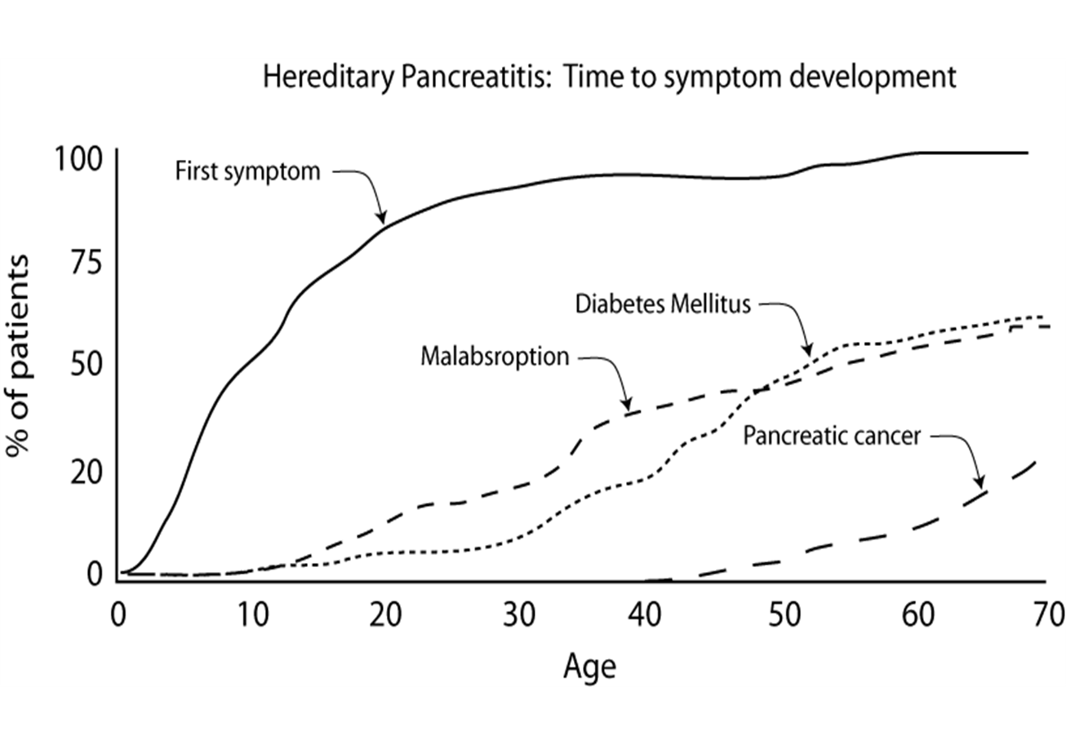
Pediatric CP WG Cohort Study
Howes et al. Clin Gastroenterol Hepatol 2004; 2: 252

Slide 5
Origins of the CPDPC
NIDDK (June 2012) and NIDDK/NCI (June 2013) sponsored workshops to discuss:
  Type 3c Diabetes Mellitus (T3cDM) and risk of pancreatic cancer
  Basic and translational studies in the area of chronic pancreatitis
  Risk factors which link chronic pancreatitis, diabetes, and pancreatic cancer
  Strategies and therapeutic targets to reduce the burden of disease
  NCI’s Scientific Framework for Pancreatic Ductal Adenocarcinoma, February 2014
  “The NCI will continue to work with NIDDK to develop new funding opportunities for studying the diabetes-PDAC connection.”

Slide 6
Origins of the CPDPC
RFAs were developed by NCI and NIDDK staff and on April 2 2015 applications received in response to two RFAs:
DK14-027 for Clinical Centers
and
DK-14-028 for a Coordinating and Data Management Center

Slide 7
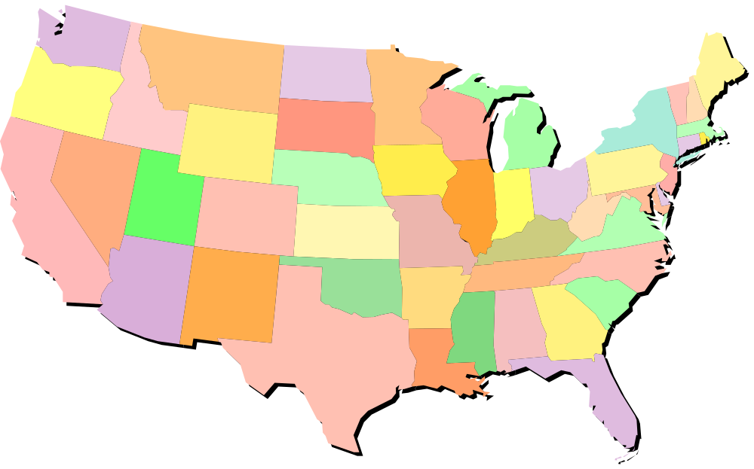
RFA-DK- 14-027/28: Consortium for the Study of Chronic Pancreatitis Diabetes and Pancreatic Cancer
Fred Hutch
Mayo C
Ohio State U
U.Iowa
Kaiser F, UCSF
Indiana U
U.Pittsburgh
Stanford U.
Cedars Sinai LA
U.Florida
U.Texas - M.D. Anderson
Baylor U.

Slide 8
Goals of the CPDPC
Through the acquisition of cohorts of well-characterized patients and associated biospecimens the CPDPC will provide the resources and collaborative opportunities necessary for achieving many of the research objectives identified in the strategic plans for pancreatic research of NCI and NIDDK.
To pursue clinical research :
  (1) on Chronic Pancreatitis by identifying and characterizing a large cohort of pediatric and adult patients with (or at risk for) CP to encourage translational research focusing upon elucidating the pathogenesis that will provide the basis for understanding the natural history and developing means of diagnosis, treatment and clinical management of CP and its sequela: chronic pain, exocrine and endocrine pancreatic insufficiency , and
  (2) on Pancreatic Cancer and Pancreatogenic Diabetes Mellitus (T3cDM) and their pathogenic interrelationships, by identifying and following a cohort of newly diagnosed diabetic patients.

Slide 9
CPDPC Cohorts
DM-PDAC Working Group: NOD
  A prospective cohort of up to 10,000 individuals above the age of 50 with new onset diabetes mellitus
Adult CP Working Group: PROCEED
  A prospective cohort of 1570 subjects (and 250 normal controls) with definite or possible chronic pancreatitis, relapsing pancreatitis, unexplained pancreatic pain, and other abdominal pain syndromes
Pediatric CP Working Group: INSPPIRE 2
  A prospective cohort of 628 pediatric patients with acute relapsing and chronic pancreatitis
Type 3c DM Working Group: DETECT
  A cross sectional cohort of 452 patients with new onset diabetes (Type 2, Type 3c associated with chronic pancreatitis, Type 3c associated with pancreatic cancer)

Slide 10
Ancillary Studies
40 approved
13 funded (NIH, PanCAN, others)
Examples of Ancillary study topics:
Disease mechanisms and characterization (Diabetes)
Prediction and modeling (using electronic patient data systems and legacy cohorts)
Biomarker development (both liquid biopsy and imaging)
Prevention and therapy trials (chronic pancreatitis)
Disease models

Slide 11
Glycemic status in PC at diagnosis (n=220)
Long standing DM
Normal fasting glucose/
unknown glycemic status
Impaired fasting glucose
Chari et al GE 2001, Pannala et al GE 2008, Chari et al GE 2008

Slide 12
PC in New-onset Diabetes vs. All Subjects >50 6-8 fold Higher Risk
New-onset diabetes
>age 50 years
All subjects >50 years
850/100,000
101/100,000
Chari et al Gastroenterology 2005; Sharma/Chari (submitted)

Slide 13
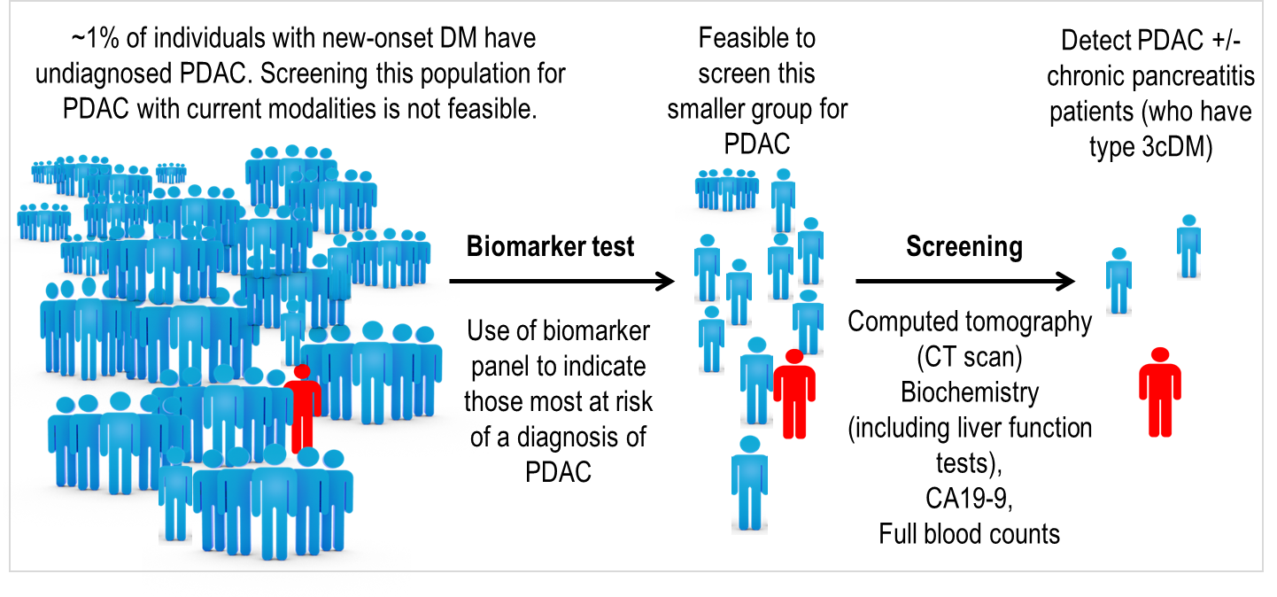
NOD Study

Slide 14
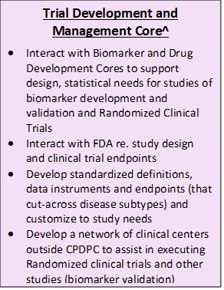
Administrative Core*
Steering Committee, Executive Committee, CDMC
Other Committees (Ancillary Studies, Publication, etc.)
Working Groups*
DM-PDAC, Adult CP-RAP, Pediatric CP-RAP, Type 3c-DM, Biospecimen
Big Data Analysis Core
Biomarker Development and Validation Core^
Identify potential/promising biomarkers that deserve further evaluation
Develop partnership(s) with scientific community (basic and translational research)
Interact with Trial Development Core to execute ideas of biomarker development and validation
Interact with FDA re. regulatory issues
Develop partnerships with Industry for clinical translation of validated biomarkers
Drug Development Core^
Identify potential/promising drugs (new indication or repurposed) or other treatments (e.g. endoscopic therapy) that deserve further evaluation
Interact with scientific community (basic and translational research) and industry to develop partnerships
Interact with Trial Development Core to execute Randomized Clinical Trials
Interact with FDA re. regulatory issues

Slide 15
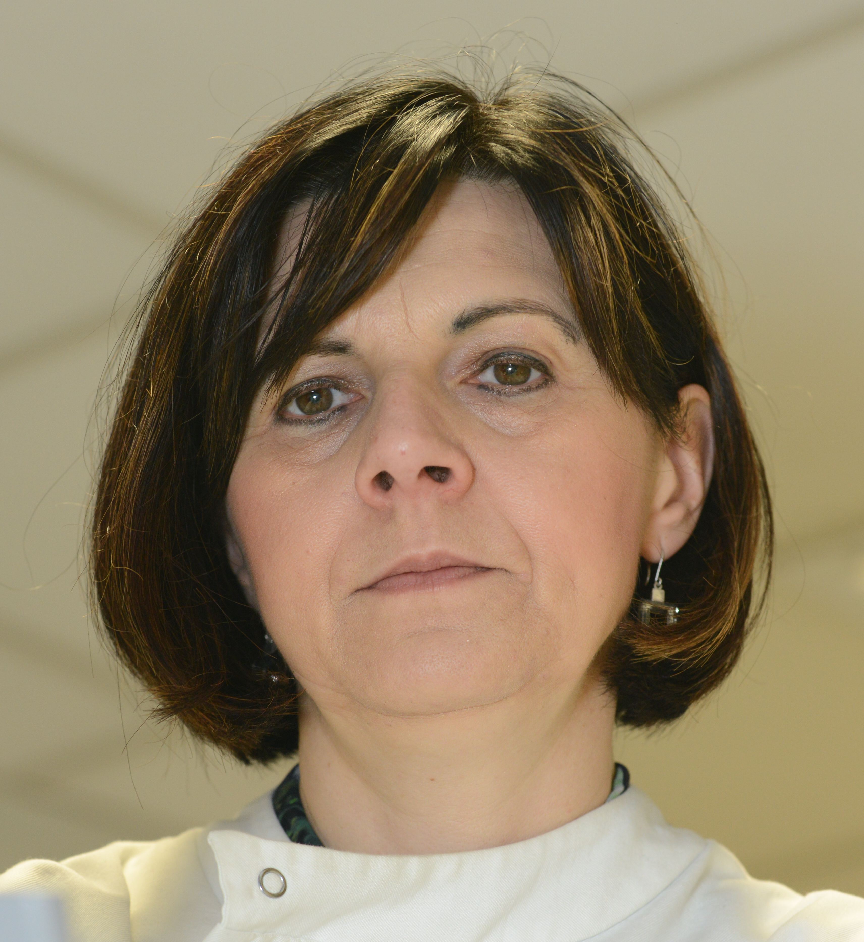

Towards early detection of pancreatic cancer
in urine
Tatjana Crnogorac-Jurcevic, MD, PhD
28 August, 2019

Slide 16


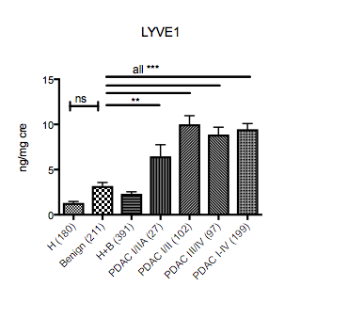
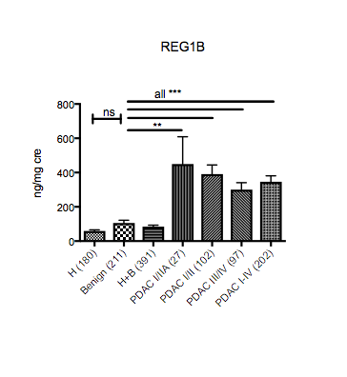
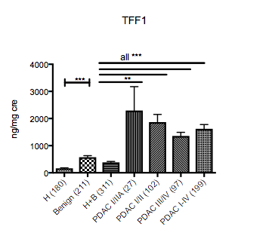

Validation
Silvana Debernardi
Harrison O’Brien
Total 590 urines
@QMBCI
www.bci.qmul.ac.uk
Notes:
This is additional validation we did in the meantime (since Radon et al was published) that again proved the validity of our data

Slide 17
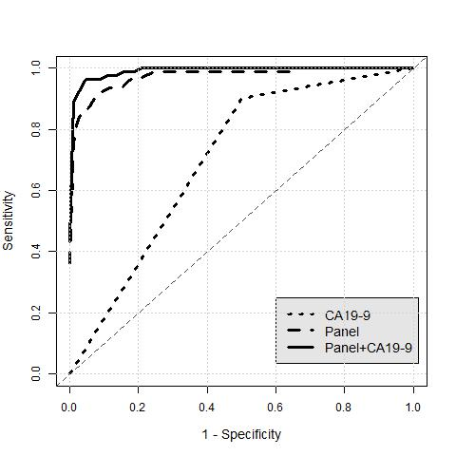

H vs PDAC stage I/II + CA19-9
Total set n= 171: 91 H, 80 PDAC
Notes:
Oleg (Stephen Duffy’s statistician) has done the stats: the table contains both SN and SP at optimal cut off and SN data at fixed SP of 0.90 (p value in the brackets show that the panel is significantly better than each of the biomarkers)

Slide 18

3rd Street Diagnostics
Research and medical centers play a major role in biomarker discovery and clinical validation
Cedars-Sinai’s Technology Ventures Office established 3rd Street Diagnostics, an operational unit that evaluates promising early-stage non-invasive biomarkers from intra- and extra-mural research with the goal of in-licensing, developing and marketing these biomarkers as innovative molecular and cell-based diagnostic tests and services
CEDARS-SINAI
TECHNOLOGY VENTURES
  Source internal/external technologies & evaluate for product development potential
  Established collaboration framework and global network of partners
Sale & distribution of IVD kits via distributors
Offer testing service
through CLIA/CAP
certified labs
3rd STREET DIAGNOSTICS
Develop diagnostic, prognostic, and personalized medicine tests

Slide 19

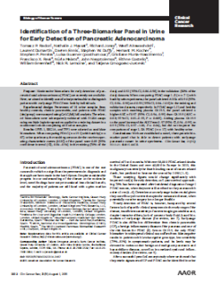
Pancreatic Ductal Adenocarcinoma (PDAC) Test is a semi-quantitative test that combines measurements of three protein markers (REG1B, TFF1 and LYVE1) in urine, all in an ELISA-based platform, into a risk/probability score
To be used as an aid in the diagnosis of PDAC in conjunction with clinicopathologic information, for patients with symptoms consistent with PDAC
The test is not intended to be used for tumor classification or as a stand-alone diagnostic assay
Market Research
Regulatory
Product Development
Clinical Validation
Clinical Adoption
Reimbursement
Target Product
Profile
Radon et al. Clin Cancer Res. 2015 Aug 1;21(15):3512-21.

Slide 20


Laboratory Developed Test (LDT)
Test Development
Intended Use
Diagnostic aid in identifying patients with PDAC, in conjunction with clinicopathological symptoms and CT/MRI
Established performance to identify high-risk patients to have PDAC with high sensitivity
Clinical implementation in high-risk clinics
Ongoing
Planned

Slide 21

PDAC Prediction Model Using Radiomics & Artificial Intelligence

Slide 22
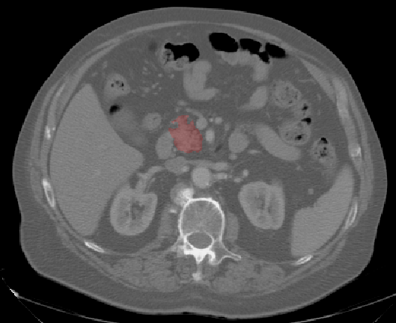
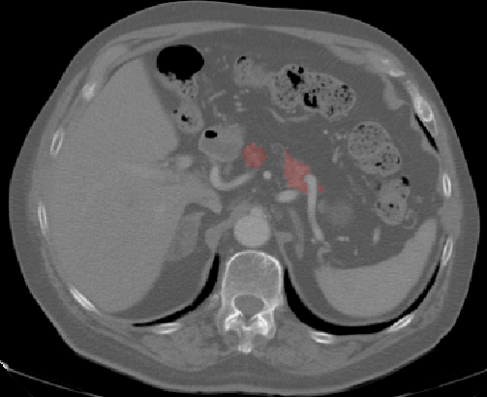
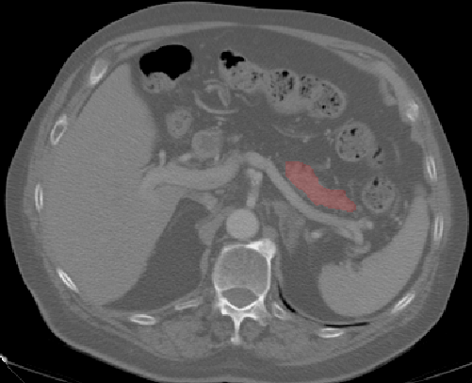
Our Approach
Computer Software Extracts Features
Feature Selection
Set of features selected that predict the cancer at the stage declared “normal” by radiologists
Input
Shape
Intensity/color
Size
Texture
Mr. Smith’s “Normal” CT scan

Slide 23
Prediction of PDAC using Radiomics-based Machine learning
Dataset:
  Normal controlled (Scans of normal pancreas)
  Pre-diagnosed (Scans of the subjects with healthy pancreas; these subjects develop PDAC within 6-12 months)
  Diagnosed (Scans of same subjects from Pre-diagnosed class who have now developed PDAC)
Radiomics
  Extracted 15000 Features (Color/Size/Shape/Texture features) from three groups
  Performed Statistical analysis (identified several potential predictive features)
Radiomics-based Machine Learning Prediction model
  21 Training Cases (7 Normal, 7 Pre-Diagnosed, 7 Diagnosed)
  21 Testing Cases (7 Normal, 7 Pre-Diagnosed, 7 Diagnosed)
Results:
  The system was 75.3% successful in predicting the cancer diagnoses within 6-12 months based on the CT imaging features.

Slide 24

Healthy Control Pancreas

Slide 25



Pre-diagnostic Pancreas
What is a feature map?
Let’s look at one feature example: tissue heterogeneity
Tissue in unhighlighted areas is very uniform/
homogeneous
Tissue in darker region shows increased pattern of heterogeneity

Slide 27
Considering Future Directions
“Completing” the work planned during first cycle
  Finishing recruitment and follow-up in all cohorts
  Characterizing pediatric CP and ARP: etiology, prognosis, predictors, disease burden, etc
  Adult CP and ARP: etiology, progression, mechanisms, complications, prognosis, etc
  Characterizing DM associated with CP and PDAC: diagnosis, prediction, etc
  Identifying early PDAC: Risk modeling, biomarker, strategies, etc
Envision, develop (and implement) a plan for the next 5 years
  Biomarker development
  Drug identification and development
  Intervention trials

Slide 28
Administrative Core*
Steering Committee, Executive Committee, CDMC
Other Committees (Ancillary Studies, Publication, etc.)
Working Groups*
DM-PDAC, Adult CP-RAP, Pediatric CP-RAP, Type 3c-DM, Biospecimen, Biomarker
Big Data Analysis Core
Biomarker Development and Validation Core^
Identify potential/promising biomarkers that deserve further evaluation
Develop partnership(s) with scientific community (basic and translational research)
Interact with Trial Development Core to execute ideas of biomarker development and validation
Interact with FDA re. regulatory issues
Develop partnerships with Industry for clinical translation of validated biomarkers
Drug Development Core^
Identify potential/promising drugs (new indication or repurposed) or other treatments (e.g. endoscopic therapy) that deserve further evaluation
Interact with scientific community (basic and translational research) and industry to develop partnerships
Interact with Trial Development Core to execute Randomized Clinical Trials
Interact with FDA re. regulatory issues

