Slide 1
Cancer Overdiagnosis
(A Biological Challenge and Clinical Dilemma)
Barry Kramer

Slide 2
Requirements for Overdiagnosis
Existence of a silent disease reservoir
Activities leading to its detection (particularly screening)
G. Welch and W. Black, JNCI 2010

Slide 3
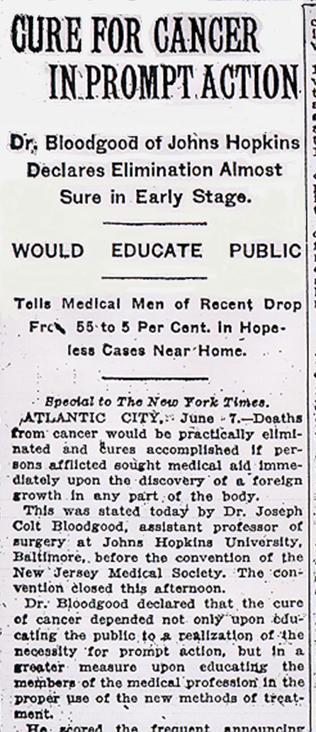

NY Times June 8, 1924
“Dr. Bloodgood of Johns Hopkins declares elimination [of cancer] almost sure in early stage.”
“Deaths from cancer would be practically eliminated.. If persons afflicted sought medical aid immediately upon the discovery of a foreign growth in any part of the body.”

Slide 4

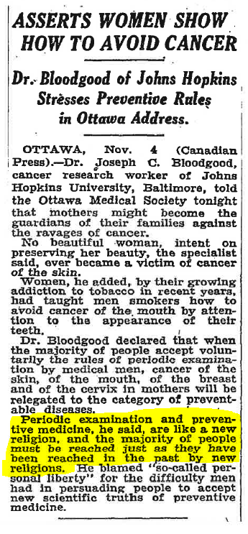
Medical Testing is Transmuted
  into Religion
“Periodic examination and preventive medicine, he said, are like a new religion, and the majority of people must be reached just as they have been reached in the past by new religions.”

Slide 5
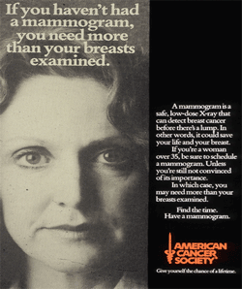
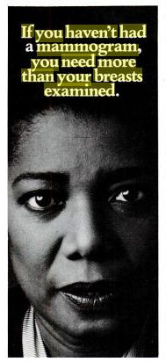

Slide 6


Slide 7
Screening Prevalence in U.S. Adults Aged ≥ 85 (2015)
(National Health Interview Survey)
Mammography (past 2 years) | 34%
Pap test (past 3 years) | 18%
Stool (1 yr); Sigmoidoscopy (5 yrs); Colonoscopy (10 yrs) | 52%
Males | 60%
Females | 47%
PSA test (past 1 year) | 29%
(CE DeSantis et al.: CA Journal for Clinicians, 2019)

Slide 8
Medical Testing: A Quest to Reduce Uncertainty
“But, unless you are extraordinarily careful, trying to erase uncertainty comes with downsides.”
(Hannah Fry, The New Yorker, 9 Sept 2019)
The greatest deficiency of medical education throughout the twentieth century……was the failure to train learners properly for clinical uncertainty, which led to the systematic overuse in clinical practice of tests, procedures, and treatments.” (Kenneth Ludmerer, Time to Heal)

Slide 9
Core Issues in Screening
It is difficult to make healthy people better off than they already are.
  It is sometimes easy to make healthy people worse off.
Strong evidence of benefit is important when putting large numbers of healthy people in harm’s way.

Slide 10
Consequences of Screening:
The Good
Reduced risk of death from the target cancer (compared to no screening)
  Usually need a randomized controlled trial to determine this
  Major successes: e.g., cervix, colon, lung
Reassurance (assuming healthy people need reassurance)

Slide 11
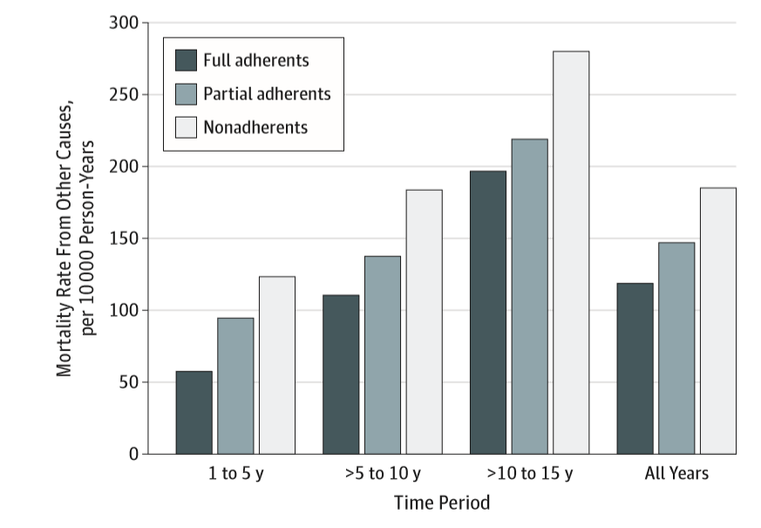
Inherent Biases in Cancer Screening:
Mortality Rates from Non-screened Causes in the PLCO Trial
Pierre-Victor, JAMA Internal Medicine, 2018

Slide 12
Consequences of Screening:
The Bad
False reassurance when you have cancer
False alarms (false positive tests)
  Harms of an unnecessary work-up
Harms of the test: bleeding, sepsis after biopsy, etc.
Detection of a lethal cancer without changing the outcome
  Spend more of your life as a cancer patient
Detection of non-lethal cancers (over-diagnosis)
  Unnecessary treatment
  Treatment-related deaths of other causes (e.g., heart disease, secondary cancers)

Slide 13
The Heterogeneity of Cancer Progression
Size
Size at which
cancer causes death
Size at which
cancer causes symptoms
Fast
Slow
Very Slow
This is
over-Dx.
Non-progressive
Abnormal
cell
Time
Death from other causes
(Courtesy of H. Gilbert Welch)

Slide 14
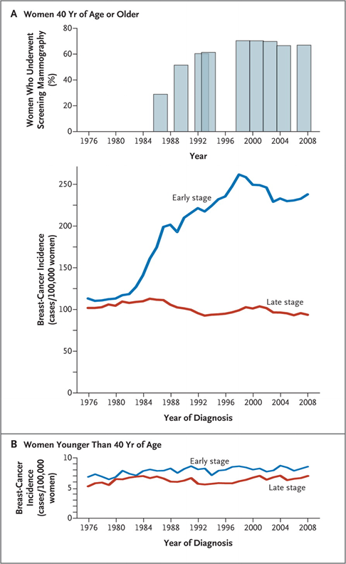
Use of Screening Mammography and Incidence of
Stage-Specific Breast Cancer in the U.S., 1976–2008

Slide 15
Incidence and Mortality of Five Cancers:
(Surveillance, Epidemiology, and End Results: SEER)
Thyroid Cancer
Prostate
Cancer
10
225
8
200
New Diagnoses
175
New Diagnoses
Rate
(per 100,000 people)
150
6
125
Rate
(per 100,000 people)
4
100
75
Deaths
2
Deaths
50
0
25
1975
1980
1985
0
1990
1995
2000
2005
1975
1980
1985
1990
1995
2000
2005
Year
Year
Melanoma
175
Breast Cancer
20
New Diagnoses
150
15
125
New Diagnoses
100
Rate
(per 100,000 people)
Rate
(per 100,000 people)
10
75
5
Deaths
50
Deaths
25
0
0
1975
1980
1985
1990
1995
2000
2005
1975
1980
1985
1990
1995
2000
2005
Year
Year
Kidney Cancer
12
New Diagnoses
10
HG Welch, JNCI 2010
8
Rate
(per 100,000 people)
6
Deaths
4
2
0
1975
1980
1985
1990
1995
2000
2005

Slide 16
Harms of Cancer Overdiagnosis
Labels healthy people as cancer patients
“Cures” people that did not need to be cured
    Artificially raises the “cure” and survival rates
        Vicious cycle: prevalence, fear, advocacy, screening, overDx
Incurs unnecessary but toxic treatments
    Surgery
    Carcinogens and cardiotoxins: e.g. radiation, chemotherapy, transtuzumab
    Financial toxicity for patients
    Opportunity costs for the healthcare system

Slide 17
Screening and the Transformation of Medicine
“Ancient medical history”: diagnosis & management of established disease
  Testicular cancer, lymphomas, childhood malignancies
Screening for early, asymptomatic disease
  Cervical cancer, colorectal cancer, lung cancer
Screening for risk factors of disease
  Family history, genetics, obesity
Screening for risk factors for risk factors (“disease risk predisposition”)
  Genetic markers for nicotine addiction, obesity, microbiomics, diabetes…
  Mammogram calcium to predict cardiac atherosclerosis

Slide 18
Consequences of Screening for Cancer:
Iatrogenic Epidemics
100
Proportion of Population Affected
0
Risk Factor for Risk Factor
Risk Factor
Preneoplasia
Asymptomatic Cancer
Symptoms Appear
Risk of Having/Getting Cancer

Slide 19
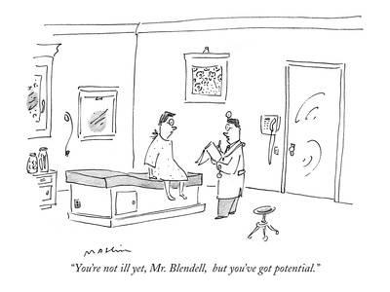
“You’re not ill yet, Mr. Blendell, but you’ve got potential.”

Slide 20
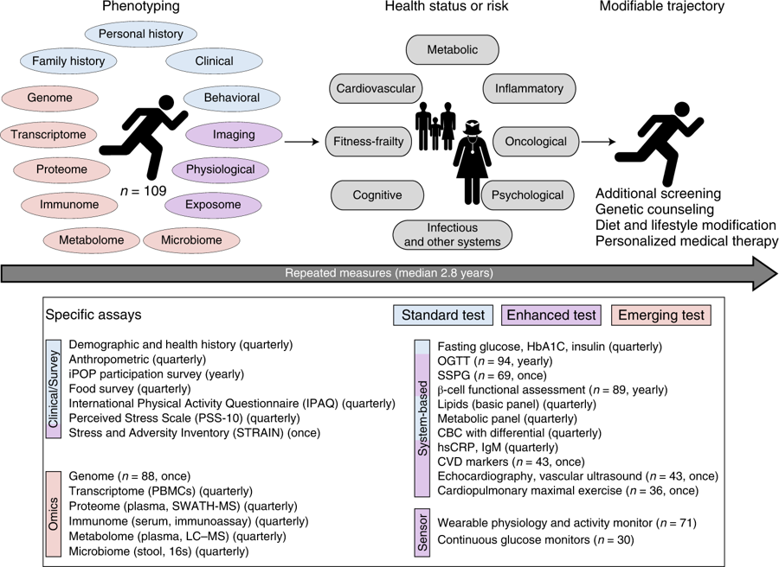
Multi-omics and “Precision Health” (1)
{Schussler-Fiorenza Rose et al. Nature Medicine 25(5):792-804 (May 2019)}
“narcissomics”?

Slide 21
Multi-omics and “Precision Health” (2)
{Schussler-Fiorenza Rose et al. Nature Medicine 25(5):792-804 (May 2019)}
>67 “major clinically actionable findings” in 109 healthy volunteers

Slide 22
The Last Well Person
A resident's answer to the question, “What is a well person?”:
“A well person is a patient who has not been completely worked up.”
Clifton K. Meadow, NEJM 1994; 330:440-441

Slide 23
What Can We Do about Cancer Overdiagnosis?
Education about its existence
      Public and Media (the honest brokers of information)
      Health professionals
Change the terminology
      Language corrupts thought (and action): e.g., CIN vs. CIS, IDLE tumors
Primary prevention
Research to recognize and targeting the underlying biology at the individual level

Slide 24
Ethics of Screening
… there is an ethical difference between everyday medical practice and screening. If a patient asks a medical practitioner for help, the doctor does the best he can. He is not responsible for defects in medical knowledge. If, however, the practitioner initiates screening procedures he is in a very different situation. He should, in our view, have conclusive evidence that screening can alter the natural history of disease in a significant proportion of those screened.
A. Cochrane and W. Holland, BMJ

Slide 25
Potential Discussion Questions
How should we balance overdiagnosis issues when dealing with rare, lethal cancer? Pancreatic? Ovarian?
With newer diagnostic assays with high sensitivity how should we deal with overdiagnosis? (a clinical dilemma)
What predictive values for overdiagnosis are needed for impact at the public health level?
What predictive values for overdiagnosis are needed for impact at the individual (clinical) level?
Should focus be on high-risk populations? Average risk? Both? How should resources be apportioned?
What are the most efficient & valid clinical study designs?

Slide 27
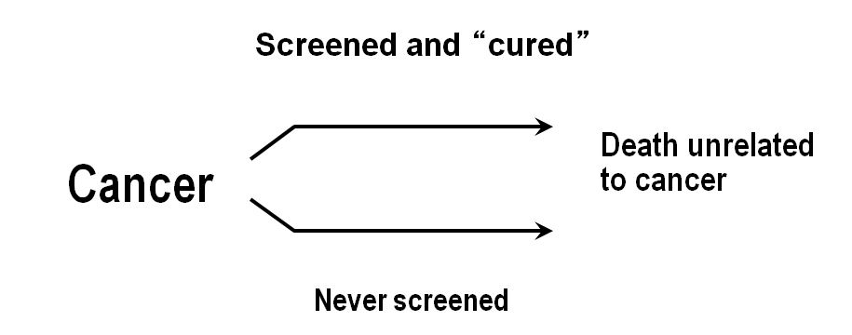
Overdiagnosis

