Slide 1
Pancreatic Cancer Detection Consortium
EDRN Scientific Workshop
Brian Wolpin, MD, MPH
Dana-Farber Cancer Institute
Harvard Medical School
September 11, 2019

Slide 2
NCI Focus on Pancreatic Cancer
NCI Scientific Framework for pancreatic ductal adenocarcinoma (PDAC) in 2014; Four proposed initiatives:
(1) PDAC and recent-onset diabetes
(2) Molecular & imaging biomarkers for early cancer detection
(3) PDAC microenvironment and immunotherapy
(4) Treatment strategies targeting RAS signaling pathways

Slide 3
20%
25%
55%
Stage at Presentation
100
1 or 2
3
4
75
80%
5-Year Survival (%)
40%
50
25
15%
<5%
0%
1
2
3
4
Localized
Locally Advanced
Metastatic

Slide 4
Pancreatic Cancer Detection Consortium (PCDC)
 | Grant PI | Lead Institution | Collaborating Institutions
(1) | Mike Goggins | JHU | CWRU, DFCI, UPenn, UPitt
(2) | Gloria Petersen & Ken Zaret | Mayo Clinic* & UPenn
(3) | Brian Wolpin | Dana-Farber | BIDMC, BWH, CUMC, HU, HSPH, MGH, MSKCC
(4) | Tony Hollingsworth | Univ Nebraska | CSHL, Univ Wash
(5) | Walter Park | Stanford Univ
(6) | Julie Sutcliffe | UCSD
(7) | Ajay Goel & Dan Von Hoff | City of Hope & TGen | MCW, Ochsner, Nagoya Univ, Samsung, Univ Arizona, USC
(8) | Ann Killary & Subrata Sen | MDACC
* Mayo Clinic also serves as coordinating site for PCDC

Slide 5
Pancreatic Cancer Detection Consortium
Led at NCI: Drs. Sudhir Srivastava, Sharmistha Ghosh, Matthew Young, Guillermo Marquez, and Jo Ann Rinaudo
PCDC activities overview:
- Data & biospecimen collection
- Risk assessment
- Biomarkers for earlier detection
- Novel imaging modalities to identify small cancers
Flagship projects / Signature protocols:
- Data and biospecimen hub
- Pancreatic cystic lesions: Longitudinal data and sample collection (goal N=2000)
- Familial risk: Longitudinal data and sample collection (goal N=2000)

Slide 6
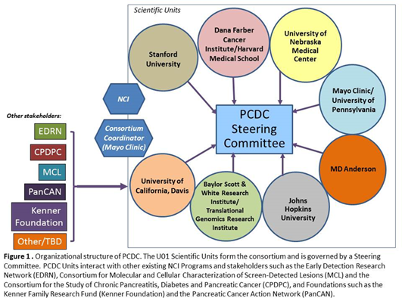
Data and Biospecimen Hub
Patient Cohort | Accrual No.
Pancreatic Adenocarcinoma | 1,254
Healthy Controls | 294
Pancreatic Cysts | 598
Chronic Pancreatitis | 151
Familial Risk | 1,169
Total patients enrolled | 3,647
Notes:
Include table for enrollment numbers for the grant, including PDAC, healthy controls, chronic pancreatitis, pancreatic cysts, and familial risk.

Slide 7
Risk Assessment: High Risk Populations
Familial risk (10-15%)
Adult new-onset diabetes (15-20%)
Pancreatic cystic lesions (10-15%)
35-50%

Slide 8
Pathogenic Germline Alterations in Non-Selected PDAC Patients
Gene | DFCI (N=354)
Total | 41 (11.6%)
ATM | 7 (2.0%)
BRCA1 | 5 (1.4%)
BRCA2 | 7 (2.0%)
CDKN2A | 3 (0.8%)
MLH1 | 0 (0%)
TP53 | 1 (0.3%)
Others* | 18 (5.1%)
Gene | Mayo Clinic (N=3030) | OR (95% CI)†
Total | 253 (8.4%)
ATM | 69 (2.3%) | 5.7 (4.4-7.3)
BRCA1 | 18 (0.6%) | 2.6 (1.5-4.1)
BRCA2 | 59 (2.0%) | 6.2 (4.6-8.2)
CDKN2A | 10 (0.3%) | 12.3 (5.4-25.6)
MLH1 | 5 (0.2%) | 6.7 (1.9-17.5)
TP53 | 6 (0.2%) | 6.7 (2.5-15.0)
Others* | 86 (3.4%)
6.5%
5.5%
* APC (2), BRIP1 (3), CHEK2 (4), FANCA (1), MSH2 (1), MSH6 (2), NBN (1), PALB2 (1) RAD50 (2), RAD51C (1)
* BARD1 (4), BRIP1 (5), CHEK2 (33), FANCC (8), MRE11A (2), MSH2 (1), MSH6 (7), NBN (4), NF1 (4), PALB2 (12), PMS2 (2), RAD51C (3)
Aguirre et al. Cancer Discovery. 2018;8:1096.
† Weighted by race/ethnicity
Yurgelun et al. Genet Med. 2018;21:213-23
Hu et al. JAMA. 2018;319:2401.

Slide 9
Universal Genetic Testing at Dana-Farber
Evaluate genetic testing referrals for 1,214 new patients: ~50 new patients with pancreatic cancer/month from 3/17-3/19
Reminder program (Dec 2016): 8 pts/month (16%).
Automatic referral program (Oct 2018): ~20 pts/month (40%).
Updated automated workflow (Mar 2019): ~30 pts/month (60%).
10% of pts who underwent genetic testing had inherited mutation.
2/3 of patients had one or more 1st relative who underwent genetic testing and 1/3 of patients received targeted or immune therapy

Slide 10
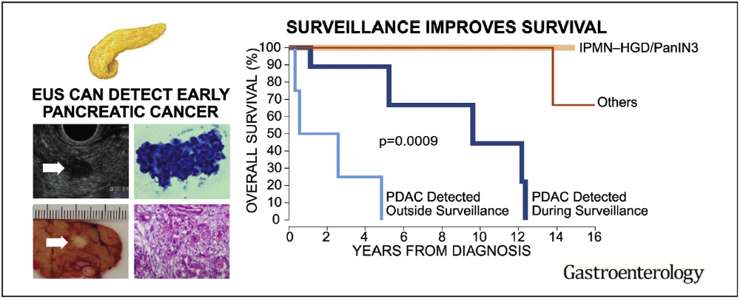
Surveillance = Earlier Diagnosis
?
At Risk for Other Cancers:
- Breast cancer
- Colorectal cancer
- Melanoma
- Ovarian cancer
- Prostate cancer
- Small bowel & biliary cancer
- Uterine cancer
CAPS protocol
Canto et al. Gastroenterology. 2018;155:740-51.

Slide 11
Olaparib as maintenance treatment following first-line platinum-based chemotherapy in patients with a germline BRCA mutation and metastatic pancreatic cancer: Phase III POLO trial
ASCO Annual Meeting
Chicago, IL
1-4 pm Sunday June 2, 2019
Plenary Session Presentation
Abstract LBA4

Slide 12



Slide 13
High Risk Populations
Familial risk (10-15%)
Adult new-onset diabetes (15-20%)
Pancreatic cystic lesions (10-15%)

Slide 14
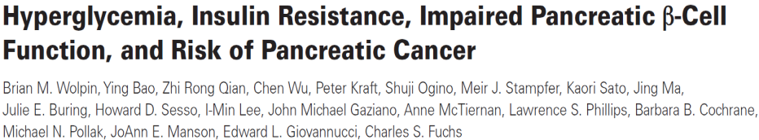
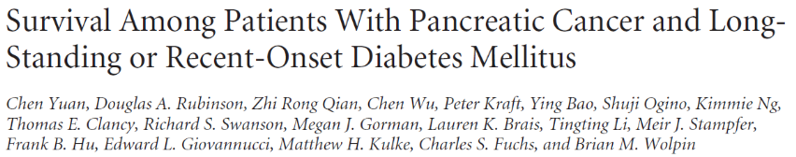



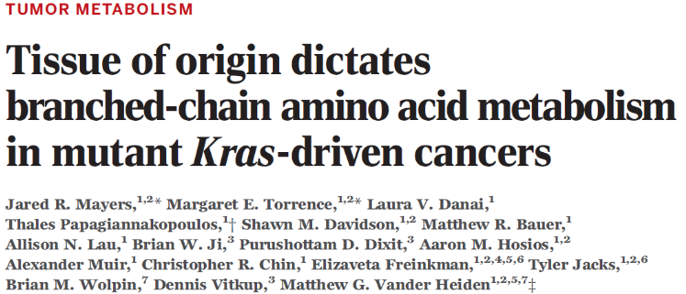
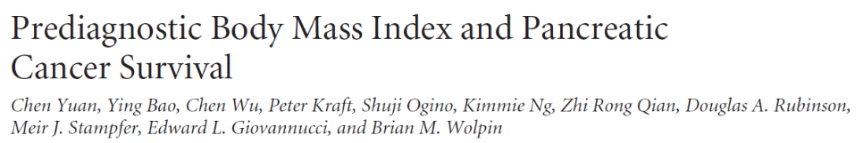
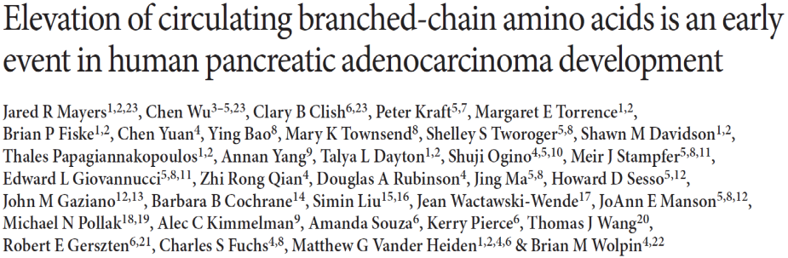
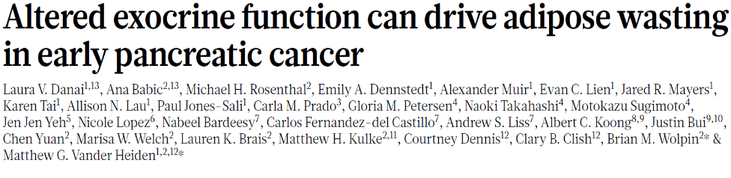
Prediagnosis Metabolic Alterations

Slide 15
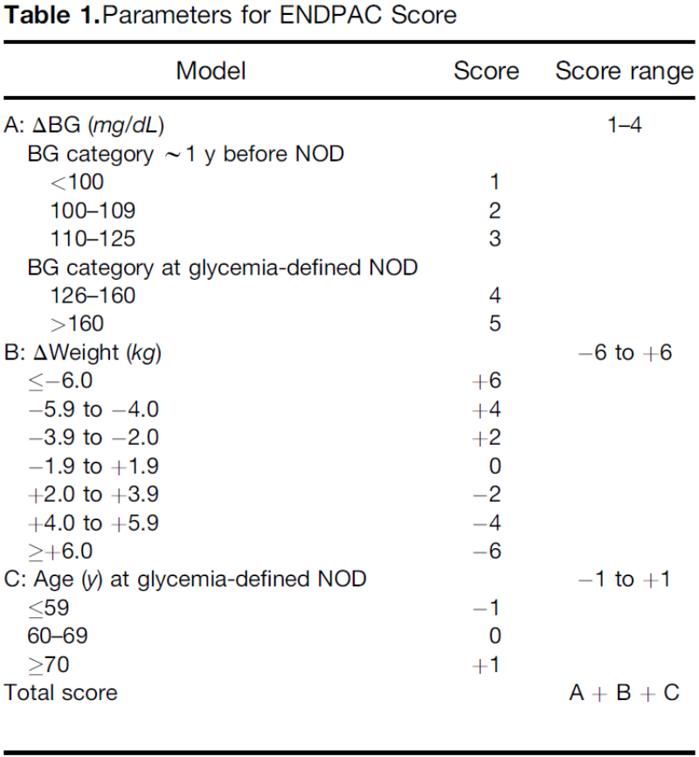
Prediagnosis Metabolic Alterations
ENDPAC Score:
>3: Very high risk (3.6%)
1-2: Intermediate risk (0.5%)
≤0: Low risk (<0.1%)
Sharma et al. Gastroenterol. 2018;155:730

Slide 16
Longitudinal Cohorts
Pancreatic Cancer
Weight
Diabetes
Diabetes
1976
1978
1980
1982
1984
1986
1988
1990
1992
1994
1996
1998
2000
2002
2018
NHS
HPFS
121,700 women (30-55yo)
51,529 men (40-75yo)
Weight Change
= Questionnaire
- Demographics
- Diet & Exposures
- Medical diagnoses
- Medications
 | NHS & HPFS Participants | PDAC Cases
Total No. | 163,677 | 961 (0.6%)

Slide 17
Pancreatic Cancer Risks by Diabetes & Weight Change
 | Diabetes Status
 | No diabetes | Diabetes ≤4 yrs | Diabetes >4 yrs
Person-years | 4,341,248 | 87,640 | 178,288
No. cases* | 759 (79%) | 67 (7%) | 135 (14%)
Age-adjusted RR (95% CI) | Ref | 2.9 (2.2-3.7) | 2.3 (2.0-2.8)
 | Weight Change
 | No Weight Loss | Lost 1-4 lbs | Lost 5-8 lbs | Lost >8 lbs
Person-years | 2,172,024 | 494,658 | 337,369 | 354,849
No. cases* | 383 (49%) | 138 (18%) | 101 (13%) | 153 (20%)
Age-adjusted RR (95% CI) | Ref | 1.2 (1.0-1.5) | 1.3 (1.1-1.7) | 1.9 (1.6-2.3)
Chen Yuan

Slide 18
Diabetes and Weight by Change and Time
 | Person-years | No. cases | Incidence per 100K PY | Incidence Rate Ratio
No diabetes
+ No weight loss | 2,065,836 | 321 | 16 (14, 17) | Referent
+ Weight loss: 1-8 pounds | 780,859 | 192 | 25 (21, 28) | 1.6 (1.3, 1.9)
+ Weight loss: >8 pounds | 311,747 | 103 | 33 (27, 40) | 2.1 (1.7, 2.7)
Diabetes ≤4 years
+ No weight loss | 33,272 | 16 | 48 (29, 78) | 3.1 (1.9, 5.1)
+ Weight loss: 1-8 pounds | 16,463 | 15 | 91 (55, 151) | 5.9 (3.5, 9.8)
+ Weight loss: >8 pounds | 17,324 | 28 | 162 (112, 234) | 10.4 (7.1, 15.3)
Diabetes >4 years
+ No weight loss | 70,512 | 43 | 61 (45, 82) | 3.9 (2.9, 5.4)
+ Weight loss: 1-8 pounds | 33,742 | 31 | 92 (65, 131) | 5.9 (4.1, 8.6)
+ Weight loss: >8 pounds | 25,158 | 22 | 87 (58, 133) | 5.6 (3.7, 8.7)
6%
7%
N=771
Chen Yuan

Slide 19
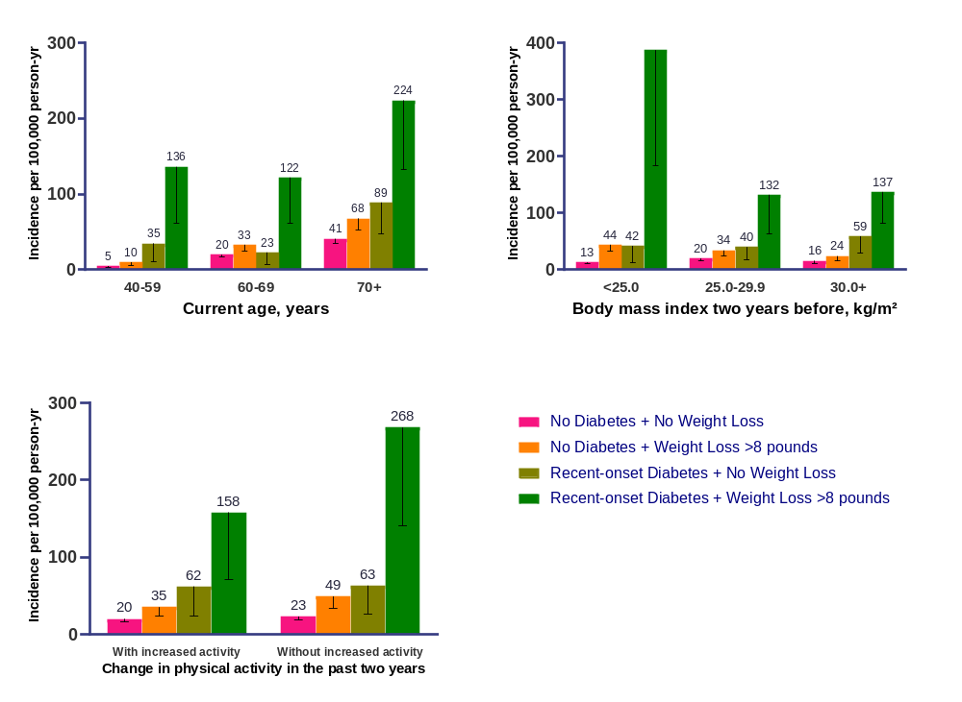
Context Dependencies
382
BMI:
5’: <128 lbs
5’5’’: <150 lbs
6’: <184 lbs
Chen Yuan

Slide 20
Incidence Rates in US General Population
Age group | NHS (women) |  |  | HPFS (men) |  |  | SEER incidence*
 | Person-yr | No. cases | Incidence (95% CI)* | Person-yr | No. cases | Incidence (95% CI)* | Women | Men
40-44 yr | 315,392 | 2 | 1 (0, 3) | 41,608 | 2 | 5 (1, 19) | 3 | 3
45-49 yr | 434,369 | 10 | 2 (1, 4) | 84,245 | 5 | 6 (2, 14) | 5 | 7
50-54 yr | 552,726 | 43 | 8 (6, 10) | 119,052 | 9 | 8 (4, 15) | 10 | 13
55-59 yr | 587,776 | 65 | 11 (9, 14) | 157,639 | 26 | 16 (11, 24) | 17 | 24
60-64 yr | 569,382 | 103 | 18 (15, 22) | 187,033 | 52 | 28 (21, 36) | 27 | 38
65-69 yr | 497,144 | 142 | 29 (24, 34) | 179,054 | 84 | 47 (38, 58) | 40 | 56
70-74 yr | 368,486 | 190 | 52 (45, 59) | 147,612 | 96 | 65 (53, 79) | 55 | 73
75-79 yr | 235,045 | 143 | 61 (52, 72) | 107,695 | 86 | 80 (65, 99) | 74 | 89
80-84 yr | 117,553 | 78 | 66 (53, 83) | 61,387 | 59 | 96 (75, 124) | 87 | 106
*Per 100,000 person-years

Slide 21
Continual Risk Assessment using Medical Records
Risk Factors
Demographics: Older Age, Men, AA, AJ
Exposures: Cigarettes, Obesity, Low Physical Activity, Heavy Alcohol, Unhealthy Diet
Comorbidities: Diabetes, Chronic Pancreatitis, Pancreatic cysts
Family History
Laboratories
- Glucose/HbA1c
- LFTs
- Albumin
- CBC
Symptoms
- Abd/Back d/c
- Upset stomach
- Loose stools
Medication Changes
- NSAIDs/Tylenol
- TUMS
- H2 blockers / PPIs
- BP medications
- Hypoglycemics
Vital Signs
- Weight loss
- Decreased BP
Dietary Changes
- Malabsorption
- Food preferences
Pancreatic Cancer Diagnosis
Time (years)
-20
-10
-3
-1
0
Genetics
Rare, Medium-High Penetrance: BRCA1/2, PALB2, ATM, CDKN2A, TP53, PRSS1, MMR genes
Common, Low Penetrance: 22 loci from GWAS – polygenic risk score
New Diagnoses
- Diabetes
- Gastritis/Indigestion
- Heartburn/Reflux
- MSK back pain
Imaging Features
- AP CT scan
- AP MRI
- EUS
Procedures
- EGD
- Spine MRI
- RUQ ultrasound

Slide 22

Early Detection Team
MIT
Matthew Vander Heiden
Laura Danai
Jared Mayers
DFCI
Michael Rosenthal
Ana Babic
Chen Yuan
Natalia Khalaf
Jonathan Nowak
Lauren Brais
Zunelly Odhiambo
Marisa Welch
Natalia Boos
Maureen Loftus
Leah Caplan
Vicente Morales
Pancreatic Cancer Detection Consortium
NIH/NCI U01 CA 210171
PI: Brian Wolpin
Pasi Janne, Cloud Paweletz, Michael Rosenthal, Sapna Syngal (DFCI)
Nabeel Bardeesy, Dan Chung, Ralph Weissleder, (MGH)
Yuval Dor (Hebrew Univ)
Clary Clish (Broad Inst)
Peter Kraft (HSPH)
Jeanine Genkinger (CUMC)
Andrea Bullock (BIDMC)
David Kelsen (MSKCC)
Collaborators
Clary Clish (Broad Inst)
Gloria Peterson (Mayo Clinic)
Albert Koong (MDACC)
Nabeel Bardeesy (MGH)
Carlos Fernandez (MGH)
Pari Pandharipande (MGH)
Jen Jen Yeh (UNC)
Alison Klein (JHU)
Laufey Amundadottir (NCI)
Rachael Solomon (NCI)
Tilak Sundaresan (KPNC)
Bette Caan (KPNC)
Regina Barzilay (MIT)
Chris Sander (DFCI)
NIH/NCI
Jo Ann Rinaudo
Sudhir Srivastava
Cohort Studies
Peter Kraft Jihye Kim
Charlie Fuchs Meir Stampfer
Ed Giovannucci Howard Sesso
JoAnn Manson Julie Buring

Slide 23
Thank you.

Slide 24

