Slide 1

Urine Based Molecular Assay for Early Detection of Prostate Cancer in Context of Race
Indu Kohaar, Ph.D.
Assistant Professor, USU Walter Reed Surgery
Henry M Jackson Foundation
Notes:
Title Slide Design

Slide 2
DISCLAIMER
The contents of this publication are the sole responsibility of the author(s) and do not necessarily reflect the views, opinions or policies of Uniformed Services University of the Health Sciences (USUHS), The Henry M. Jackson Foundation for the Advancement of Military Medicine, Inc., the Department of Defense (DoD), the Departments of the Army, Navy, or Air Force. Mention of trade names, commercial products, or organizations does not imply endorsement by the U.S. Government.

Slide 3
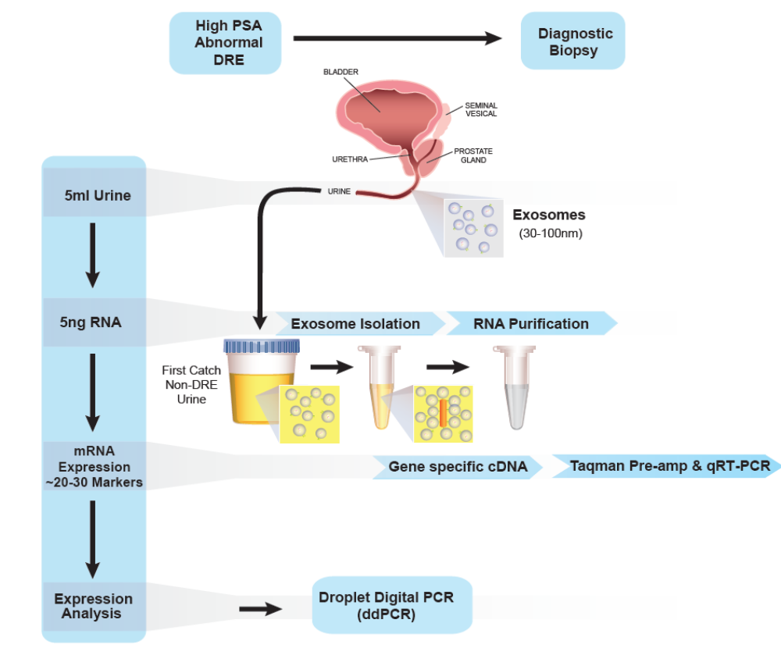
Early Detection of Prostate Cancer: Assay development
Urine Exosome mRNA Expression Assay Platform
Background:
African American (AA) men have significantly higher incidence and mortality from prostate cancer (CaP) compared to Caucasian American (CA) men.
Genes commonly overexpressed in CaP which are currently used as diagnostic CaP markers, exhibit a much lower prevalence in AA men.
In earlier work, we reported the development of a multi-gene, mRNA expression assay platform using first-catch, non-DRE urine specimens.
Goal:
To develop a urine based, racially-informed prostate cancer diagnostic/prognostic marker panel derived from a pre-determined list of selected markers.
Notes:
The assay was developed and optimized for SPDEF, PSGR, DLX1, HOXC6, PCGEM1, as well as PCA3 and ERG in regular (non-DRE) urine specimen
Highlight- non-DRE, .
Schematic representation of the assay work flow in patient urine derived exosome specimen.

Slide 4
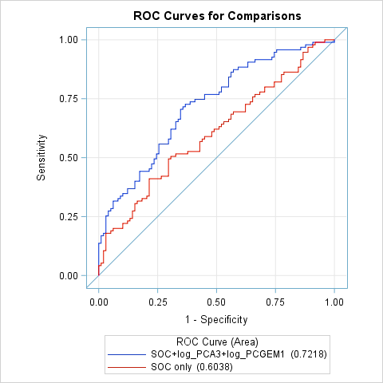
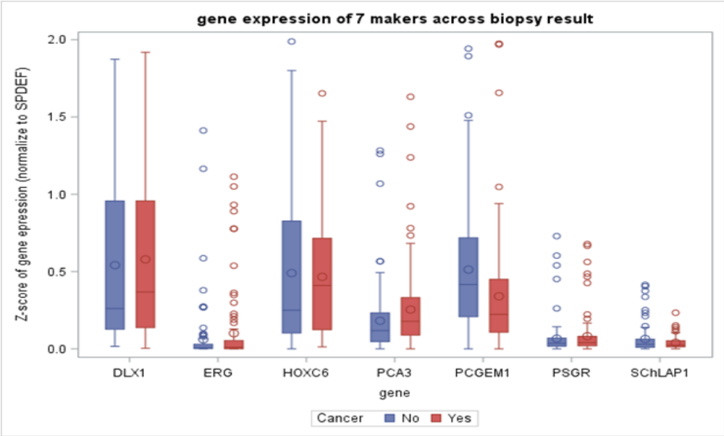
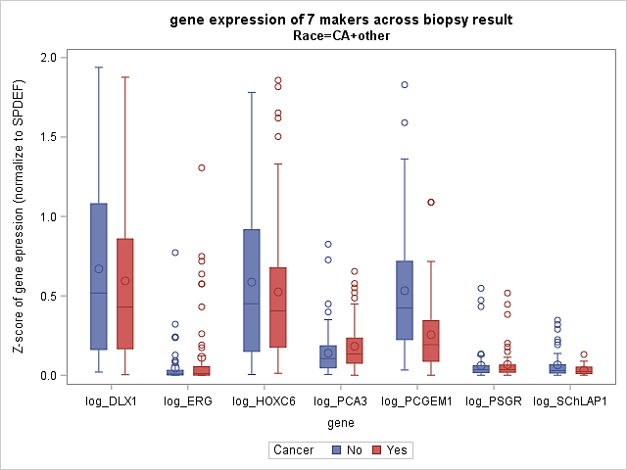
PCA3 and PCGEM1 were associated with CaP Detection at Diagnostic Biopsy
Overall Cohort; N=193
PCA3 (p= 0.001;
PCGEM1 (p<0.0001)
Receiver operating characteristic (ROC) curves to predict biopsy result (positive vs. negative) for: PCA3, PCGEM1 plus SOC* variables vs. SOC alone
2-marker panel + SOC: AUC 0.72
SOC alone: AUC 0.60
p= 0.0048
CA Cohort; N=124
PCGEM1 (CA; p <0.0001)
* SOC (Standard of Care) model = Age at biopsy + race + PSA at biopsy
Notes:
* Among AA: PCA3 (p = 0.016) is significantly different across biopsy groups
Among CA: PCGEM1 (p = 0.001) is significantly different across biopsy groups
Box &
PCA3 level was significantly higher in AA versus CA/Other (p = 0.016); Significantly lower PCGEM1 levels were observed for biopsy positive vs. negative patients in CA(p=0.001).
Whisker plots of biomarker distributions
2-gene panel (PCA3, PCGEM1) along with SOC was significantly associated with improved discrimination between cancer positives and cancer negatives at biopsy
Evaluation of Biomarker Candidates for CaP Detection at Diagnostic Biopsy in Urine Exosome Specimens (N=193)

Slide 5
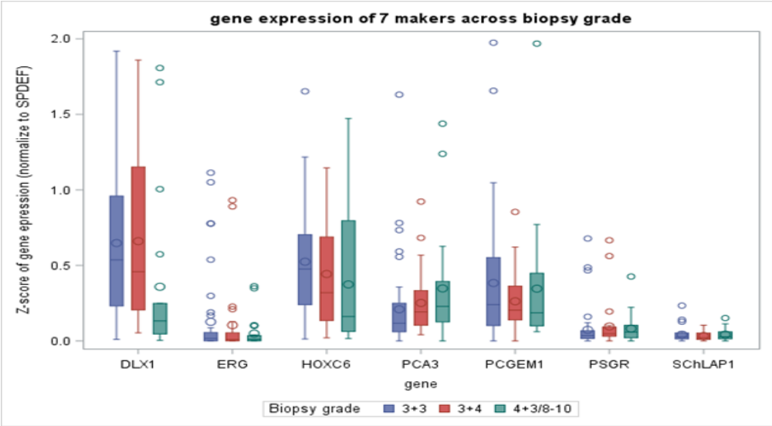
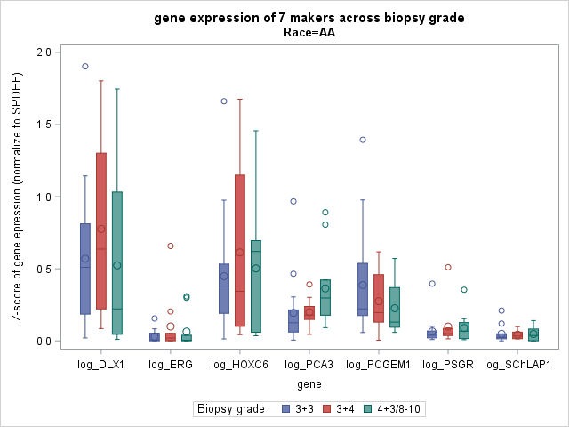
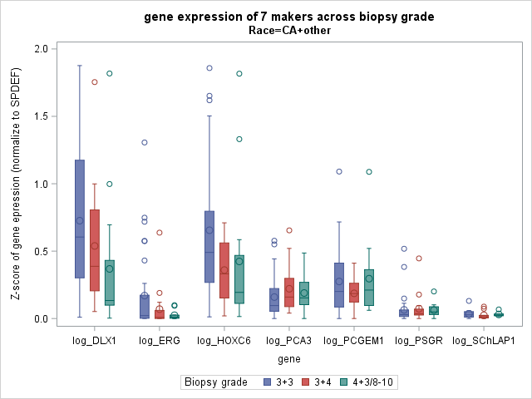
PCA3, HOXC6 and DLX1 were associated across Biopsy Grades in Cancer Positive Cohort
Overall, N=95
PCA3 (p= 0.03)
Biopsy Grade Legend
3+3 3+4 4+3/8-10
AA, N=37
CA, N=58
PCA3 (p=0.04) DLX1 (p <0.01), HOXC6 (p=0.04)

Slide 6
Conclusion and Future Goals
We have developed a non-DRE urine exosome RNA based gene expression assay platform.
2 genes (PCA3, PCGEM1) were found to be associated with CaP detection. Combining 2-gene marker panel (PCA3, PCGEM1) with SOC variables, significantly improved the model prediction for predicting biopsy result. Moreover, higher PCA3 levels were associated with higher CaP grade at biopsy.
Analysis of candidate markers in a set of additional 100 patients is currently in progress, with strategic enhancement of the AA cohort, as well as post-DRE specimens for comparison.
The markers will further be analyzed in an independent cohort of patients under a pre-validation study with EDRN collaborators.

Slide 7
Questions
Indu Kohaar, Ph.D., HJF
Assistant Professor, USU Walter Reed Surgery

