Slide 1

Overview of Colon Collaborative
Group Activities
Robert E. Schoen, MD, MPH
Professor of Medicine & Epidemiology
Chief, Division of Gastroenterology
University of Pittsburgh │ UPMC

Slide 2
Blood-based Testing for CRC
EDRN is evaluating ctDNA + protein (CancerSEEK) for screening and monitoring of CRC
Markers of aberrantly methylated genes may be informative and complementary to CancerSEEK

Slide 3
Rationale/Approach
ctDNA/proteins and aberrantly methylated genes are not mutually exclusive
Aberrantly methylated markers could also have utility in monitoring CRC
Evaluation should occur in samples of plasma collected simultaneously and processed similarly – in a uniform reference set

Slide 4
Aims of Set Aside Project
AIM 1. Hypothesis: ctDNA/proteins and aberrantly methylated genes will be more sensitive and specific for detection of colorectal cancer than either marker panel alone.
AIM 2. Hypothesis: ctDNA/proteins and aberrantly methylated genes will be better for monitoring of CRC patients with regional metastatic disease (stage III) than either panel of markers alone.

Slide 5
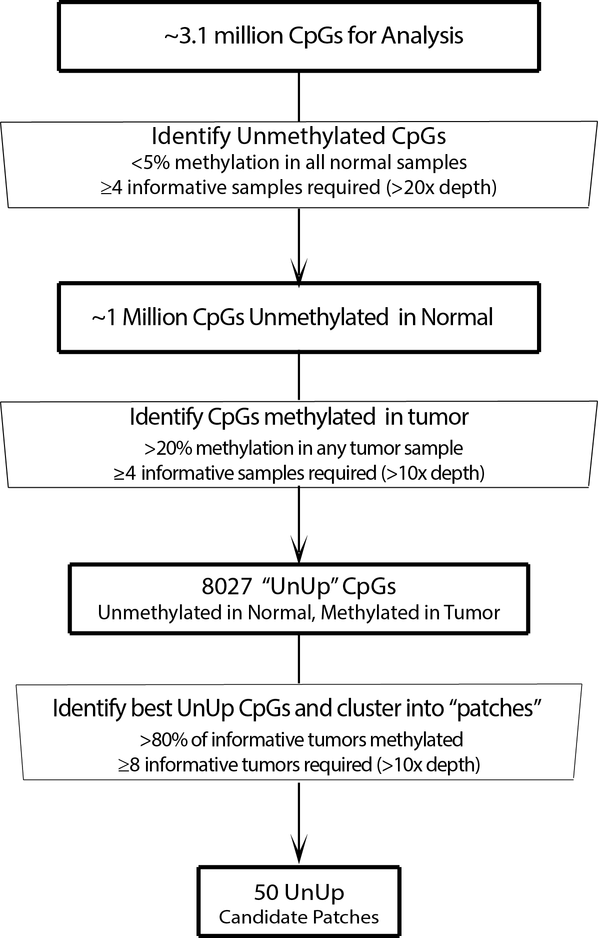
Reduced Representation Bisulfide Sequencing (RBBS) Analysis of CRC

Slide 6
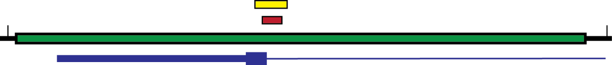
New Complementary Methylation Marker (SDC2 novel region)
chr8:96,493,500-96,495,455 (hg38)
mSDC2 NGS amplicon
111bp, 10 CpGs
UnUp146 RRBS patch
63bp, 7 CpGs
SDC2 transcript
5’ end
Notes:
Patch had greatest discrimination between normal and tumor then NGS asssay to interrogate that region

Slide 7
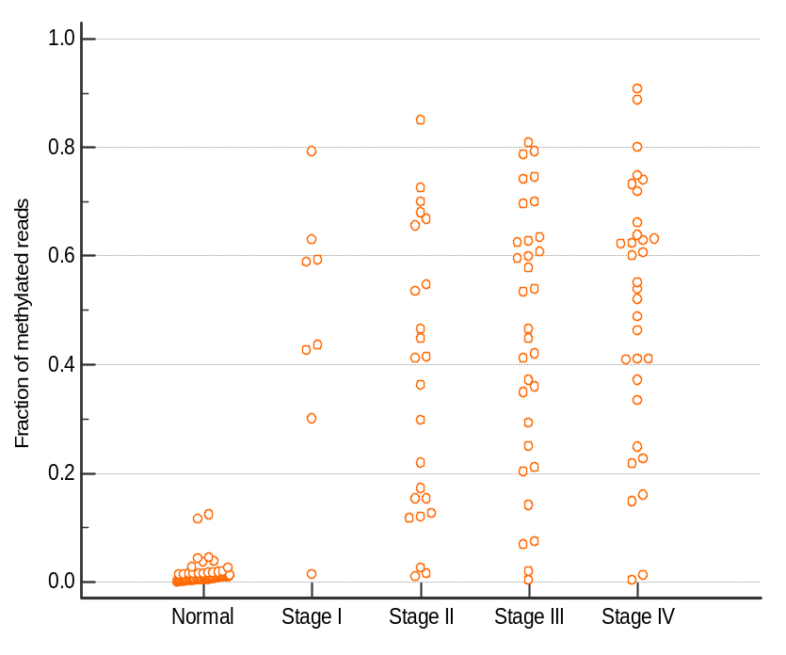
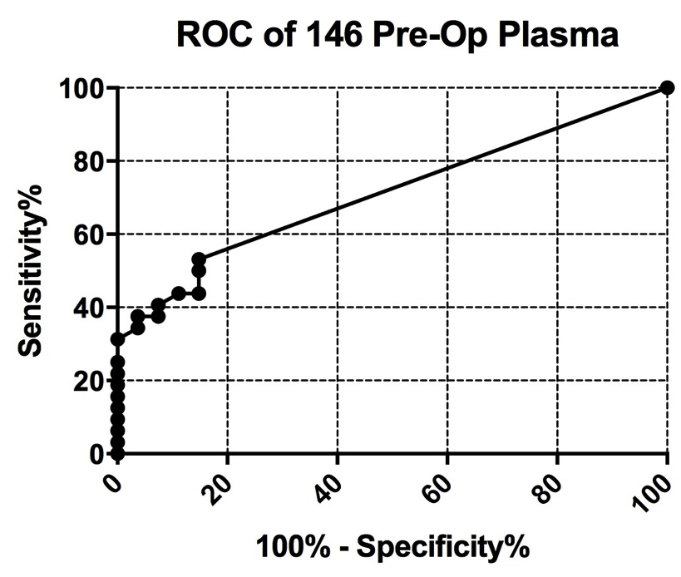
New Complementary Methylation Marker (SDC2 novel region)
Tissue
Blood
AUC: 0.710
At > 1.85%
Sensitivity: 31%
Specificity: 100%
Notes:
Tumor vs. normal, well discriminated.

Slide 8
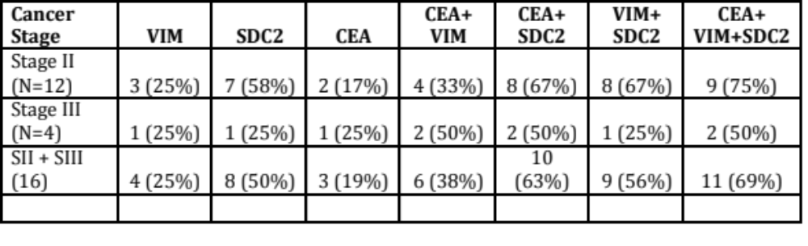
Panel Construction mVim + mSDC2+ CEA

Slide 9
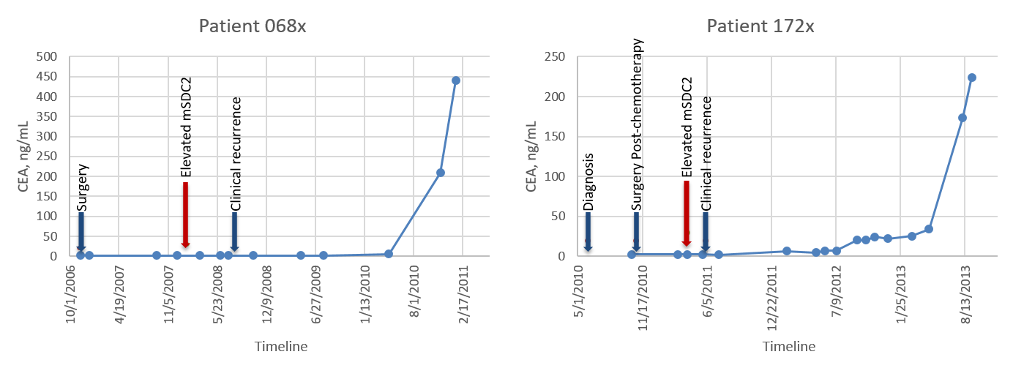
Early Detection of Relapse Ahead of CEA

Slide 10
Next Steps for Team Project
Test Retrospectively in GLNE-7 Archive (Test and Validation Sets - unblinded)
Blinded samples from UPMC, cases/controls, all stages CRC
Test for Complementarity/Integration with CancerSeek Panel (R. Schoen/K. Kinzler)

Slide 11
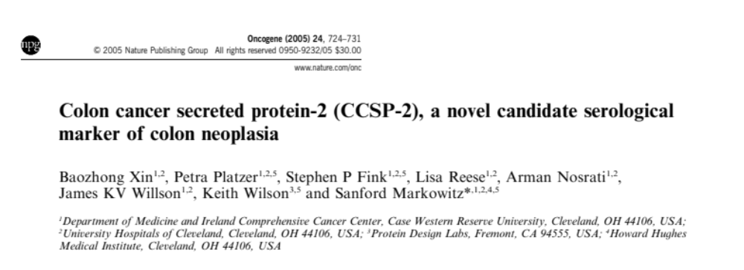
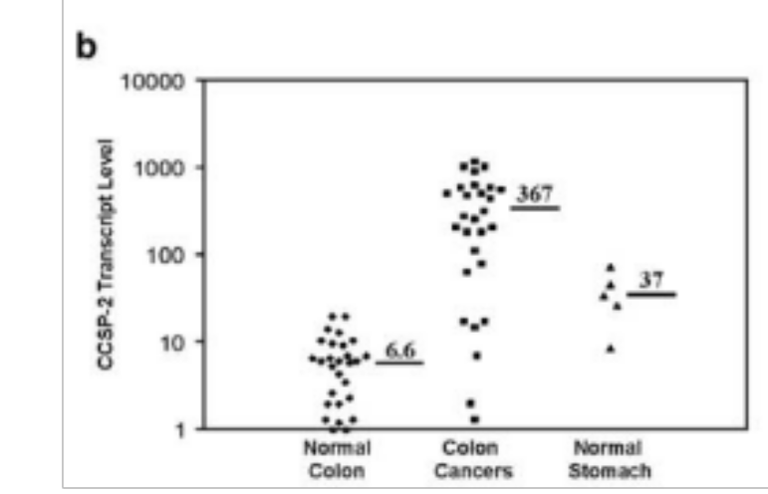
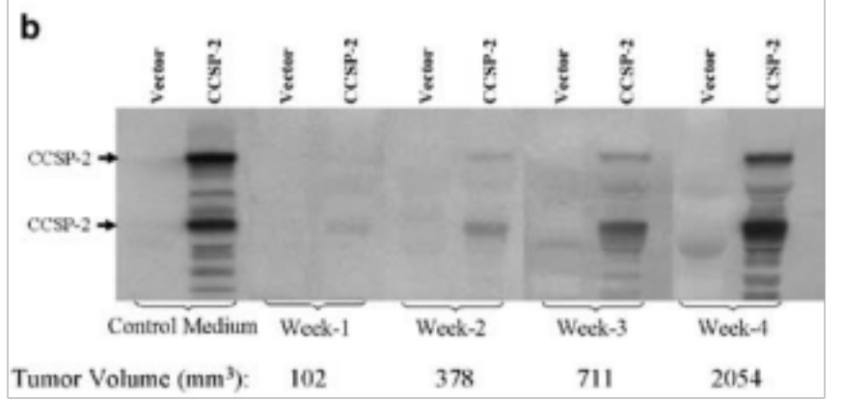
CRC Xenograft CCSP-2 Detection in Mouse Blood
Notes:
New candidate protein marker mined CRC transcriptome for predicted secreted proteins
B: confirm transcript level – induced
C. Confirmed in blood in mouse: implant CRC tumor ex;resses this transcript – you can find it in blood (confirms that its secreted)

Slide 12
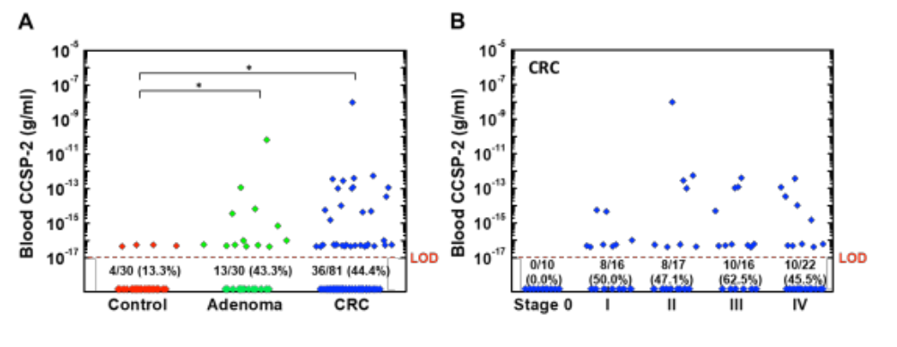
CCSP-2 Detection in Human CRC Blood
Adv Sci (Weinh). (2019) 16;6(11):1802115.
Notes:
Ccsp2 is there in human blood and its there in early stage disease

Slide 13
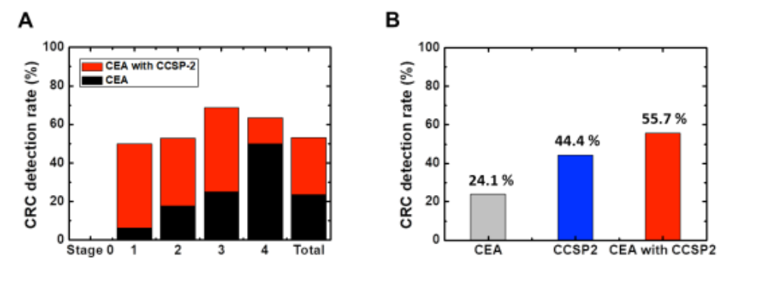
CCSP-2 Complementation of CEA
Adv Sci (Weinh). (2019) 16;6(11):1802115.
Notes:
By stage: Black is detected by CEA, red additioanl detection with CCSP2
B. percentage of cases detected

Slide 14
CCSP-2 Summary
Detects 20% CRC at 100% Specificity
Is complementary with CEA
Can detect a subset of advanced adenomas

Slide 15
Next Steps for CCSP-2
Blinded samples from UPMC, cases/controls, all stages CRC
Test for Complementarity/Integration with CancerSeek Panel (R. Schoen/K. Kinzler)

Slide 16
cfDNA Detection of
Advanced Adenoma
40 Advanced adenomas – Large volume plasma collected prior to resection
Age 37-81, ~40% surgical, Size: 1 - 4.5cm, 25% HGD, 1/3rd tubulovillous

Slide 17
cfDNA Detection of
Advanced Adenoma
Advanced adenomas – sequenced for driver mutations
Modified SafeSeqs assay applied – designed to maximize sensitivity, using design for monitoring for residual disease as opposed to screening

Slide 18

FHCRC CVC: Phase 3 validation of early detection biomarkers for colorectal cancer
Paul D. Lampe, PhD (Li, Lampe, Drescher, multi-PIs)
Head, Translational Research Program
Fred Hutchinson Cancer Research Center
Professor, Department of Global Health
University of Washington

Slide 19

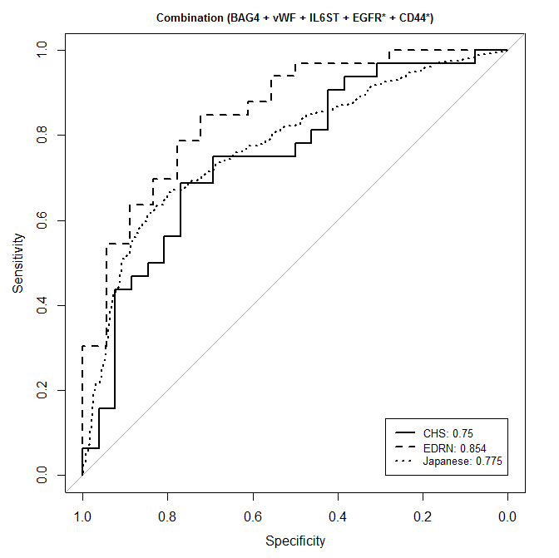
Panel performance across 3 sample sets
 | CHS | EDRN | Ogaki
AUC | 0.75 | 0.854 | 0.775
95% CI | 0.62-0.88 | 0.74-0.96 | 0.74-0.81
Sens | 40.6% | 54.5% | 51.4%
95% CI | 0.03-0.72 | 0.18-0.85 | 0.41-0.59
Opt Spec | 76.9% | 72.2% | 84.7%
Opt Sens | 68.8% | 84.8% | 61.7%
Equal weight combination

Slide 20
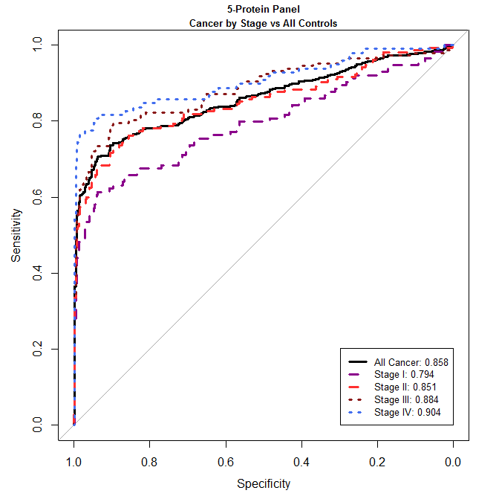
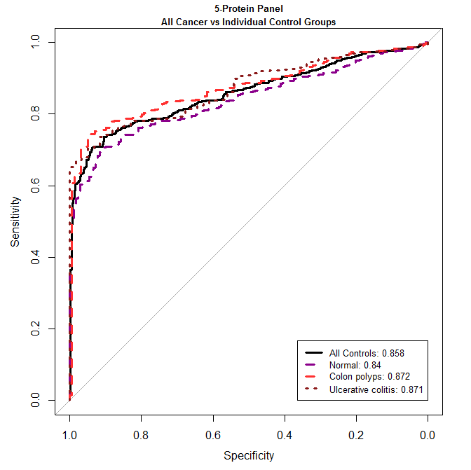
5 Protein panel performance in different stage CRC samples
Case | Ctrl | n |  | BAG4+IL6ST+VWF+CD44*+EGFR*
 |  |  |  | Sens | 95%CI
All cancer | All ctrls | 386 |  | 73.0% | 0.68-0.78
All cancer | Normal | 168 |  | 70.0% | 0.62-0.75
All cancer | Polyps | 159 |  | 76.5% | 0.72-0.81
All cancer | Colitis | 59 |  | 73.3% | 0.66-0.80
Stage | n |  | BAG4+IL6ST+VWF+CD44*+EGFR*
 |  |  | Sens | 95%CI
I | 114 |  | 62.3% | 0.54-0.71
II | 155 |  | 71.6% | 0.63-0.79
III | 147 |  | 77.6% | 0.68-0.85
IV | 98 |  | 81.6% | 0.73-0.89
Rho, et. al, Gut 2018

Slide 21
University of Copenhagen/Hvidovre Hospital –
Hans Jørgen Nielsen
Endo II: Plasma collected from CRC screening in Denmark;
Age 50-74 years: positive (N=8,415) or negative FIT (N=5,112).
100 FIT-negative with no CRC diagnosed within 2 years post blood draw
100 FIT-positive no CRC by colonoscopy
100 FIT-positive advanced adenoma
100 FIT-positive CRC (25 stage I, 25 stage II, 33 stage III, 17 stage IV)
100 FIT-negative CRC (25 stage I, 25 stage II, 25 stage III, 25 stage IV)*
* 100 of these could not be identified. Proceeding with FIT-negative cancers of all types.

Slide 22

Blood-Based Markers for Early Detection of Colorectal Neoplasia
Robert S. Bresalier, M.D.
Professor of Medicine and Distinguished
Professor in Gastrointestinal Oncology
University of Texas MD Anderson Cancer Center

Slide 23

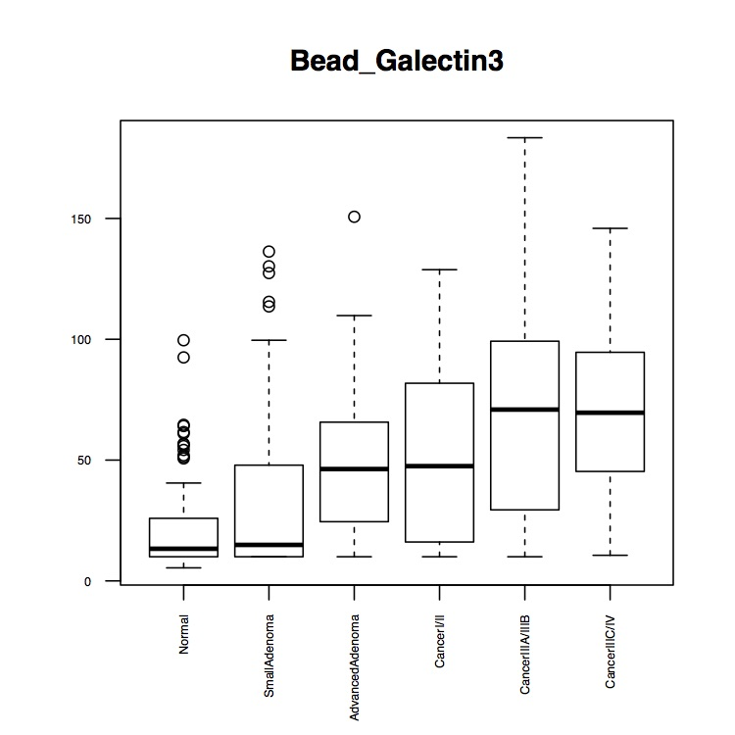
Galectin-3 Ligand Initial Data Set EDRN(Single Marker)
Status | 1Q | Median | Mean | 3Q
Normal | 10 | 13.3 | 22.48 | 25.9
Small Adenoma | 10 | 14.9 | 38.1 | 47.9
Advanced Adenoma | 24.5 | 46.3 | 48.7 | 65.7
Cancer I/II | 16.8 | 47.5 | 52.05 | 81.42
Cancer IIIA/B | 29.4 | 70.9 | 71.43 | 99.2
Cancer IIIC/IV | 45.3 | 69.6 | 68.59 | 94.6
Galectin-3 Ligand
100 Normal
100 Adenomas
-50 advanced
-50 non-advanced
100 Cancer
-50 early (I + II)
-50 late (III + IV)

Slide 24
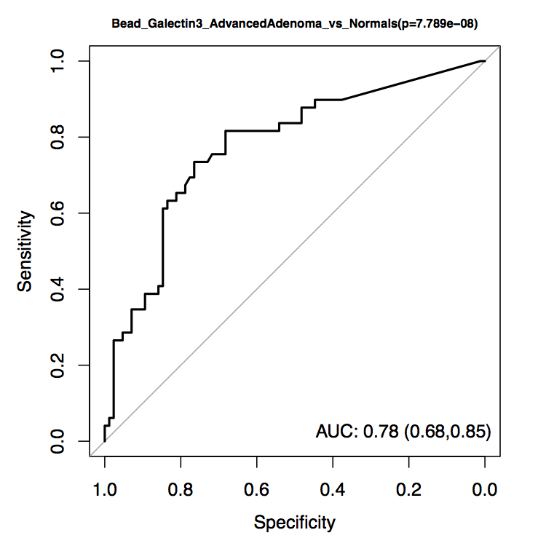
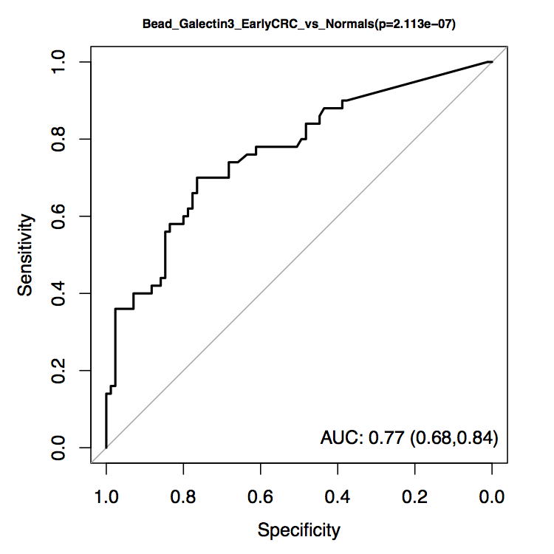
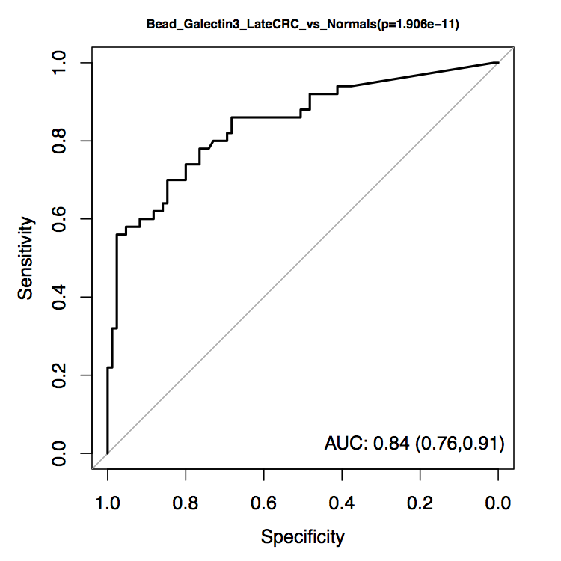
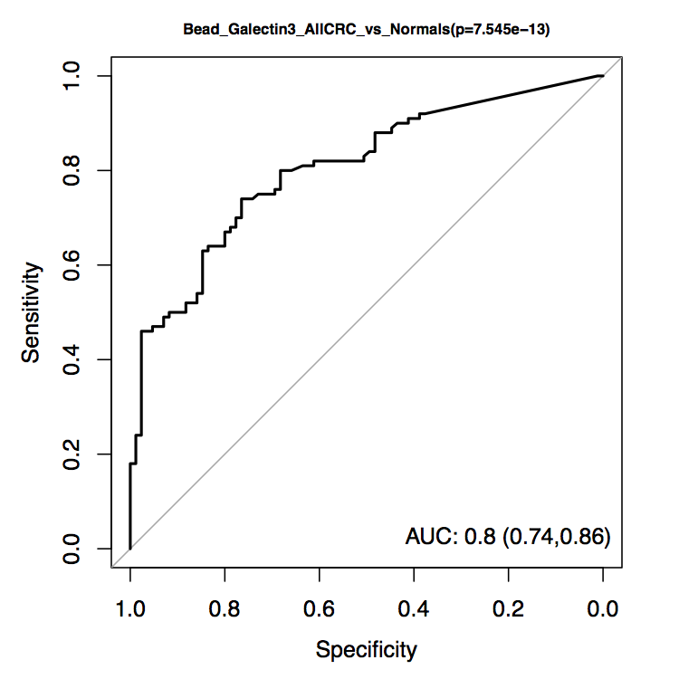
Galectin-3 Ligand Initial Data Set EDRN ROC Curves (Single Marker)
Advanced Adenoma
Early Stage Cancer (I + II)
AUC 0.79
AUC 0.77
Late Stage Cancer (III + IV)
All Cancer
AUC 0.84
AUC 0.80

Slide 25
Our Panel Outperforms both Cologuard and FIT for Detection of Advanced Adenomas
Performance of Marker Panels by Patient Group (AUC, Sensitivities at 85% and 90% Specificities)
Patient Group (vs. Normal) | Model 1 |  |  | Model 2 |  |  | Model 3 |  |  | Model 4
 | AUC | Sensitivity |  | AUC | Sensitivity |  | AUC | Sensitivity |  | AUC | Sensitivity
 |  | 90% Spec | 85% Spec |  | 90% Spec | 85% Spec |  | 90% Spec | 85% Spec |  | 90% Spec | 85% Spec
All CRC | 0.90 | 0.74 | 0.80 | 0.89 | 0.72 | 0.76 | 0.86 | 0.71 | 0.75 | 0.87 | 0.74 | 0.75
Adv. Adenoma | 0.82 | 0.55 | 0.64 | 0.81 | 0.47 | 0.59 | 0.76 | 0.46 | 0.62 | 0.79 | 0.56 | 0.56
Stage I + II CRC | 0.88 | 0.66 | 0.71 | 0.88 | 0.64 | 0.69 | 0.82 | 0.63 | 0.68 | 0.83 | 0.61 | 0.63
Stage I, II, III CRC | 0.88 | 0.70 | 0.74 | 0.87 | 0.68 | 0.71 | 0.84 | 0.66 | 0.71 | 0.84 | 0.68 | 0.69
Stage IV CRC | 0.93 | 0.84 | 0.90 | 0.92 | 0.82 | 0.85 | 0.90 | 0.80 | 0.83 | 0.91 | 0.88 | 0.88
SRN (CRC + Adv. Adenoma) | 0.87 | 0.68 | 0.75 | 0.87 | 0.64 | 0.71 | 0.83 | 0.63 | 0.71 | 0.85 | 0.68 | 0.69
Model 1- [Galectin-3 ligand, CEA, CYFRA21, Galectin3]: This is the marker panel with the smallest AIC.
Model 2- [Galectin-3 ligand, CYFRA21, CEA]: This is the 3-marker panel with the smallest AIC, the 3-marker panel with the largest AUC, and the best model based on forward selection method.
Model 3- [Galectin-3 ligand, CYFRA21]: This is the 2-marker panel with the smallest AIC.
Model 4- [Galectin-3 ligand, CEA]: This is the 2-marker panel with the largest AUC.
Compare with 23.8% sensitivity (AUC 0.67) for FIT and 42.4% (AUC 0.73) for Cologuard ® for detecting “advanced precancerous lesions” (NEJM 2014; 370:1287)

Slide 26
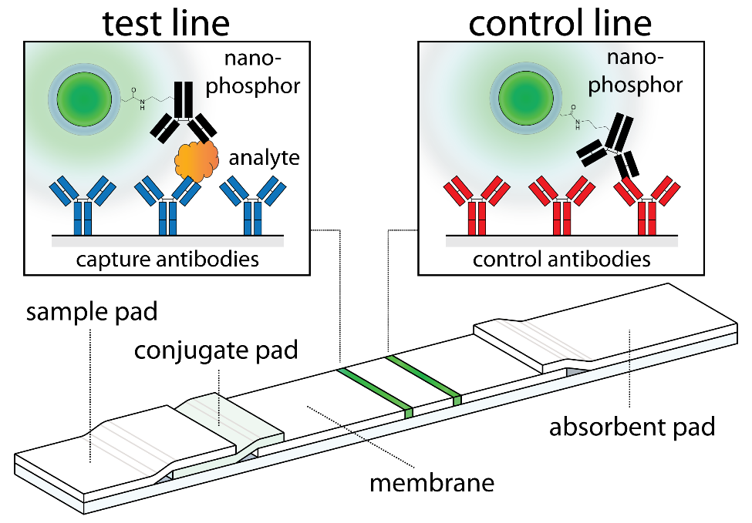
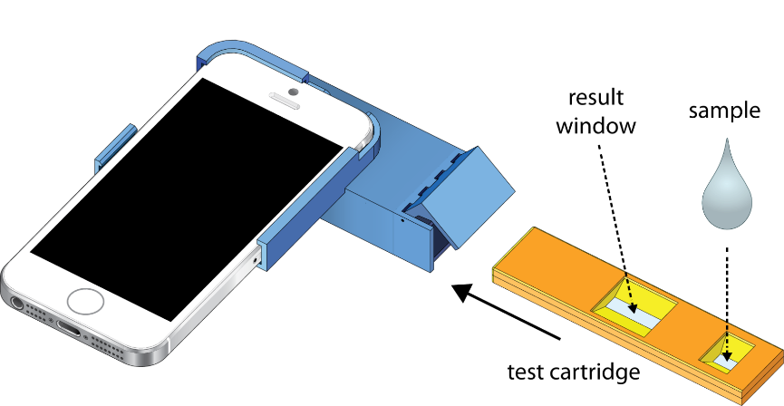
New Directions: Lateral Flow Platform
Figure 1. (A) Layout of a typical PLNP lateral flow test. Nanophosphors are either added mixed with the sample, or released from a conjugate release pad just downstream (In Figure A, left) of the sample pad. (B) Illustration of <$20 smartphone attachment and LFA cartridge.
We have demonstrated the successful detection of galectin-3 ligand from serum, in a point-of-care, lateral flow assay format. Pooled samples (Endoscopy II trial) were interrogated by LFA and compared to a standard curve. The calculated ligand concentrations were obtained; Cancer 7.94 mg/ml, Normal 1.17 mg/ml. The resulting DCancer/DNormal ratio was 6.79, higher than obtained by ELISA (current test is ELISA or Luminex).
We are piloting this in clinics representing underserved populations
MD Anderson Confidential Material
MD Anderson Confidential Material

Slide 28
Aim 1: Evaluation ctDNA/Protein and
Aberrant Methlylation in Detection of CRC
ctDNA evaluated via SafeSeqs sequencing using panel of mutations (61 amplicons in 16 genes – 2001 positions)
Proteins – 8
Methylation markers (Markowitz/Grady)
~ 40 CRC (all stages) and 40 controls (clean and non-advanced adenomas)
CEA

