Slide 1
BloodPAC: Establishing Standards to Accelerate Development and Approval of Liquid Biopsy Technology
Lauren C. Leiman
Executive Director

Slide 2


BloodPAC Members
THE ARKANSAS BIOINFORMATICS CONSORTIUM (AR-BIC) . ASTRAZENECA . Biodesix. BREAST CANCER RESEARCH FOUNDATION (BCRF) . CELGENE . Chop, COLLEGE OF AMERICAN PATHOLOGISTS (CAP) . CYTOLUMINA . DEPARTMENT OF DEFENSE (DOD) . EPIC SCIENCES . FDA . FOUNDATION MEDICINE . GENOMIC HEALTH . GUARDANT HEALTH . MEMORIAL SLOAN KETTERING CANCER CENTER . National cancer institute (NCI). NOVARTIS . OPEN COMMONS CONSORTIUM (OCC) . Pcctc, PERSONAL GENOME DIAGNOSTICS . PFIZER . PROSTATE CANCER FOUNDATION (PCF) . PROVISTA . SEVEN BRIDGES . Streck. SYSMEX INOSTICS . THERMO FISHER SCIENTIFIC . UNIVERSITY OF CHICAGO . UNIVERSITY OF MICHIGAN . UNIVERSITY OF SOUTHERN CALIFORNIA, Weill cornell Medicine.

Slide 3
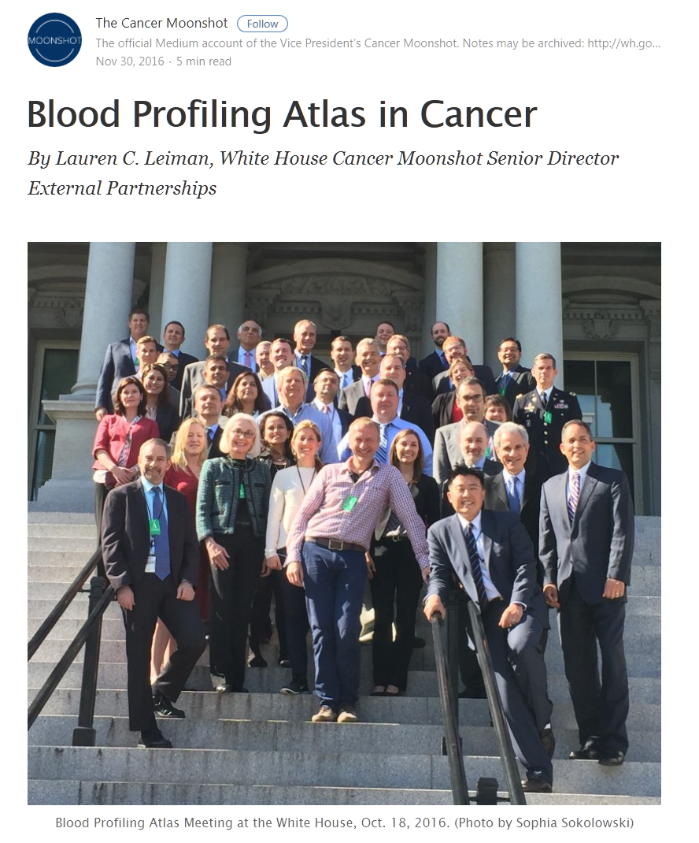
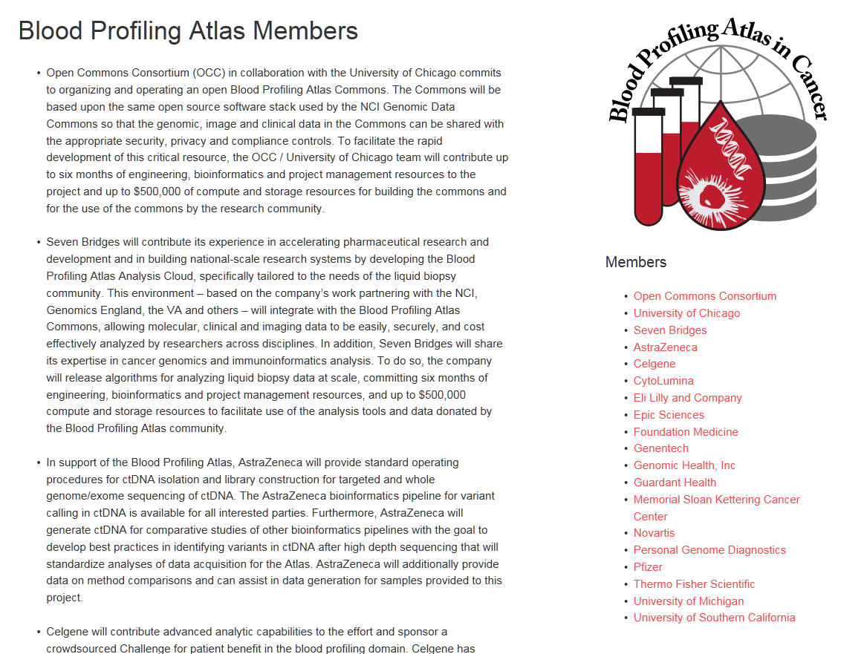
12/20/16
https://medium.com/cancer-moonshot/blood-profiling-atlas-in-cancer
https://www.bloodpac-data.org/

Slide 4
THE BLOOD PROFILING ATLAS IN CANCER IS BORN
BCRF and PCF announce pilot projects with Blood PAC
12/20/16
Pre-Analytical Minimal Technical Data Elements Established and Supported by FDA & CAP
Q4 2017 & Q1 2018
Memorandum sent to Vice President on Liquid Biopsies and Blood Profiling
9/8/16
Initial Group Meeting at White House
9/28/16
First Full Blood PAC Meeting
10/18/16
Blood PAC Data Train 1 Meeting at White House
12/20/16
Vice President Biden Announces Blood PAC
10/17/16
BloodPAC Generic Analytic Protocol
Pre-Sub
2019
Moonshot Meeting with the FDA
8/31/16
Initial Discovery Meeting in LA
9/10/16
BloodPAC Established as an Independent Organization
2/2017
Data Train 1 Departed
12/2/16
August 31, 2016
December 20, 2016
TODAY

Slide 5
BloodPAC MISSION
February 2017
Our mission is to accelerate the development and validation of liquid biopsy assays to improve the outcomes of patients with cancer. To do so we will develop a collaborative infrastructure that enables sharing of information between stakeholders in the public, industry, academia, and regulatory agencies.

Slide 6
BloodPAC VISION
The BloodPAC consortium recognizes data sharing and evidence generation as the two fundamental requirements for success and is pursuing them through dedicated workstreams:
  Create BloodPAC Data Commons to serve the community at large for all liquid biopsy stakeholders
  Align around a framework for evidence generation to bring liquid biopsy into routine clinical practice

Slide 7
Recent 2019 BloodPAC Accomplishments
Launched BloodPAC data commons
  Becoming a source of valid scientific evidence
  Becoming a hub of a cancer data ecosystem for LBx data
Developed generic analytical validation protocol and socialized with FDA
JFDI progressed through Phase I and into phase II of understanding variation across assays
Started 3 clinical trials; one each in breast, prostate, and lung
  All studies leverage data commons.
  Studies incorporate BloodPAC pre-analytical and patient context MTDEs
Started a Reimbursement Working Group

Slide 8
BloodPAC DATA COMMONS - STRATEGIC PLAN
Establish BPDC is a source of valid scientific evidence.
  To serve as a basis for hypothesis driven in silico research;
  To support submissions to regulatory agencies in premarket submissions;
  Data for agencies and organizations making decisions about reimbursements.
Make BPDC a hub of a cancer data ecosystem for LBx data. Interoperate as part of a broader cancer data ecosystem.
Establish formal SOP around data curation and processing.
  Develop an application to the FDA so that BloodPAC can be recognized as a database containing valid scientific evidence that can be used to support clinical validity in premarket submissions.

Slide 9





THE BLOODPAC DATA COMMONS
1
2
3
4
Define variables
Collaborate and develop standards
Submit data to the BloodPAC Data Commons
Organize & analyze data
Courtesy of Thermo Fisher Scientific

Slide 10
BloodPAC Areas of Focus
Evidence Generation – Accelerate Development
    Analytical Validation WG
    Data Experience WG
    Data Roadmap WG
    Just F*$#%@# Do It WG
    Patient Context Variable WG
    Pre-Analytical MTDE WG
Stakeholder Engagement – Accelerate Approval
    Reimbursement WG
    Sustainability Roadmap WG

Slide 11
EXAMPLES OF WG MANDATES
Pre-Analytical Variable Working Group
  The BloodPAC Minimum Technical Data Element (MTDE) Working Group developed recommendations for 11 required preanalytic attributes that are essential for studies that it sponsors and for data contributed to the BloodPAC Data Commons.
Analytical Validation Working Group
  The Analytical Variables Working Group takes on the challenge of defining a set of generic protocols to determine the performance limits and robustness of an assay that has been developed under design control and has completed the process of design lock in collaboration with FDA and NCI.
Just F*$#%@# Do It Working Group
  The Just F*$#%@# Do It Working Group is a community effort to increase quality and consistency of ctDNA testing through well recognized tools and reference materials.

Slide 12
A Range of Assays are in Development for Different
Tumor Products in Blood and other Fluids
BloodPAC Data Contributing Members
cfDNA
cfRNA
cfProtein
Exosomes
CTC
Future Analytes
Aggregation of Existing Data and New Data Generation
Contribution to BloodPAC Data Commons

Slide 13
Technology Development Process
Pre-Analytics
Sample Collection
Analytics
Sample Storage and Processing
Clinical Validation
Patient Data
Assay Results
Assay SOP
Analyte
Patient Factors

Slide 14
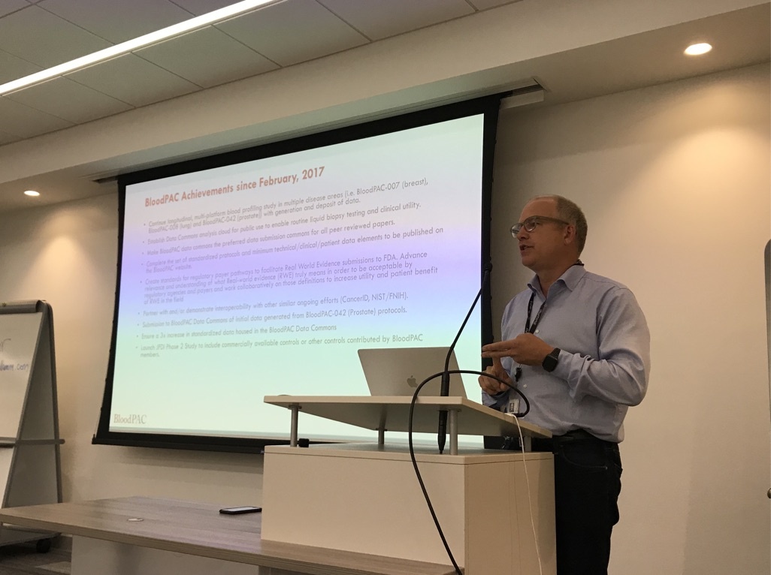
BloodPAC
Pre-Analytical Variable WG

Slide 15
Pre-Analytical WG Leadership
Leadership
Anne-Marie Martin, PhD Novartis Chairholder | Phil Febbo, MD Illumina Co-Chairholder | Howard Scher, MD MSKCC Co-Chairholder

Slide 16
Pre-Analytic MTDE Progress
BloodPAC Member Review
26 Pre-Analytical Variables
11 Pre-Analytical MTDEs
BloodPAC Member Review
52 Variables
FDA Consultation
Meeting 1
MTDEs
BloodPAC Data Commons
FDA Consultation
Meeting 2
Additional Pre-Analytical Variables
= Completed

Slide 17
BloodPAC Pre-Analytic cfDNA
11 MTDEs
cfDNA MTDEs
Blood collection tube type
Blood fractionation approach
Time to fractionation
Time to freezer
Storage temperature
Shipment temperature
DNA isolation method name
DNA quantification method
DNA yield
Sample type
Time to assay

Slide 18
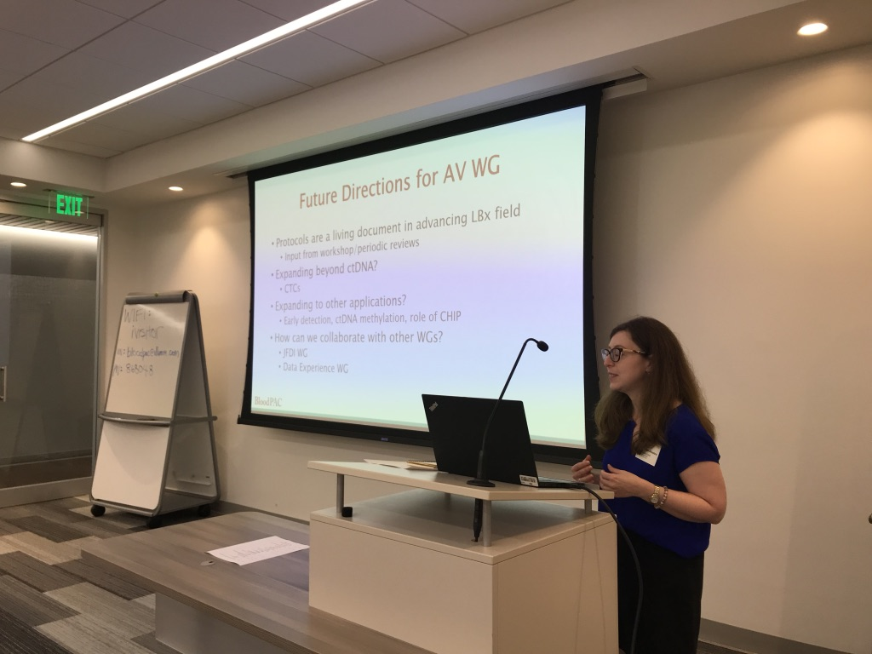
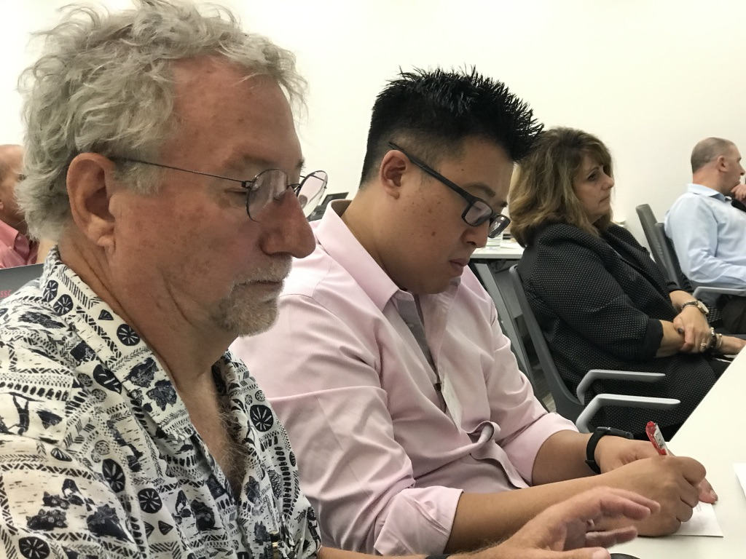
BloodPAC
Analytical Validation WG

Slide 19
Technology Development Process
Pre-Analytics
Sample Collection
Analytics
Sample Storage and Processing
Clinical Validation
Patient Data
Assay Results
Assay SOP
Analyte
Patient Factors
Patient Context Variables

Slide 20
AV WG Membership
Members
James H. Godsey Illumina Chairholder | Angela Silvestro Novartis Co-Chairholder
J. Carl Barrett AstraZeneca | Kelli Bramlett Thermo Fisher Scientific | Darya Chudova Guardant Health
Ina Deras Illumina | Jennifer Dickey PGDx | Ryon Graf EPIC Sciences
James Hicks USC | Jennifer Jackson PGDx | Donald Johann University of Arkansas for Medical Science
Rebecca Leary Novartis | Jerry S.H. Lee USC | Lauren Leiman Blood PAC
Joe McMullen Illumina | Lisa McShane NIH/NCI | Katherine Nakamura Thermo Fisher Scientific
Aaron Richardson Guardant Health | Matthew Ryder Sysmex-Inostics | John Simmons PGDx
Kelli Tanzella Thermo Fisher Scientific | Laura Yee NIH/NCI

Slide 21
Anaytical Variable Project Objective
The objective for the BloodPAC’s Generic Analytical Validation Protocols for Cell Free Assay Performance Verification is to provide a complete set of generic protocols designed to provide test developers/manufacturers with a core baseline of standardized analytical validation protocols with which to document a cell free assay’s analytical performance.
Revision 1 is intended for use by developers/manufacturers of NGS-based ctDNA in vitro diagnostic tests for oncology, regulatory bodies and clinical laboratories.

Slide 22
Benefits of Developing Generic Protocols
Overall: Accelerate the development and approval of NGS-based ctDNA assays
FDA
  Minimize the amount of time of pre-subs, standardizes terminology
Test Developers
  Minimize time on pre-subs, evens the playing field for approvals
Pharma
  Alignment with IVD partners on validation, educational tool

Slide 23
Analytical Variables Working Group Process
(AV WG)
FDA Meeting
Nov, 2017
Gather key Blood PAC members to form the “AV WG”
Kickoff AV WG at Blood PAC Q4 Meeting in Dec, 2017
State objectives and
key assumptions
Develop standard protocols and methods
Consult with statisticians to refine analysis methods
FDA Consult
Meeting 1
May 15, 2018
Revisions
FDA Consult Meeting 2
Jun, 2018
Revisions
Submit protocol as Pre-Sub Submitted to CDRH Aug, 2018
FDA Face-to-Face Meeting Dec, 2018
Revisions
Resubmit to CDRH as supplement to Pre-Sub
18 Feb, 2019
Next Steps:
Publication, AACR/FDA workshop, Symposium at AACR

Slide 24
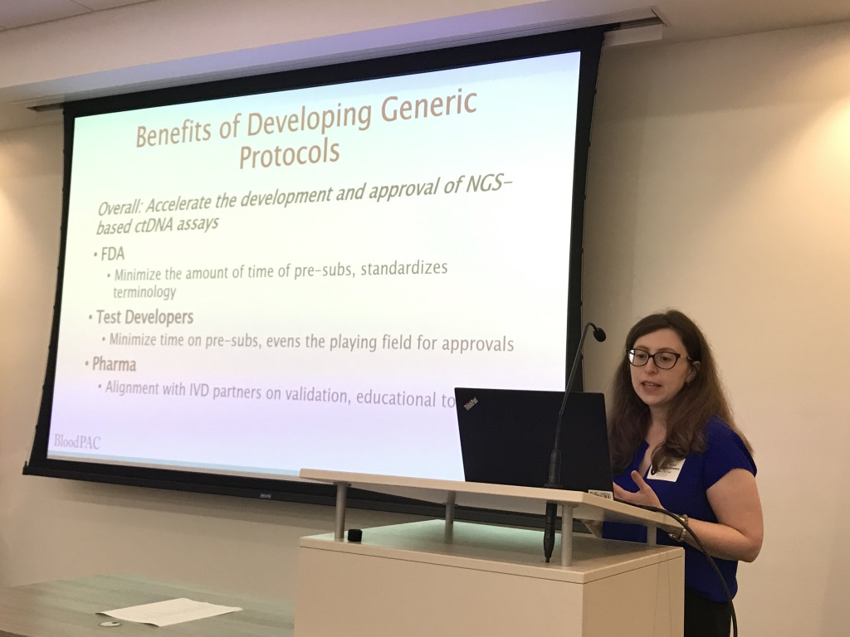
AV WG Upcoming Events
Press Release (in progress)
Manuscript to be submitted to Clinical Cancer Research
AACR to co-sponsor workshop (to be held Q1 2020)
AACR to publish AV WG white paper after workshop (TBD)
Symposium at AACR annual meeting (TBD)

Slide 25
Progress Leads to Next Set of Questions
How can AV WG leverage the BloodPAC Data Commons to streamline AV testing?
  Potentially, add/revise variables in data model to facilitate the upload and analysis of structured validation data
  How can we encourage users to submit data to the Data Commons, including data formally submitted to the FDA? Data can be mined to refine the protocols.
How do we expect that organizations/companies will use these protocols?
How do we expect the FDA to integrate these protocols into their approval process?

Slide 26
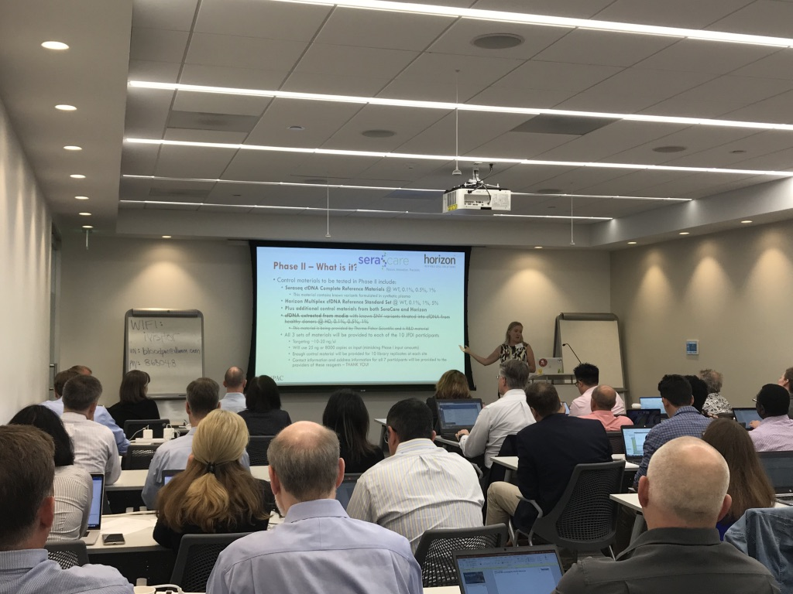
BloodPAC
JFDI Challenge

Slide 27
JFDI WG Leadership
Leadership
Kelli Bramlett, MS Thermo Fisher Scientific Chairholder |  | Justin Johnson AstraZeneca Co-Chairholder

Slide 28



Currently Committed

Slide 29
Question: How do the same liquid biopsy cfDNA-like samples function across different labs and on different analysis platforms?
Answer: Through a collaborative research effort from Blood PAC members….we will run the experiments and make the results available to you all!
Goal:
Establish some reference standards that can be evaluated across multiple platforms
Provide Analysis tools that can query this data and demonstrate the capabilities of the data commons
Provide benefit to the larger community (beyond BloodPAC)

Slide 30
What’s the Plan?
Provide four (4) sets of contrived cfDNA control samples to all participants
Each participant tests the control material as input into their liquid biopsy NGS sequencing system for rare variant detection
Review findings with BloodPAC members and FDA
Draft a paper
Make data accessible to BloodPAC members and the public
Notes:
We had calls twice a week with all of the co-chairs.
We had homework assignments.
We had multiple face to face meetings.
THANK YOU
The commitment has been TREMENDOUS. We have all been working triple overtime to come together for this project.

Slide 31
BloodPAC Co-Chairs
Kelli Bramlett, MS Jerry Lee, PhD
Thermo Fisher Scientific University of Southern California
Darya Chudova, PhD Anne-Marie Martin, PhD
Guardant Health Novartis
Jim Godsey, PhD Howard Scher, MD
Illumina MSKCC
Robert L. Grossman, PhD John Simmons, PhD
OCC and University of Chicago PGDx
Peter Kuhn, PhD Jake Vinson, MHA
University of Southern California PCCTC
Notes:
We had calls twice a week with all of the co-chairs.
We had homework assignments.
We had multiple face to face meetings.
THANK YOU
The commitment has been TREMENDOUS. We have all been working triple overtime to come together for this project.

Slide 32
BloodPAC NCI Participants
Doug Lowy, MD
Tracey Lively, PhD
James Doroshow, MD
Mickey Williams, PhD
Gary Kelloff, MD
Laura Yee, PhD
Lisa McShane, PhD
Tony Dickherber, PhD
Sean Hanlon, PhD
Notes:
We had calls twice a week with all of the co-chairs.
We had homework assignments.
We had multiple face to face meetings.
THANK YOU
The commitment has been TREMENDOUS. We have all been working triple overtime to come together for this project.

Slide 33
BloodPAC FDA Participants
Gideon Blumenthal, MD – Director, Oncology Center of Excellence and Office of Hematology and Oncology Products
Julia Beaver, MD - Office of Hematology and Oncology Products
Julie Schneider, PhD - Office of Hematology and Oncology Products
Reena Philip, PhD - Center for Devices and Radiologic Health
Soma Ghosh, PhD - Center for Devices and Radiologic Health
Anad Pathak, MD PhD - Center for Devices and Radiologic Health
Notes:
We had calls twice a week with all of the co-chairs.
We had homework assignments.
We had multiple face to face meetings.
THANK YOU
The commitment has been TREMENDOUS. We have all been working triple overtime to come together for this project.

Slide 34
What BloodPAC Offers its Members
Allows approved researchers access to member contributed datasets in a scalable, reproducible, privacy and security protected manner as part of the Consortium’s collaborative effort.
Access to samples while working in collaboration with the Department of Defense and Applied Proteogenomics OrganizationaL Learning and Outcomes (APOLLO) network.
The ability to mold and influence the development of assays through a collaborative relationship with the FDA Oncology Center of Excellence, and the leadership of the Associate Director, Office of Hematology Oncology FDA and the CDRH Director.
The opportunity to establish best practices and principles to incorporate into operating procedures and eliminate duplication of efforts.
Foster the development and enhancement of relationships across all stakeholders in the field – pharmaceutical companies, technology companies, academic institutions, foundations, patient advocacy groups, physicians and government agencies.
`

Slide 35
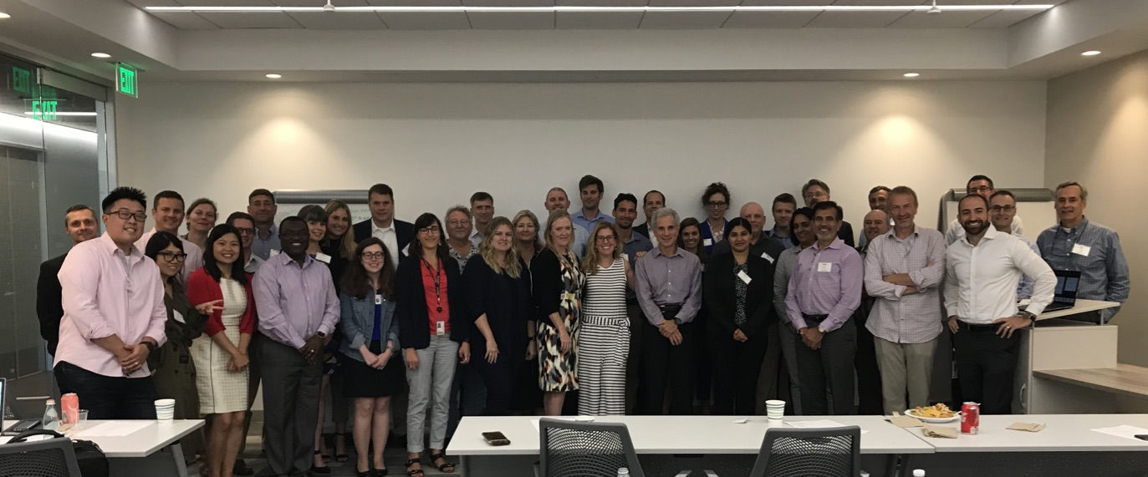
Questions and Discussion
Lauren C. Leiman
Email: Lauren@BloodPAC.org
C: (301) 580-3691 www.BloodPAC.org
@Blood_PAC

Slide 36
BloodPAC Members
THE ARKANSAS BIOINFORMATICS CONSORTIUM (AR-BIC) . ASTRAZENECA . Biodesix. BREAST CANCER RESEARCH FOUNDATION (BCRF) . CELGENE . Chop, COLLEGE OF AMERICAN PATHOLOGISTS (CAP) . CYTOLUMINA . DEPARTMENT OF DEFENSE (DOD) . EPIC SCIENCES . FDA . FOUNDATION MEDICINE . GENOMIC HEALTH . GUARDANT HEALTH . MEMORIAL SLOAN KETTERING CANCER CENTER . National cancer institute (NCI). NOVARTIS . OPEN COMMONS CONSORTIUM (OCC) . Pcctc, PERSONAL GENOME DIAGNOSTICS . PFIZER . PROSTATE CANCER FOUNDATION (PCF) . PROVISTA . SEVEN BRIDGES . Streck. SYSMEX INOSTICS . THERMO FISHER SCIENTIFIC . UNIVERSITY OF CHICAGO . UNIVERSITY OF MICHIGAN . UNIVERSITY OF SOUTHERN CALIFORNIA, Weill cornell Medicine.

